Slide 1
ACADEMIC ML PROJECT
Bangla Preference
Dataset
Creating, validating and using ranked Bangla model responses for preference fine-tuning
Dataset creation • Human validation • DPO fine-tuning • Blind evaluation
6,254 prompts | 18,762 candidate responses | 100 held-out tests
Project presentation
Notes:
Open with the contribution: this project is primarily a validated Bangla preference-data pipeline, with fine-tuning as a proof of use.
[Sources]
- output/pdf/bangla_preference_dataset_project_report.pdf, Abstract and Project Goal
- preference_finetuning/data/split_manifest.json

Slide 2
Project Team
Name: Rahul Sheikh
Roll: 2107063
Name: Rezwan Ahammad Raad
Roll: 2107072
Name: Ziadul Hasan
Roll: 2107074
Name: Rezuan Mustafa Hasan
Roll: 2107075
Name: Hassan Muhammad Naquibul Hoque
Roll: 2107077
Name: Sumaiya Akter
Roll: 2107080
Bangla Preference Dataset Project
Notes:
[Sources]
- Team member names and roll numbers are intentional placeholders requested for the presentation.

Slide 3
BANGLA PREFERENCE DATASET
Can ranked responses improve a smaller model?
One reference answer is not enough. For the same Bangla prompt, answers can differ in correctness, relevance and clarity.
Question
Which answer
should the model
learn to prefer?
Primary contribution
• Collect comparable answers
• Create anonymous preference rankings
• Validate the rankings with people
• Reuse only reliable pairs for training
Repeated, blinded comparisons—not one model score—supply the answer.
Bangla Preference Dataset Project
03
Notes:
Explain that preference data teaches relative quality: for the same prompt, the model learns which answer is preferred over another.
[Sources]
- output/pdf/bangla_preference_dataset_project_report.pdf, Abstract and Project Goal

Slide 4
SOURCE PAPER: DEVINE (2024)
Source paper: the actual Repeat Ranking workflow
1
2
3
4
5
6
7
Sample
2,996
Generate
7 answers
Shuffle
A-G
GPT-4
ranks
Repeat
5x
Score
W
Train
ORPO
Base paper introduction
Peter Devine's 2024 paper was published by the Association for Computational Linguistics (ACL) in the MRL 2024 proceedings. It introduces Repeat Ranking: evaluate shuffled answers several times and keep the most consistent preference data.
Scale: 2,996 prompts, 74 languages, seven answer models, five GPT-4 rankings, and 2,714 valid prompts.
Devine (2024) | ACL Anthology
04
Notes:
[Sources]
- ACL Anthology: https://aclanthology.org/2024.mrl-1.5/
- DOI: https://doi.org/10.18653/v1/2024.mrl-1.5
- Peter Devine (2024), Are You Sure? Rank Them Again: Repeated Ranking For Better Preference Datasets. Proceedings of MRL 2024, pages 93-105. Association for Computational Linguistics.

Slide 5
SOURCE PAPER: DEVINE (2024)
Source paper: how W creates training subsets
Kendall’s W measures agreement across five full GPT-4 rankings.
W = 12S / [m²(n³ − n)]
2,714
5x
W
For each of 2,714 valid prompts, W measured how consistently GPT-4 ranked seven answers. The paper trained on the highest 25%, 50%, and 75% by W, plus all prompts for comparison.
valid
prompts
GPT-4
rankings
per
prompt
W-ranked subsets
25%
50%
75%
Pair selection (Borda)
674 prompts
1,350
2,018
5 ranks -> Borda Count
highest = positive; lowest = negative
100% comparison: all 2,714 prompts
05
Notes:
[Sources]
- Peter Devine (2024), “Are You Sure? Rank Them Again: Repeated Ranking For Better Preference Datasets,” MRL 2024, §3.1–3.2, pp. 96–97.
- /Users/rezuanmustafahasan/Desktop/4-1/2024.mrl-1.5.pdf
The paper created W-ranked subsets of 674 prompts (top 25%), 1,350 (top 50%), and 2,018 (top 75%), and compared them with all 2,714 prompts. For each selected prompt, it computed Borda Count across the five rankings and used the highest-count answer as positive and lowest-count answer as negative for ORPO.

Slide 6
BANGLA PREFERENCE DATASET
6,254 prompts; 18,762 candidate responses
6,254
18,762
6
source prompts
responses (three per prompt)
practical domains
Domains
Economics
Education
History
Mathematics
Moral & ethics
Sports
Response generators
Gemma 4 • Qwen3 • TigerLLM-9B
All candidate responses were attached to the matching prompt before ranking.
Bangla Preference Dataset Project
06
Notes:
Emphasize that the dataset has multiple answers for each prompt. The comparison is meaningful because each response addresses exactly the same question.
[Sources]
- output/pdf/bangla_preference_dataset_project_report.pdf, Dataset Construction and Response Collection

Slide 7
BANGLA PREFERENCE DATASET
One pipeline turns prompts into training evidence
1
2
3
4
5
6
7
Collect
Generate
Rank ×3
Human check
Filter W = 1.0
DPO
Test 100
Why this design matters
Repeated ranking helps stabilize labels; human review checks that the automated preference signal is usable; held-out prompts test generated answers rather than training loss.
The final model experiment is the last step—not the only result of the project.
Bangla Preference Dataset Project
07
Notes:
Walk through this once as the whole story. Later slides explain the most important quality controls: anonymity, human validation, and strict confidence filtering.
[Sources]
- output/pdf/bangla_preference_dataset_project_report.pdf, End-to-end methodology

Slide 8
BANGLA PREFERENCE DATASET
Anonymous repetition reduces ranking bias
For each prompt, the three responses are labeled A/B/C. The labels are shuffled independently for every ranking run.
Ranking outcomes across the full dataset
Unanimous
76.8
4,802 prompts
A/B/C mapping
Run 1: A > B > C
Run 2: B > C > A
Run 3: C > A > B
Majority
22.9
1,432 prompts
Model names never shown to the judge
Disputed
0.3
20 prompts
76.8% of prompts received the same full order in all three runs.
Bangla Preference Dataset Project
08
Notes:
The important control is independent A/B/C shuffling. The judge sees quality, not source model identity or a persistent on-screen position.
[Sources]
- output/pdf/bangla_preference_dataset_project_report.pdf, Repeated Anonymous LLM Ranking
- C. Devine (2024), Are You Sure? Rank Them Again: Repeated Ranking for Better Preference Datasets.

Slide 9
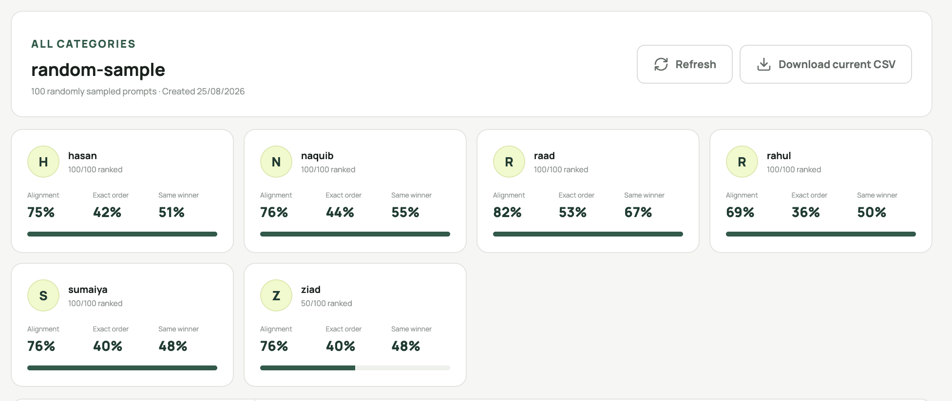
BANGLA PREFERENCE DATASET
Human annotation supported the automated labels
~75.7%
average pairwise alignment
with Gemini rankings
Human study design
• Random 100-prompt sample
• Answer identities hidden
• Annotators rank all three answers
• Pairwise agreement gives partial credit
Interpretation: useful, not perfect
The dashboard records progress, pairwise alignment, exact-order agreement and same-winner agreement.
Bangla Preference Dataset Project
09
Notes:
Make the distinction clear: alignment of about 75% supports the ranking as a practical signal, but it does not make it a replacement for human preference.
[Sources]
- output/pdf/bangla_preference_dataset_project_report.pdf, Human Validation of the Preference Labels
- output/pdf/assets/human_alignment.png (user-owned project screenshot)

Slide 10
BANGLA PREFERENCE DATASET
Only the clearest preference signals entered training
Kendall’s W measures agreement among the three repeated rankings.
W = 12S / [m²(n³ − n)]
6,254
5,743
4,469
For this project, m = 3 ranking runs and n = 3 candidate answers. Only unanimous rankings with W = 1.0 were used for training.
raw ranked
records
normalized
unique prompts
filtered
pairs
Leakage-safe split
3,932
437
100
One final JSONL record
training pairs
validation
held-out test
{ prompt, chosen, rejected,
winner_model, W = 1.0 }
Bangla Preference Dataset Project
10
Notes:
Show the calculation as a confidence filter. The project intentionally discarded lower-agreement records rather than maximizing training-set size.
[Sources]
- preference_finetuning/data/split_manifest.json
- output/pdf/bangla_preference_dataset_project_report.pdf, Confidence Filtering and the Final Training Dataset

Slide 11
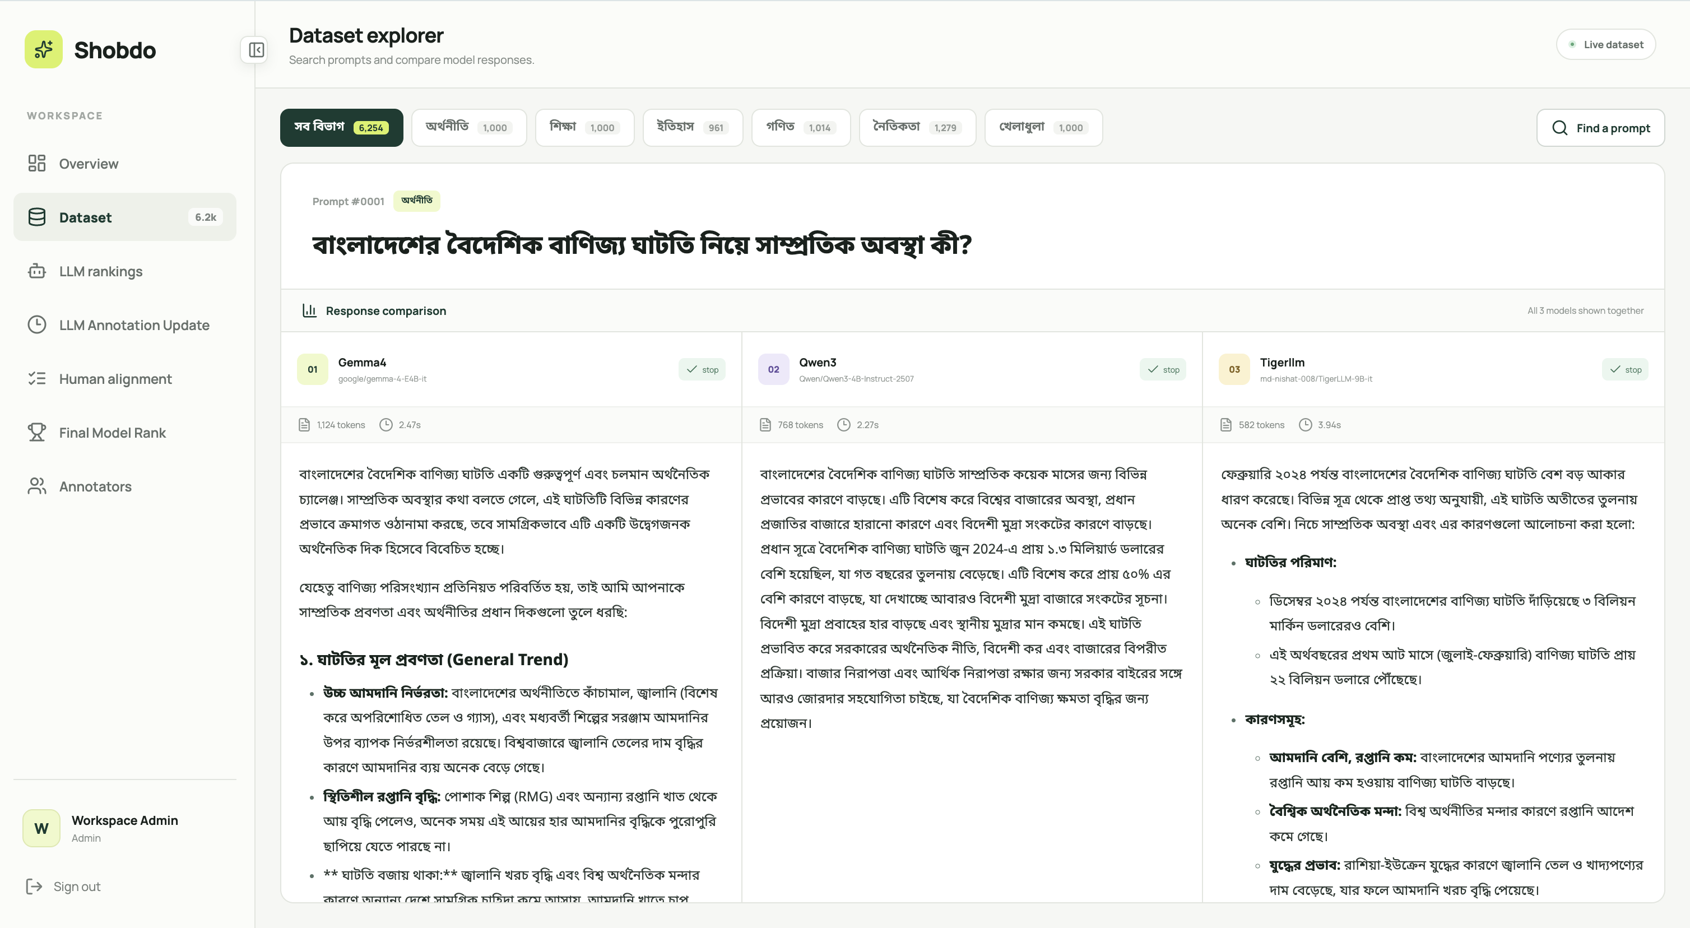
BANGLA PREFERENCE DATASET
The web platform makes the dataset auditable
Dataset explorer
Browse categories, search Bangla prompts, inspect three candidate responses.
Bangla Preference Dataset Project
11
Notes:
This is not just a static dataset folder. The web system lets an administrator audit source data, supervise annotation and export current results.
[Sources]
- output/pdf/bangla_preference_dataset_project_report.pdf, Web System for Dataset and Annotation Management
- output/pdf/assets/dataset_explorer.png (user-owned project screenshot)
- output/pdf/assets/llm_rankings.png (user-owned project screenshot)

Slide 12
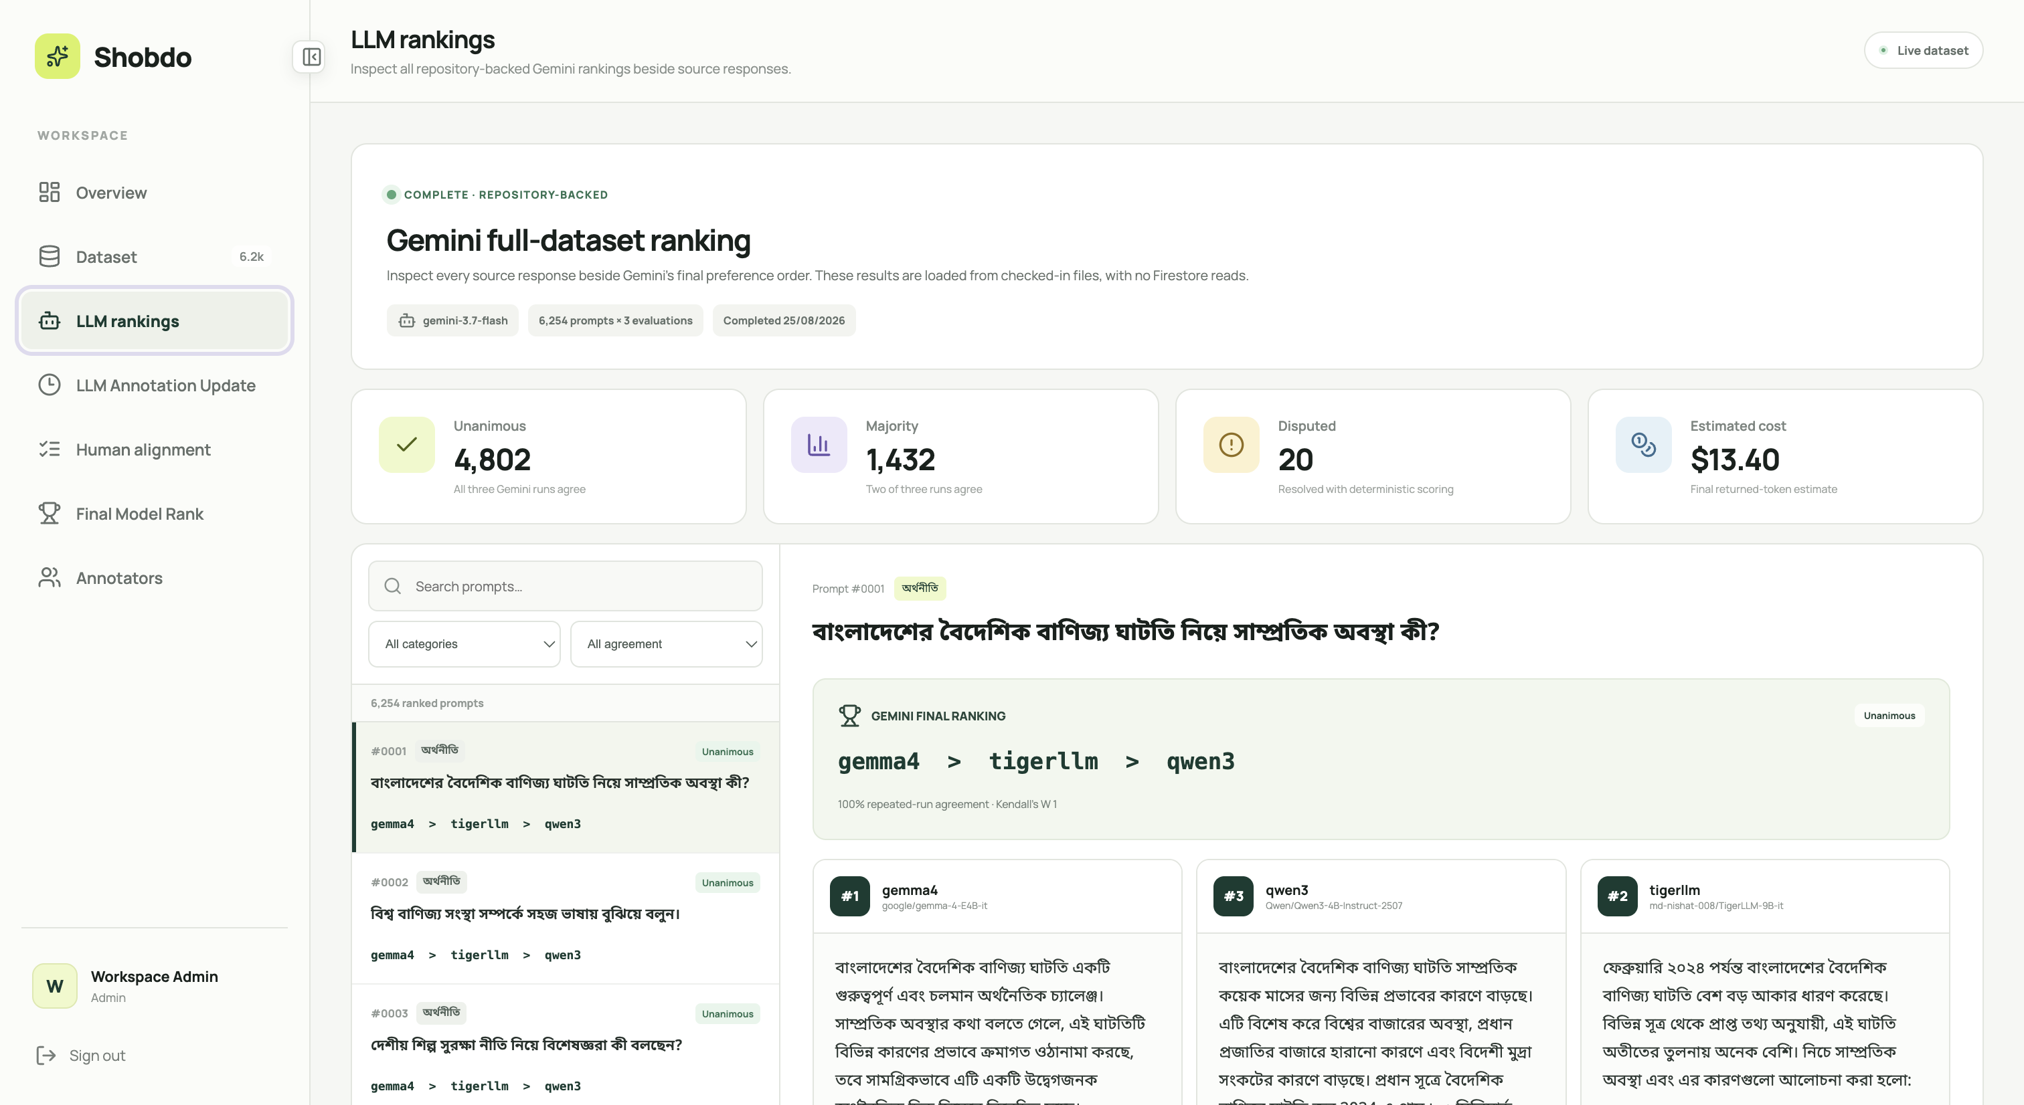
BANGLA PREFERENCE DATASET
The web platform makes the dataset auditable
Ranking & annotation management
Inspect votes, assign annotators, monitor completion and export the latest CSV.
Git LFS stores response artifacts; Firebase stores accounts, assignments and changing annotations.
Bangla Preference Dataset Project
12
Notes:
This is not just a static dataset folder. The web system lets an administrator audit source data, supervise annotation and export current results.
[Sources]
- output/pdf/bangla_preference_dataset_project_report.pdf, Web System for Dataset and Annotation Management
- output/pdf/assets/dataset_explorer.png (user-owned project screenshot)
- output/pdf/assets/llm_rankings.png (user-owned project screenshot)

Slide 13
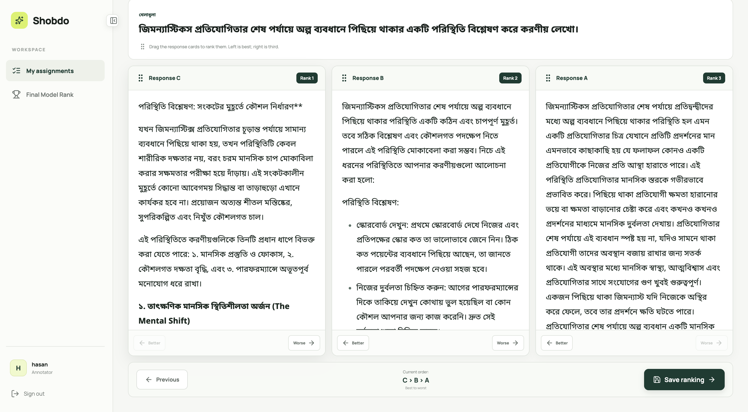
BANGLA PREFERENCE DATASET
The web platform makes the dataset auditable
Annotators worked from their separate accounts
Git LFS stores response artifacts; Firebase stores accounts, assignments and changing annotations.
Bangla Preference Dataset Project
13
Notes:
This is not just a static dataset folder. The web system lets an administrator audit source data, supervise annotation and export current results.
[Sources]
- output/pdf/bangla_preference_dataset_project_report.pdf, Web System for Dataset and Annotation Management
- output/pdf/assets/dataset_explorer.png (user-owned project screenshot)
- output/pdf/assets/llm_rankings.png (user-owned project screenshot)

Slide 14
BANGLA PREFERENCE DATASET
TigerLLM-1B made L4 fine-tuning feasible
Base model
Preference objective
Efficient adaptation
md-nishat-008/
TigerLLM-1B-it
Compact Bangla model for training and inference.
DPO
Increase the probability of the chosen answer relative to the rejected answer for the same prompt.
QLoRA
Keep the 4-bit base frozen and learn small rank-16 LoRA adapters instead of updating all weights.
Google Cloud g2-standard-8 + NVIDIA L4 • 100 optimizer steps • 1,024-token response cap • identical decoding for base and fine-tuned inference
Bangla Preference Dataset Project
14
Notes:
DPO uses the chosen/rejected pairs directly. QLoRA is why this can be demonstrated on a single L4 GPU without full parameter training.
[Sources]
- output/pdf/bangla_preference_dataset_project_report.pdf, Fine-Tuning TigerLLM-1B
- R. Rafailov et al. (2023), Direct Preference Optimization, NeurIPS.
- T. Dettmers et al. (2023), QLoRA, NeurIPS.

Slide 15
BANGLA PREFERENCE DATASET
A matched blind test compares 100 unseen prompts
100 held-out
prompts
Generate twice
Anonymize answers
Blind comparison
Never used for training or model selection
Base and fine-tuned models use the same decoding settings
A/B positions are balanced; judges cannot see model identity
Judges select the better response or declare a tie when allowed
This measures response quality on generated text, not just a training loss.
Bangla Preference Dataset Project
15
Notes:
Stress fairness of the comparison. Both models are tested on exactly the same prompts with balanced anonymous positions.
[Sources]
- preference_finetuning/data/split_manifest.json, leakage_checks and evaluation split
- output/pdf/bangla_preference_dataset_project_report.pdf, Matched blinded evaluation

Slide 16
BANGLA PREFERENCE DATASET
Blind judges slightly preferred the fine-tuned model
Gemini 2.5 Flash-Lite
GPT-5.6 Luna
Three votes per prompt; ties allowed
One strict A/B choice per prompt; no tie
Fine-tuned
55%
40
Base
fine-tuned win rate
(55 wins vs 45)
28
32 ties • Fine-tuned margin: +12
Positive but modest improvement
Interpretation: both views favor the fine-tuned model, but human comparison remains the most important next confirmation.
Bangla Preference Dataset Project
16
Notes:
Report the result precisely. Do not call it a dramatic gain: the two automated blind comparisons are directionally consistent, but the margin is modest.
[Sources]
- output/pdf/bangla_preference_dataset_project_report.pdf, Before/After Evaluation, Findings, and Conclusion
- final_model_rank/final_model_responses.json, automated evaluation summaries

Slide 17
BANGLA PREFERENCE DATASET
Examples 1 & 2: correctness and relevance
Mathematics — “45 runs + 33 runs = total?”
Before • base model
After • fine-tuned model
৪৫ + ৩৩ = ৫৫
সুতরাং, দুই দল মিলে মোট ৫৫ রান করেছে।
৪৫ + ৩৩ = ৭৮
মোট ৭৮ রান হয়েছে।
Visible change: the arithmetic result is corrected.
Sports — “What could a weekly fencing training plan look like?”
Before • base model
After • fine-tuned model
সকার পজিশন: সেন্টার, ডাম, ব্যাক।
বিভিন্ন ধরনের স্কিন এবং শটের অনুশীলন।
দৌড়, জাম্পিং ও স্ট্রেচিং।
ম্যাচ বা সিমুলেশন অনুশীলন।
ভিডিও বিশ্লেষণ থেকে নতুন কৌশল শেখা।
Visible change: unrelated football terms are replaced by a fencing-relevant practice plan.
Bangla Preference Dataset Project
17
Notes:
These are illustrative excerpts from held-out prompts. The first four qualitative examples in this deck were preferred by both automated evaluation methods.
[Sources]
- output/pdf/bangla_preference_dataset_project_report.pdf, Selected Before/After Response Examples
- final_model_rank/final_model_responses.json, held-out item math:504 and sports:298

Slide 18
BANGLA PREFERENCE DATASET
Examples 3 & 4: clearer explanations
Education — “Explain electric current simply for my child.”
Before • base model
After • fine-tuned model
তড়িৎ প্রবাহের উৎস হতে পারে:
লাইট বাল্ব, কম্পিউটার, মোবাইল ফোন।
বিদ্যুৎ উৎস: ব্যাটারি বা জেনারেটর।
পরিবাহী পদার্থ: তার।
তার দিয়ে বিদ্যুৎ চললে তড়িৎ প্রবাহ সৃষ্টি হয়।
Visible change: the fine-tuned answer distinguishes an energy source from a conductor.
Economics — “Explain classical economics in simple words.”
Before • base model
After • fine-tuned model
অ্যাকাডেমি মডেল: নির্দিষ্ট নিয়ম ও শর্ত।
গাণিতিক মডেল: সংখ্যা ও সূত্র ব্যবহার।
চাহিদা বেশি ও সরবরাহ কম হলে দাম বাড়ে।
সরবরাহ বেশি ও চাহিদা কম হলে দাম কমে।
Visible change: vague labels are replaced by familiar demand–supply mechanisms.
Bangla Preference Dataset Project
18
Notes:
Use these examples to show not only correctness but practical teaching quality: the fine-tuned answers contain clearer conceptual distinctions and mechanisms.
[Sources]
- output/pdf/bangla_preference_dataset_project_report.pdf, Selected Examples (continued)
- final_model_rank/final_model_responses.json, held-out item education:259 and economics:856

Slide 19
BANGLA PREFERENCE DATASET
Programming practice becomes more achievable
Prompt: স্কুলে আইসিটি ক্লাসে প্রোগ্রামিং শেখার ধাপ পড়ানো হচ্ছে, বাসায় কীভাবে চর্চা করব?
Before • base model
After • fine-tuned model
উন্নত বিষয় শিখুন—অ্যালগরিদম, গ্রাফ থিওরি।
ছোট প্রকল্প হিসেবে ক্যালকুলেটর, গেম ও ডেটাবেস তৈরি করুন।
প্রথমে একটি প্রোগ্রামিং ভাষা নির্বাচন করুন—পাইথন, জাভা বা সি++।
অনলাইন কোডিং চ্যালেঞ্জ ও সমস্যা সমাধান করুন।
একই ভাষা শেখা বন্ধুদের সঙ্গে আলোচনা করুন।
Visible change
The base answer jumps to advanced topics. The fine-tuned answer starts with an achievable choice, practice activity and peer discussion.
Illustrative qualitative example; the aggregate claim remains the 100-prompt blind comparison.
Bangla Preference Dataset Project
19
Notes:
This is a manually selected educational example because the difference is visible to an audience. Gemini favored the fine-tuned response 2–1; the strict GPT evaluator chose the base response. Present it as qualitative illustration, not unanimous quantitative evidence.
[Sources]
- output/pdf/bangla_preference_dataset_project_report.pdf, Example 5
- final_model_rank/final_model_responses.json, held-out item education:989

Slide 20
What this project demonstrates
01
02
03
A usable dataset
Evidence it is reliable
A practical use case
6,254 Bangla prompts
18,762 candidate responses
6 practical domains
Repeated anonymous ranking
~75.7% human pairwise alignment
Strict W = 1.0 filtering
DPO/QLoRA on TigerLLM-1B
Single L4 GPU
Modest positive blind-test signal
The validated Bangla preference-data pipeline is the durable contribution.
Fine-tuning demonstrates how the data can be reused.
Bangla Preference Dataset Project
Notes:
Close on the contribution hierarchy: the dataset and validation workflow are the main deliverables; the fine-tuned model demonstrates a realistic use of the data.
[Sources]
- output/pdf/bangla_preference_dataset_project_report.pdf, Conclusion
- preference_finetuning/data/split_manifest.json
- final_model_rank/final_model_responses.json

Slide 21
Limitations
01
02
03
Modest improvement
Limited resources
Small evaluation
Fine-tuned responses won more often, but the overall gain was small.
1B model, one L4 GPU, and limited time for hyperparameter exploration.
Only 100 held-out prompts; results may not cover every Bangla task or domain.
More diverse training data could strengthen the model.
Objective achieved: fine-tuned model won more often in the strict blind test.
Bangla Preference Dataset Project
Notes:
[Sources]
- Project training data: 4,469 filtered preference pairs, 1B TigerLLM, one NVIDIA L4 GPU, and 100 held-out prompts.
- Project blind evaluation: GPT-5.6 Luna, 55 fine-tuned wins vs 45 base wins.
This slide gives the project-specific caveats. It does not claim a dramatic improvement; it states the modest result accurately.

Slide 22
Connection to the base paper
01
02
03
Limited data
Small gains
Evaluator bias
This project: 4,469 pairs.
Paper: fewer than 3,000 training examples.
This project: 55% vs 45%.
Paper: differences largely below 10%.
Both used LLM judges; the paper warns a single evaluator can introduce bias.
Finding: preference filtering can help, but larger training sets and more human-checked evaluation are still needed.
Devine (2024), Limitations
Notes:
[Sources]
- Peter Devine (2024), “Are You Sure? Rank Them Again: Repeated Ranking For Better Preference Datasets,” MRL 2024, p. 101 (Limitations).
- /Users/rezuanmustafahasan/Desktop/4-1/2024.mrl-1.5.pdf
The paper reports fewer than 3,000 examples, improvements largely below 10%, and potential bias from relying on GPT-4 as an evaluator. The comparison is qualitative; the exact data scale and win rate on this slide come from this project.

Slide 23
CONCLUSION
A validated Bangla
preference pipeline
The project created an auditable dataset, checked automated preferences with people, and demonstrated a modest positive gain after fine-tuning TigerLLM-1B.
Dataset creation • Repeated ranking • Human validation • Fine-tuning
6,254 prompts | ~75.7% human alignment | 55% strict blind-test win rate
Bangla Preference Dataset Project
Notes:
[Sources]
- output/pdf/bangla_preference_dataset_project_report.pdf
- preference_finetuning/data/split_manifest.json
- final_model_rank/final_model_responses.json
End by stressing that the validated preference-data pipeline is the main contribution. The fine-tuning result is a small but positive proof that the data can help.

Slide 24
References
Selected sources and project links
1. Devine (2024), Repeat Ranking | https://aclanthology.org/2024.mrl-1.5/
2. Rafailov et al. (2023), Direct Preference Optimization | https://arxiv.org/abs/2305.18290
3. Hu et al. (2022), LoRA | https://arxiv.org/abs/2106.09685
4. Dettmers et al. (2023), QLoRA | https://arxiv.org/abs/2305.14314
5. TigerLLM-1B-it | https://huggingface.co/md-nishat-008/TigerLLM-1B-it
6. Project repository | https://github.com/RezuanMustafaHasan/bangla-preference-dataset
Thank you • Questions are welcome
Prepared for academic presentation
Notes:
[Sources]
- https://aclanthology.org/2024.mrl-1.5/
- https://arxiv.org/abs/2305.18290
- https://arxiv.org/abs/2106.09685
- https://arxiv.org/abs/2305.14314
- https://huggingface.co/md-nishat-008/TigerLLM-1B-it
- https://github.com/RezuanMustafaHasan/bangla-preference-dataset

