Slide 1
COMPUTER GRAPHICS LAB DEMONSTRATION
Medieval Fortress Siege Simulation
Hierarchical Kinematics, Gouraud & Blinn-Phong Shading, Soft Shadow Mapping,
Real-Time Ray Tracing, and Ballistic Destruction in C++ / OpenGL 3.3 Core
• Core Deliverables: Transformations, Dual Shading (Gouraud & Phong), Lighting, Motion/Animation, Interaction, Ray Tracing
• Framework: Pure C++17, OpenGL 3.3 Core, GLSL, GLFW 3.5, GLAD, GLM | Toolchain: WinLibs MinGW-w64 (GCC 16)

Slide 2
COMPUTER GRAPHICS PROJECT
Scope Fulfillment: Proposal vs. Final Implementation
📋 ORIGINAL PROPOSAL SCOPE
• Language & API: Python 3 / PyOpenGL Compatibility Profile
• Cannon Model: Single static/translating field cannon
• Kinematics: Wheel roll linked to distance, barrel elevation
• Shading Model: Basic Phong shading model with directional light
• Materials: 2 basic materials (matte wood carriage, shiny barrel)
• Projectile: Optional simple parabolic cannonball arc
• Target Scene: Flat ground plane with simple static target
• User Controls: Fixed viewpoint, basic keyboard input
🚀 DELIVERED FINAL IMPLEMENTATION
✓ C++17 & OpenGL 3.3 Core Profile: Zero legacy GL; pure modern shaders
✓ Artillery Battery: 3 independently articulated cannons (drive, yaw, elevate)
✓ Dual Shading Models: Runtime toggle between Gouraud & Blinn-Phong ('G')
✓ Multi-Light System: Sun/Moon, sky/ground ambient, 8 point lights (braziers)
✓ Soft Shadow Mapping: 2048² Depth FBO pass with 3×3 PCF & depth bias ('X')
✓ Real-Time Ray Tracing: Kay-Kajiya slab intersection test on GPU ('K')
✓ Full Compound Fortress: 4 towers, double curtain walls, river, drawbridge
✓ Autonomous Tactical Siege: 6-phase battle, archers, shields, destruction

Slide 3
COMPUTER GRAPHICS PROJECT
System Architecture & Real-Time Graphics Pipeline
1. Input & Camera
Poll GLFW keyboard & mouse
Update 360° spherical orbit camera
Calculate deltaTime & frame pacing
2. Physical Simulation
Semi-implicit Euler ballistics
Sphere-vs-AABB continuous collision
Autonomous 6-phase state machine
3. Shadow Depth Pass
Render light-space depth map
2048×2048 32-bit floating-point FBO
Cull front faces to prevent acne
4. Main Render Pass
Activate active shader (Gouraud/Phong)
Traverse hierarchical scene graph
Upload lighting, PCF shadows & ray boxes
Modular C++ Architecture (Over 40 Modular Classes):
• Core Math & Pipeline: Transform, Mesh (VAO/VBO/EBO), shaderClass, Primitives, Dimensions, Palette
• Scene Graph Entities: Cannon (Carriage, Wheel, Shaft), Projectile, CompoundCastle, Tower, Door, Bridge, Water
• Characters & Dynamic Systems: Soldier, Archer, Arrow, ShadowMap, ParticleSystem, Scenery, SkyClouds, Birds

Slide 4
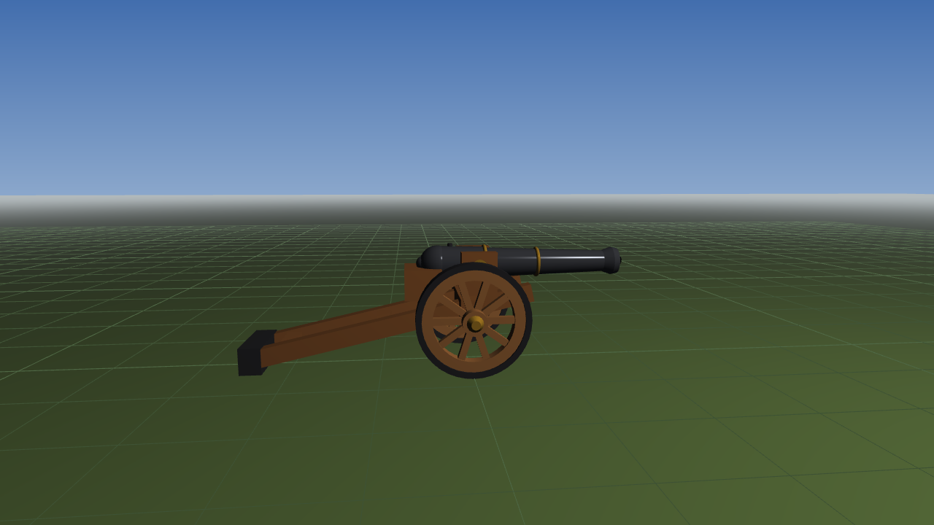
COMPUTER GRAPHICS PROJECT
Hierarchical Transformations & Kinematics
📐 KINEMATIC FORMULATION & EQUATIONS
• Affine Model Matrix:
M_model = T(t) • R_y(ψ) • R_z(θ) • S(s)
• Non-Slip Rolling Constraint:
Δθ_wheel = −Δs / R_wheel (R = 0.584 m)
Guarantees zero linear tire skid across ground
• Trunnion Elevation Pivot:
M_barrel = T(p_pivot) • R_z(θ_elev) • T(−p_pivot) • T(x_recoil)
Rotates about arbitrary hinge; clamped 0° to 45°
• Muzzle Spawn Projection:
p_muzzle = M_carriage • M_barrel • [L_barrel, 0, 0, 1]^T
Exact world-space spawn coordinate for ballistics
• View & Perspective Matrices:
V = lookAt(E, C, Up), P = perspective(45°, aspect, 0.1, 600)
ELEVATION STAGES (0°, 25°, 45°)

Slide 5
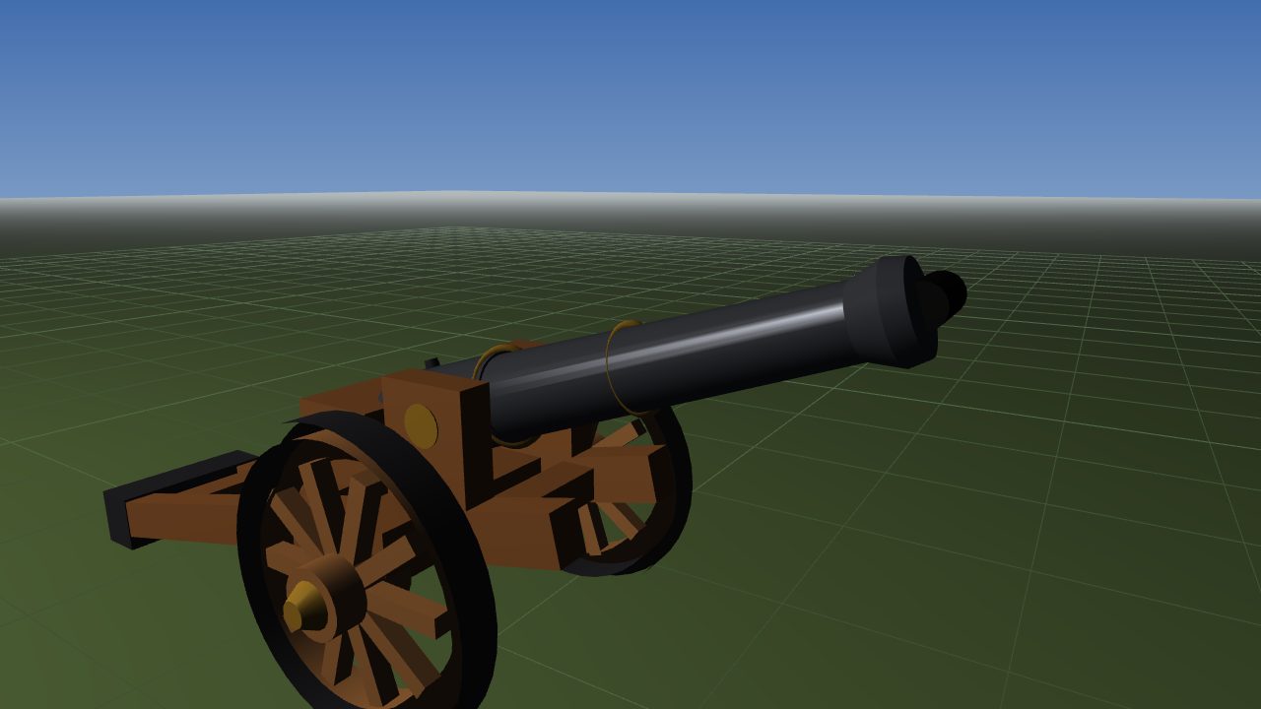
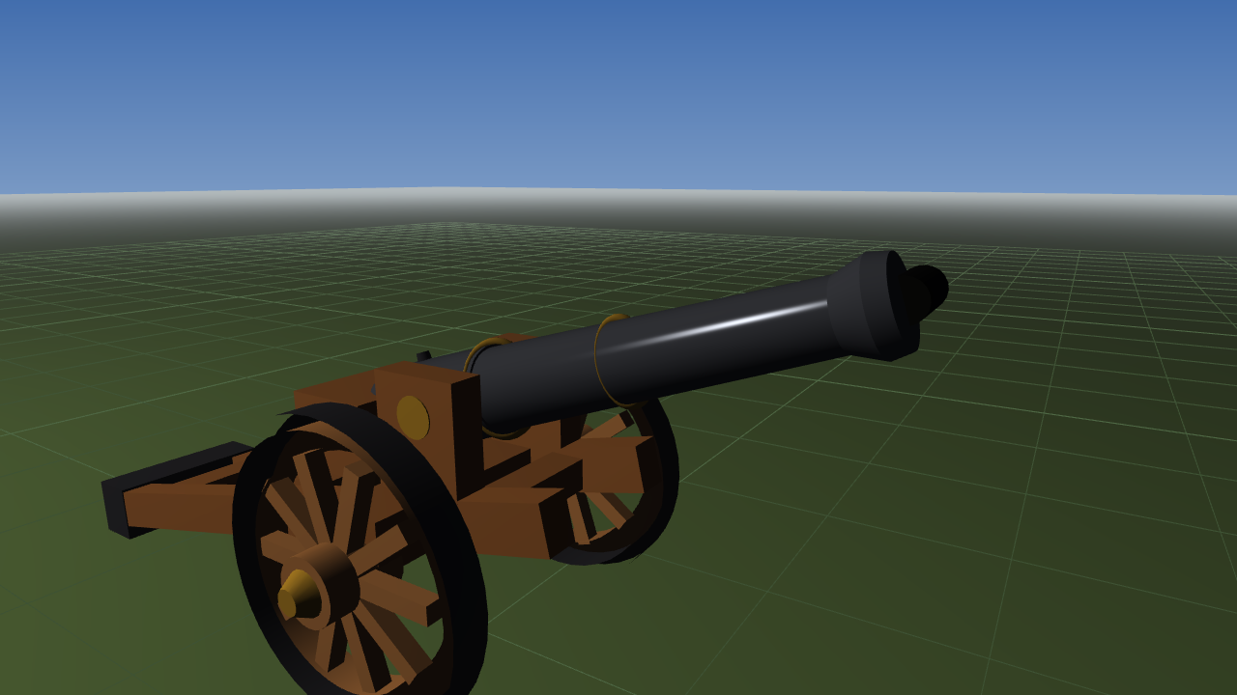
COMPUTER GRAPHICS PROJECT
Dual Shading Models: Gouraud vs. Blinn-Phong (Key 'G')
GOURAUD SHADING (PER-VERTEX)
• Implementation: gouraud.vert + gouraud.frag
• Evaluation: Lighting calculated strictly at vertices in vertex shader
• Interpolation: Hardware rasterizer linearly interpolates RGB colors
• Equation: I_v = I_amb + I_diff(N•L) + I_spec(R•V)^α
• Characteristics: Ultra-fast execution, O(V) ALU cost
• Artifacts: Prone to Mach banding; misses specular highlights if they land inside large polygons
BLINN-PHONG SHADING (PER-FRAGMENT)
• Implementation: lit.vert + lit.frag (ACTIVE DEFAULT)
• Evaluation: Normal & world position interpolated; full lighting evaluated per pixel in fragment shader
• Halfway Vector: H = (L + V) / ||L + V||
• Equation: I_f = I_amb + (N•L)•C_diff + (N•H)^α • C_spec + I_rim
• Fresnel Term: I_rim = k_metal • (1 − max(N•V, 0))^3.5 • C_rim
• Characteristics: Smooth elliptical highlights, eliminates Mach banding, supports procedural stone/wood

Slide 6
COMPUTER GRAPHICS PROJECT
Multi-Light System & Atmospheric Rendering
Hemispheric Ambient
I_amb = mix(C_ground, C_sky, (N_y + 1)/2) • k_a
Warm ground reflections + cool celestial skylight.
Directional Sun & Moon
Dynamic sunlight (day) & pale moonlight (night).
Toggle in real time with key 'N'. Includes visible emissive celestial bodies.
8 Quadratic Point Lights
f_att(d) = 1 / (1 + 0.12d + 0.045d²)
Applied to castle wall braziers, torches, and explosive cannon muzzle sparks.
Distance Fog & ACES
Exponential fog: 1 − exp(−(d_fog • k)^1.35)
ACES Filmic Tone Mapping + Gamma 2.2 correction.

Slide 7
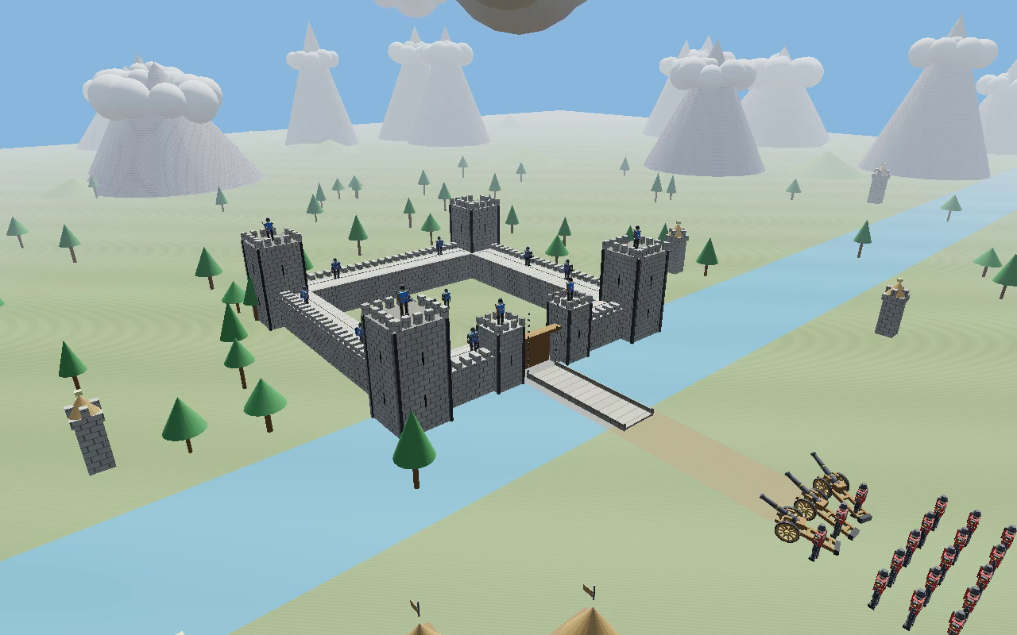
COMPUTER GRAPHICS PROJECT
Soft Shadow Mapping with 3x3 PCF (Key 'X')
🎯 SHADOW PIPELINE & PCF ALGORITHM
• Pass 1 (Light Space): Render depth to 2048² 32-bit floating-point FBO texture
• Light Projection: Orthographic frustum covering entire battlefield
• Slope-Scaled Depth Bias: Eliminates shadow acne on grazing surfaces:
bias = max(0.0035 • (1.0 − N•L), 0.0006)
• Percentage-Closer Filtering (PCF): 3×3 kernel averaging 9 depth samples:
shadow = (1/9) Σ Σ (proj_z − bias > depth ? 0.0 : 1.0)
• Result: Visually realistic soft penumbrae under wheels, fortress walls, and soldiers

Slide 8
COMPUTER GRAPHICS PROJECT
Real-Time Ray Tracing: Kay-Kajiya Slab Method (Key 'K')
⚡ GPU SLAB RAY-BOX INTERSECTION
• Target Feature: Real-time ray tracing implemented directly on GPU in GLSL
• Ray Formulation: r(t) = o + t•d, where o = p_frag + 0.05•N, d = lightDir
• Kay-Kajiya Slab Algorithm: Evaluates ray intersection across 3 pairs of parallel AABB planes:
t0 = (bMin − ro) / rd, t1 = (bMax − ro) / rd
tNear = max(tmin.x, tmin.y, tmin.z), tFar = min(tmax.x, tmax.y, tmax.z)
• Hit Condition: (tNear ≤ tFar) && (tFar > 0.0)
• Obstacle Array: Active castle walls & towers uploaded as uniform array of 36 boxes
• Key 'K' Toggle: Real-time switch casting exact, razor-sharp ray-traced shadows without texture discretization!
GLSL SHADOW RAY KERNEL
// In lit.frag:
float calcRayShadow(vec3 ro, vec3 rd, float maxDist) {
for (int i = 0; i < numBoxes; i++) {
float tHit;
if (hitBox(ro, rd, boxMin[i], boxMax[i], tHit)) {
if (tHit > 0.15 && tHit < maxDist) {
return 0.0; // Occluded!
}
}
}
return 1.0; // Fully visible
}
// Live runtime toggle:
// Press 'K' to toggle Ray Tracing mode
// Press 'X' to return to Soft PCF Depth Map

Slide 9
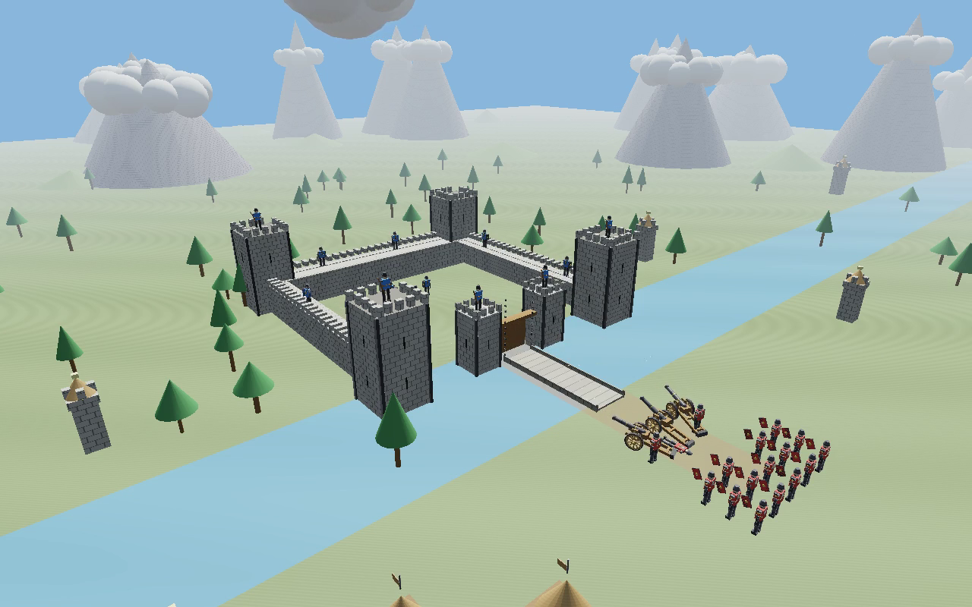
COMPUTER GRAPHICS PROJECT
Physics Simulation, Ballistics & Progressive Destruction
💥 BALLISTIC PHYSICS & COLLISION
• Semi-Implicit Euler Integration:
v(t + Δt) = v(t) + g • Δt
p(t + Δt) = p(t) + v(t + Δt) • Δt
Energy-conserving symplectic numerical integrator
• Sphere-vs-AABB Collision:
c_i = clamp(p_i, bMin_i, bMax_i)
Hit if ||p_sphere − c|| ≤ r_sphere
• Wall Fracture & Chipping:
10% health per impact; color darkens on hit;
boundaries removed at 0 HP so balls fly through gap
• Door Splintering:
Wooden gates shatter completely after 2 cannon hits
• Drawbridge Physics:
Bridge chains snap when shot; timber deck falls 85° → 0°

Slide 10
COMPUTER GRAPHICS PROJECT
Autonomous 6-Phase Tactical Siege State Machine (Key 'B')
Phase 0: Peaceful Patrol
Sentries pace side walls.
Relief guards climb wooden ladders periodically.
Phase 1: Advance & Alarm
Alarm rings; defenders raise drawbridge (0°→85°).
Cannons & infantry march in synchronized lockstep.
Phase 2: Archer Barrage
Castle archers loose arrows; infantry raise shields.
Cannoneer 1 hit while priming; relieved by infantryman.
Phase 3: Severing Hinge
Cannoneer 2 (preserved unharmed) shoots bridge chains.
Chains snap; drawbridge slams flat across moat.
Phase 4: Coordinated Siege
Simultaneous 3-cannon barrage:
Cannon 1 hits left wall, Cannon 3 hits right, Cannon 2 breaks door.
Phase 5: Courtyard Charge
Infantry form 2-column bridge crossing;
charge courtyard; animated melee duel; golden crest victory!

Slide 11
COMPUTER GRAPHICS PROJECT
User Interaction & Comprehensive Controls
INTERACTIVE KEYBOARD & MOUSE CONTROLS
• Mouse Left Drag : 360° Spherical orbit camera rotation (yaw & pitch)
• Mouse Wheel : Interactive zoom in / zoom out (radius 12m to 240m)
• Left / Right Arrows : Drive active cannon forward / backward (wheels roll with no slip)
• Up / Down Arrows : Elevate / depress active cannon barrel (clamped 0° to 45°)
• W / S Keys : Steer / yaw active cannon barrel left / right
• Spacebar : Fire active cannon (triggers recoil, ballistic ball, muzzle sparks)
• Keys 1, 2, 3 / A : Select Cannon 1 (left), Cannon 2 (center), Cannon 3 (right), or All (A)
• G Key : Toggle Shading Mode in real time: Gouraud (per-vertex) <-> Blinn-Phong
• X / Y Keys : Toggle Soft Shadow Mapping: Enable/disable 3×3 PCF depth FBO shadows
• K Key : Toggle Real-Time Ray Tracing: Enable GPU ray-box slab shadow rays
• R Key (Hold) : Manually raise drawbridge (0° → 85°); release to lower
• N Key : Toggle Day / Night: Switch solar/lunar illumination and sky
• B / P / T Keys : Start battle simulation (B), Pause/resume (P), Reset simulation (T)

Slide 12
COMPUTER GRAPHICS PROJECT
Project Demo Video Breakdown (presentation.mp4)
⏱ 0:00 - 0:05 — Peaceful Patrol & Wall Sentries
Sentries patrol curtain walls; soft PCF shadows visible across grass; day sky.
⏱ 0:05 - 0:10 — Alarm & Synchronized Advance
Defenders winch up drawbridge; 3 cannons & infantry battalion march in formation.
⏱ 0:10 - 0:18 — Archer Barrage & Relief
Archers loose volleys; troops raise shields; cannoneer 1 hit & replaced by infantry.
⏱ 0:18 - 0:25 — Severing the Bridge Hinge
Center cannon fires precision shot; drawbridge chains snap; bridge drops across moat.
⏱ 0:25 - 0:35 — Coordinated Artillery Bombardment
Cannons 1 & 3 pound curtain walls; Cannon 2 shatters wooden gatehouse doors.
⏱ 0:35 - 0:48 — Courtyard Charge & Melee Victory
Infantry form 2-column bridge march, breach courtyard, win melee, gold crest pulses!

Slide 13
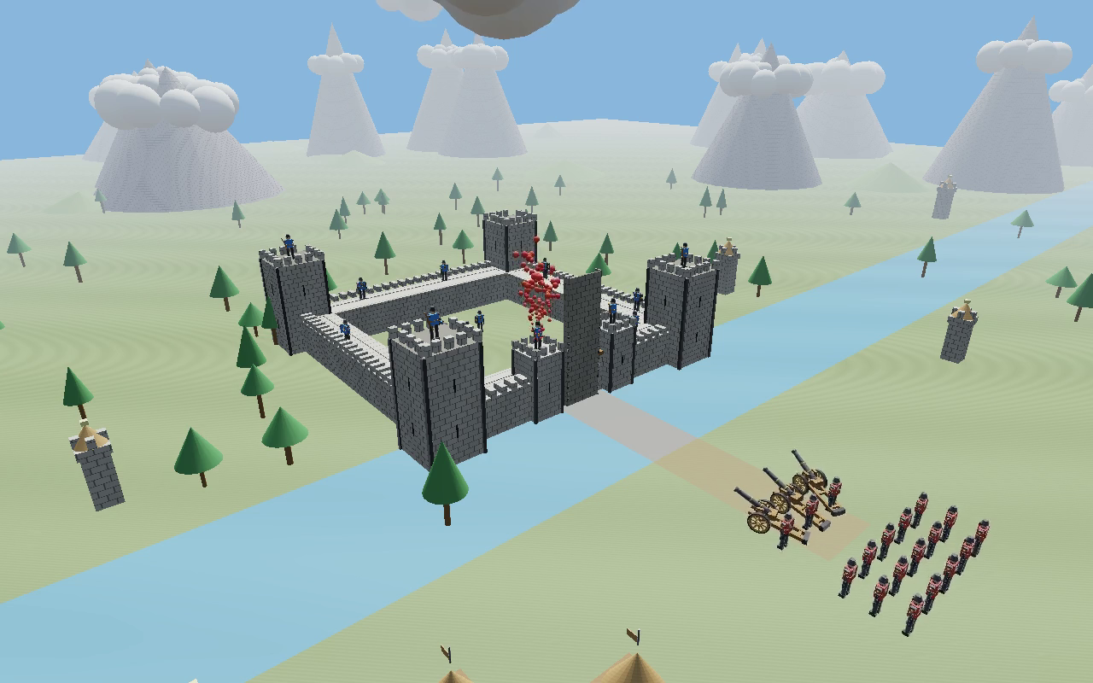
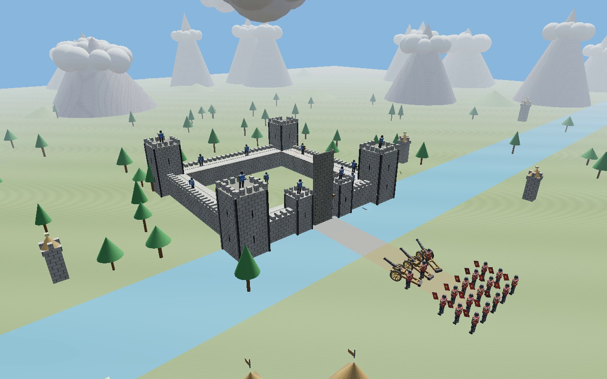
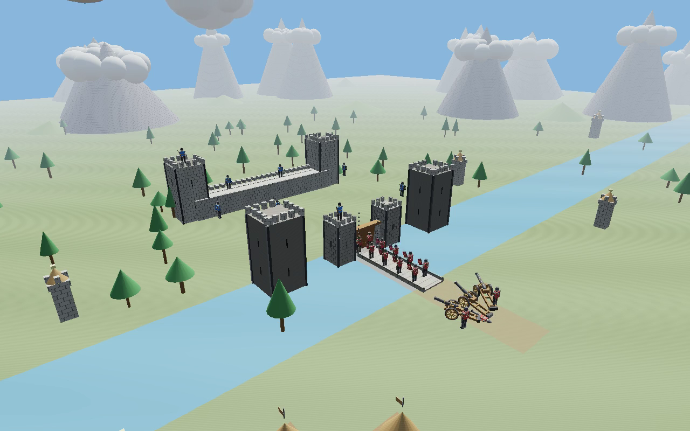
COMPUTER GRAPHICS PROJECT
Visual Results & Screenshot Gallery
Full Scene Overview & March
Archer Barrage & Shield Wall
Artillery Breach of Gatehouse
Courtyard Breach & Melee

Slide 14
COMPUTER GRAPHICS PROJECT
Conclusion & Academic Takeaways
KEY ACADEMIC ACHIEVEMENTS & LEARNINGS
✓ 100% Scope Fulfillment: Delivered every baseline requirement and expanded into an advanced 3-D siege simulator.
✓ Mathematical Rigor: Exact affine transformations, forward kinematic scene graph, and non-slipping rolling constraints.
✓ Shading Mastery: Deep comparative analysis and real-time switching between Gouraud and Blinn-Phong shading.
✓ Advanced Illumination: Multi-light system, quadratic distance attenuation, and hemispherical ambient bounce.
✓ Dual Shadow Implementations: Real-time 3×3 PCF soft shadow mapping and GPU ray-box slab ray tracing.
✓ Physical Simulation: Symplectic semi-implicit Euler integration, continuous AABB collisions, and multi-stage fracture.
✓ Dynamic Interactivity: Full orbit camera control, manual artillery firing, and interactive drawbridge winches.
✓ Academic References Followed: Joey de Vries (LearnOpenGL), Blinn (1977), Phong (1975), Kay & Kajiya (1986).

Slide 15
THANK YOU!
Medieval Fortress Siege Simulation
Computer Graphics Lab Project Showcase
Ready for Live Demo, Parameter Adjustments & Questions

