Slide 1


Designing for a Unified Experience
A New Perspective and a Case Study
Course No: CSE 4XYZ
Course Teacher: Dr. John Doe
Presentation by: Student Name (Roll: 123456)
Date: October 24, 2023

Slide 2

Agenda
0 counter(toc-counter)
The Enterprise Software "Nightmare"
0 counter(toc-counter)
Why Current Solutions Fail
0 counter(toc-counter)
The Concept of Unified Experience (UX)
0 counter(toc-counter)
Implementation Framework
0 counter(toc-counter)
Case Study: "Paul the Buyer"
0 counter(toc-counter)
Results & Business Impact
0 counter(toc-counter)
Conclusion

Slide 3

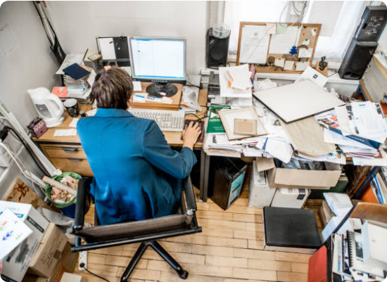
The Enterprise Software Nightmare
Today's enterprise environment is a chaotic hybrid of:
Legacy Systems: Ancient software that won't die.
Vendor Solutions: Purchased SaaS tools (Salesforce, SAP).
Home-Grown Apps: Internal tools built in silos.
The Result? A fractured user experience that kills productivity and frustrates employees.

Slide 4


Why "Visual Consistency" Isn't Enough
The Common Trap
Most companies try to fix the problem by just making everything look the same (e.g., using Google Material Design everywhere).
The Reality
Klocek's Hierarchy
•
Lipstick on a pig: It ignores the underlying business process.
Visual consistency is just the bottom layer. Real change happens at the organizational and process levels.
•
Vendor Lock-in: You can't easily change the UI of bought software.
•
Lack of Integration: Looking the same doesn't mean working together.

Slide 5









Exam Focus: The 5 Attributes of Unified Experience
To fix the broken experience, we need these 5 pillars working together:
Consistency
Efficiency
Personalization
Integration
Optimization
Uniform look & feel across apps.
Streamlined workflows & processes.
Targeted content based on user role.
Seamless data flow across systems.
Best performance across all touchpoints.

Slide 6



How to Build It: The Framework
1. Top-Down Approach
Requires leadership commitment. Changing the culture to prioritize UX. Setting organizational standards.
UNIFIED EXPERIENCE
The 5 Attributes meet here
2. Bottom-Up Approach
Tactical execution. Creating UI assets, design guidelines, and integration toolkits that developers can use immediately.

Slide 7


Case Study: Meet Paul
The User: Paul (Supply Chain Buyer)
Role: Manages factory spare parts inventory.
The Pain:
•
Fighting fires daily (reactive, not proactive).
•
Uses dozens of different systems to do one job.
•
Manual copy-pasting leads to errors.
•
"I wish I had one system instead of twelve."

Slide 8

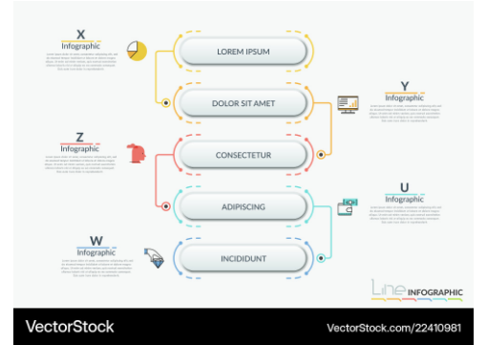
The Solution: BOMA Application
Redesigning the Process
We didn't just fix the UI. We fixed the job.
•
Consolidated: Merged data from ERP, MRP, and Email into one dashboard.
•
Automated: The system now analyzes risks and recommends actions (instead of Paul guessing).
•
Optimized: Reduced clicks and screen switching.
Simplified Process Flow

Slide 9



Exam Focus: Tangible Business Impact
50%
$1.2M
0
TIME SAVED
COST SAVINGS
LEARNING CURVE
Task time dropped from 10 mins to 5 mins.
Saved per buyer via proactive inventory planning.
"How do I?" support tickets dropped to zero.
"The system shifted users from being Reactive to Proactive."

Slide 10


Conclusion
Key Takeaways
•
UX is Business Value: It's not just about "looking pretty." It saves money and reduces risk.
•
Beyond the UI: True Unified Experience requires deep integration and process redesign.
"Unified Experience is the ultimate goal for the enterprise world."
•
Measure It: Use a UX Scorecard to prove value to management (e.g., time saved, error reduction).

Slide 11
Fin!
Questions?
Thank you for listening.

Slide 12




Image Sources
https://admission.kuet.ac.bd/static/logo.png
Source: admission.kuet.ac.bd
https://media.istockphoto.com/id/860536912/photo/high-angle-view-of-office-worker-working-on-computer.jpg?s=612x612&w=0&k=20&c=97F652FYtS00cs4AxnHOl0FHI-5UuKYPT345n4i3aNI=
Source: www.istockphoto.com
https://haslam.utk.edu/wp-content/uploads/2024/05/Steve-Harris-Headshot-1-700x700-1.webp
Source: haslam.utk.edu
https://cdn.vectorstock.com/i/1000v/09/81/modern-flowchart-template-vector-22410981.jpg
Source: www.vectorstock.com

