Slide 1
Image Compression using MDCT
Video Coding Seminar Project
Group Members:
Sheikh Muhammad Mujtaba (70614)
Syed Zeeshan Ali Shah (66546)

Slide 2
Objectives
Image Compression using MDCT
Compare the Perceptual Similarity

Slide 3
Introduction
Image compression refers to reducing the size of an image file while maintaining its visual quality. This project explores the use of Modified Discrete Cosine Transform (MDCT) for image compression, comparing its effectiveness with the widely used Discrete Cosine Transform (DCT). The project aims to evaluate the compression ratio, image quality, and overall performance of MDCT against DCT.

Slide 4
Methodology
The project methodology involved the following steps: 1. Image Compression using MDCT 2. Image Compression using DCT 3. Perceptual Similarity (MDCT, DCT) 4. Result Analysis

Slide 5

Results
These are original images used for image compression

Slide 6

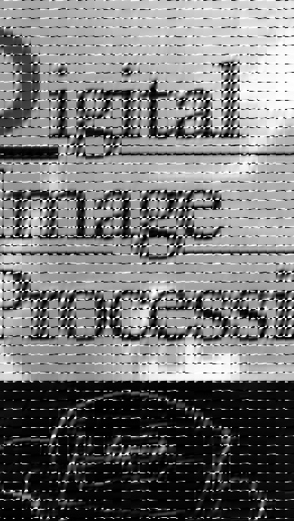
Result-MDCT
Compression Ratio: 1.92936119981234 1.3988771719826436
MDCT Bits Per Pixel: 6.721700032552083 5.196018117901568
MDCT Perceptual Similarity: 0.7304627895355225 0.6927622556686401

Slide 7

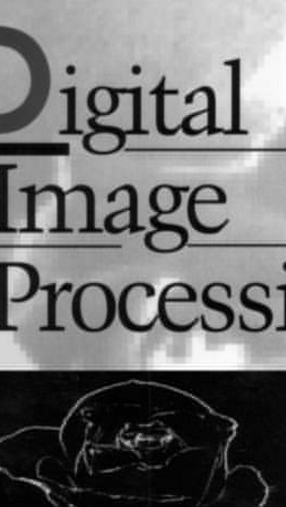
Result-DCT
DCT Compression Ratio: 6.482579070476965 4.7954773533150465
DCT Bits Per Pixel: 2.0005289713541665 1.5157179556517035
DCT Perceptual Similarity: 0.21777290105819702 0.062057480216026306

Slide 8
Result Analysis
The analysis revealed that while MDCT has potential, especially in audio compression, DCT is more effective for image compression. DCT consistently provided better compression ratios, lower bits per pixel, and better visual quality. MDCT's overlapping block structure may have contributed to its lower performance in this context.

Slide 9
Conclusion
In conclusion, the DCT method outperformed MDCT in the key areas of image compression efficiency and quality. While MDCT has its applications, particularly in overlapping data blocks for audio, DCT remains the preferred choice for image compression. Future work could explore optimizations to MDCT or hybrid approaches that combine the strengths of both techniques.

