Slide 1
Image Compression using MDCT
Video Coding Seminar Project
Group Members:
Sheikh Muhammad Mujtaba (70614)
Syed Zeeshan Ali Shah (66546)

Slide 2
Objectives
Image Compression using MDCT
Compare the Perceptual Similarity

Slide 3
Introduction
Image compression refers to reducing the size of an image file while maintaining its visual quality. This project explores the use of Modified Discrete Cosine Transform (MDCT) for image compression, comparing its effectiveness with the widely used Discrete Cosine Transform (DCT). The project aims to evaluate the compression ratio, image quality, and overall performance of MDCT against DCT.

Slide 4
Methodology
The project methodology involved the following steps: 1. Image Compression using MDCT 2. Image Compression using DCT 3. Perceptual Similarity (MDCT, DCT) 4. Result Analysis

Slide 5

Results
These are original images used for image compression

Slide 6

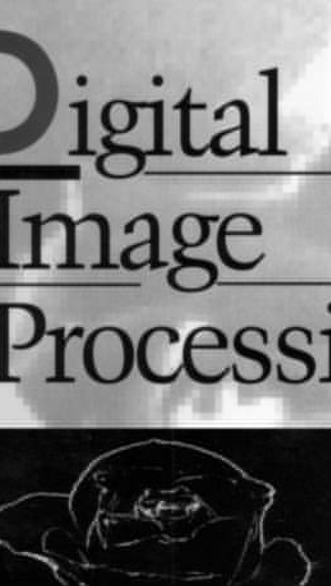
Result-DCT
DCT Compression Ratio: 5.340594523945173 4.7954773533150465
DCT Bits Per Pixel: 2.4283040364583335 1.416238507301244
DCT Perceptual Similarity: 0.09168823063373566702 0.01662929356098175

Slide 7
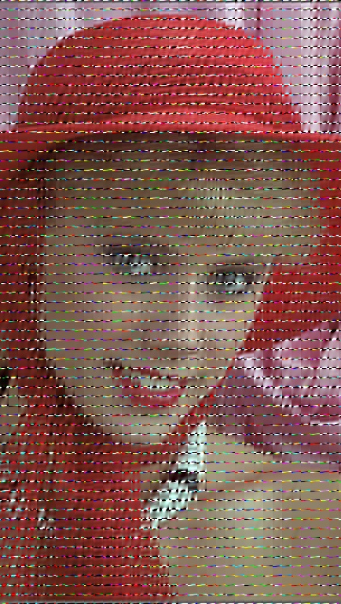
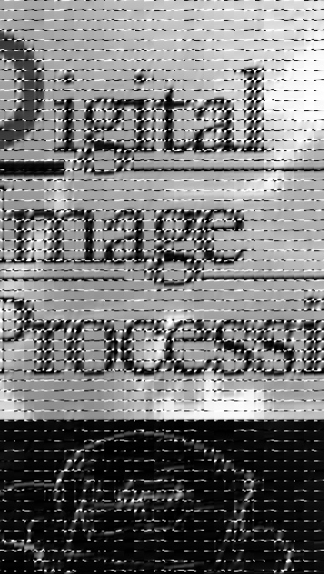
Result-MDCT
Compression Ratio:
1.6714836754012645 (Blackman-Harris)
3.418525828041874 (Hamming)
1.9459532066624334 (hann)
2.7774634789010735 (Blackman-Harris)
2.7774634789010735 (hamming)
1.4856057204048498 (hann)

Slide 8
Comparison Graph
Compression Ratio

Slide 9
Result-MDCT
MDCT Bits Per Pixel:
7.75872802734375 (Blackman-Harris)
3.7936197916666665 (Hamming)
6.664388020833333 (hann)
2.616988912925906 (Blackman-Harris)
2.616988912925906 (hamming)
4.892678474851271 (hann)

Slide 10
Comparison Graph
BPP

Slide 11
MDCT-Result
MDCT Perceptual Similarity:
0.7755568027496338 (Blackman-Harris)
0.4168405532836914 (Hamming)
0.6923218369483948 (hann)
0.4458668828010559 (Blackman-Harris)
0.4458668828010559 (hamming)
0.6887151002883911 (hann)

Slide 12
Comparison Graph
Perceptual Similarity

Slide 13
Result Analysis
The analysis revealed that while MDCT has potential, especially in audio compression, DCT is more effective for image compression. DCT consistently provided better compression ratios, lower bits per pixel, and better visual quality. MDCT's overlapping block structure may have contributed to its lower performance in this context.

Slide 14
Conclusion
In conclusion, the DCT method outperformed MDCT in the key areas of image compression efficiency and quality. While MDCT has its applications, particularly in overlapping data blocks for audio, DCT remains the preferred choice for image compression. Future work could explore optimizations to MDCT or hybrid approaches that combine the strengths of both techniques.

