Slide 1
Domain Knowledge Aided
Explainable and Fair Artificial Intelligence
Sheikh Rabiul Islam, Ph.D.
Assistant Professor, University of Hartford

Slide 2
Outline
Explainable Artificial Intelligence (XAI)
Motivation, and why do we need to care about XAI?
Application of XAI in different domains
Quantification of explainability
Fair Artificial Intelligence
Research accomplishments and future research plans

Slide 3
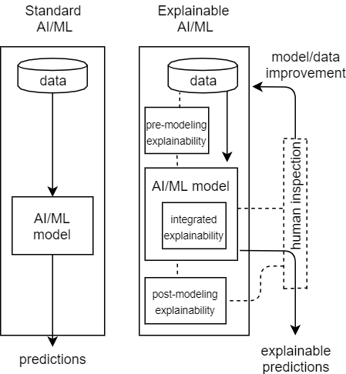
Explainable Artificial Intelligence (XAI)

Slide 4
Explainability
”Explanations are . . . the currency in which we exchanged belief”
–Lombrozo (2006)
“Explanations consist of interpretations of how the world works and why” –Deutsch (1998)
Explainability of an AI model’s prediction is the extent of transferable qualitative understanding of the relationship between model input and prediction in a recipient friendly manner.

Slide 5
Motivation
IoT and Big Data has necessitated the adoption of Artificial Intelligence.
AI based “black box” models lack explainability.
Lack of explainability -> lack of trust -> ethical issues.
Recent laws:
Right of Explanation
Algorithmic Accountability Act
The DARPA division of DoD is spending $2 billion on an XAI
program.
DoD’s Ethical Principles for AI (Feb, 2020): responsible, equitable, traceable, reliable, and governable.

Slide 6
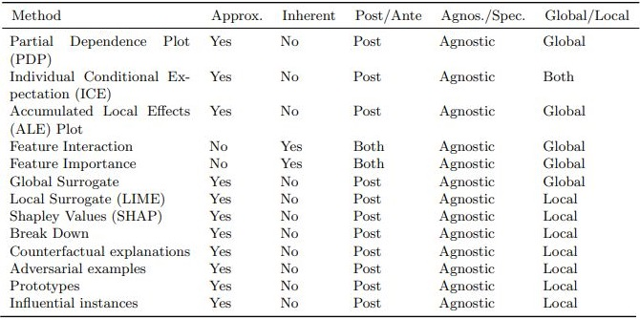
Existing Techniques/Tools for Explainability
Blank 1
Blank 2
Blank 3
There is a lack of an explainability method, which is, at the same time actual and direct, model agnostic, and local method to utilize the full potential.

Slide 7
Research Question
How to make explainable and fair prediction by keeping the core AI/ML-based prediction algorithm unchanged?
How to leverage domain knowledge to improve explainability and fairness? Also, how that affects input and output, and what are the associated gain/compromises?
How to translate the proposed approach to a different domain?

Slide 8
XAI for Finance—Bankruptcy prediction (Test Case I)

Slide 9
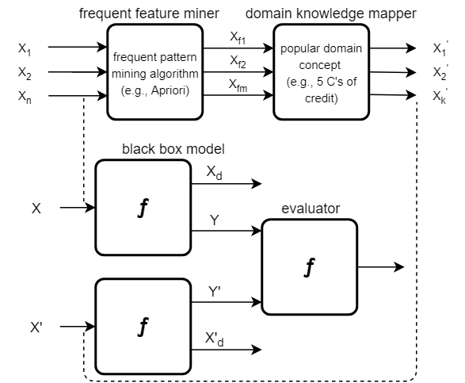
Test Case I: Infusing Domain Knowledge in AI-based "black box" Models for Better Explainability with Application in Bankruptcy Prediction
Figure 2: Feature Generalizer (on the top); Evaluator (on the bottom)
Sheikh Rabiul Islam, William Eberle, Sid Bundy, and Sheikh Khaled Ghafoor, “Infusing domain knowledge in AI-based "black box" models for better explainability with application in bankruptcy prediction”, 25th ACM SIGKDD, Workshop: Anomaly Detection in Finance, 2019.

Slide 10
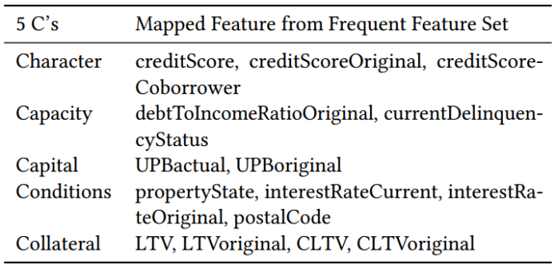

Test Case I: Domain Knowledge Incorporation
…….. (1)
{ character, capacity, capital,
conditions, collateral }
Table 2: Feature mapping with 5 C’s of credit

Slide 11
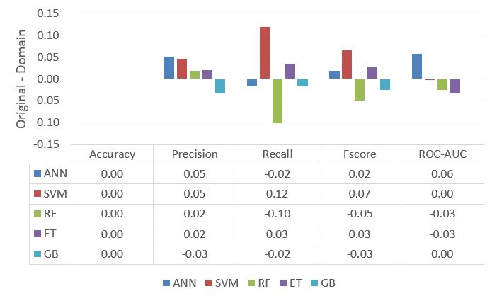
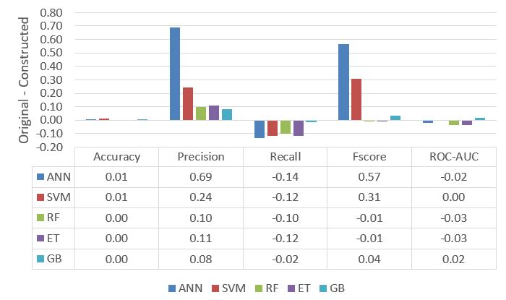
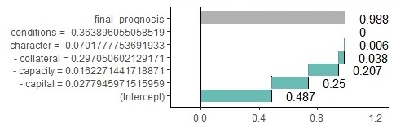
Test Case I: Results
We get better recall and explainability from using generalized frequent feature.
Computational efficiency.

Slide 12
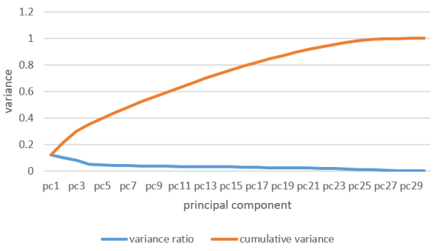
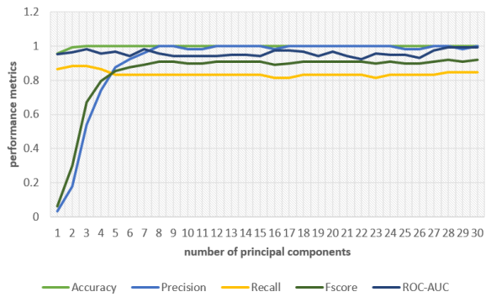
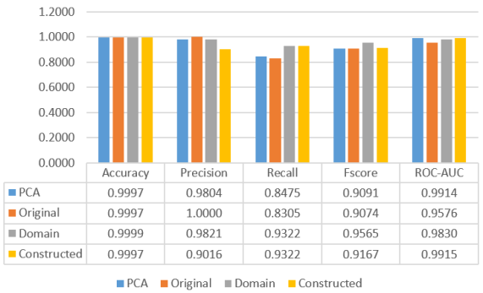
Information sacrificing?
Our approach retains enough valuable information and does not trade valuable information to achieve explainability.

Slide 13
XAI for Cybersecurity—Network Intrusion Detection
and Response (Test Case II)

Slide 14
Test Case II: Domain Knowledge Aided Explainable Artificial
Intelligence for Intrusion Detection and Response
AI has become an integral part of modern-day security solutions.
Intrusion detection is fast, but the response is at human speed.
We infuse popular domain knowledge (e.g., CIA principle) in the model.
CICIDS dataset covering popular attacks: DDoS, Brute Force, XSS, SQL Injection, Infiltration, Portscan, and Botnet.
Sheikh Rabiul Islam, William Eberle, Sheikh K. Ghafoor, Ambareen Siraj, and Mike Rogers,
“Domain Knowledge Aided Explainable Artificial Intelligence for Intrusion Detection and Response ”, Accepted in AAAI-MAKE 2020.

Slide 15
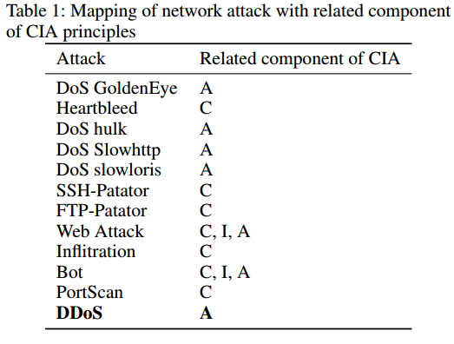
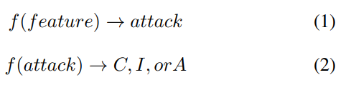
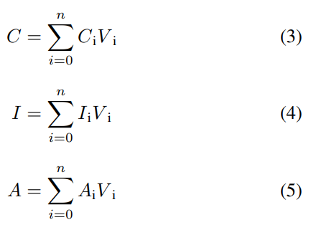
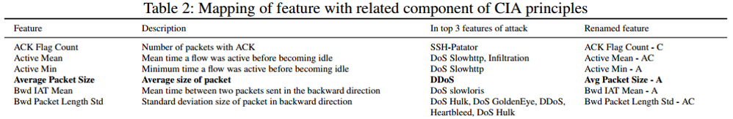
Test Case II: Domain Knowledge Incorporation
Blank reference

Slide 16

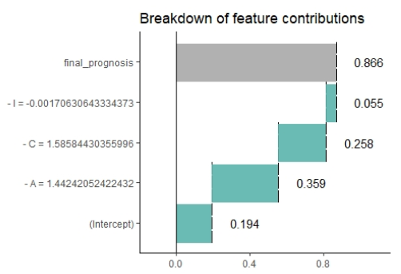
Test Case II: Experimental Results
Doman knowledge mapped features provides better explainability with negligible compromises (<.005%) in any performance metrics.
Figure 1: Breakdown of feature contributions in the prediction for a random sample.

Slide 17
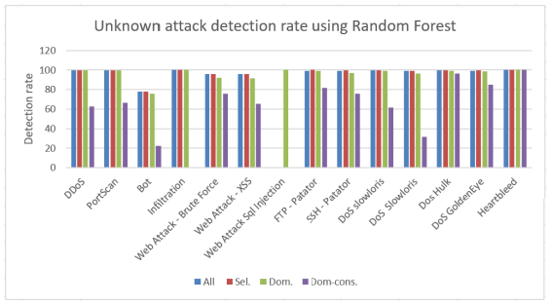
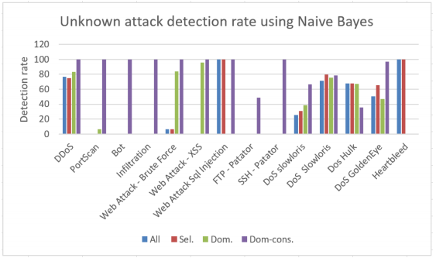
Test Case II: Experimental Results
The infused domain knowledge (i.e., constructed features) generalizes the model to work well with unknown attack and Big Data.

Slide 18
Evaluation of Explainability
Application-level evaluation (real task by domain expert)
Human-level evaluation (simplified task by a layperson)
Function-level evaluation (proxy task)
Doshi-Velez, Finale and Kim, Been. Towards a rigorous science of interpretable machine learning." arXiv preprint arXiv:1702.08608 , 2017.

Slide 19
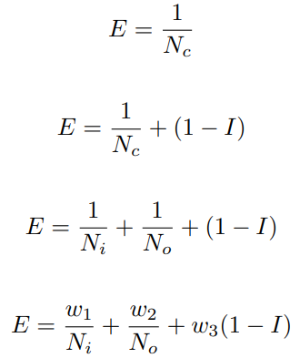
Proposed Explainability Quantification Method
E = explainability;
N_{c} = # cognitive chunks;
I = interaction;
N_{i} = # input cognitive chunks;
N_{o} = # cognitive chunks involves in explanation representation
Sheikh Rabiul Islam, William Eberle, Sheikh K. Ghafoor. “Towards Quantification of Explainability
in Explainable Artificial Intelligence Methods. ” Accepted in FLAIRS-33, 2020.

Slide 20
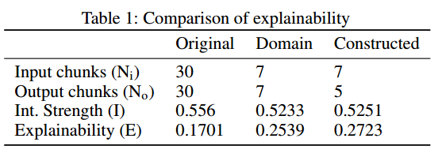
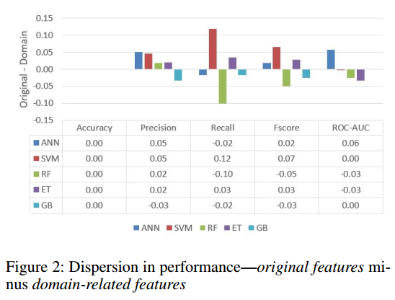
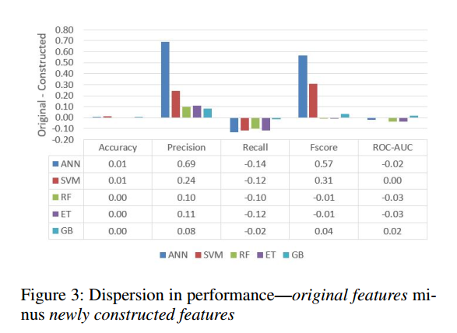
Experimental Results
Blank reference

Slide 21
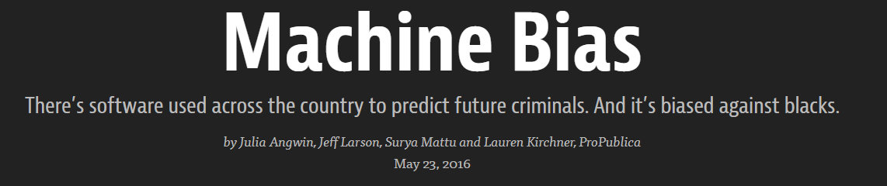
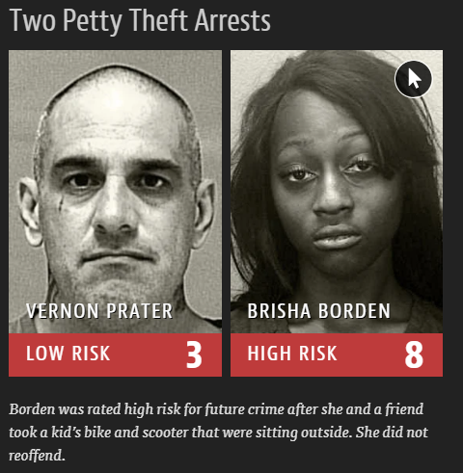
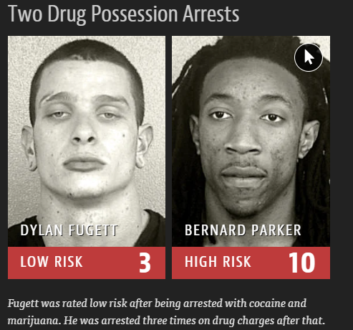
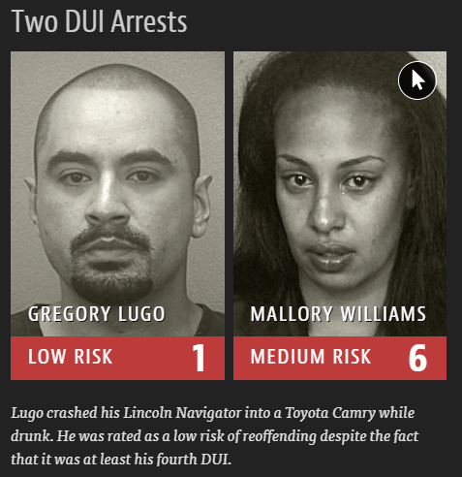
ProPublica is an independent, non-profit newsroom that produces investigative journalism in the public interest
https://www.propublica.org/article/machine-bias-risk-assessments-in-criminal-sentencing

Slide 22
Predictive Policing System is Biased
According to an NYU Law Review [1], “predictive policing systems to forecast criminal activity and allocate police resources are built on data produced during documented periods of flawed, racially-biased, and sometimes unlawful practices and policies (a.k.a. ”dirty policing”). As a result, decisions grounded on systematically biased data (”dirty data”) can not escape the legacies of unlawful and biased policing practices”
Predictive policing has been found to lead to disproportionate patrolling and arrests in communities of color and to disproportionate ``false positives'' among people of color [2] (relative to whites) in both predicting their likelihood of future offending and in their identification as perpetrators using AI facial recognition from video surveillance evidence [3]. As a result, in June 2020, Santa Cruz, CA has become the first U.S. city to ban predictive policing [4].

Slide 23
Primary Factors for Fairness Related Risks
Data bias and algorithmic bias are the primary contributing factors for fairness related risks in AI-based decision making.
A particular group can be disproportionately represented in the data due to natural or systematic bias in the data collection process; and a group could be subject to statistical discrimination that is inherent in AI algorithms.

Slide 24
What is Bias in Decision-making?
In the context of decision making, a fair decision is free from favoritism or prejudice towards individuals or groups based on their inherent or acquired characteristics; in contrast, a biased decision is skewed towards a particular person or group.
Data bias and algorithmic bias are the primary contributing factors for fairness related risks.

Slide 25
Different Kinds of Discriminations
Direct Discrimination: when the protected attributes (e.g., sex, race) of individuals explicitly result in a non-favorable outcome toward them;
Indirect discrimination: when non-protected attributes (e.g., zip code) are used for decision making (e.g., loan approval decision), but the individual can still be discriminated from the implicit effect (e.g., an implicit guess of race from zip code) of the protected attribute (e.g., race);
Systemic discrimination: results from flawed policies, custom, or behaviors (i.e., perpetuating discrimination against certain groups) that are part of the culture or structure of an organization;
Statistical discrimination: results from the use of group statistics to judge an individual belonging to that group.
Ninareh Mehrabi, Fred Morstatter, Nripsuta Saxena, Kristina Lerman, and Aram Galstyan. A survey on bias and fairness in machine learning. arXiv preprint arXiv:1908.09635, 2019.

Slide 26
Different Grounds for Discriminations
Title VII of the Civil Rights Act of 1964: Race/color, religion, sex, sexual harassment, pregnancy, national origin.
Equal Pay Act of 1963: equal pay and compensation discrimination
Age Discrimination in Employment Act of 1967.
Rehabilitation Act of 1973: employment discrimination based on disability.
Can you think of any other ground for discrimination?
My students think the following could also be a ground for discrimination:
Educational background; Criminal history; Language; Cultural background; Zip code; Name;
LGBTQ; Individual’s physical; Nepotism; Someone with kids.

Slide 27
How can we defend bias in AI?
It is very hard to completely eliminate bias in data, and most algorithms are prone to bias.
We have to detect and mitigate bias.

Slide 28
Tools to detect an mitigate bias
Aequitas: Bias and Fairness Audit Toolkit ( http://aequitas.dssg.io )
Scikit-Fairness ( https://scikit-fairness.netlify.app )
AI Fairness 360 ( https://aif360.mybluemix.net/ )

Slide 29
Fairness in AI
Advancing Fairness in Public Funding Using Domain Knowledge
In the transportation sector, in general, the funding allocation in a particular geographic area corresponds to the population in that area.
However, we found that areas with high diversity index have a higher public transit ridership, and this is a crucial piece of information to consider for an equitable distribution of funding.
Therefore, in our proposed approach, we use the above fact as domain knowledge to guide the developed model to detect and mitigate the hidden bias in funding distribution.
Our intervention has the potential to improve the declining rate of public transit ridership which has decreased by 3% in the last decade.
Goolsby, T., Islam, S. R., & Russell, I. Advancing Fairness in Public Funding Using Domain Knowledge. AAAI Spring Symposium 2022

Slide 30
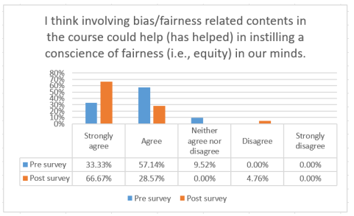
Fairness in AI
we share our experiences with ongoing work to develop and evaluate a cybersecurity curricular module that demonstrates (a) data bias detection, (b) data bias mitigation, (c) algorithmic bias detection, and (d) algorithmic bias mitigation, using a network intrusion detection problem on real-world data.
we share our experience in building and incorporating a fairness module [3] in undergraduate Data Mining course. The module includes lectures and hands-on exercises, using state-of-the-art and open-source bias detection and mitigation software, on real-world datasets.
(1) Islam, S. R., Russell, I., Eberle, W., & Dicheva, D. (2022, March). Incorporating the Concepts of Fairness and Bias into an Undergraduate Computer Science Course to Promote Fair Automated Decision Systems. In Proceedings of the 53rd ACM Technical Symposium on Computer Science Education V. 2 (pp. 1075-1075).
(2) Incorporating the Concept of Bias and Fairness in Cybersecurity Curricular Module,
Sheikh Rabiul Islam, Ingrid Russell, and Maanak Gupta
Accepted in SIGCSE TS 2023
(3) https://sheikhrabiul.github.io/publications/bias-fairness-module-v1.pdf

Slide 31
Health Informatics
[1] Visualization of COVID-19 Symptoms across different locations and times.
[2,3] Mined tweets and COVID related research paper archive to enhance the chain of infection and observing global research trends.
[4] Analyzed the impact of non-pharmaceutical Interventions (NPIs), such as Stay-at-Home, across different race and communities.
[1] Biddut Sarker Bijoy, Syeda Jannatus Saba, Souvika Sarker, Md Saiful Islam, Sheikh Rabiul Islam, Md. Ruhul Amin and Shubhra Kanti Karmaker, “COVID19-Alpha : Spatio-Temporal Visualization of COVID-19 Symptoms through Tweet Analysis”, ACM IUI '21: 26th International Conference on Intelligent User Interfaces. 2021
[2] Syeda Jannatus Saba, Biddut Sarker Bijoy, Souvika Sarkar, Md Saiful Islam, Sheikh Rabiul Islam, Md. Ruhul Amin and Shubhra Kanti Karmaker, “Towards Containing COVID-19 Pandemic by Mining Knowledge from Scientific Literature and Social Media”, 17th Int. Conference on Data Science (ICDATA’21).
[3] Souvika Sarker, Shubhra Karmaker, Mohammad Ruhul Amin, Biddut Sarker Bijoy, Yash Mahajan, Sheikh Rabiul Islam, “Ad-Hoc Monitoring of COVID-19 Global Research Trends for Well-Informed Policy Making,ACM Transactions on Intelligent Systems and Technology
[4] Yash Mahajan, Sheikh Rabiul Islam, Mohammad Ruhul Amin, and Shubhra Karmaker “Data-Driven Estimation of Effectiveness of COVID-19 Non-pharmaceutical Intervention Policies”, IEEE BigData 2022 - 5th Special Session on HealthCare Data

Slide 32
Summary of Research Accomplishments
My research has resulted in 23 research papers and one book.
[6], [7], [9], and [15] are on domain knowledge aided Explainable Artificial Intelligence (XAI) research, considering the Big Data aspect (e.g., intrusion detection from the stream of IoT data);
[9], [3], and [2] are on predictive modeling (e.g., bankruptcy prediction);
[14], [8], and [5] are on pattern discovery and anomaly/intrusion detection (e.g., illegal insider trading detection, network intrusion detection).
[10-13] and [20-21] are on health informatics focusing on COVID-19 and Dengue.
[17], [19], and [22] are focused on introducing a fairness module in the Computer Science curriculum, and [18] is focused on advancing fairness in public funding allocation.
Recently, I have co-edited and authored a chapter in a book [23] on Explainable Artificial Intelligence for Cyber Security.

Slide 33
Future Research Agenda
Advancing ongoing work to develop Fair, Accountable, and Transparent AI system for different application domain (e.g., Cybersecurity, Social justice related issues).
XAI enhances understandability directly and it increases trust as a byproduct. Using explanation techniques to uncover potential bias related risks is another future research agenda.
Human Machine Teaming
To ensure responsible use of AI
Multidisciplinary effort for the design of human-centered AI.

Slide 34
Research Grant
Internal
University of Hartford: 2021-22 Greenburg Junior Faculty Research Grant
University of Hartford: 2021-22 Dean's Research and Teaching Grant
University of Hartford: 2021-22 Grants to Promote Diversity, Equity, and Inclusion within the Classroom
University of Hartford: 2020-21 Grants to Promote Diversity, Equity, and Inclusion within the Classroom
External Grant Writing Experience
NSF CRII (Single PI) - Declined
NSF Fairness in AI (Collaborative) - Declined
NSF Training-based Workforce Development for Advanced Cyberinfrastructure (Collaborative) - Pending

Slide 35
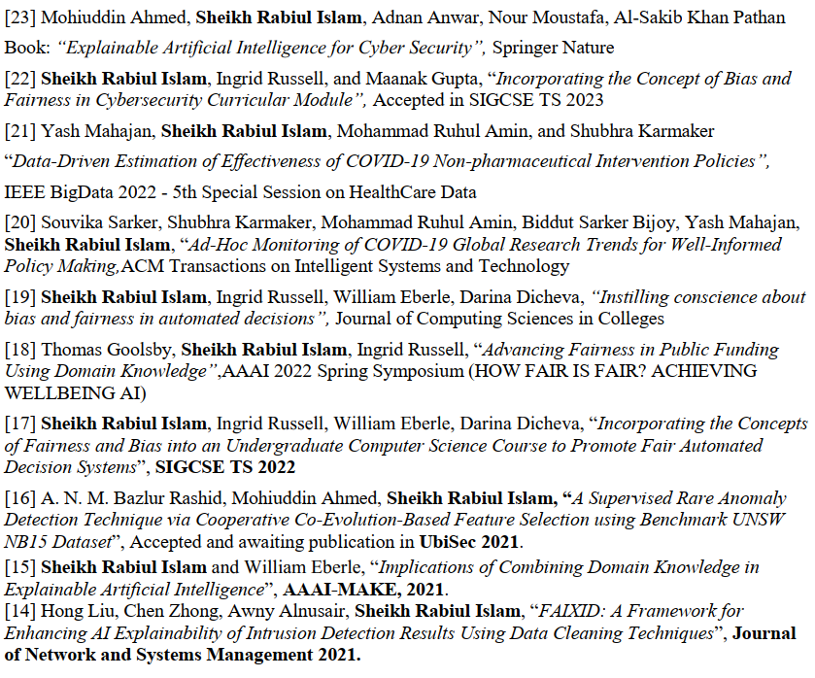
References

Slide 36
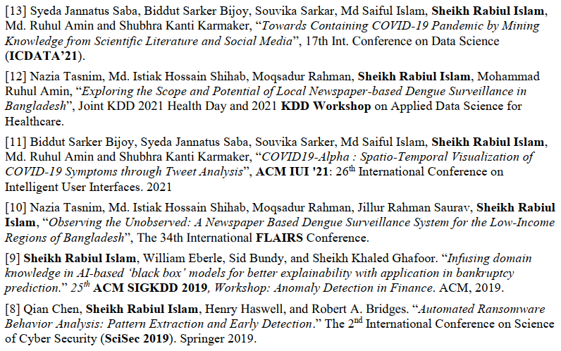
References

Slide 37
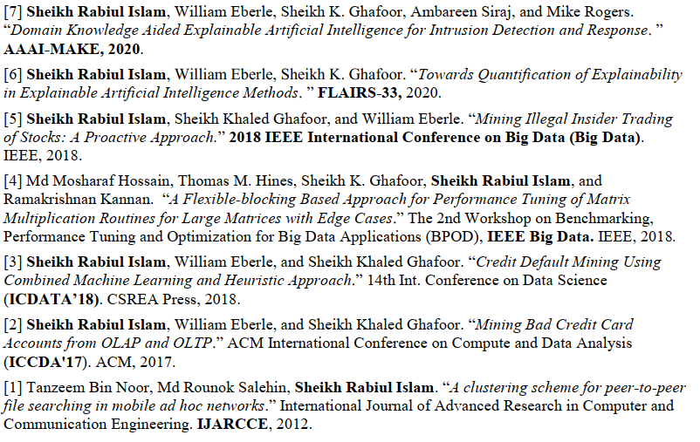
References

Slide 38
Thank You
Q & A
https://SheikhRabiul.github.io/
shislam@hartford.edu

