Slide 1
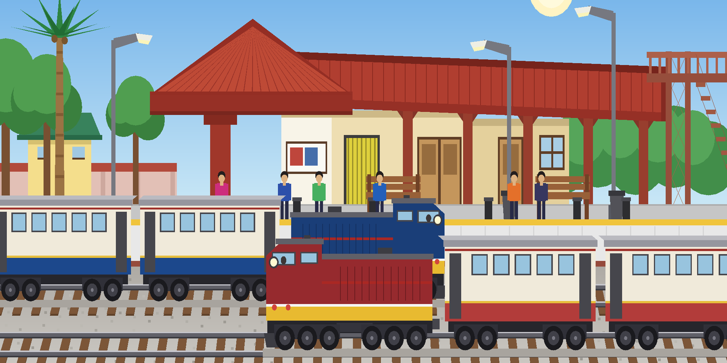
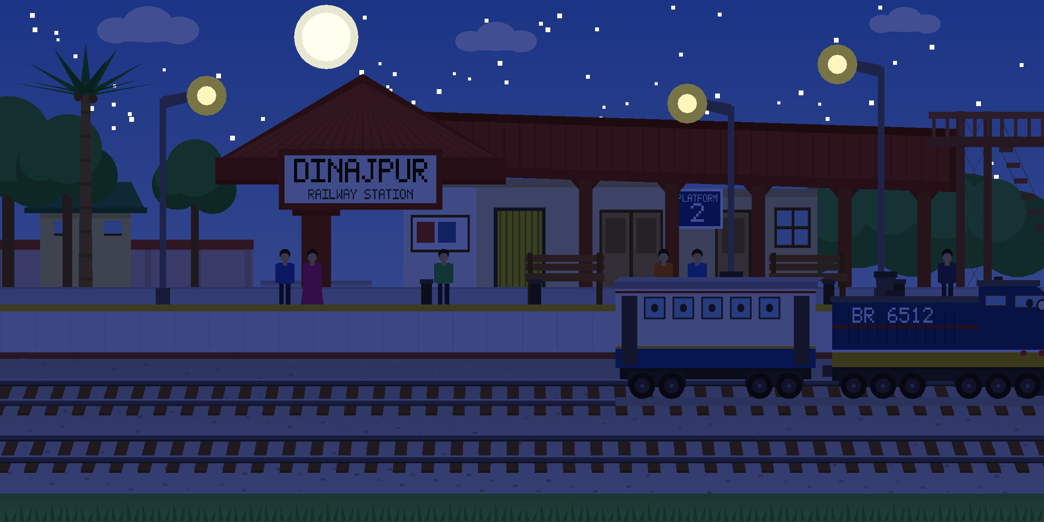
DINAJPUR
RAILWAY STATION
A 2D animated scene built in C++ with OpenGL and GLUT
Day · Night · Rain on demand two trains of three coaches, six passengers, three soundscapes
PLATFORM 2
Computer Graphics - Lab Project
Notes:
Title slide. The board is the same name board that appears in the scene itself.

Slide 2
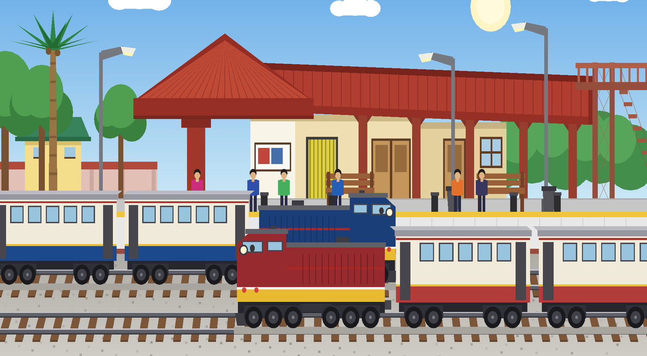
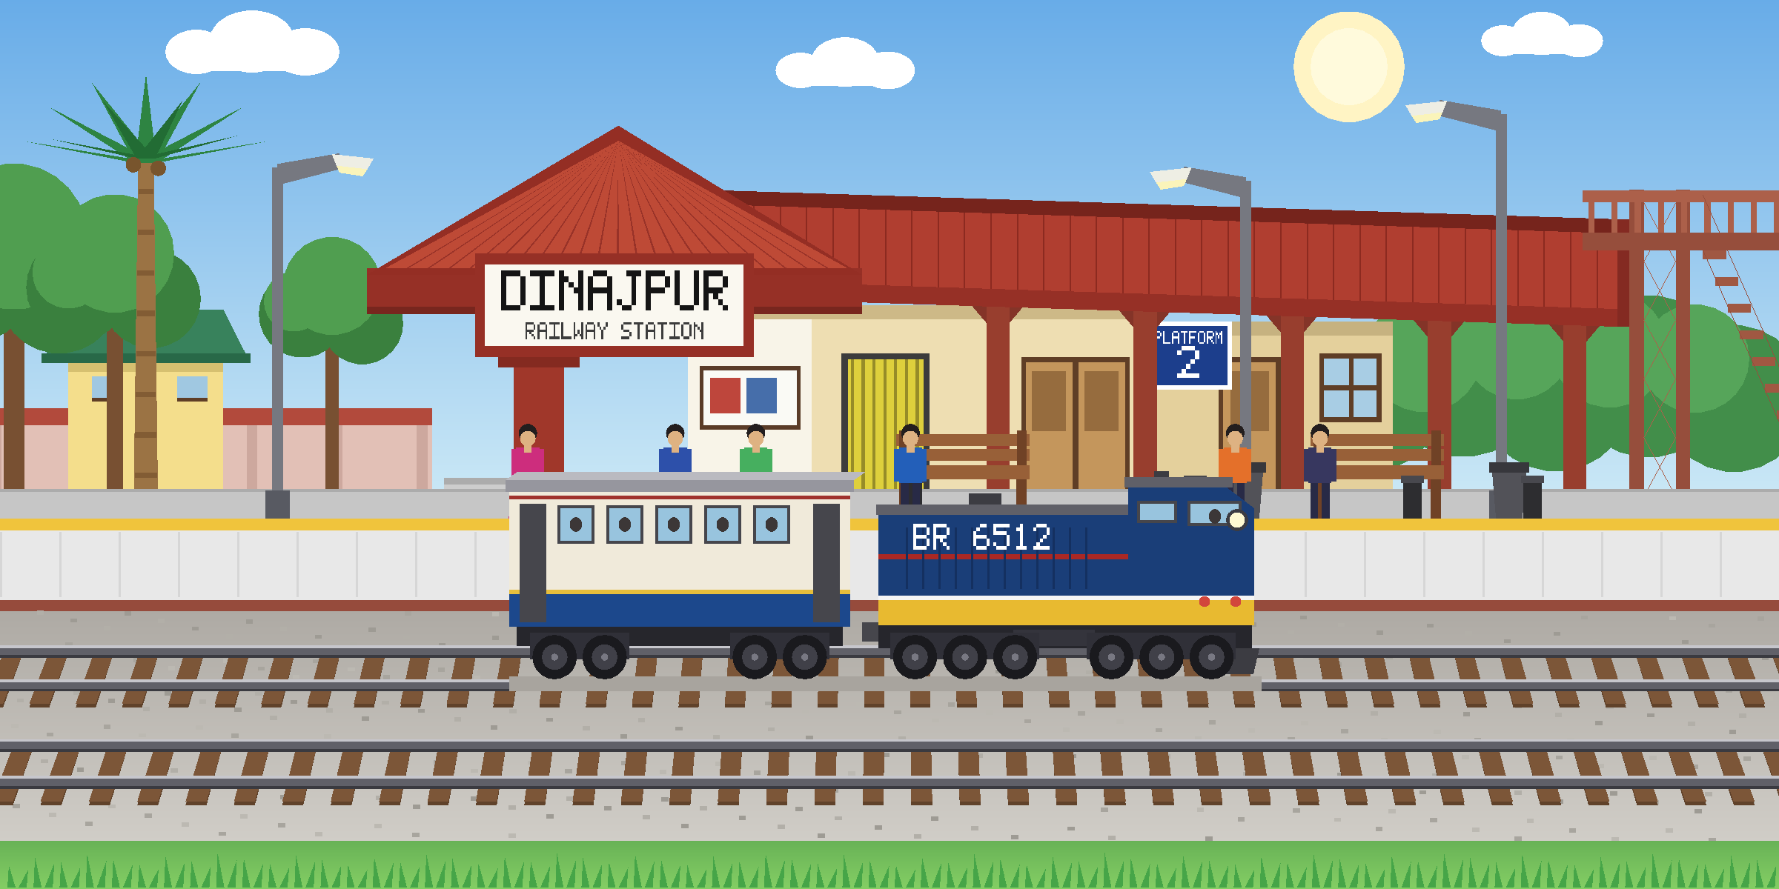
Introduction
2
What the program is
A picture that runs.
The whole of Dinajpur Railway Station - building, canopy, foot over bridge, platform, two tracks and the land around them is drawn from scratch in immediate-mode OpenGL. Nothing is an imported image.
Built from a hand drawing.
The scene began as a sketch on graph paper. Every coordinate was read off that drawing and written into the source by hand.
One file.
Eleven small drawing functions do the work. The file is long only because display() lists the scene shape by shape, not because the idea is complicated.
The scene at midday. Each train is three coaches and an engine, drawn by one function called three times.
Notes:
Introduce the project: fully hand-drawn geometry, no textures or imported images.

Slide 3
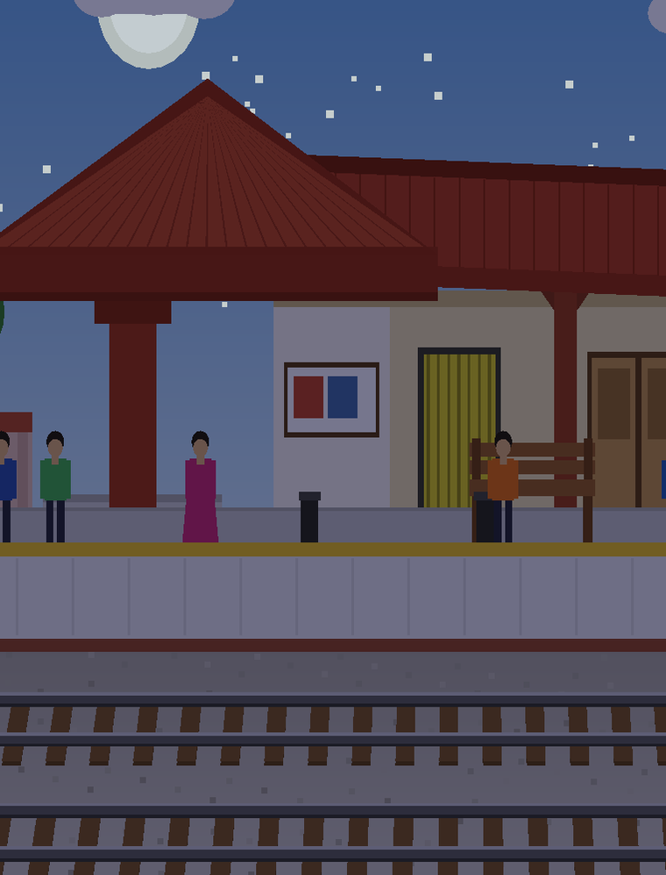
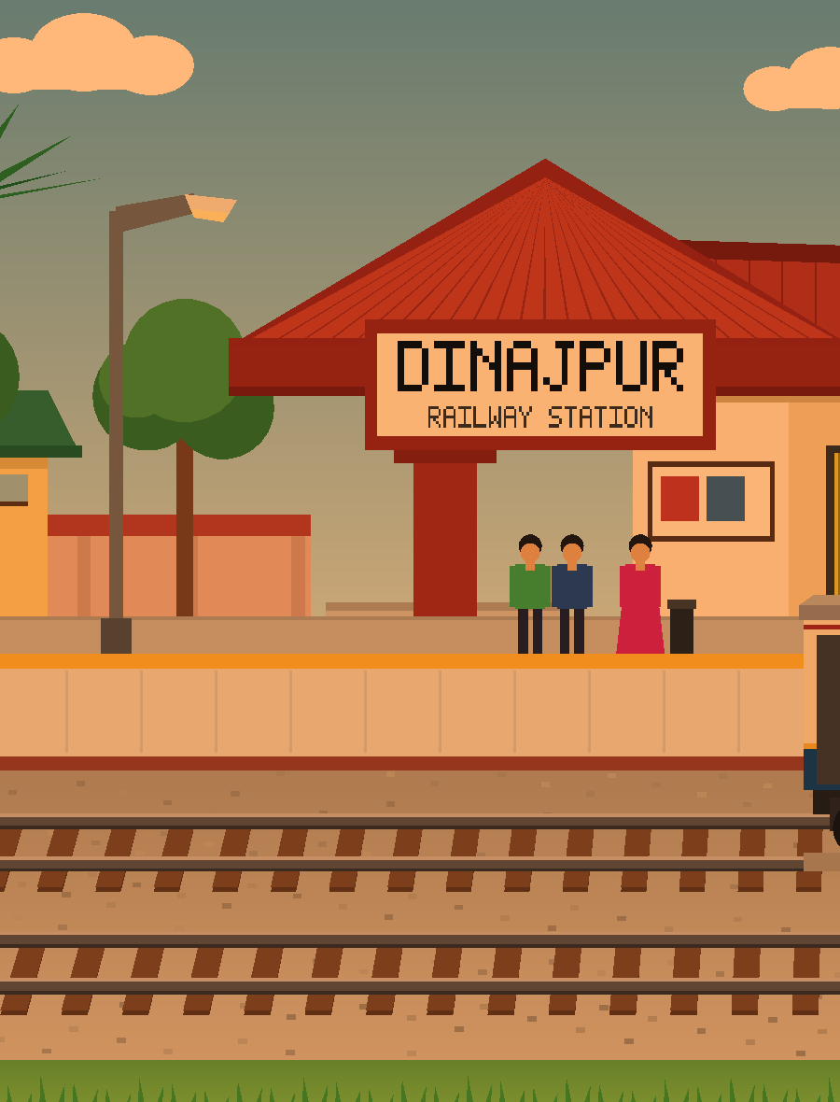
Why this topic
3
Reasons for choosing a railway station
01
A place everyone knows
Dinajpur station is familiar to look at, so a viewer can judge instantly whether the drawing is right.
02
It holds every primitive
Rails, sleepers, roofs, wheels and lamps need quads, triangles, lines and points — the whole lab toolkit in one picture.
03
It has natural movement
A station is never still. Trains arrive, people walk, the light changes animation belongs here instead of being added on.
04
Depth without 3D
Two tracks laid in perspective give the flat scene real distance, using nothing but carefully placed 2D coordinates.
Night light on the station front
Notes:
Four reasons: familiarity, primitive coverage, natural motion, and perspective depth.

Slide 4
Features
4
Everything in the scene that moves, changes or answers a key
An hour that turns itself
Two trains
Six passengers
Day and night follow one another with no key pressed. The tint travels gradually, so nothing ever snaps.
One train waits at the platform on track 1. The other runs the near track from right to left, and only when it is called. Each pulls three coaches.
Each stroll has its own speed and its own two turning points, so no two people ever walk in step.
Sun, moon, stars, clouds
Keyboard control
Three soundscapes
The sun sinks behind the station as night comes on, while the moon, 80 stars and three lamp halos fade up in its place. Clouds drift across the sky and wrap round.
DOWN stops the platform train and UP starts it. RIGHT sends the through train across. R turns the rain on and off.
Day and night each carry a looping ambience and the rain brings a third. The through train blows a whistle that the ambience politely waits out.
UP
start the platform train
DOWN
stop it at the station
RIGHT
send the through train
R
rain on and off
Notes:
Six features. The RIGHT arrow was added so the through train's whistle never overlaps the other train's sound.

Slide 5
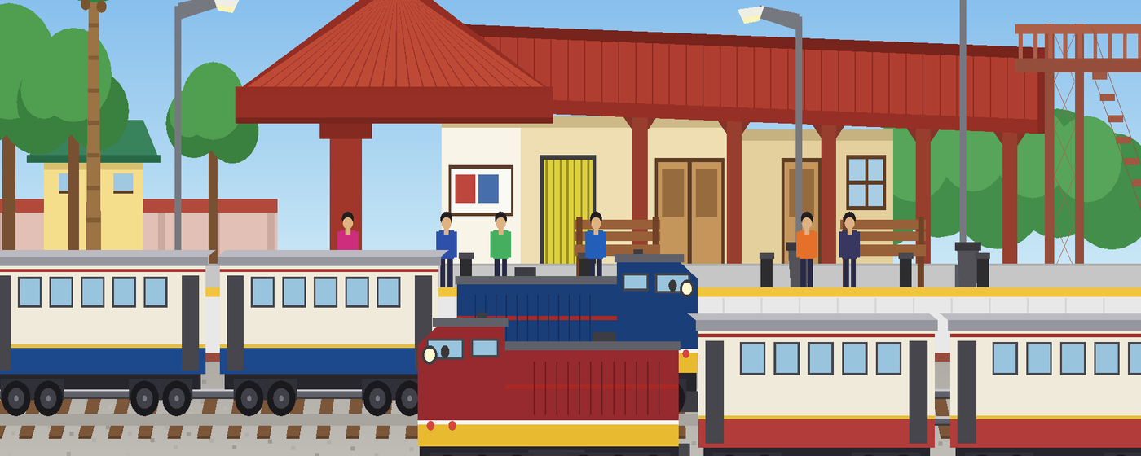
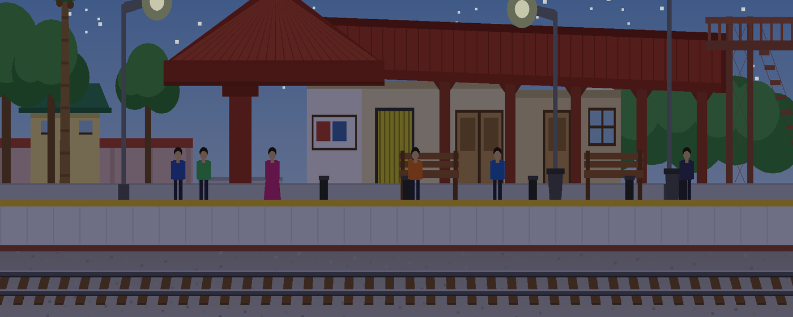
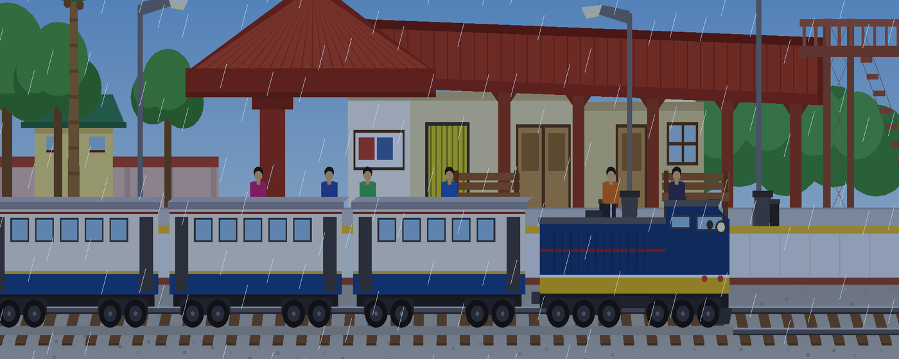
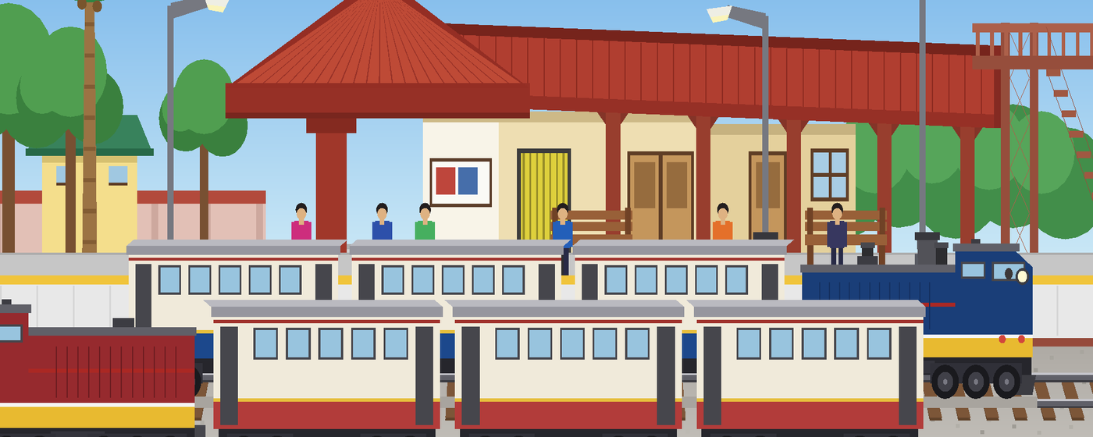
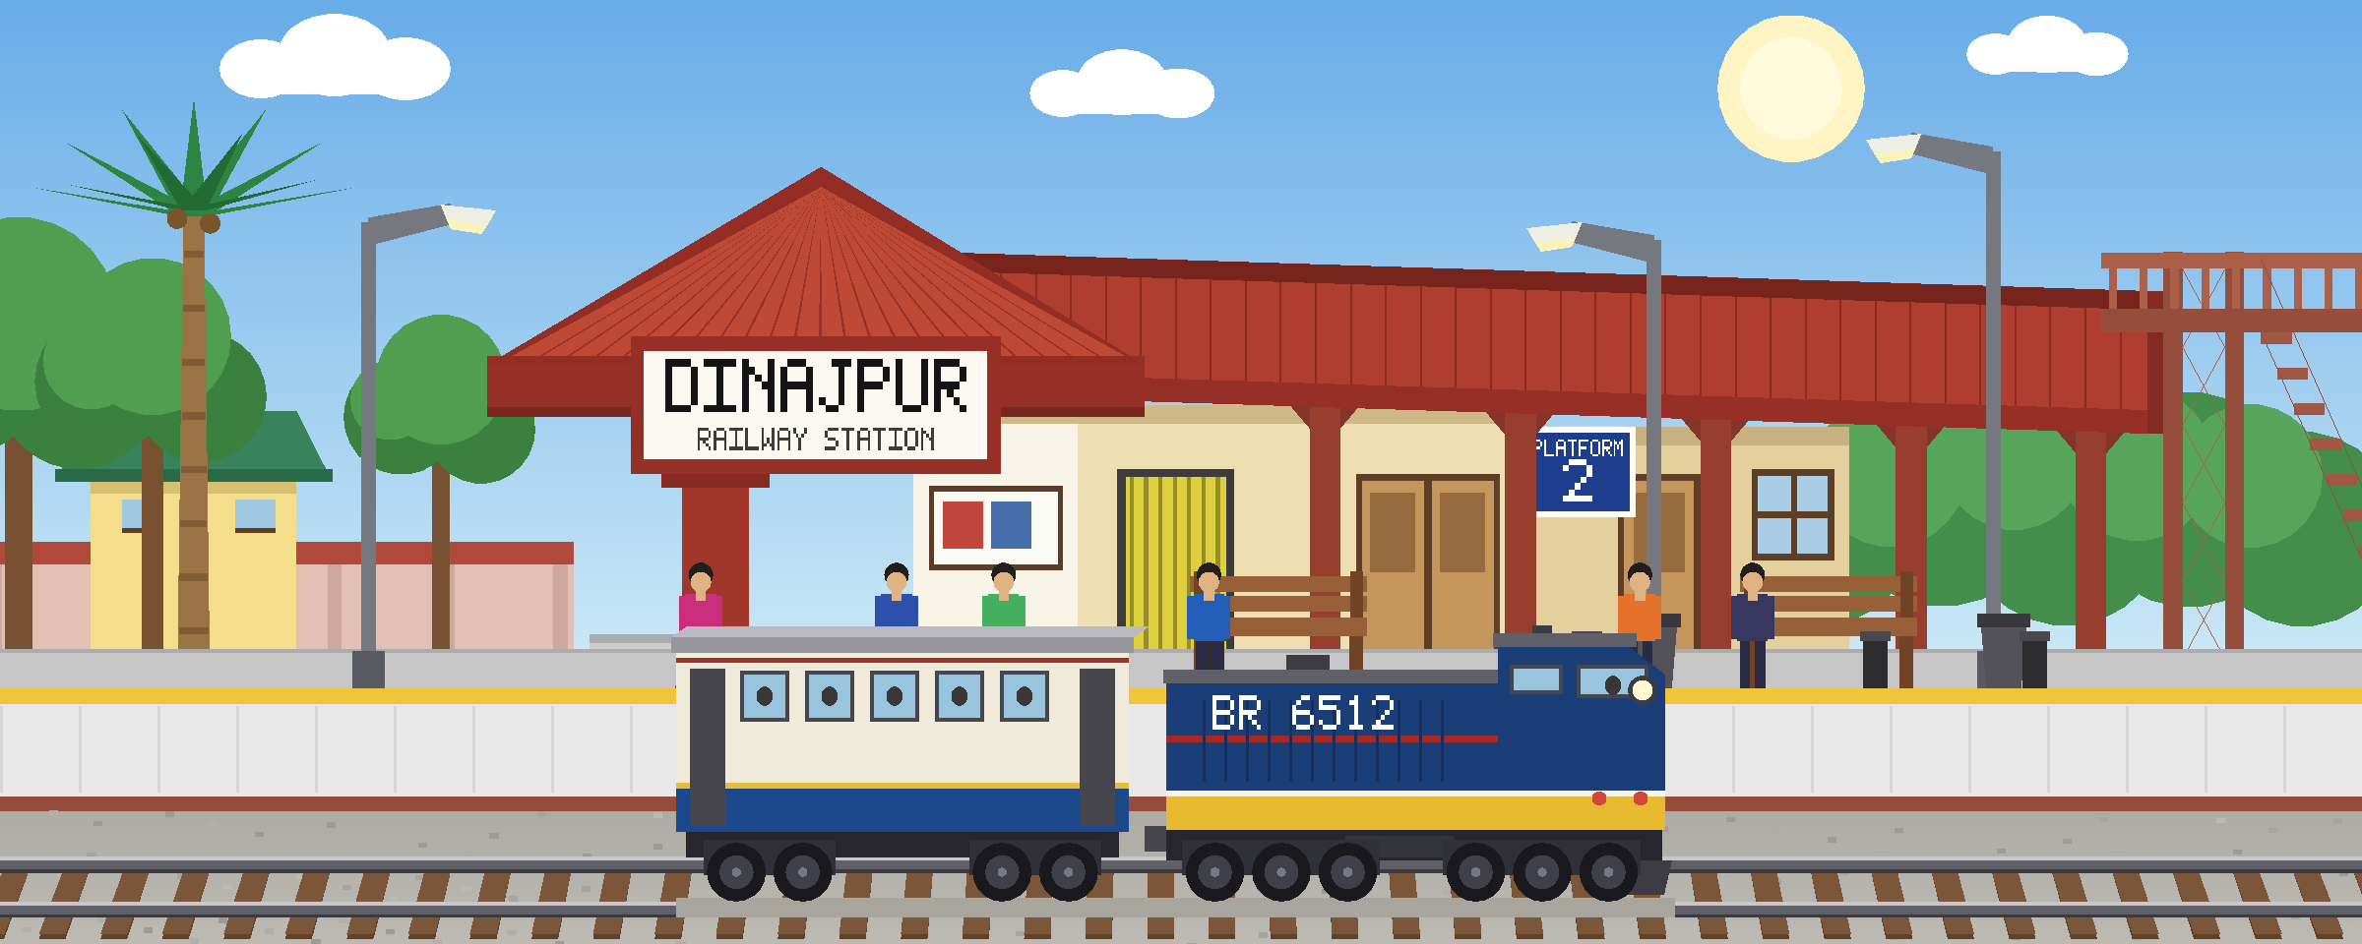
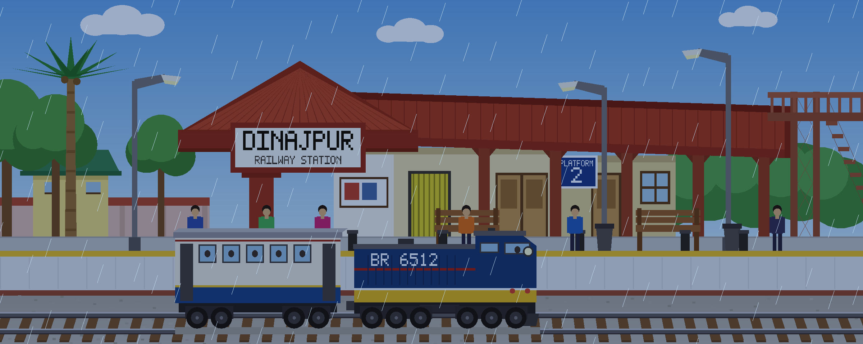
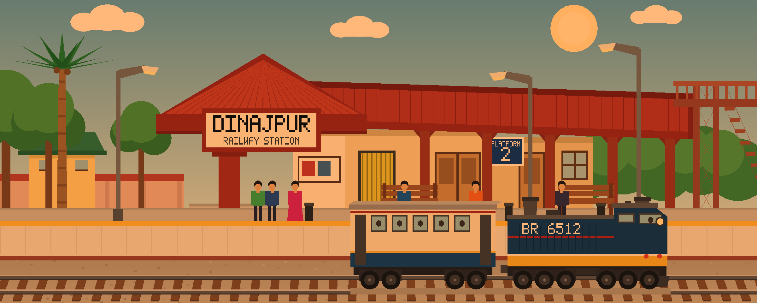
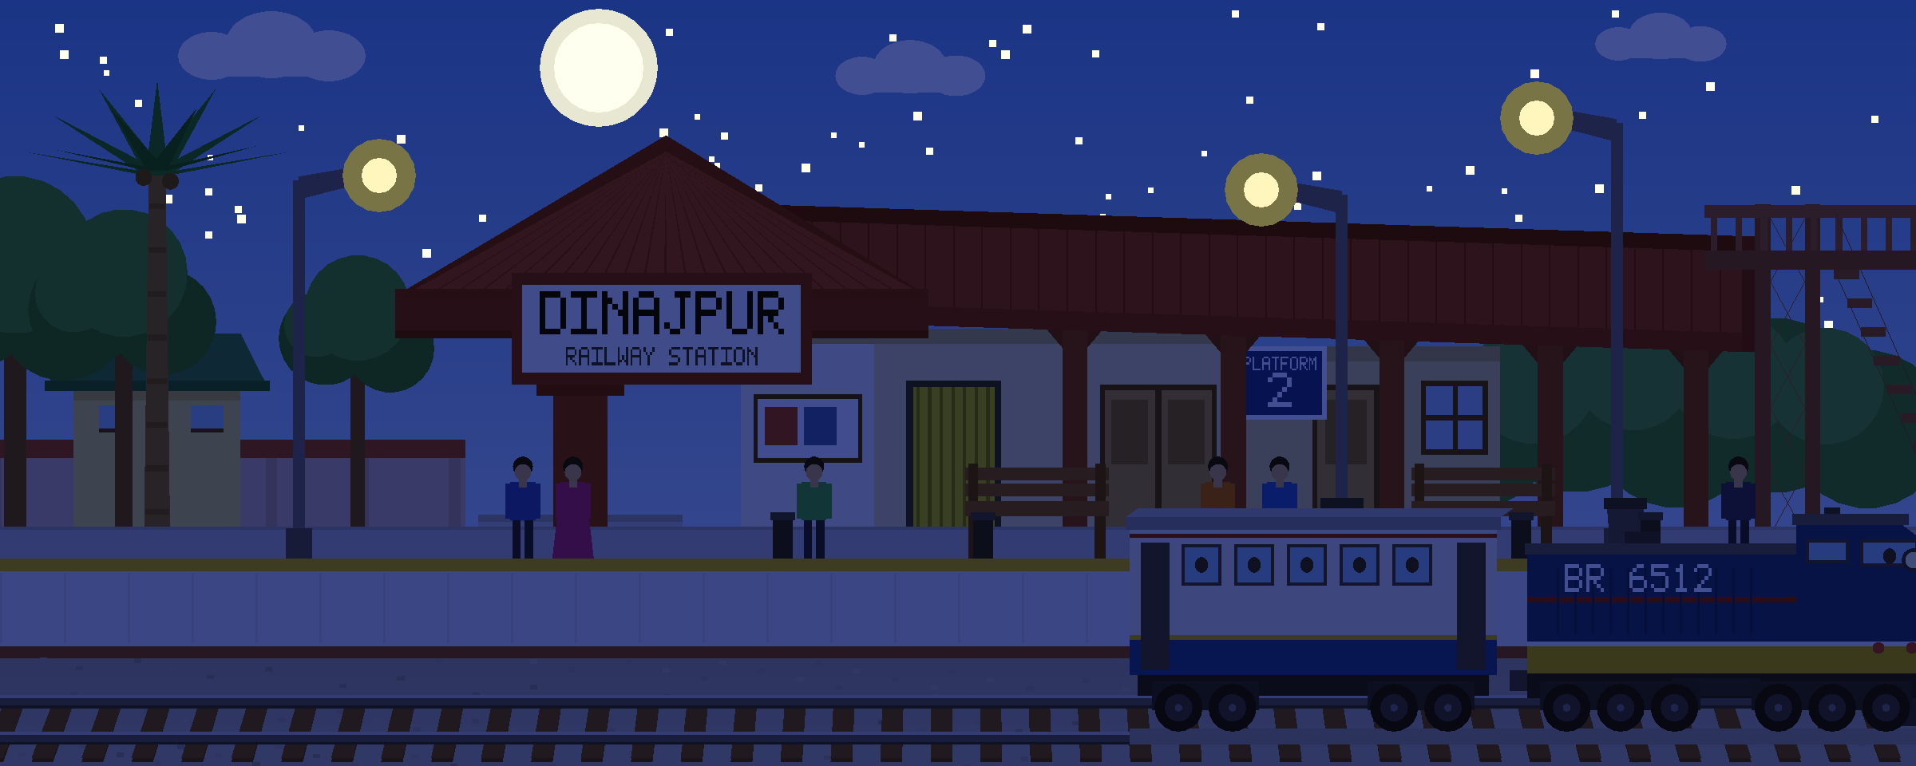
Screenshots
5
One scene, its three states, and both trains on the tracks
Clear day
Night
Rain, after pressing R
Both trains crossing
Notes:
Four phases. Each is the same geometry under a different GL_LIGHT_MODEL_AMBIENT colour.

Slide 6
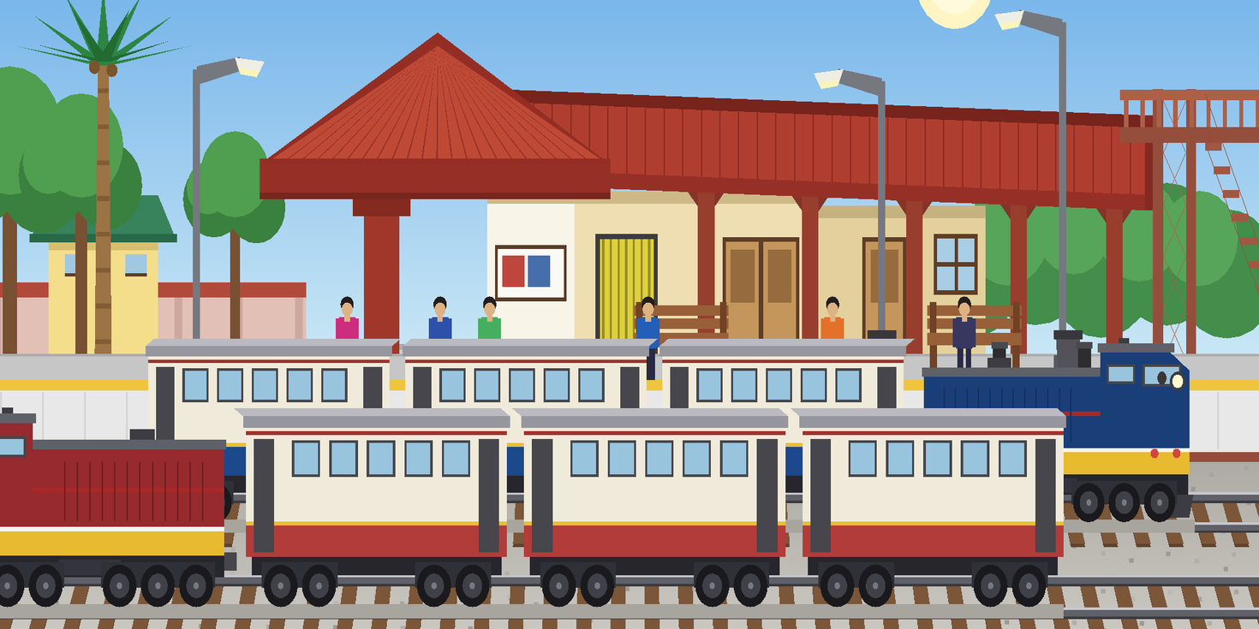
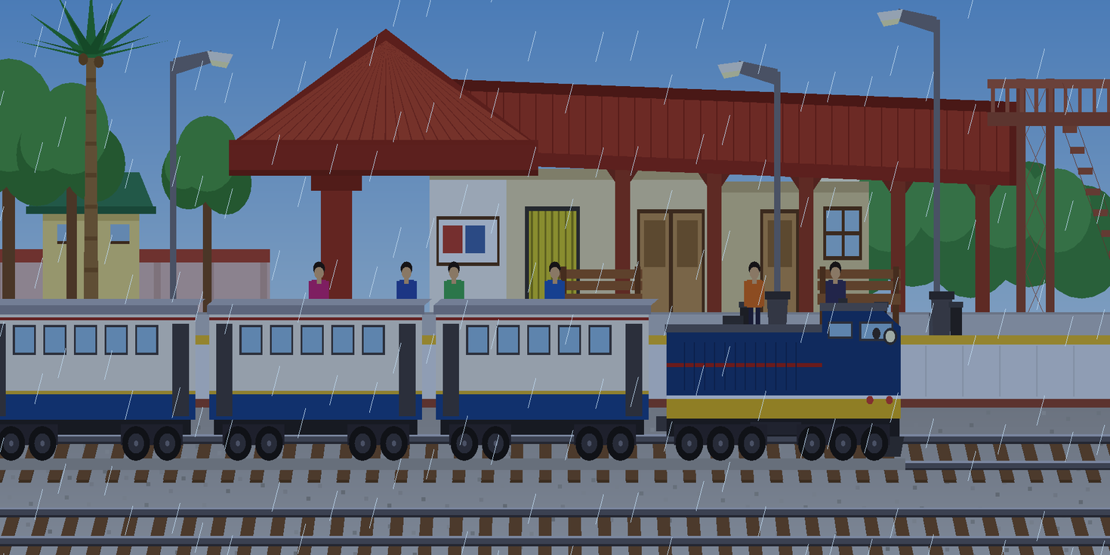
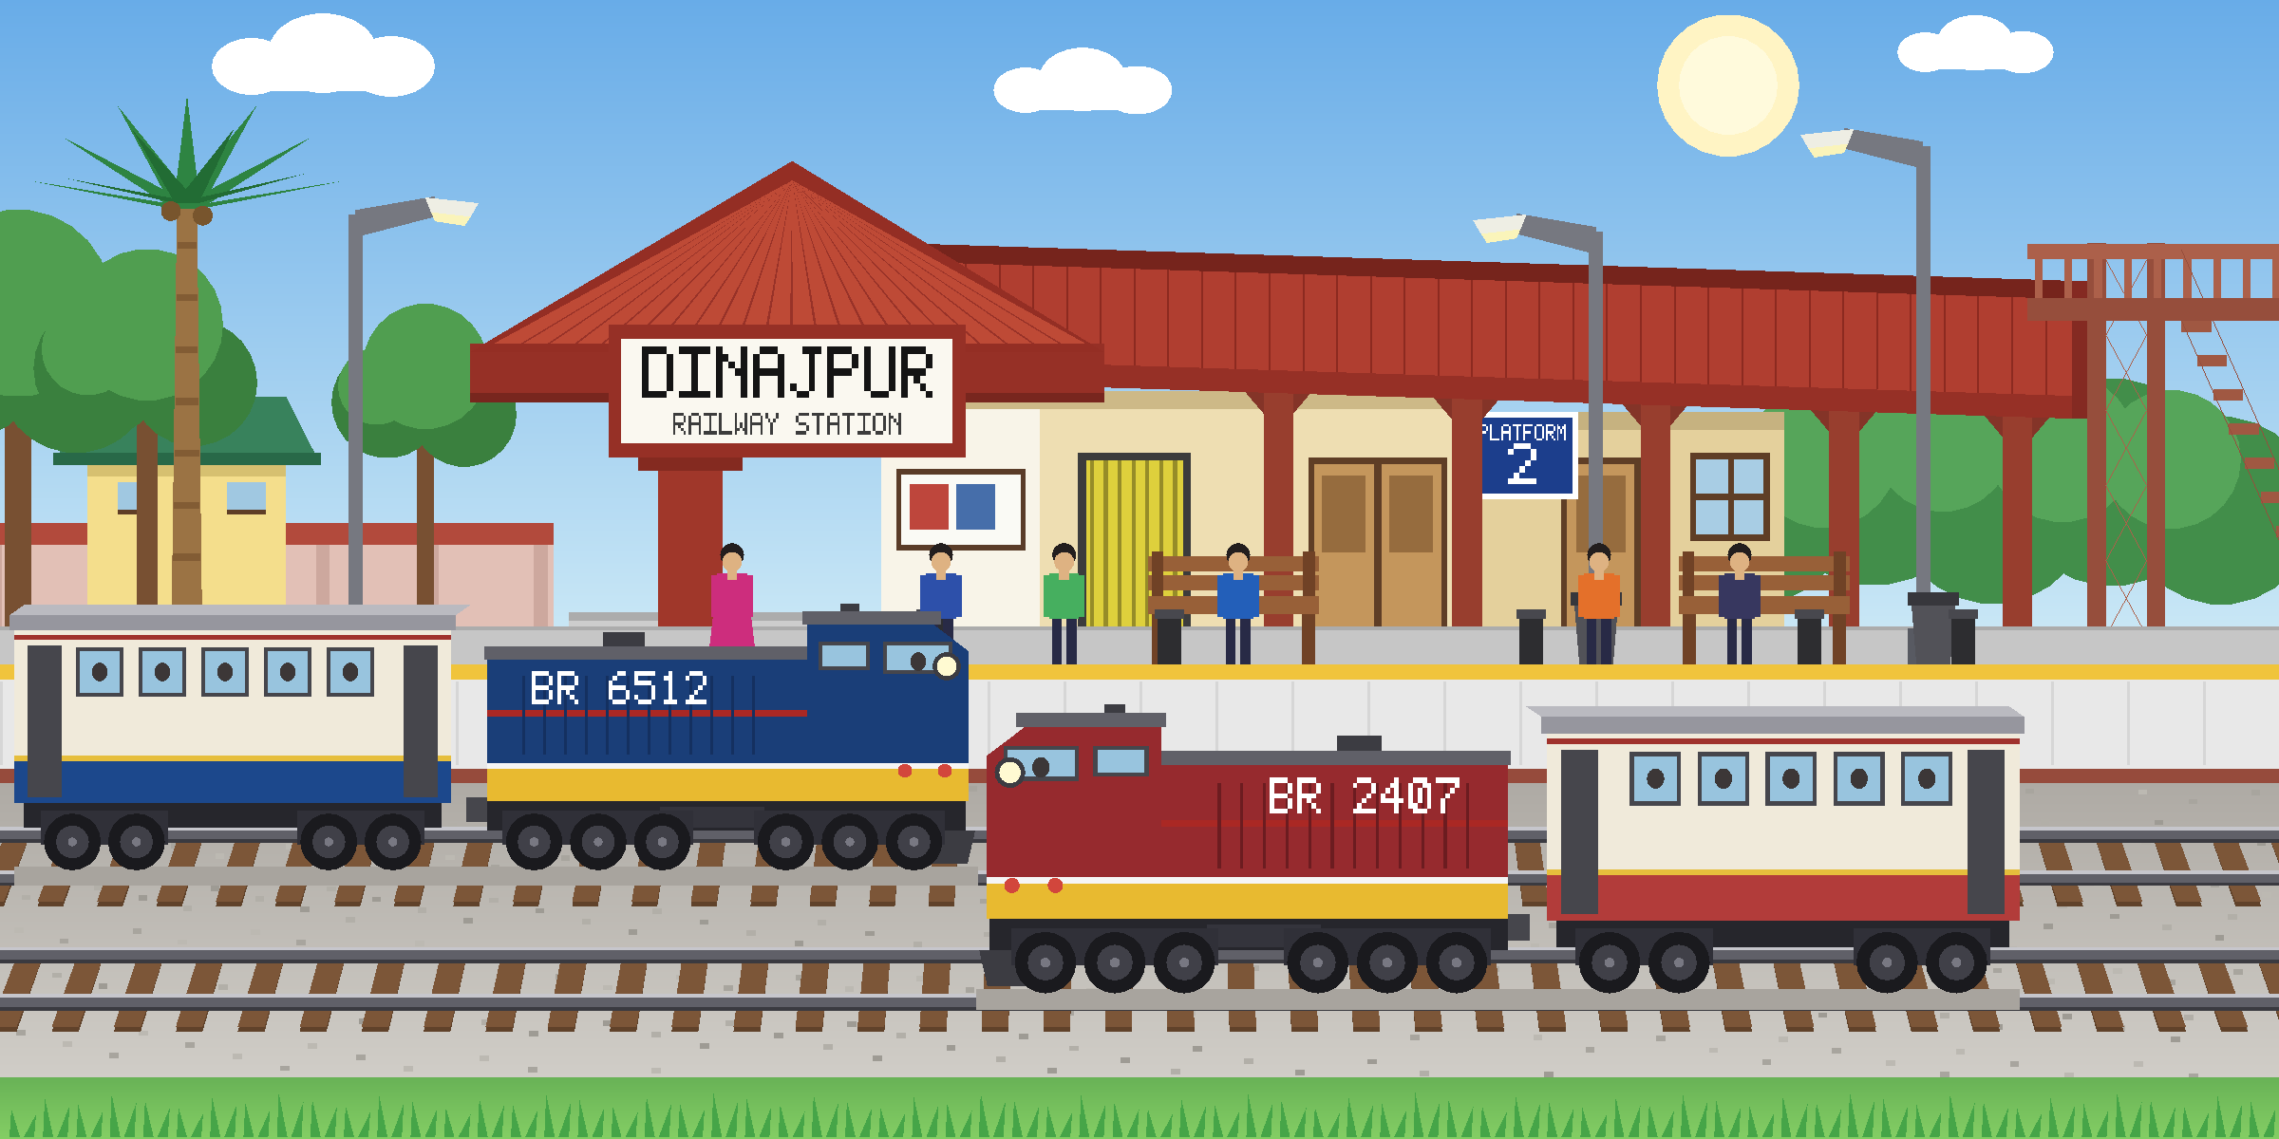
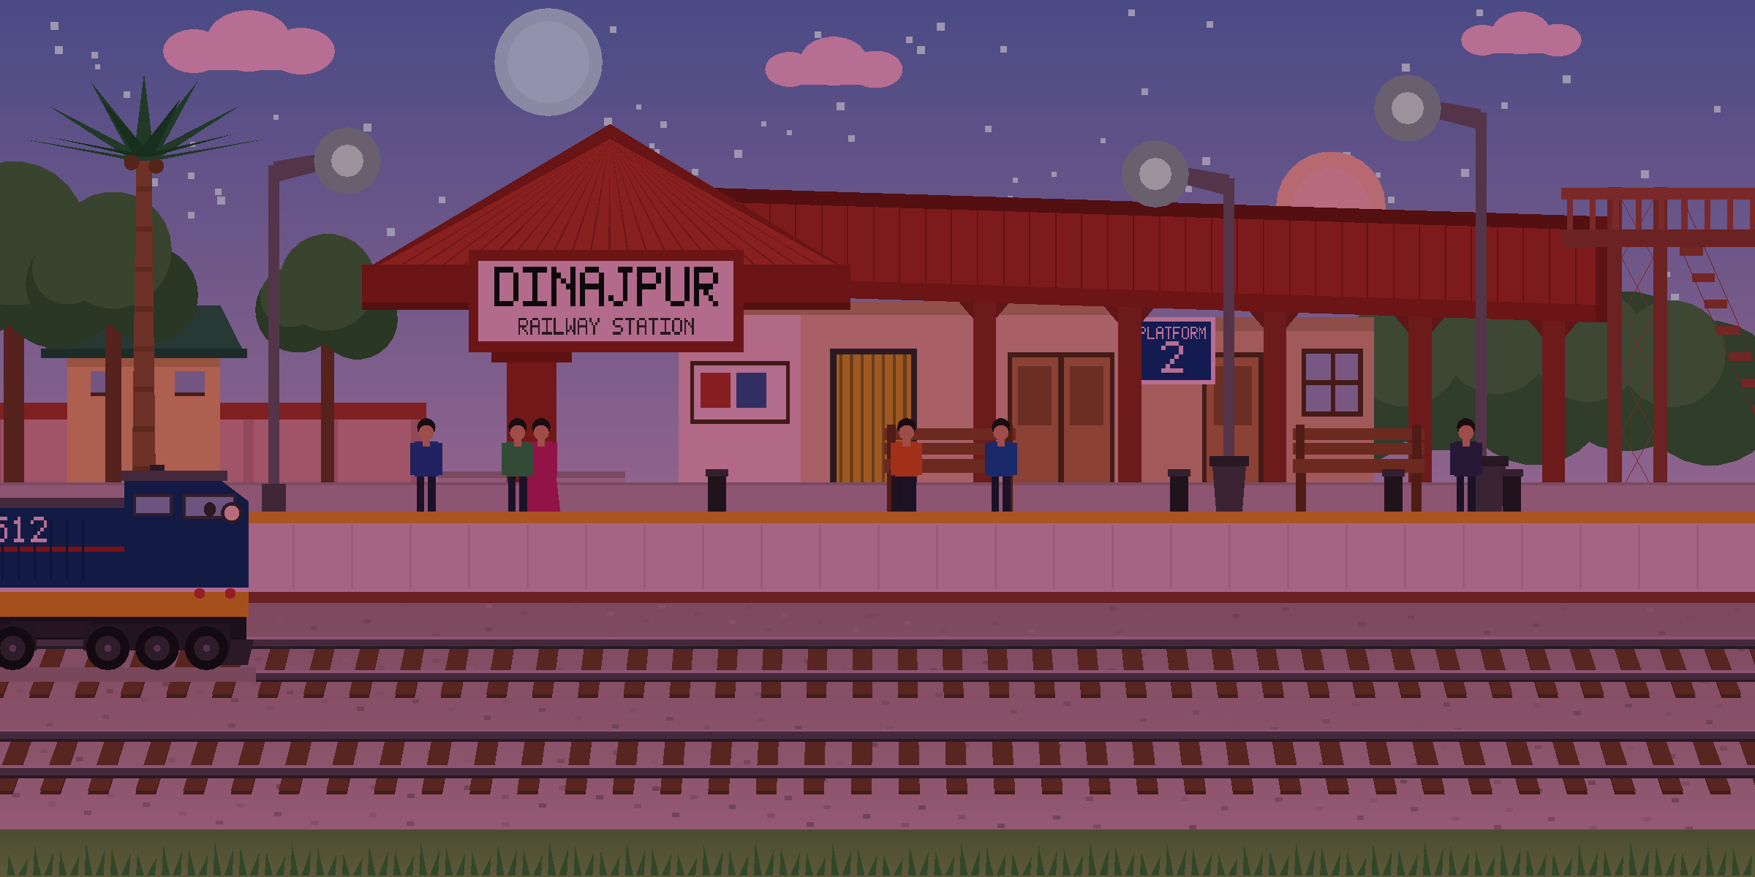
Screenshots
6
The two moments the scene is built around
The through train, called across
Rain, held on the R key
The through train waits out of sight until the RIGHT arrow is pressed, then crosses once in about seven seconds with its whistle. Pressing again mid-crossing does nothing, so one press is always one pass.
Pressing R starts the rain and stops the clock where it stands, so the hour stops turning until R is pressed again. The daylight greys down and the rain falls in front of everything, trains included.
Notes:
Left: the key-triggered through train. Right: a single frame from the middle of the dusk transition.

