Slide 1
Housing: Price Prediction
By Sk Shahbaz Ali

Slide 2
Introduction
Objective: Houses are one of the necessary need of each and every person around the globe and therefore housing and real estate market is one of the markets which is one of the major contributors in the world’s economy. It is a very large market and there are various companies working in the domain. Data science comes as a very important tool to solve problems in the domain to help the companies increase their overall revenue, profits, improving their marketing strategies and focusing on changing trends in house sales and purchases. Predictive modelling, Market mix modelling, recommendation systems are some of the machine learning techniques used for achieving the business goals for housing companies. Our problem is related to one such housing company. A US-based housing company named Surprise Housing has decided to enter the Australian market. The company uses Logistic Regression is a part of the Supervised Learning method of Machine Learning. It is a statistical method for the analysis of a dataset. It has one or more independent variables that determine an outcome. There is one basic difference between Linear Regression and Logistic Regression which is that Linear Regression's outcome is continuous whereas Logistic Regression's outcome is only limited. Here, the outcome represents a dependent variable.

Slide 3
Terms used for this project:
Year Built
Total Basement in Sqr. Ft.
Lot Area
Floor Area
Overall condition
Lot Frontage
Garage details
Detail about fireplace
We will have two types of data,
Training Data - This data will contain the information related to the Year Sold and Sale Price of House.
Test Data - It will contain all the information about a house. And, based on all the given information, Logistic Regression Algorithm will predict the selling price of a house.

Slide 4
Problem Statement
Houses are one of the necessary need of each and every person around the globe and therefore housing and real estate market is one of the markets which is one of the major contributors in the world’s economy. It is a very large market and there are various companies working in the domain. Data science comes as a very important tool to solve problems in the domain to help the companies increase their overall revenue, profits, improving their marketing strategies and focusing on changing trends in house sales and purchases. Predictive modelling, Market mix modelling, recommendation systems are some of the machine learning techniques used for achieving the business goals for housing companies. Our problem is related to one such housing company. A US-based housing company named Surprise Housing has decided to enter the Australian market. The company uses data analytics to purchase houses at a price below their actual values and flip them at a higher price. For the same purpose, the company has collected a data set from the sale of houses in Australia. The data is provided in the CSV file below. The company is looking at prospective properties to buy houses to enter the market. You are required to build a model using Machine Learning in order to predict the actual value of the prospective properties and decide whether to invest in them or not. For this company wants to know: • Which variables are important to predict the price of variable? • How do these variables describe the price of the house?

Slide 5
Insight
Reading From the Data
Pre-Processing the Data
Missing Values Treatment: All the Missing Values has been Assumed to be Zero
Other Methods Include: Mean, Median, Most Frequent, Deleting the rows
Data Duplicity Treatment: Using the Data Frame attribute
Data Scaling
Predicting the Output
ASSUMPTIONS:
No deletion of record.
Default Hyper parameters for the algorithm taken.

Slide 6
Describe Data
 | MSSubClass | LotFrontage | LotArea | OverallQual | OverallCond
count | 1430 | 1430 | 1430 | 1430 | 1430
mean | 56.84965 | 69.962659 | 10546.1035 | 6.137063 | 5.584615
std | 42.335448 | 22.277564 | 10072.8448 | 1.364125 | 1.110816
min | 20 | 21 | 1300 | 1 | 1
25% | 20 | 60 | 7585.75 | 5 | 5
50% | 50 | 70.98847 | 9501.5 | 6 | 5
75% | 70 | 79 | 11635.5 | 7 | 6
max | 190 | 313 | 215245 | 10 | 9

Slide 7
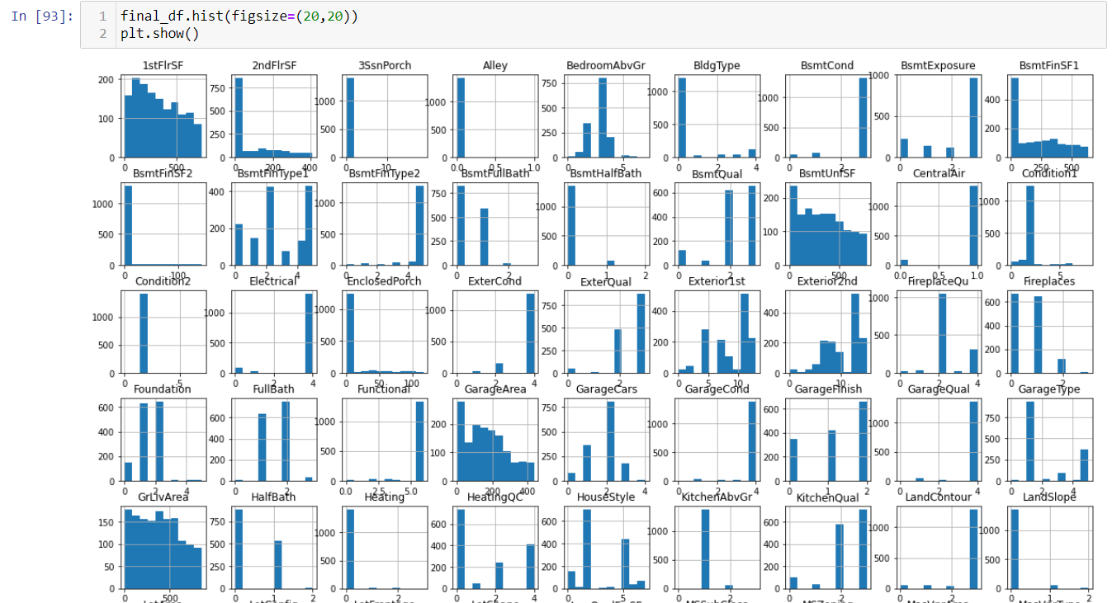

Slide 8
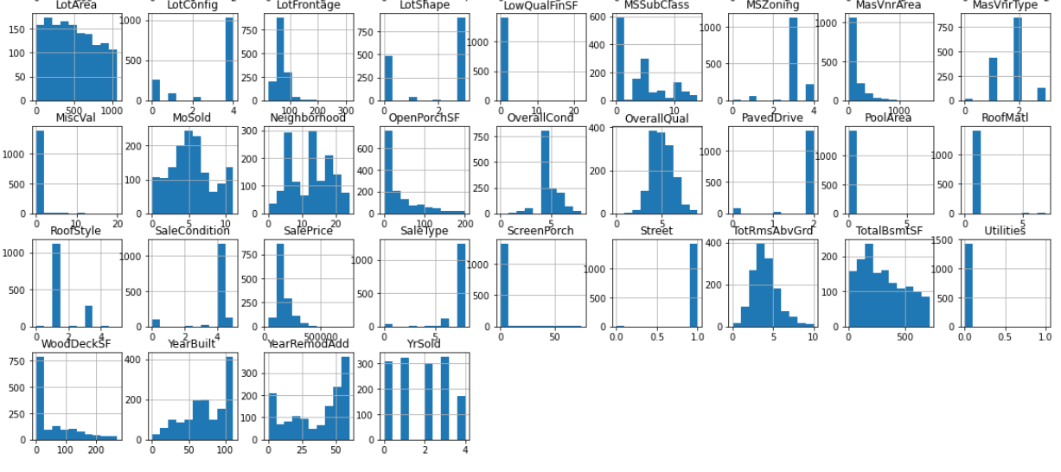

Slide 9
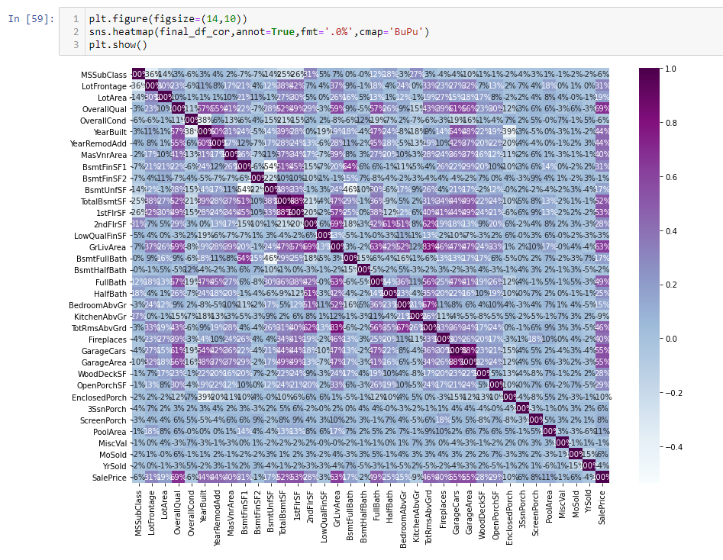
Heat Map

Slide 10
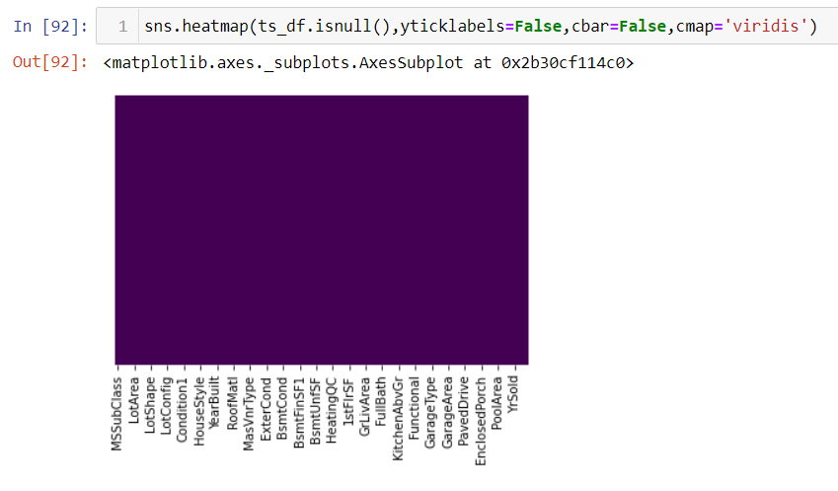
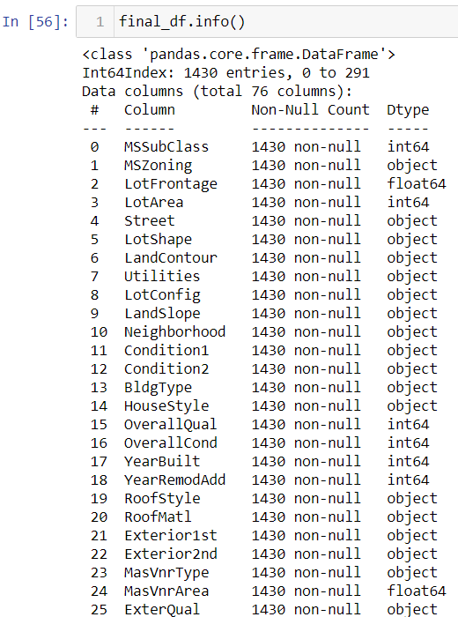
Features Important

Slide 11
Predicting the Output
Here the following Algorithms are used for the prediction of Accuracy.
Logistic Regression
Decision Trees
Ridge
ElasticNet
Random Forest
Lasso

Slide 12
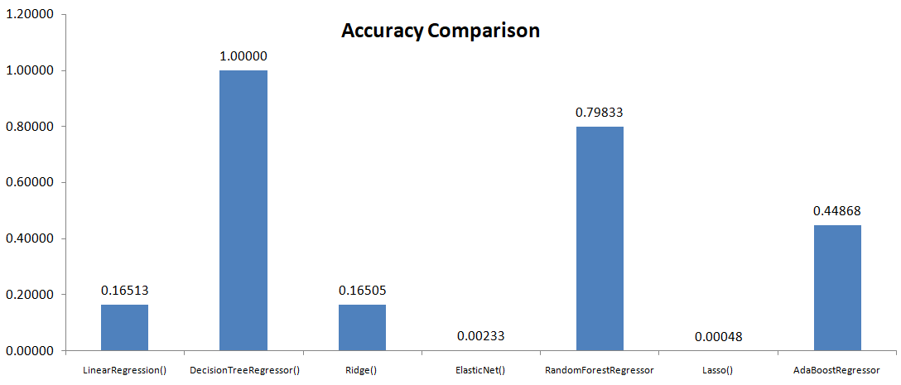
Accuracy Comparison:
The ensemble model : Modeling Consumer Housing Price Prediction using Machine Learning
Project Name: Housing Price Prediction
Accuracy: 79.83% (Random Forest)

Slide 13
THANK YOU!!

