Slide 1
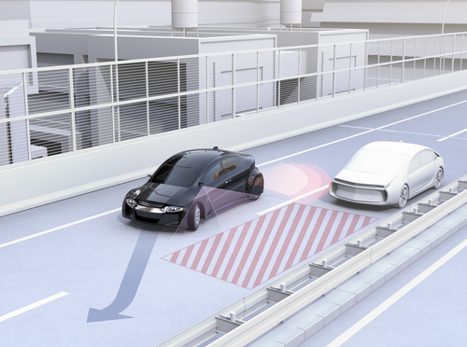

CSAGV Challenge 2023/24 Lateral control for lane changing manoeuvre Implementation of lateral and longitudial control in a decoupled dynamics
Prepared by: Sheikh Umer Aijaz
Email: s.aijaz@studenti.unina.it
Professor: Stefania Santini & Aniello Mungiello

Slide 2
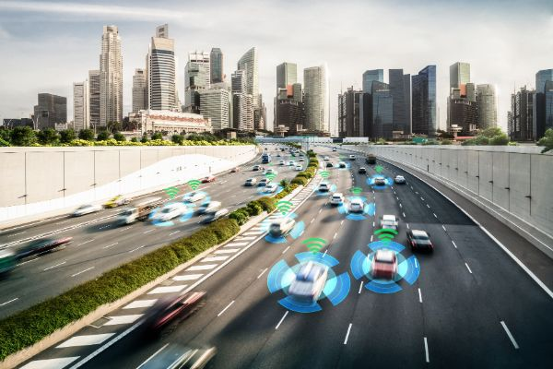
Table of Contents
Introduction & Scenario
Mathematical Expressions
MATLAB code
The SIMULINK Model
Vehicle Longitudinal Dynamics Control
Vehicle Lateral Dynamics Control
Results
Robustness

Slide 3
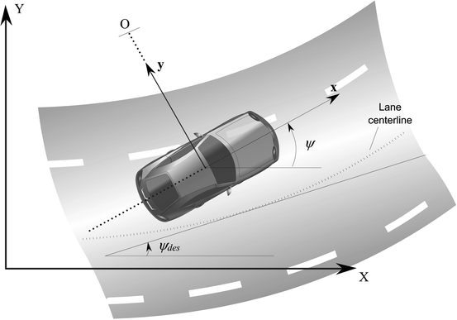
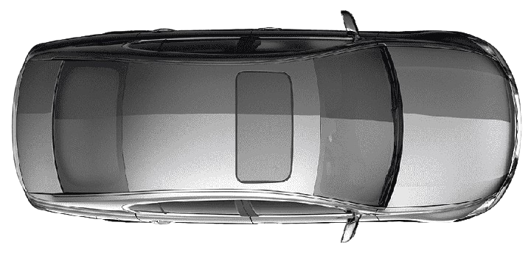
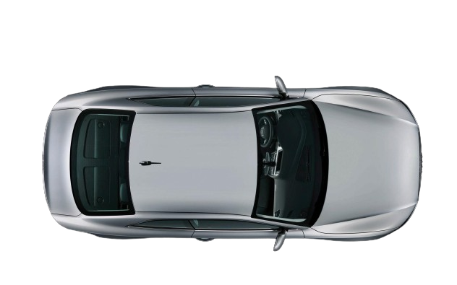
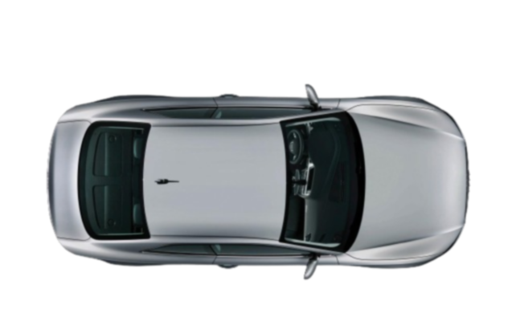
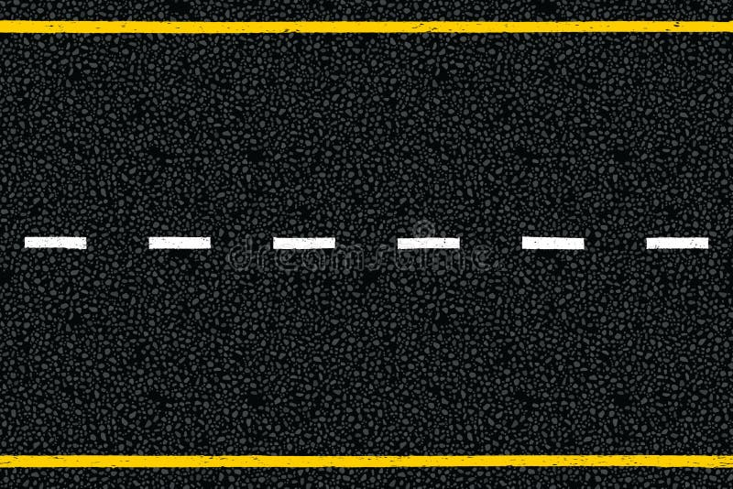
Introduction/ Scenario
Subject Vehicle [Honda Civic X]
Following vehicle [Audi A5]
The Subject Vehicle is moving with the velocity of 7 m/s initially. While the following vehicle (to be overtaken) is moving with a constant speed of 5 m/s.
The scenario here is the overtaking of Following vehicle [Audi A5] via lane changing by increasing velocity of the Subject Vehicle [Honda Civic X]
5 m/s
3m
7 m/s
← Table of contents

Slide 4
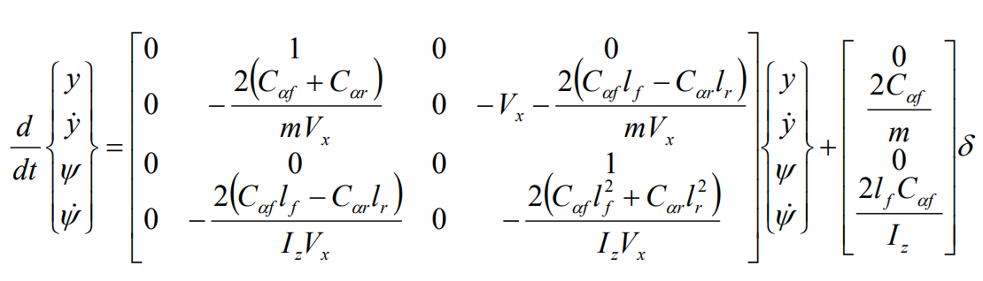

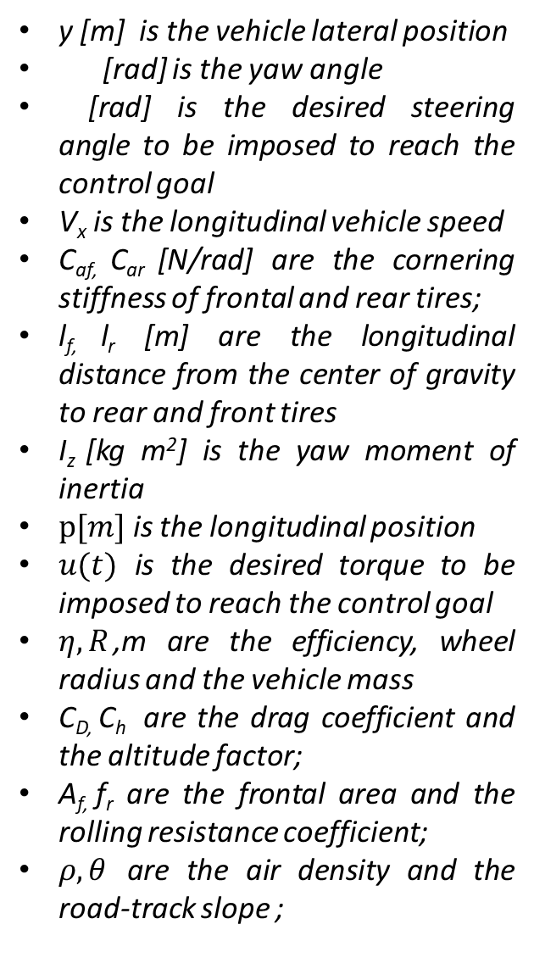
Mathematical Expressions
y [m] is the vehicle lateral position
[rad] is the yaw angle
[rad] is the desired steering angle to be imposed to reach the control goal
V_{x} is the longitudinal vehicle speed
C_{af,} C_{ar} [N/rad] are the cornering stiffness of frontal and rear tires;
l_{f,} l_{r} [m] are the longitudinal distance from the center of gravity to rear and front tires
I_{z} [kg m²] is the yaw moment of inertia
$p[m]$ is the longitudinal position
$u(t)$ is the desired torque to be imposed to reach the control goal
$η, R$,m are the efficiency, wheel radius and the vehicle mass
C_{D,} C_{h} are the drag coefficient and the altitude factor;
A_{f,} f_{r} are the frontal area and the rolling resistance coefficient;
$ρ,θ$ are the air density and the road-track slope ;
Lateral Behaviour
Longitudinal Behaviour
← Table of contents

Slide 5
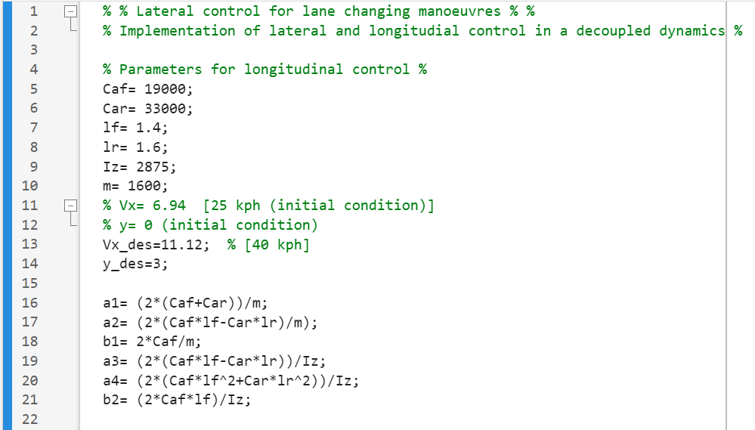
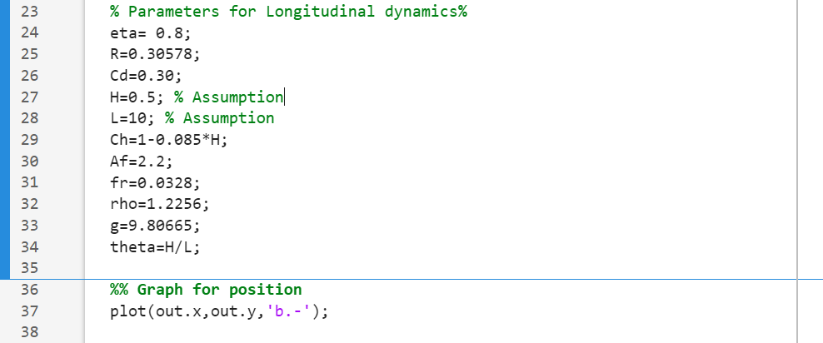
MATLAB Code
Vx (initial) = 6.94 m/s
Y (initial) = 0
Vx (desired) = 11.12 m/s
Y (desired) = 3m
← Table of contents

Slide 6
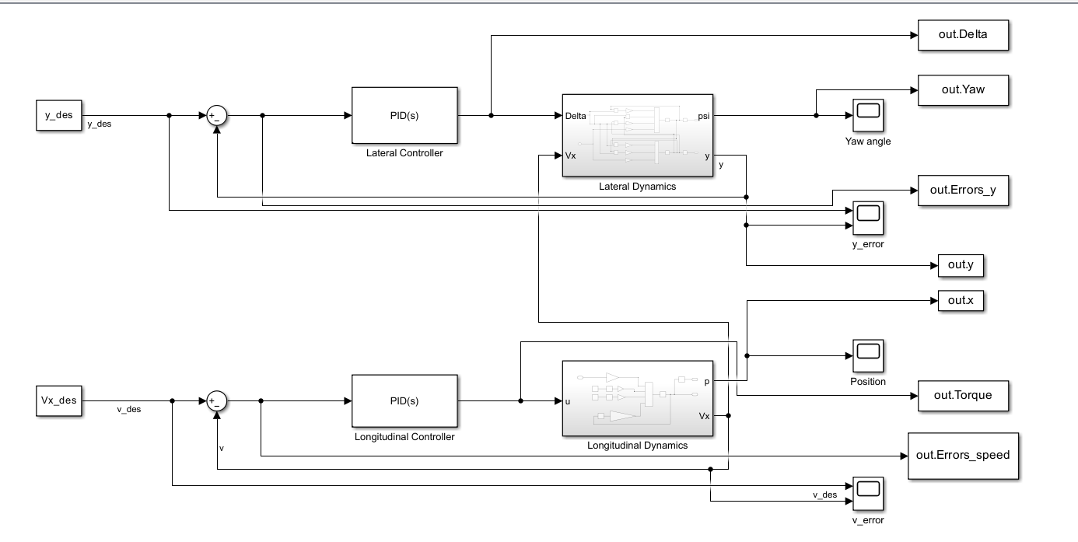
The SIMULINK Model
← Table of contents

Slide 7
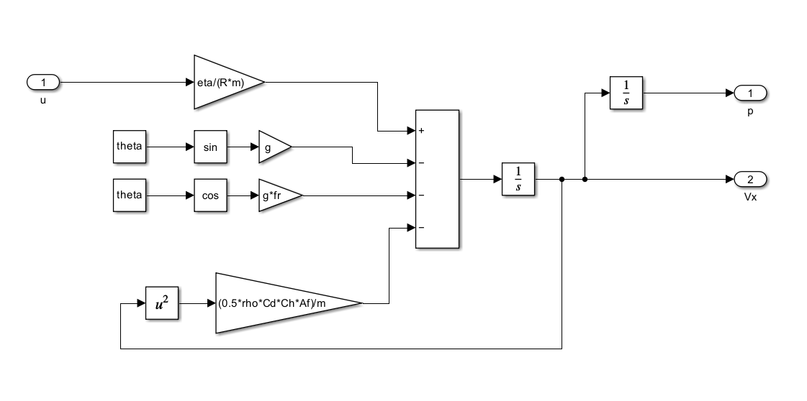
Vehicle Longitudinal Dynamics Control
← Table of contents

Slide 8
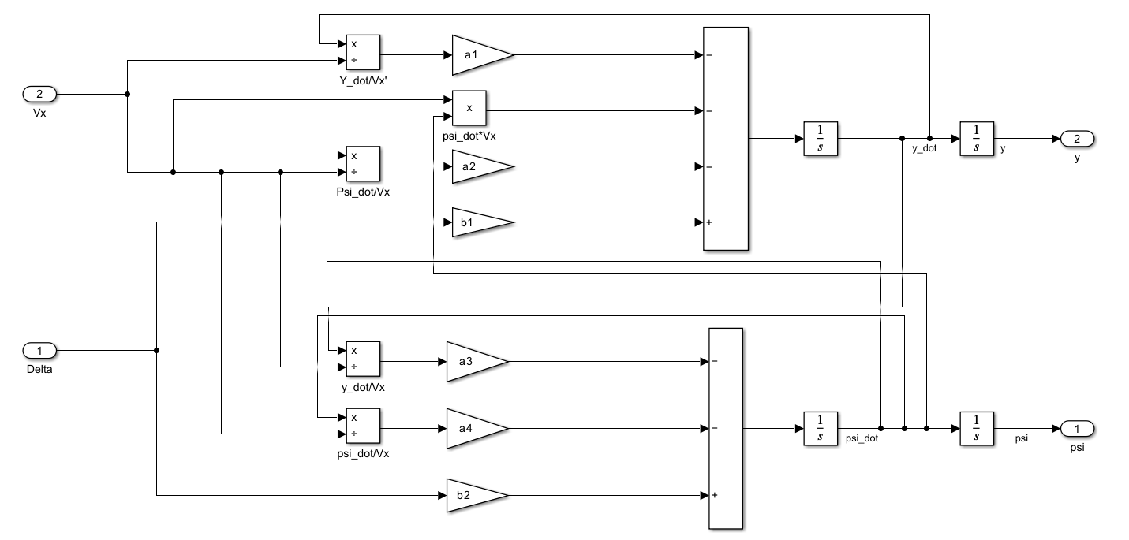
Vehicle Lateral Dynamics Control
← Table of contents

Slide 9
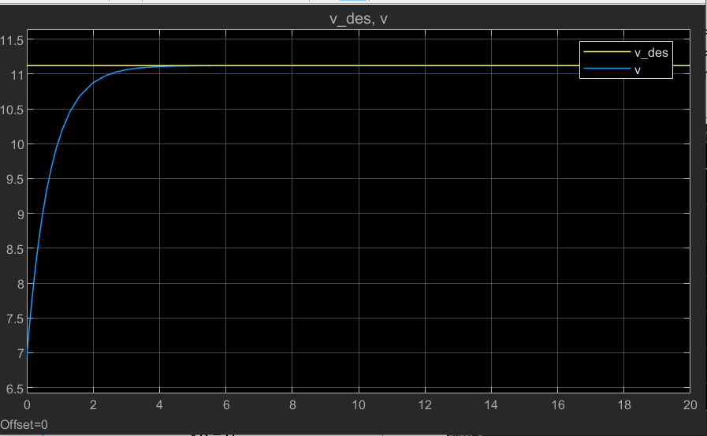
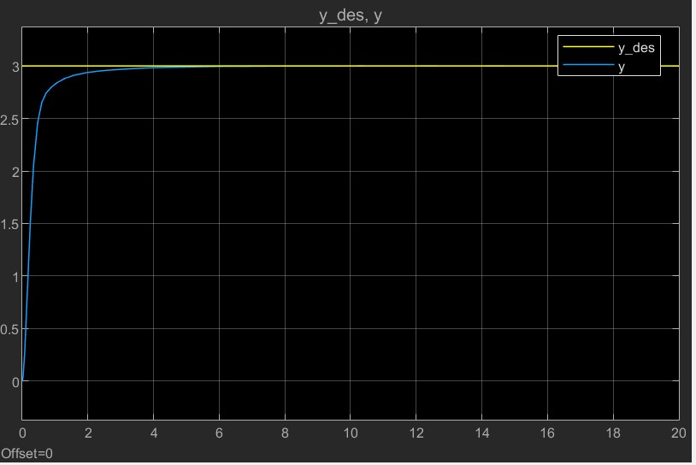
Results (1/2)
PID Controller for Lateral Dynamics
Kp = 1.5
Ki = 0
Kd = 0
Settling time = ~5s
PID Controller for Longitudinal Dynamics
Kp = 987.5
Ki = 175
Kd = 0
Settling time = ~4s
← Table of contents

Slide 10
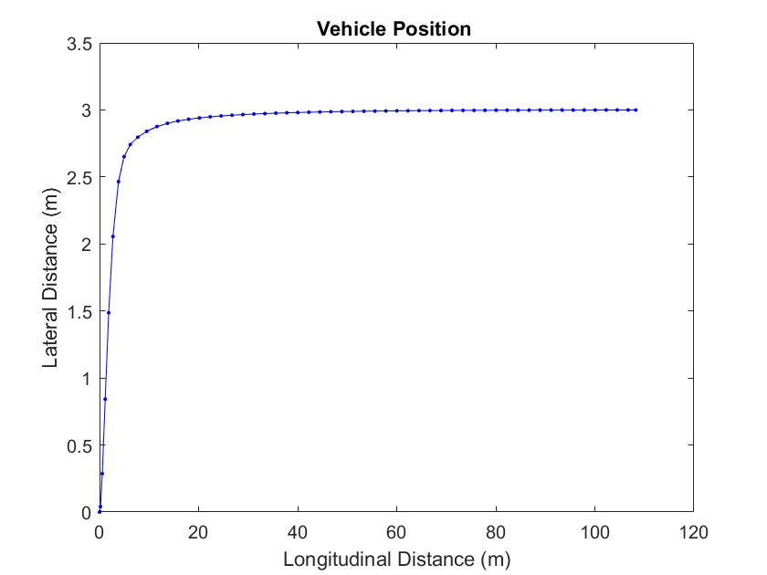
Results (2/2)
← Table of contents

Slide 11
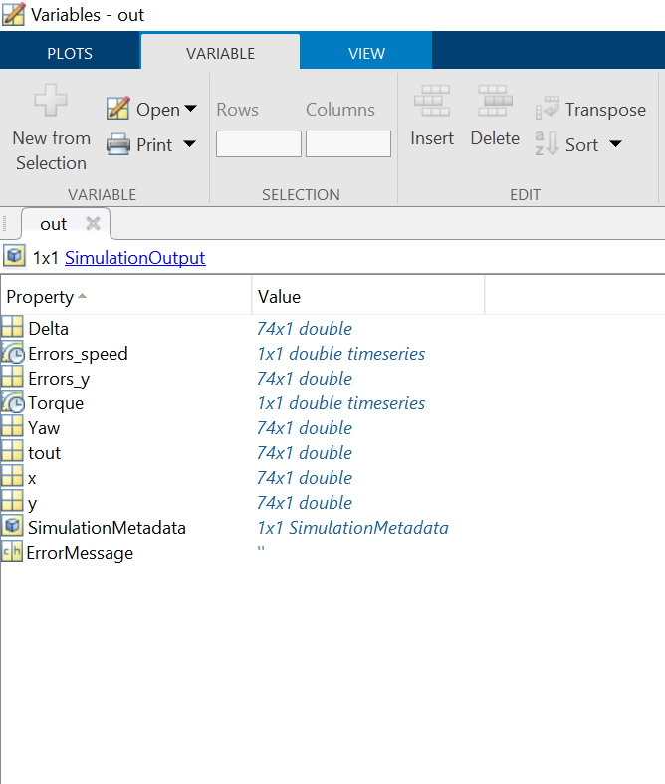
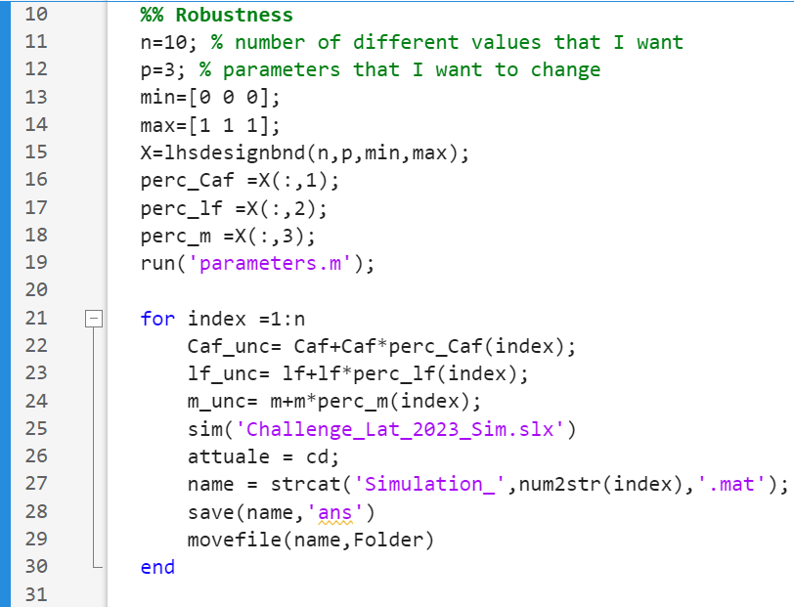
Robustness(1/2)
← Table of contents

Slide 12
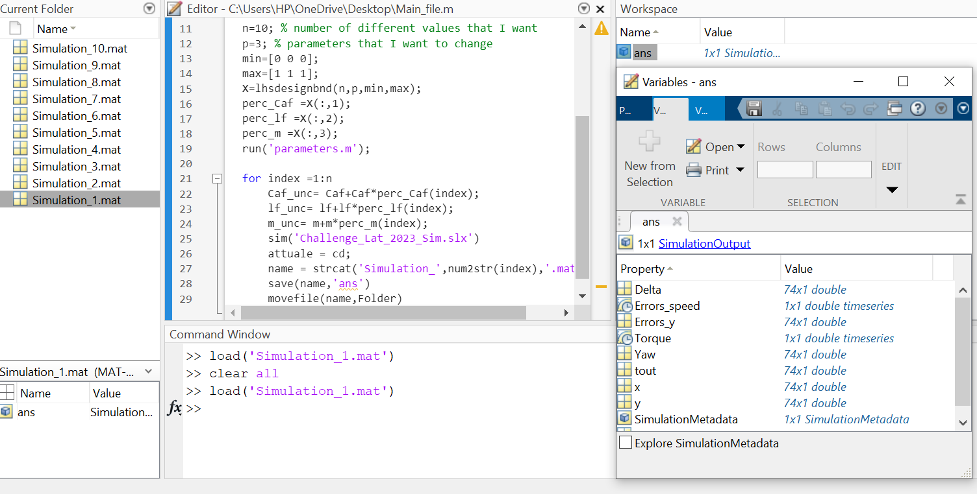
Robustness(2/2)
← Table of contents

Slide 13


