Slide 1
Model Generalization

Slide 2
K Value Affects Decision Boundary
60
60
K = 1
K = 34
40
40
Age
20
20
10
20
0
10
20
0
Number of Malignant Nodes
Number of Malignant Nodes
Notes:
As we saw last week, the value chosen for `k` in KNN can have a significant effect on the prediction
Two extremes, k=1 and k=34, are shown here
Identifying the best choice of model parameters is a common consideration in machine learning

Slide 3
Choosing Between Different Complexities
Polynomial Degree = 1
Polynomial Degree = 4
Polynomial Degree = 15
Model
True Function
Samples
Y
Y
Y
X
X
X
Notes:
Problem can be framed as choice between different model complexities
Fitting a polynomial model to data (redpoints) and the true function we are after is shown in gray
Various models are shown in blue.
Model can involve polynomials of different degrees—first order, fourth order, fifteenth order
Error function continually decreases with model order—that on right fits data almost perfectly
Despite deviating from actual function in many areas

Slide 4
How Well Does the Model Generalize?
Polynomial Degree = 1
Polynomial Degree = 4
Polynomial Degree = 15
Model
True Function
Samples
Y
Y
Y
X
X
X
Poor at Training
Poor at Predicting
Good at Training
Poor at Predicting
Just Right
Notes:
Another way to find the best model is to ask how well does it generalize?
Model on left performs poorly during both training and predicting
Model on right performs perfectly during training, poorly when predicting
Middle model is just right for both training and prediction

Slide 5
Underfitting vs Overfitting
Polynomial Degree = 1
Polynomial Degree = 4
Polynomial Degree = 15
Model
True Function
Samples
Y
Y
Y
X
X
X
Underfitting
Just Right
Overfitting
Notes:
These concepts have names:
Example on left is underfitting the data—model is too simple to represent data
Example on right is overfitting the data—model is too complex to represent data
As we've discussed, center example is just right

Slide 6
Bias – Variance Tradeoff
Polynomial Degree = 1
Polynomial Degree = 4
Polynomial Degree = 15
Model
True Function
Samples
Y
Y
Y
X
X
X
High Bias
Low Variance
Low Bias
High Variance
Just Right
Notes:
In machine learning lingo, the situation on the left is high bias and low variance
On right is low bias and high variance
So, how do we know that we have achieved the center, a balance of bias and variance?
Put differently, we want to find the combination of parameters that will generalize to unknown/new data

Slide 7
Training and Test Splits
Notes:
Solution lies in the existing data used to fit our model.
Let’s say this is some historical trainingset we have.

Slide 8
Training and Test Splits
Training
Data
Test
Data
Notes:
Split the data into two parts—one is usually larger than the other (say 60/40 or 70/30)
Larger data set is the training data that we use to train the model, as before
Smaller data set is unseen until last step where the error of the model is calculated
Ensures the model generalizes to new situations
Make sure the splits are independent from each other!

Slide 9
Using Training and Test Data
Training
Data
fit the model
measure performance
- predict label with model
- compare with actual value
- measure error
Test
Data
Notes:
To summarize, the training data is used to fit the model
Using this model, predict results on the test data
Measure performance

Slide 10
Using Training and Test Data
Training Data
Test Data
x10⁸
x10⁸
4.0
4.0
3.0
3.0
2.0
2.0
1.0
1.0
0.0
1.0
2.0
0.0
1.0
2.0
x10⁸
x10⁸
Notes:
Let's look at an actual scenario
Here we have split data in to training and test sets
Will be performing linear regression – that is, we’re going to fit a line that explains the training set.

Slide 11
Using Training and Test Data
Training Data
Test Data
x10⁸
x10⁸
4.0
4.0
3.0
3.0
2.0
2.0
1.0
1.0
0.0
1.0
2.0
0.0
1.0
2.0
x10⁸
x10⁸
Fit the model
Notes:
Perform regression on the the training data
Determine parameters of best fit

Slide 12
Using Training and Test Data
Training Data
Test Data
x10⁸
x10⁸
4.0
4.0
3.0
3.0
2.0
2.0
1.0
1.0
0.0
1.0
2.0
0.0
1.0
2.0
x10⁸
x10⁸
Make predictions
Notes:
Predict value for each point in the test data based on previously determined parameters
Predictions are shown by purple squares
How did the predictions do?

Slide 13
Using Training and Test Data
Training Data
Test Data
x10⁸
x10⁸
4.0
4.0
3.0
3.0
2.0
2.0
1.0
1.0
0.0
1.0
2.0
0.0
1.0
2.0
x10⁸
x10⁸
Measure error
Notes:
Measure error for each predicted point
Residuals used for error metric are shown as black lines
Model with smallest error value is chosen as best fit

Slide 14
Fitting Training and Test Data
Training
Data
X_train
KNN( X_train, Y_train ).fit()
model
Y_train
Test
Data
X_test
model
.predict( X_test )
Y_predict
Notes:
Conceptual workflow for using train and test data
Training data (both features and labels) are given to a model, K-nearest neighbors is shown here
Model parameters are fit using this data
Error is then calculated on the features that were split into the test data set

Slide 15
Fitting Training and Test Data
Training
Data
X_train
KNN( X_train, Y_train ).fit()
model
Y_train
Test
Data
X_test
model
.predict( X_test )
Y_predict
error_metric( Y_test, Y_predict)
test error
Y_test
Notes:
The predicted labels (Y_predict) can then be compared to the actual ones (Y_test)
Can use these two data sets to calculate the error
Choice of error metric depends on situation, but we will cover these at the end of this lecture

Slide 16
Train and Test Splitting: The Syntax
Import the train and test split function
from sklearn.model_selection import train_test_split
Notes:
Let's take a look from a practical stand point now about how the data are split
Scikit learn has a model selection library that contains train_test_split

Slide 17
Train and Test Splitting: The Syntax
Import the train and test split function
from sklearn.model_selection import train_test_split
Split the data and put 30% into the test set
train, test = train_test_split(data, test_size=0.3)
Notes:
This is used to split the data into train and test sets
Can set parameters like the percent of test (or train data)

Slide 18
Train and Test Splitting: The Syntax
Import the train and test split function
from sklearn.model_selection import train_test_split
Split the data and put 30% into the test set
train, test = train_test_split(data, test_size=0.3)
Other method for splitting data:
from sklearn.model_selection import ShuffleSplit
Notes:
There are other ways of splitting the data
For example, the data can be stratified, which means to ensure the label composition is uniformly distributed
This is to guarantee that we don’t get an unlucky split that’s skewed. Our splits should be similar to the original dataset.

Slide 19
Beyond a Single Test Set: Cross Validation
Training
Data
Validation
Data
Notes:
Even better than calculating error on a single test split is to use cross validation to calculate the error
Involves splitting the data into two parts, like before
This time we will call them training and validation data
However, we will be doing this split multiple times and then will be averaging the resulting error
This takes more time, however the performance measure is more statistically significant.

Slide 20
Beyond a Single Test Set: Cross Validation
Training Data
Test Data
x10⁸
x10⁸
4.0
4.0
3.0
3.0
2.0
2.0
1.0
1.0
0.0
1.0
2.0
0.0
1.0
2.0
x10⁸
x10⁸
Best model for this test set
Notes:
As before, the model parameters are determined from training data
Error calculated on the validation data is recorded

Slide 21
Beyond a Single Test Set: Cross Validation
Training
Data 1
Validation
Data 1
Notes:
The process is actually repeated many times for different splits
Here is the first split with the training data on top
Smaller validation set on the bottom

Slide 22
Beyond a Single Test Set: Cross Validation
Training
Data 2
Validation
Data 2
Notes:
The second set could look something like this with the validation set encompassing a different data set

Slide 23
Beyond a Single Test Set: Cross Validation
Validation
Data 3
Training
Data 3
Notes:
And then here would be the third cross validation split with the validation data being a different part of the data

Slide 24
Beyond a Single Test Set: Cross Validation
Validation
Data 4
Training
Data 4
Notes:
And this is the final cross validation split

Slide 25
Beyond a Single Test Set: Cross Validation
Training Split
Training Split
Training Split
Test Split
+
Training Split
Training Split
Test Split
Training Split
+
Training Split
Test Split
Training Split
Training Split
+
Test Split
Training Split
Training Split
Training Split
Average cross validation results.
Notes:
Errors are averaged together and a single performance measure for the model is produced

Slide 26
Beyond a Single Test Set: Cross Validation
Training Split
Training Split
Training Split
Test Split
+
Training Split
Training Split
Test Split
Training Split
+
Training Split
Test Split
Training Split
Training Split
+
Test Split
Training Split
Training Split
Training Split
Average cross validation results.
Average cross validation results.
Notes:
This can be used to compare models: We can do this for several models, and choose the best model
To contrast, choosing the best model by testing on a single test split can be a bad idea, as trying many things can produce a result that does really well on THAT test split, but not so much on others.

Slide 27
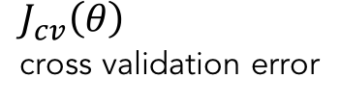
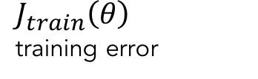
Model Complexity vs Error
cross validation error
error
training error
Notes:
Let’s look at how the error metrics (usually) behave with various levels of model complexity.
Training error: we’re fitting our model on the training data, and then testing it on the same training data (bad practice if this is the only thing that we do)
Cross-validation error: same as before, averaged out error values obtained from the various test splits.
Error for the training data will continue to decrease and eventually plateau
Doesn't increase because we can always fit training data better with more complex model.

Slide 28
Model Complexity vs Error
cross validation error
error
training error
Notes:
However, Effect of polynomial complexity on cross validation error is a different story
Error will decrease for a while and then start to increase again
Increase signifies failure of model to generalize

Slide 29
Model Complexity vs Error
cross validation error
error
training error
Notes:
This can be used to find the best model parameters, such as the best polynomial degree
Here is what the error looks like on the training and cross validation data sets on a validation curve

Slide 30
Model Complexity vs Error
Polynomial Degree = 1
Model
True Function
Samples
cross validation error
error
Y
training error
X
Underfitting: training and cross validation error are high
Notes:
Models associated with left side of this curve are underfitting the data
Diagnostic is that they have high error for both training and cross validation data
Training error probably can be improved with a more complicated model.

Slide 31
Model Complexity vs Error
Polynomial Degree = 15
Model
True Function
Samples
cross validation error
error
Y
training error
X
model complexity
Overfitting: training error is low, cross validation is high
Notes:
Models associated with the right side of this curve are overfitting the data
Diagnostic is that training error is low while cross validation error is high
Cross validation error can probably be improved by simplifying the model a little bit

Slide 32
Model Complexity vs Error
Polynomial Degree = 4
Model
True Function
Samples
cross validation error
error
Y
training error
X
Just right: training and cross validation errors are low
Notes:
Middle of the curve is where we'd like to be
Diagnostic here is that both training and cross validation error are low, and they are close to each other.

Slide 33
Cross Validation: The Syntax
Import the train and test split function
from sklearn.model_selection import cross_val_score
Perform cross-validation with a given model
cross_val = cross_val_score(KNN, X_data, y_data, cv=4, scoring='neg_mean_squared_error')
Other methods for cross validation:
from sklearn.model_selection import KFold, StratifiedKFold
Notes:
The model selection library of scikit learn also contains a cross validation scoring function

Slide 34
Cross Validation: The Syntax
Import the train and test split function
from sklearn.model_selection import cross_val_score
Perform cross-validation with a given model
cross_val = cross_val_score(KNN, X_data, y_data, cv=4, scoring='neg_mean_squared_error')
Other methods for cross validation:
from sklearn.model_selection import KFold, StratifiedKFold
Notes:
Cross validation requires the model, feature data, label data, number of splits and method of scoring
Will return the average score of all cross validations

Slide 35
Cross Validation: The Syntax
Import the train and test split function
from sklearn.model_selection import cross_val_score
Perform cross-validation with a given model
cross_val = cross_val_score(KNN, X_data, y_data, cv=4, scoring='neg_mean_squared_error')
Other methods for cross validation:
from sklearn.model_selection import KFold, StratifiedKFold
Notes:
There are other, lower level, methods available for splitting data into multiple cross validation splits
Difference generally is whether or not the labels are stratified into the splits.

Slide 36
Introduction to Linear Regression
Notes:
Linear Regression is a very popular ML algorithm
It is a Regression algorithm, which means it is used to predict continuous values, as opposed to “classes”

Slide 37
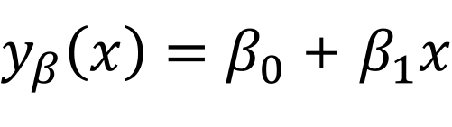
Introduction to Linear Regression
x10⁸
2.0
Box Office
1.0
0.0
1.0
2.0
x10⁸
Budget
Notes:
Example: Let’s try to predict the box office revenue of a movie, using the budget only.
Here is a scatter plot of some movies.
We are going to try to find a line, of the form y = b0 + b1x, which describes this dataset the best.

Slide 38
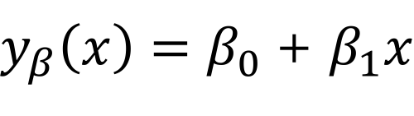
Introduction to Linear Regression
x10⁸
2.0
Box Office
1.0
0.0
1.0
2.0
x10⁸
Budget
box office revenue
movie budget
coefficient 0
coefficient 1
Notes:
Our target var is box office revenue
Our feature is movie budget only
B0 is called the “intercept”
And B1, coeff of x, is the slope of the line.

Slide 39
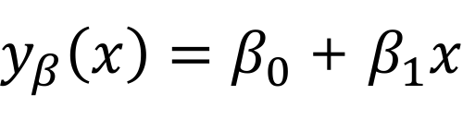
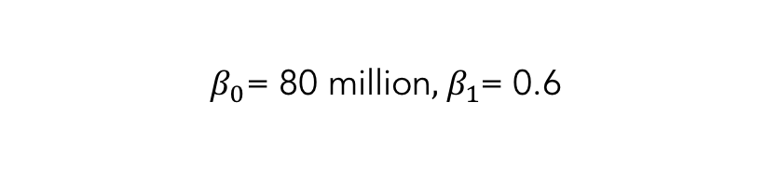
Introduction to Linear Regression
x10⁸
2.0
Box Office
1.0
0.0
1.0
2.0
x10⁸
Budget
Notes:
This is the best line, defined by coefficients B0 and B1.
How did we get here though? We minimized a cost function!

Slide 40
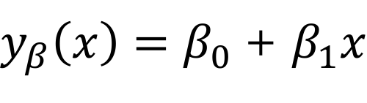
Predicting from Linear Regression
x10⁸
2.0
Box Office
1.0
0.0
1.0
2.0
x10⁸
Budget
Predict 175 Million Gross for 160 Million Budget
Notes:
With this line, we can predict what the box office revenue will be, for a new movie.
And it is not going to be a any random prediction.
It’s going to be relatively accurate.

Slide 41
Which Model Fits the Best?
x10⁸
2.0
Box Office
1.0
0.0
1.0
2.0
x10⁸
Budget
Notes:
So let’s analyze how we found that special line.
Why not this purple line instead of the blue?

Slide 42
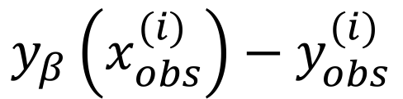
Calculating the Residuals
x10⁸
2.0
Box Office
1.0
0.0
1.0
2.0
x10⁸
Budget
predicted value
observed value
Notes:
For a given line, we have predicted values (values on the line), and the ground truth from our training set
Thus, for any movie, we know the magnitude of the error in our predictions!

Slide 43
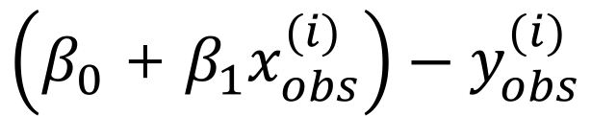
Calculating the Residuals
x10⁸
2.0
Box Office
1.0
0.0
1.0
2.0
x10⁸
Budget
Notes:
This is the error formula for a given observation.
Since this can be negative, we’re more interested in a positive version of this.
Something like the absolute value of this (L1 norm)
Or the euclidean distance / length of the gray line segments (L2 norm) – more popular

Slide 44
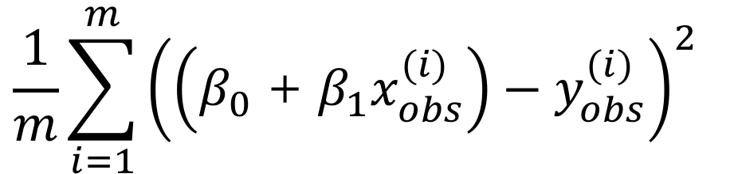
Mean Squared Error
x10⁸
2.0
Box Office
1.0
0.0
1.0
2.0
x10⁸
Budget
Notes:
This is probably the most popular cost function for linear regression
It’s called the Mean Squared Error
It gives us the average length of the gray line segments in the figure.
Here, x’s and y’s are given in the trainingset, and we’re thinking of this as a function of B0 and B1

Slide 45
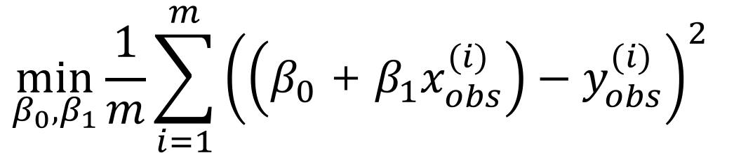
Minimum Mean Squared Error
x10⁸
2.0
Box Office
1.0
0.0
1.0
2.0
x10⁸
Budget
Notes:
The pair of values (B0, B1) which minimizes this gives us the best line!

Slide 46
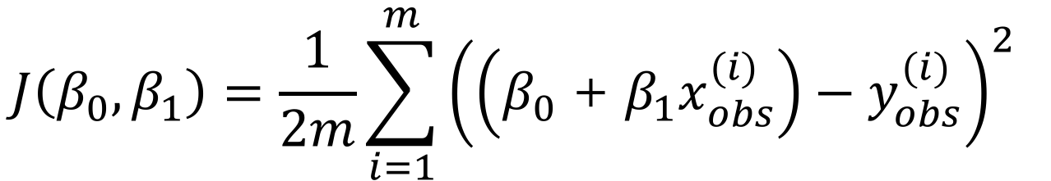
Cost Function
x10⁸
2.0
Box Office
1.0
0.0
1.0
2.0
x10⁸
Budget
Notes:
Sometimes the cost function will be written like this. Minimizing this is equivalent to the previous function.

Slide 47
Modelling Best Practice
Use cost function to fit model
Develop multiple models
Compare results and choose best one

Slide 48
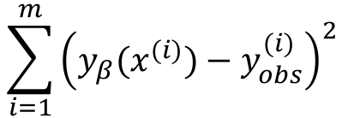
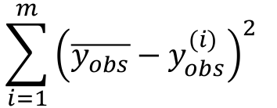
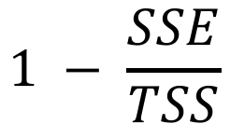
Other Model Metrics
Sum of Squared Error (SSE):
$\sum_{i=1}^{m}{{\left(\overset{´}{y_{obs}}−y_{obs}^{\left(i\right)}\right)}^{2} }$
Total Sum of Squares (TSS):
$1−\frac{SSE}{TSS}$
Correlation Coefficient (R²):
Notes:
These are some model metrics.
Sum of Squared Error, or Sum of Squared Residuals. This is the total squared error the model is making. Related to the cost function.

Slide 49
Other Measures of Error
Sum of Squared Error (SSE):
Total Sum of Squares (TSS):
$1−\frac{SSE}{TSS}$
Correlation Coefficient (R²):
Notes:
Total sum of squares;
Difference between our observed values and the average observed value.
Notice there is no predictions involved with this one.
It’s a measure of how the observed values differ from the mean. Are they concentrated around the mean or not?

Slide 50
Other Measures of Error
Sum of Squared Error (SSE):
Total Sum of Squares (TSS):
$1−\frac{SSE}{TSS}$
Correlation Coefficient (R²):
Notes:
This is the famous R^2 metric.
SSE measures the distance between truth and our predictions
TSS measures the distance between truth and average truth.
SSE is the unexplained variation by our model
TSS is the total variation of the truth values
So R2 is a measure of the explained variation by our model! (1-unexplained/total = explained / total)
Keep in mind that this can be applied to any regression algorithm, not restricted to linear reg.

Slide 51
Comparing Linear Regression and KNN
Linear Regression
K Nearest Neighbors
Fitting involves minimizing cost function (slow)
Model has few parameters (memory efficient)
Prediction involves calculation (fast)
Fitting involves storing training data (fast)
Model has many parameters (memory intensive)
Prediction involves finding closest neighbors (slow)
Notes:
Let’s compare the Linear Regression and KNNs side by side
Model fitting is slow for Linear Regression, since we’re conducting a search for best parameters
Whereas KNNs is very fast to fit, since it’s just storing the data.

Slide 52
Comparing Linear Regression and KNN
Linear Regression
K Nearest Neighbors
Fitting involves minimizing cost function (slow)
Model has few parameters (memory efficient)
Prediction involves calculation (fast)
Fitting involves storing training data (fast)
Model has many parameters (memory intensive)
Prediction involves finding closest neighbors (slow)
Notes:
Once the model is fit, Lin.Reg. costs basically nothing. It’s just a short sequence of parameters (coefficients determining the line)
On the other hand, KNNs need to remember all the points, so it is memory intensive.

Slide 53
Comparing Linear Regression and KNN
Linear Regression
K Nearest Neighbors
Fitting involves minimizing cost function (slow)
Model has few parameters (memory efficient)
Prediction involves calculation (fast)
Fitting involves storing training data (fast)
Model has many parameters (memory intensive)
Prediction involves finding closest neighbors (slow)
Notes:
And prediction for Linear regression is simply a linear combination of two vectors – fast
Knns need to determine which points are the closest. That is several distance computations, which can take some time.

Slide 54
Linear Regression: The Syntax
Import the class containing the regression method
from sklearn.linear_model import LinearRegression
Create an instance of the class
LR = LinearRegression()
Fit the instance on the data and then predict the expected value
LR = LR.fit(X_train, y_train)
y_predict = LR.predict(X_test)
Notes:
Sklearn syntax
Import is as follows.

Slide 55
Linear Regression: The Syntax
Import the class containing the regression method
from sklearn.linear_model import LinearRegression
Create an instance of the class
LR = LinearRegression()
Fit the instance on the data and then predict the expected value
LR = LR.fit(X_train, y_train)
y_predict = LR.predict(X_test)
Notes:
Create an instance of the class. This is our algorithm, It has not been fitted to any dataset yet.
It’s just a recipe containing linear regression, waiting to be applied.

Slide 56
Linear Regression: The Syntax
Import the class containing the regression method
from sklearn.linear_model import LinearRegression
Create an instance of the class
LR = LinearRegression()
Fit the instance on the data and then predict the expected value
LR = LR.fit(X_train, y_train)
y_predict = LR.predict(X_test)
Notes:
And this is how we fit to the training data.
Here the training data is given by Xtrain, ytrain
And .predict() can be used to get predictions on new samples.

Slide 57
Advanced Linear Regression
Notes:
Let’s dive a little deeper, consider some good practices, and optimizations.

Slide 58
Scaling is a Type of Feature Transformation
60
60
24
40
40
22
Age
20
20
20
18
1
2
3
1
2
3
4
5
4
5
Number of Surgeries
Number of Surgeries
Notes:
Linear regression, Knns, and more generally all distance based algorithms are pretty sensitive to large scale features.
Which means, if you have 1 variable that ranges from 1-5, and another that ranges from -10million to 10million, that could be a problem for those algorithms.
Small changes in the large scale feature can affect the algorithm unfairly and undesirably.
If we scale this distribution on the left so that things look more evenly distributed, that is a better dataset to feed to the Linear regression algorithm.
Unblocked by the numerical, computational limitations, the algorithm will find a better solution for us.

Slide 59
Transformation of Data Distributions
Predictions from linear regression models assume residuals are normally distributed
Features and predicted data are often skewed
Data transformations can solve this issue
Notes:
Transformations other than scaling may be necessary as well
For example, linear regression makes assumptions regarding the residuals and the target variable’s distributions.

Slide 60
Transformation of Data Distributions
Predictions from linear regression models assume residuals are normally distributed
Features and predicted data are often skewed
Data transformations can solve this issue
Notes:
However, in real life, the data in hand might not satisfy these assumptions.
Algorithm will still work, but it can be optimized by some preprocessing transformations.

Slide 61
Transformation of Data Distributions
from numpy import log, log1p
from scipy.stats import boxcox
Notes:
Here are some common functions which can take inputs and output a more ”gaussian” looking curves.

Slide 62
Transformation of Data Distributions
Predictions from linear regression models assume residuals are normally distributed
Features and predicted data are often skewed
Data transformations can solve this issue
Notes:
Mathematical theory behind Linear regression assumes the residuals are normally distributed.
In real life, data can come in all shapes and sizes.
Data transformations can help the algorithm find a better solution.

Slide 63
Feature Types
Feature Type
Transformation
Continuous: numerical values
Nominal: categorical, unordered features (True or False)
Ordinal: categorical, ordered features (movie ratings)
Standard Scaling, Min-Max Scaling
One-hot encoding (0, 1)
Ordinal encoding (0, 1, 2, 3)
Notes:
Let’s look at some transformations we can apply to features with various data types

Slide 64
Feature Types
Feature Type
Transformation
Continuous: numerical values
Nominal: categorical, unordered features (True or False)
Ordinal: categorical, ordered features (movie ratings)
Standard Scaling, Min-Max Scaling
One-hot encoding (0, 1)
Ordinal encoding (0, 1, 2, 3)
Notes:
Scaling is essential for numerical features.
Standard scaling will replace a value with its z-score
Min-max scaling will force the feature to have values between 0-1.

Slide 65
Feature Types
Feature Type
Transformation
Continuous: numerical values
Nominal: categorical, unordered features (True or False)
Ordinal: categorical, ordered features (movie ratings)
Standard Scaling, Min-Max Scaling
One-hot encoding (0, 1)
Ordinal encoding (0, 1, 2, 3)
from sklearn.preprocessing import LabelEncoder, LabelBinarizer, OneHotEncoder
Notes:
For categorical features, that can’t be encoded with integers, one-hot encoding is the best option.
Ex: hair color, interests of a person, country etc

Slide 66
Feature Types
Feature Type
Transformation
Continuous: numerical values
Nominal: categorical, unordered features (True or False)
Ordinal: categorical, ordered features (movie ratings)
Standard Scaling, Min-Max Scaling
One-hot encoding (0, 1)
Ordinal encoding (0, 1, 2, 3)
from sklearn.feature_extraction import DictVectorizer
from pandas import get_dummies
Notes:
Sometimes it makes sense to encode some categorical features with integers.
When there’s a natural order between the categories, like
Tshirt size –small, med, large, xlarge..
Grades; A+, A, B+, B, …

Slide 67
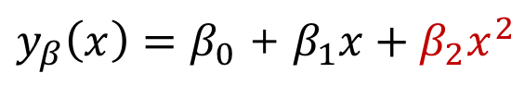
Addition of Polynomial Features
Capture higher order features of data by adding polynomial features
"Linear regression" means linear combinations of features
Box Office
Budget
Notes:
Another preprocessing trick we can apply is to create new features out of the ones we already have.
We have seen this during the overfitting discussion. Instead of a line, we can add budget^2 to the list of features and fit a polynomial.

Slide 68
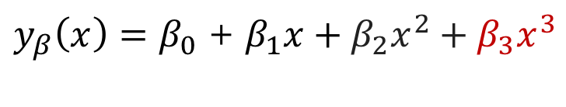
Addition of Polynomial Features
Capture higher order features of data by adding polynomial features
"Linear regression" means linear combinations of features
Box Office
Budget
Notes:
The resulting algorithm is still linear regression, since the outcome is still a linear combination of the features.
The non-linear relationship between one feature and the other does not make the algorithm non-linear.

Slide 69
Addition of Polynomial Features
Capture higher order features of data by adding polynomial features
"Linear regression" means linear combinations of features
Box Office
Budget
Notes:
XXX

Slide 70
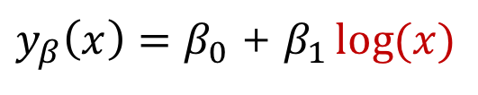
Addition of Polynomial Features
Capture higher order features of data by adding polynomial features
"Linear regression" means linear combinations of features
Box Office
Budget
Notes:
Still linear regression.

Slide 71
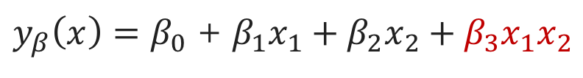
Addition of Polynomial Features
Can also include variable interactions
How is the correct functional form chosen?
Check relationship of each variable or with outcome
Notes:
We can get creative in creating additional features.

Slide 72
Addition of Polynomial Features
Can also include variable interactions
How is the correct functional form chosen?
Check relationship of each variable or with outcome
Notes:
We can have a list of things to try and check relationship (correlation) of each manufactured feature with the outcome.

Slide 73
Polynomial Features: The Syntax
Import the class containing the transformation method
from sklearn.preprocessing import PolynomialFeatures
Create an instance of the class
polyFeat = PolynomialFeatures(degree=2)
Create the polynomial features and then transform the data
polyFeat = polyFeat.fit(X_data)
X_poly = polyFeat.transform(X_data)
Notes:
Sklearn provides tools to create features like this.
PolynomialFeatures will create the square, cube etc of variables.

Slide 74
Polynomial Features: The Syntax
Import the class containing the transformation method
from sklearn.preprocessing import PolynomialFeatures
Create an instance of the class
polyFeat = PolynomialFeatures(degree=2)
Create the polynomial features and then transform the data
polyFeat = polyFeat.fit(X_data)
X_poly = polyFeat.transform(X_data)
Notes:
Degree is 2.
Keep in mind that number of new features grows rapidly with degree.

Slide 75
Polynomial Features: The Syntax
Import the class containing the transformation method
from sklearn.preprocessing import PolynomialFeatures
Create an instance of the class
polyFeat = PolynomialFeatures(degree=2)
Create the polynomial features and then transform the data
polyFeat = polyFeat.fit(X_data)
X_poly = polyFeat.transform(X_data)
Notes:
Fit, transform can fit and transform the dataset, before plugging in to the ML models.

