Slide 1
Naïve Bayes

Slide 2

Probability Basics
Single event probability:
$P\left(X\right)$
$P\left(Y\right)$
Notes:
Here we’re visualizing probabilities with Venn diagrams
Bigger the bubble representing the event, the bigger the probability

Slide 3
Probability Basics
Single event probability:
$P\left(X\right)$
Notes:
Here we’re visualizing probabilities with Venn diagrams
Bigger the bubble representing the event, the bigger the probability.
Two events, X and Y.

Slide 4


Probability Basics
Single event probability:
Joint event probability:
Conditional probability:
Joint and conditional relationship:
$P\left(X∨Y\right),P\left(Y∨X\right)$
Notes:
Joint probability P(X, Y) means, the probability of events X AND Y happening together.
Visually, it is the intersection of the two sets.

Slide 5

Probability Basics
Single event probability:
Joint event probability:
Conditional probability:
Notes:
On the other hand, when we talk about conditional probability P(X | Y), we’re taking Y for granted.
Event Y already happened. Given that, what is the probability of event X happening?
INTUITION: It is almost always higher than the joint probability, as there we’re not taking anything for granted. When are they equal?
Taking Y for granted visually means, we’re erasing the bubbles outside the bubble representing Y. So our total universe becomes Y.

Slide 6

Probability Basics
Single event probability:
Joint event probability:
Conditional probability:
Joint and conditional relationship:
$P\left(X∨Y\right),P\left(Y∨X\right)$
Notes:
Symmetrically, we can talk about P(Y | X).
Visually, We’re always interested in the area representing JOINT PROBABILITY.
However, these two conditional probabilities need not be equal!! Depends on the bubbles P(X) and P(Y) we’re restricting to.
Mathematically, numerators are equal but denoms are (probably) not!

Slide 7
Probability Basics
Single event probability:
Joint event probability:
Conditional probability:
Joint and conditional relationship:
$P\left(X∨Y\right),P\left(Y∨X\right)$
Notes:
Reversing the equations, we can get the joint prob from the two conditional probs (since numerators are the same)

Slide 8
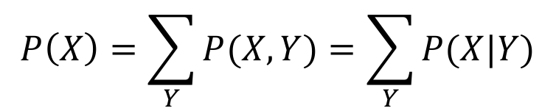
Bayes Theorem Derivation
By conditional and joint relationship:
To invert conditional probability:
$P\left(Y | X\right)∗P\left(X\right)=P\left(X | Y\right)∗P\left(Y\right)$
Notes:
We are slowly deriving Bayes thm

Slide 9
Bayes Theorem Derivation
Use conditional and joint relationship:
To invert conditional probability:
$P\left(Y | X\right)=\frac{P\left(X | Y\right)∗P\left(Y\right) }{P\left(X\right)}$
Notes:
This is the well known form of Bayes thm

Slide 10
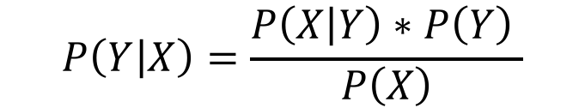
Bayes Theorem Derivation
Use conditional and joint relationship:
To invert conditional probability:
$P\left(X\right)=\sum_{Z}{P\left(X,Z\right)}=\sum_{Z}{P\left(X | Z\right)∗P\left(Z\right)}$
Notes:
In practice, computing/estimating the denominator directly is often difficult.
Practical trick to compute P(X) is:
Identify events Z1, Z2, .. That are DISJOINT (if one happens, then others don’t happen) and that cover the whole spectrum
And compute the conditional probs P(X|Z) * P(Z)
E.g.: X = “I have cancer”
Z1 = “I tested positive” → P(X|Z1) = 0.98
Z2 = “I tested negative” → P(X|Z2) = 0.001

Slide 11
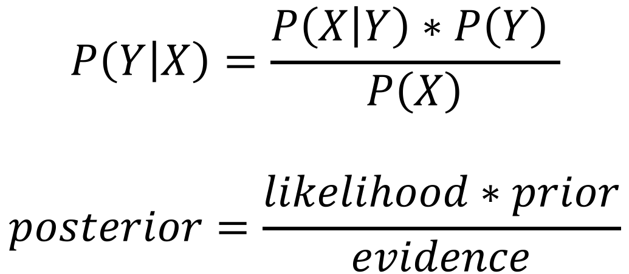
Bayes Theorem
Notes:
The terms here have names.

Slide 12
Bayes Theorem
Notes:
These terms have names … likelihood, prior etc etc

Slide 13
Naïve Bayes Classification
Notes:
Let’s go back to our classification problem
Y represents the classes. X represents the data (features)
IDEA: Given features X, what is the class Y which maximizes P(Y | X) ?
Maximize: Probability of this specific row of data belonging to class X?
Observe that, changing Y does not change the denominator P(X) in the equation! That’s a constant term (across classes) which doesn’t affect where the maximum occurs! So we can cross out the evidence from our objective function

Slide 14
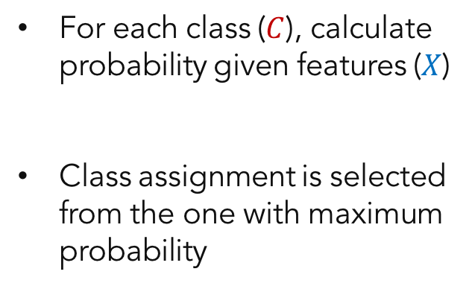

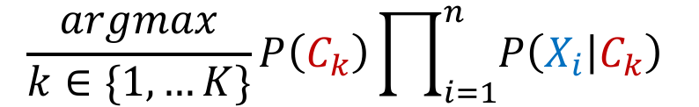
Training Naïve Bayes
Class
Features
$\frac{argmax}{k∈\{1,…K\}}P\left(C_{k}\right)\prod_{i=1}^{n}{P\left(X_{i} | C_{k}\right) }$
Notes:
So, maximizing the previous function is the same as maximizing this new function, which is just the numerator in the previous slide.
This is super convenient bc computing the numerator is difficult in real life, as noted before..
Notice we switched our notation to C for “C”lass

Slide 15
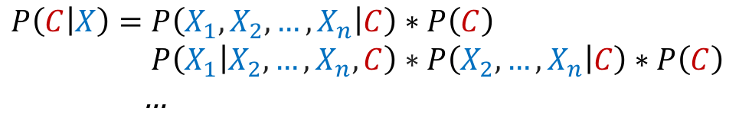
Training Naïve Bayes: The Naïve Assumption
For each class (), calculate probability given features ()
Difficult to calculate joint probabilities produced by expanding for all features
$P\left(C | X\right)=P\left(X | C\right)∗P\left(C\right)$
…
Notes:
Now our record X for which we want to predict the class, consists of many features X1, .., Xn
So we need to expand this equation.
Rigorous math would imply the following equality, which is getting messy to compute very fast.
Instead of the full solution, we need a “good-enough” solution

Slide 16
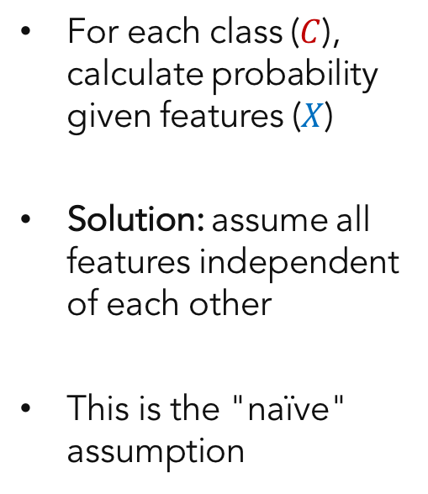

Training Naïve Bayes: The Naïve Assumption
$P\left(C | X\right)=P\left(X_{1} | C\right)∗P\left(X_{2} | C\right)∗P\left(X_{n} | C\right)∗P\left(C\right)$
$P\left(C | X\right)=P\left(C\right)\prod_{i=1}^{n}{P\left(X_{i} | C\right)}$
Notes:
Solution is to assume independence across features so all the convoluted terms go away
The terms that are left are easily “computable”. More on that later.
we’re left with this nice equation. Keep in mind that this equation is FALSE. That’s the naïve part. In naïve bayes.
It’s false, but it’s good enough! Philosophy: all models are false, but some are useful!

Slide 17
Training Naïve Bayes: The Naïve Assumption
For each class (), calculate probability given features ()
Solution: assume all features independent of each other
This is the "naïve" assumption
Notes:
Another way to write the equation above.
This is the naïve in naïve bayes.

Slide 18
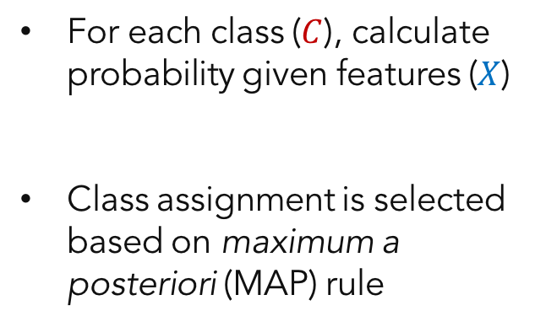

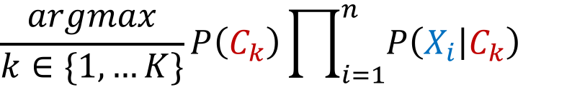
Training Naïve Bayes
Notes:
Now that we have a nice computable formula, we can write out these values for all classes, and pick the class that corresponds to the highest value.
That is called the MAP estimate

Slide 19
Training Naïve Bayes
Means select potential class with largest value
Notes:
XXX

Slide 20
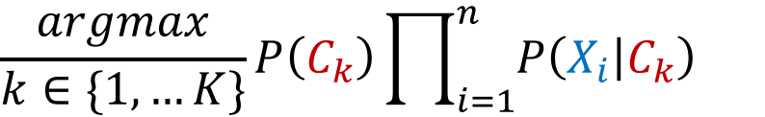
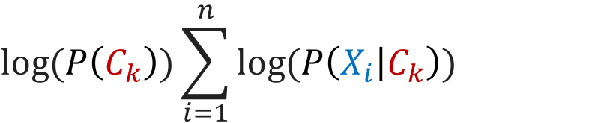
The Log Trick
Multiplying many values together causes computational instability (underflows)
Work with log values and sum the results
$log\left(P\left(C_{k}\right)\right)\sum_{i=1}^{n}{log\left(P\left(X_{i} | C_{k}\right)\right)}$
Notes:
Math Fact: Log is a function that turns products into sums.
Another math fact: while doing that, log preserves the relative order of values! so maximum Ck without log is the maximum with log, always.
This helps with the computational stability in this case. In other areas it helps with easier differentiation.

Slide 21
The Log Trick
Multiplying many values together causes computational instability (underflows)
Work with log values and sum the results
Notes:
Math Fact: Log is a function that turns products into sums.
Another math fact: while doing that, log preserves the relative order of values! so maximum Ck without log is the maximum with log, always.
This helps with the computational stability in this case. In other areas it helps with easier differentiation.

Slide 22
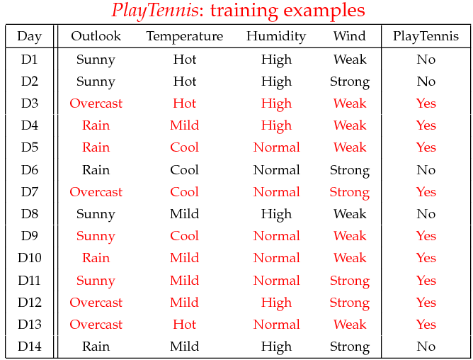
Example: Predicting Tennis With Naïve Bayes
Notes:
So let’s see how this works, in a simple example.
Here’s some weather data about some days, and a flag indicating whether or not a person played tennis on that day

Slide 23
Example: Training Naïve Bayes Tennis Model
P(Play=Yes) = 9/14
P(Play=No) = 5/14
Outlook | Play=Yes | Play=No
Sunny | 2/9 | 3/5
Overcast | 4/9 | 0/5
Rain | 3/9 | 2/5
Temperature | Play=Yes | Play=No
Hot | 2/9 | 2/5
Mild | 4/9 | 2/5
Cool | 3/9 | 1/5
Humidity | Play=Yes | Play=No
High | 3/9 | 4/5
Normal | 6/9 | 1/5
Wind | Play=Yes | Play=No
Strong | 3/9 | 3/5
Weak | 6/9 | 2/5
Create probability lookup tables based on training data
Notes:
These are the P(C) values in the formula before ( P(C|X) = P(X|C) * P(C) )

Slide 24
Example: Training Naïve Bayes Tennis Model
P(Play=Yes) = 9/14
P(Play=No) = 5/14
Outlook | Play=Yes | Play=No
Sunny | 2/9 | 3/5
Overcast | 4/9 | 0/5
Rain | 3/9 | 2/5
Temperature | Play=Yes | Play=No
Hot | 2/9 | 2/5
Mild | 4/9 | 2/5
Cool | 3/9 | 1/5
Humidity | Play=Yes | Play=No
High | 3/9 | 4/5
Normal | 6/9 | 1/5
Wind | Play=Yes | Play=No
Strong | 3/9 | 3/5
Weak | 6/9 | 2/5
Create probability lookup tables based on training data
Notes:
This table allows us to assign values to P(X1|C), P(X2|C) etc! This is where the training happens. Model learns these values from the dataset.
So, of the 9 days we play tennis, 2 of them are sunny, 4 of them overcast. Thus, P(sunny | yes) = 2/9 and P(overcast | yes) = 4/9

Slide 25
Example: Training Naïve Bayes Tennis Model
P(Play=Yes) = 9/14
P(Play=No) = 5/14
Outlook | Play=Yes | Play=No
Sunny | 2/9 | 3/5
Overcast | 4/9 | 0/5
Rain | 3/9 | 2/5
Temperature | Play=Yes | Play=No
Hot | 2/9 | 2/5
Mild | 4/9 | 2/5
Cool | 3/9 | 1/5
Humidity | Play=Yes | Play=No
High | 3/9 | 4/5
Normal | 6/9 | 1/5
Wind | Play=Yes | Play=No
Strong | 3/9 | 3/5
Weak | 6/9 | 2/5
Create probability lookup tables based on training data
Notes:
And we do the same for other features.

Slide 26
Example: Predicting Tennis With Naïve Bayes
Predict outcome for the following:
x’=(Outlook=Sunny, Temperature=Cool, Humidity=High, Wind=Strong)
Feature | Play=Yes | Play=No
Outlook=Sunny | 2/9 | 3/5
Temperature=Cool | 3/9 | 1/5
Humidity=High | 3/9 | 4/5
Wind=Strong | 3/9 | 3/5
Overall Label | 9/14 | 5/14
Probability | 0.0053 | 0.0206
Notes:
We refer back to our probability table, created out of our training set, to fill in those terms with the appropriate values

Slide 27
Example: Predicting Tennis With Naïve Bayes
Predict outcome for the following:
x’=(Outlook=Sunny, Temperature=Cool, Humidity=High, Wind=Strong)
Feature | Play=Yes | Play=No
Outlook=Sunny | 2/9 | 3/5
Temperature=Cool | 3/9 | 1/5
Humidity=High | 3/9 | 4/5
Wind=Strong | 3/9 | 3/5
Overall Label | 9/14 | 5/14
Probability | 0.0053 | 0.0206
Notes:
Multiply it out, and get two numbers

Slide 28
Example: Predicting Tennis With Naïve Bayes
Predict outcome for the following:
x’=(Outlook=Sunny, Temperature=Cool, Humidity=High, Wind=Strong)
Feature | Play=Yes | Play=No
Outlook=Sunny | 2/9 | 3/5
Temperature=Cool | 3/9 | 1/5
Humidity=High | 3/9 | 4/5
Wind=Strong | 3/9 | 3/5
Overall Label | 9/14 | 5/14
Probability | 0.0053 | 0.0206
Notes:
Keep in mind that these are not actual probabilities (that’s because we ignored the denominator in the computation)
But the class with the max probability is the class with the max value here! That stays the same, which is what we care about!

Slide 29
Example: Predicting Tennis With Naïve Bayes
Predict outcome for the following:
x’=(Outlook=Sunny, Temperature=Cool, Humidity=High, Wind=Strong)
Feature | Play=Yes | Play=No
Outlook=Sunny | 2/9 | 3/5
Temperature=Cool | 3/9 | 1/5
Humidity=High | 3/9 | 4/5
Wind=Strong | 3/9 | 3/5
Overall Label | 9/14 | 5/14
Probability | 0.0053 | 0.0206
Notes:
Conclusion: We think this person is not going to play tennis today!
Side note; the (predict_proba) numbers are not very meaningful, for several reasons.
Naïve Independence assumption hurts that the most

Slide 30
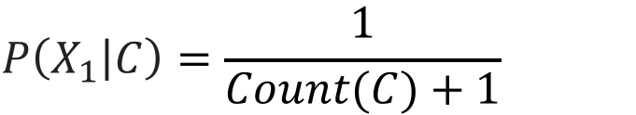
Laplace Smoothing
Problem: categories with no entries result in a value of "0" for conditional probability
Solution: add "1" to numerator and denominator of empty categories
$P\left(C | X\right)=P\left(X_{1} | C\right)∗P\left(X_{2} | C\right)∗P\left(C\right)$
$P\left(X_{1} | C\right)=\frac{1}{Count\left(C\right)+1}$
Notes:
In practice, often times one of the terms in the computation is zero.
This could be because training dataset is small, or there is a dummy feature in the dataset which appears very rarely etc.

Slide 31
Laplace Smoothing
0
Problem: categories with no entries result in a value of "0" for conditional probability
Solution: add "1" to numerator and denominator of empty categories
$P\left(X_{1} | C\right)=\frac{1}{Count\left(C\right)+1}$
Notes:
When it happens, the whole product is zero
If you apply the log trick, still problematic as log(0) is undefined!

Slide 32

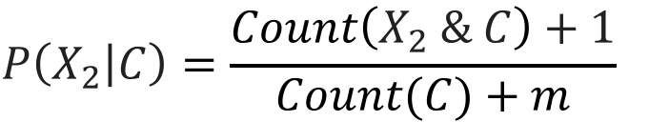
Laplace Smoothing
0
Problem: categories with no entries result in a value of "0" for conditional probability
Solution: add "1" to numerator and denominator of empty categories
$P\left(C | X\right)=P\left(X_{1} | C\right)∗P\left(X_{2} | C\right)∗P\left(C\right)$
Notes:
To remedy this, “smooth out” the probabiliies
Add 1 to numerator and adjust the denominator by how many possible X1 values there are (n)
Similarly, smooth out the non zero terms as well.

Slide 33
Types of Naïve Bayes
Naïve Bayes Model
Data Type
Bernoulli | Binary (T/F)
Bernoulli | Count
Gaussian | Continuous
Notes:
Here are several types of Naïve Bayes implemented in scikit-learn

Slide 34
Types of Naïve Bayes
Naïve Bayes Model
Data Type
Bernoulli | Binary (T/F)
Multinomial | Discrete (e.g. count)
Gaussian | Continuous
Notes:
XXX

Slide 35
Types of Naïve Bayes
Naïve Bayes Model
Data Type
Bernoulli | Binary (T/F)
Multinomial | Discrete (e.g. count)
Gaussian | Continuous
Notes:
The model here determines how e compute the terms P(X1 | C).
In the example above, we used a Multinomial distribution. Features were discrete and non binary.
Side note: In scikit-learn’s implementation, Bernoulli NB and Multinomial NB differ even if they are applied to a dataset where features are binary! Read the doc!

Slide 36
Combining Feature Types
Problem
Model features contain different data types (continuous and categorical)
Option 1: Bin continuous features to create categorical ones and fit multinomial model
Option 2: Fit Gaussian model on continuous features and multinomial on categorical features; combine to create "meta model" (week 10)
Solutions
Notes:
If we have a combination of data types in our training set, we need to mind the computation method!
Sklearn doesn’t handle the different data types automatically!

Slide 37
Combining Feature Types
Problem
Model features contain different data types (continuous and categorical)
Option 1: Bin continuous features to create categorical ones and fit multinomial model
Option 2: Fit Gaussian model on continuous features and multinomial on categorical features; combine to create "meta model" (week 10)
Solutions
Notes:
Either force continuous features into bins;
That is, make them categorical, so everything is categorical
Good practice; instead of arbitrarily binning, one could use the deciles / vintiles etc so that categories have similar size.
And then fit multinomialNB.

Slide 38
Combining Feature Types
Problem
Model features contain different data types (continuous and categorical)
Option 1: Bin continuous features to create categorical ones and fit multinomial model
Option 2: Fit Gaussian model on continuous features and multinomial on categorical features; combine to create "meta model" (week 10)
Solutions
Notes:
Alternatively, we can separate out the continuous features, fit a GaussianNB (force them into normal distributions first!!)
Fit a MultinomialNB to categorical features.
Combine!

Slide 39
Distributed Computing with Naïve Bayes
Well-suited for large data and distributed computing—limited parameters and log probabilities are a summation
Scikit-Learn implementations contain a "partial_fit" method designed for out-of-core calculations
Notes:
Naïve Bayes is a pretty lightweight algorithm. It’s well-suited for large datasets.
There is also a partial_fit method that can do out-of-core calculations, or online learning (updating model later)

Slide 40
Naïve Bayes: The Syntax
Import the class containing the classification method
from sklearn.naive_bayes import BernoulliNB
Create an instance of the class
BNB = BernoulliNB(alpha=1.0)
Fit the instance on the data and then predict the expected value
BNB = BNB.fit(X_train, y_train)
y_predict = BNB.predict(X_test)
Other naïve Bayes models: MultinomialNB, GaussianNB.
Notes:
Here is the syntax
Start by importing.

Slide 41
Naïve Bayes: The Syntax
Import the class containing the classification method
from sklearn.naive_bayes import BernoulliNB
Create an instance of the class
BNB = BernoulliNB(alpha=1.0)
Fit the instance on the data and then predict the expected value
BNB = BNB.fit(X_train, y_train)
y_predict = BNB.predict(X_test)
Other naïve Bayes models: MultinomialNB, GaussianNB.
Notes:
Instantiate like this

Slide 42
Naïve Bayes: The Syntax
Import the class containing the classification method
from sklearn.naive_bayes import BernoulliNB
Create an instance of the class
BNB = BernoulliNB(alpha=1.0)
Fit the instance on the data and then predict the expected value
BNB = BNB.fit(X_train, y_train)
y_predict = BNB.predict(X_test)
Other naïve Bayes models: MultinomialNB, GaussianNB.
Laplace smoothing parameter
Notes:
Alpha is the laplace smoothing parameter. We used the value 1 in the slides.

Slide 43
Naïve Bayes: The Syntax
Import the class containing the classification method
from sklearn.naive_bayes import BernoulliNB
Create an instance of the class
BNB = BernoulliNB(alpha=1.0)
Fit the instance on the data and then predict the expected value
BNB = BNB.fit(X_train, y_train)
y_predict = BNB.predict(X_test)
Other naïve Bayes models: MultinomialNB, GaussianNB.
Notes:
Fit, predict etc.

Slide 44
Naïve Bayes: The Syntax
Import the class containing the classification method
from sklearn.naive_bayes import BernoulliNB
Create an instance of the class
BNB = BernoulliNB(alpha=1.0)
Fit the instance on the data and then predict the expected value
BNB = BNB.fit(X_train, y_train)
y_predict = BNB.predict(X_test)
Other naïve Bayes models: MultinomialNB, GaussianNB.
Notes:
Multinomial, Gaussian.

Slide 45
Grid Search and Pipelines
Notes:
XXX

Slide 46
Generalized Hyperparameter Grid Search
Hyperparameter selection for regularization / better models requires cross validation on training data
Linear and logistic regression methods have classes devoted to grid search (e.g. LassoCV)
Parameter B
Parameter A
Notes:
Most ML algorithms have parameters
If you are not tuning those parameters, you may be leaving money on the table!

Slide 47
Generalized Hyperparameter Grid Search
Grid search can be useful for other methods too, so a generalized method is desirable
Scikit-learn contains GridSearchCV, which performs a grid search with parameters using cross validation
Parameter B
Parameter A

Slide 48
Grid Search with Cross Validation: The Syntax
Import the class containing the grid search method
from sklearn.linear_model import LogisticRegression
from sklearn.model_selection import GridSearchCV
Create an instance of the estimator and grid search class
LR = LogisticRegression(penalty='l2')
GS = GridSearchCV(LR, param_grid={'c':[0.001, 0.01, 0.1]},
scoring='accuracy', cv=4)
Fit the instance on the data to find the best model and then predict
GS = GS.fit(X_train, y_train)
y_train = GS.predict(X_test)
Notes:
Let’s see this in action.

Slide 49
Grid Search with Cross Validation: The Syntax
Import the class containing the grid search method
from sklearn.linear_model import LogisticRegression
from sklearn.model_selection import GridSearchCV
Create an instance of the estimator and grid search class
LR = LogisticRegression(penalty='l2')
GS = GridSearchCV(LR, param_grid={'c':[0.001, 0.01, 0.1]},
scoring='accuracy', cv=4)
Fit the instance on the data to find the best model and then predict
GS = GS.fit(X_train, y_train)
y_train = GS.predict(X_test)
Notes:
We are specifying the grid that we are going to perform our search on
In this example, the grid has 1 dimension (variable), the regularization parameter “c”
We are going to try these 3 values, and pick the value that results in the best “accuracy”, our scoring method.

Slide 50
Grid Search with Cross Validation: The Syntax
Import the class containing the grid search method
from sklearn.linear_model import LogisticRegression
from sklearn.model_selection import GridSearchCV
Create an instance of the estimator and grid search class
LR = LogisticRegression(penalty='l2')
GS = GridSearchCV(LR, param_grid={'c':[0.001, 0.01, 0.1]},
scoring='accuracy', cv=4)
Fit the instance on the data to find the best model and then predict
GS = GS.fit(X_train, y_train)
y_train = GS.predict(X_test)
logistic regression method
Notes:
Notice that the first argument is to grid search is the method.
LR.

Slide 51
Grid Search with Cross Validation: The Syntax
Import the class containing the grid search method
from sklearn.linear_model import LogisticRegression
from sklearn.model_selection import GridSearchCV
Create an instance of the estimator and grid search class
LR = LogisticRegression(penalty='l2')
GS = GridSearchCV(LR, param_grid={'c':[0.001, 0.01, 0.1]},
scoring='accuracy', cv=4)
Fit the instance on the data to find the best model and then predict
GS = GS.fit(X_train, y_train)
y_train = GS.predict(X_test)
Notes:
GridSearchCV will find the optimal “c” value, and retrain on the entire dataset with that value (unless otherwise specified with refit=False)
So the resulting object can be used as a single trained model.

Slide 52
Optimizing the Rest of the Pipeline
Grid searches enable model parameters to be optimized
How can this be incorporated with other steps of the process (e.g. feature extraction and transformation)?
Pipelines!
Notes:
Okay so grid search can optimize the model parameters such as regularization coefficients.

Slide 53
Optimizing the Rest of the Pipeline
Grid searches enable model parameters to be optimized
How can this be incorporated with other steps of the process (e.g. feature extraction and transformation)?
Pipelines!
Notes:
There are more things to optimize though!
Creating, eliminating features, imputation methods..

Slide 54
Optimizing the Rest of the Pipeline
Grid searches enable model parameters to be optimized
How can this be incorporated with other steps of the process (e.g. feature extraction and transformation)?
Pipelines!
Notes:
Enter pipelines!
Pipelines stack various operations sequentially one after another.
Once we define the pipeline, we have only one object that does many things sequentially → easier to deal with.

Slide 55
Automating Machine Learning with Pipelines
Machine learning models often selected empirically
By trying different processing methods and tuning multiple models
Log Transform
Standard Scaler
KNN
Prediction
Data
Notes:
In KNN and other distance based algorithms, scaling is an important part of the pipeline
Another example: During the naïve bayes discussion, we mentioned binning continuous features, making them categorical and then fitting a MultinomialNB.
PCA, manifold learning, imputing missing data, one-hot encoding categorical features etc. etc.

Slide 56
Automating Machine Learning with Pipelines
Machine learning models often selected empirically
By trying different processing methods and tuning multiple models
Log Transform
Min-Max Scaler
Logistic Regression
Best
Prediction
Data
Notes:
Maybe this is the right pipeline for our data.

Slide 57
Automating Machine Learning with Pipelines
Machine learning models often selected empirically
By trying different processing methods and tuning multiple models
Log Transform
Min-Max Scaler
Logistic Regression
Best
Prediction
Data
How to automate this process?

Slide 58
Automating Machine Learning with Pipelines
Pipelines in Scikit-Learn allow feature transformation steps and models to be chained together
Successive steps perform 'fit' and 'transform' before sending data to the next step
Min-Max Scaler
Logistic Regression
Best
Prediction
Log Transform
Data
Notes:
Sklearn has a class called Pipeline, which allows us to string together many operations and treat the whole process as a single entity.

Slide 59
Automating Machine Learning with Pipelines
Pipelines in Scikit-Learn allow feature transformation steps and models to be chained together
Successive steps perform 'fit' and 'transform' before sending data to the next step
Log Transform
Min-Max Scaler
Logistic Regression
Best
Prediction
Data
Notes:
When Pipeline.fit is called, steps in pipeline perform fit, and then transform to the input. The result is fed to the next step in the pipeline.
When the last step comes, it performs fit only.
Similarly, for Pipeline.predict,
It calls step1.transform()
Step2.transform()
…
LastStep.predict()

Slide 60
Automating Machine Learning with Pipelines
Pipelines in Scikit-Learn allow feature transformation steps and models to be chained together
Successive steps perform 'fit' and 'transform' before sending data to the next step
Log Transform
Min-Max Scaler
Logistic Regression
Best
Prediction
Data
Pipelines make automation and reproducibility easier!
Notes:
XXX

Slide 61
Pipelines: The Syntax
Import the class containing the pipeline method
from sklearn.pipeline import Pipeline
Create an instance of the class with estimators
estimators = [('scaler', MinMaxScaler()), ('lasso', Lasso())]
Pipe = Pipeline(estimators)
Fit the instance on the data and then predict the expected value
Pipe = Pipe.fit(X_train, y_train)
y_predict = Pipe.predict(X_test)
Features can be combined from different transform method using FeatureUnion
Notes:
Import

Slide 62
Pipelines: The Syntax
Import the class containing the pipeline method
from sklearn.pipeline import Pipeline
Create an instance of the class with estimators
estimators = [('scaler', MinMaxScaler()), ('lasso', Lasso())]
Pipe = Pipeline(estimators)
Fit the instance on the data and then predict the expected value
Pipe = Pipe.fit(X_train, y_train)
y_predict = Pipe.predict(X_test)
Features can be combined from different transform method using FeatureUnion
Notes:
Defining the pipeline
We’re first creating a list
Each element in the list is a step in the pipeline (same order)
They are tuples! Name of the step, and the class that does .fit and .transform (or .predict if it’s the last one)

Slide 63
Pipelines: The Syntax
Import the class containing the pipeline method
from sklearn.pipeline import Pipeline
Create an instance of the class with estimators
estimators = [('scaler', MinMaxScaler()), ('lasso', Lasso())]
Pipe = Pipeline(estimators)
Fit the instance on the data and then predict the expected value
Pipe = Pipe.fit(X_train, y_train)
y_predict = Pipe.predict(X_test)
Features can be combined from different transform method using FeatureUnion
feature scaler class
Notes:
Here, first step is the feature scaler.

Slide 64
Pipelines: The Syntax
Import the class containing the pipeline method
from sklearn.pipeline import Pipeline
Create an instance of the class with estimators
estimators = [('scaler', MinMaxScaler()), ('lasso', Lasso())]
Pipe = Pipeline(estimators)
Fit the instance on the data and then predict the expected value
Pipe = Pipe.fit(X_train, y_train)
y_predict = Pipe.predict(X_test)
Features can be combined from different transform method using FeatureUnion
lasso model class
Notes:
Second step is lasso.

Slide 65
Pipelines: The Syntax
Import the class containing the pipeline method
from sklearn.pipeline import Pipeline
Create an instance of the class with estimators
estimators = [('scaler', MinMaxScaler()), ('lasso', Lasso())]
Pipe = Pipeline(estimators)
Fit the instance on the data and then predict the expected value
Pipe = Pipe.fit(X_train, y_train)
y_predict = Pipe.predict(X_test)
Features can be combined from different transform method using FeatureUnion
Notes:
And the usage becomes just one liners!

Slide 66
Pipelines: The Syntax
Import the class containing the pipeline method
from sklearn.pipeline import Pipeline
Create an instance of the class with estimators
estimators = [('scaler', MinMaxScaler()), ('lasso', Lasso())]
Pipe = Pipeline(estimators)
Fit the instance on the data and then predict the expected value
Pipe = Pipe.fit(X_train, y_train)
y_predict = Pipe.predict(X_test)
Features can be combined from different transform method using FeatureUnion
Notes:
So here, Pipe.fit means => MinMaxScaler.fit_transform() + Lasso.fit()
Pipe.predict means => MinMaxScaler.transform() + Lasso.predict()

