Slide 1


OVERVIEW
▪
Customer churn is a
significant
businesses,
the telecom
challenge for
particularly in
industry.
▪
Understanding the factors
that contribute to customer
churn and being able
to predict it can help
companies develop strategies
to retain customers and
reduce revenue losses.

Slide 2
PROJECT WORKFLOW
Business
Understanding
Data
Understanding
Modeling
Evaluation
Conclusion
Recommendation

Slide 3

BUSINESS
UNDERSTANDING

Slide 4








BUSINESS
PROBLEM
Syriatel,
a telecommunications
company, is facing a high churn
rate, with many customers
discontinuing their services and
switching to competitors.

Slide 5
PROJECT OBJECTIVES
•
Identify
churn.
Develop
at risk
Achieve
the
factors
that
are most
likely to
lead to
customer
•
a
model
that
can
accurately predict
which
customers are
of
a
churning.
•
recall
score
of at
least
80%.

Slide 6

DATA
UNDERSTANDING
• We will work with a customer
churn dataset from the telecom
industry sourced from Kaggle
website.
• It contains 3,333 records and
21 columns(4 categorical, 17
numerical).

Slide 7
ANALYSIS
RESULTS...

Slide 8

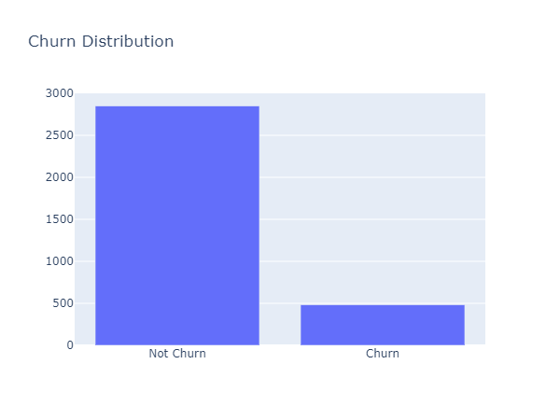
How
many
customers
have
churned?
Total number of
customers;
3,333
Number of customers
that churned;
483
Churn Percentage;
14.5%

Slide 9

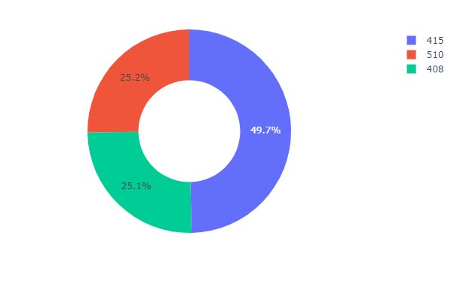
Area
Code Data
Distribution
The area code 415 has the
highest proportion, accounting for (49.7%) of the total customer base.
Both area codes 510 and 408
have an equal number of
customers.(25.2% and
25.1%) respectively.

Slide 10

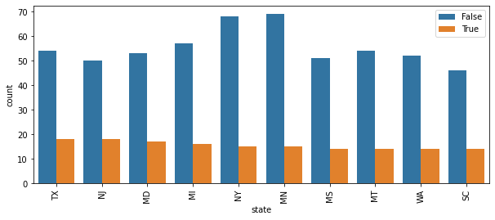
Which
states
have
the
highest
churn
rate?
Texas and
New Jersey
are leading followed
by Maryland,
Miami and New York.

Slide 11

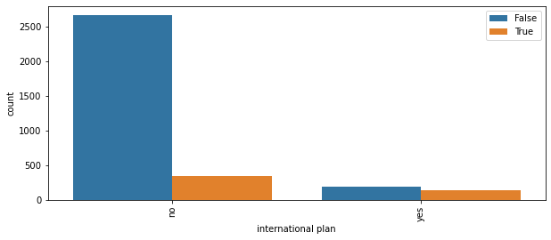
How
does
International
plan
impact
Churn?
Of the 483 customers
that churned, majority did not have an international plan.

Slide 12

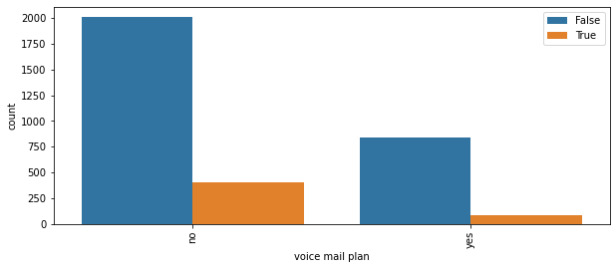
How
does
Voicemail
plan
affect
Churn?
Of the 483 customers
that churned, majority did not have a voice mail plan.

Slide 13
MODELING

Slide 14



Algorithms
Used
•
•
•
Logistic Regressi
Decision Tree
Random Forest
on
_{tly id*ent***ify}
the model's
ts the true nsitivity) against e rate (1 -
arious resholds.
•
XG Boost
Metrics
Used
'
•
Recall-focuses on
ability to correc
positive cases.
ROC_AUC Curve-plo
positive rate (se
the false positiv
specificity) at v
classification th
•

Slide 15

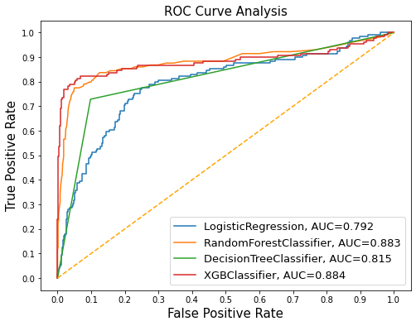
EVALUATION
Based
on
recall score;
•
•
•
•
XGBoost – 0.77
Random Forest – 0.74
Logistic Regression – 0.74
Decision Tree –
0.73
Based
on
ROC_AUC
curve;
•
•
•
•
XGBoost – 0.884
Random Forest –
Decision Tree –
0.883
0.815
Logistic Regression – 0.792

Slide 16

MODEL TUNING-RESULTS
• The tuned Random Forest model achieved a recall score of 0.76 and an ROC_AUC of 0.89, which was an improvement from the untuned model.
• The tuned XGBoost model also achieved an improvement, with a recall score of 0.79 and an ROC_AUC of 0.89.

Slide 17
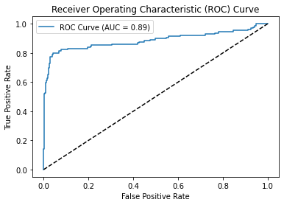
XGBoost
Model
Recall
score
0.79
ROC_AUC
score
0.89

Slide 18

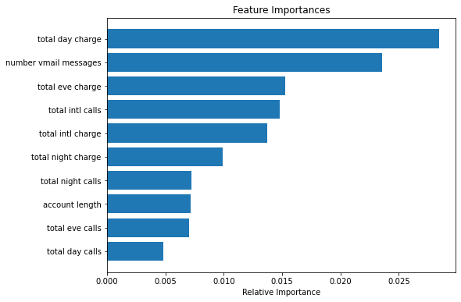
Which
features
impacted
churn
according
to
our
model?
•
Total day
customers
charge;
who had more
charges during the day
churned the most. number vmail messages; customers that received fewer number of voicemail messages churned the most
total eve charge; customers who had more charges during evening time churned the most.
•
•

Slide 19
CONCLUSION
•
The recall score of our XGB classifier was 79%. While
this is still a good predictive model, we would like to
undertake further feature engineering to boost this
recall score if we had more time.
total day charge, number vmail charge, total eve charge are the most important features in determining customer churn.
•
•
We achieved our objectives to be able to predict
customer churn and had an acceptable recall score.

Slide 20

RECOMMENDATIONS
Offer discounts or promotional offers to customers in area
code 415 and 510, as these areas have a higher churn rate.
Improve customer service quality and reduce the number
of customer service calls. Enhance training programs for
customer service representatives to ensure prompt and effective
resolution of customer issues, leading to higher customer
satisfaction and reduced churn.
Evaluate the pricing structure for day, evening, night,
and international charges. Consider adjusting pricing plans
or introducing discounted packages to address the higher
charges associated with customers who churn.
•
•
•

Slide 21
RECOMMENDATIONS
•
Focus
churn
York.
on customer retention strategies in states with higher
rates, such as Texas, New Jersey, Maryland, Miami, and New
This can involve targeted marketing campaigns, personalized
offers, or improved customer support tailored to the specific
needs and preferences of customers in those states.
•
Enhance the value proposition of the voicemail plan to increase
adoption among customers. Highlight
of voicemail services, and consider
or discounts to encourage customers
the benefits and convenience
offering additional features
to sign up.

