Slide 1



Foundations of Structural
Equation Modeling
Hair, J.F., Hult, G.T.M., Ringle, C.M., and Sarstedt, M. A Primer on Partial Least Squares Structural Equation Modeling (PLS-SEM) Sage, Thousand Oaks, 2013.
Rigdon, E.E. "Structural Equation Modeling," in: Modern Methods for Business Research, G.A. Marcoulides (ed.), Erlbaum, Mahwah, 1998, pp. 251-294.

Slide 2




The two-language concept
of empirical research
Theory
η₁
η₂
H
Correspondence rules
γ
γ
γ
1
2
3
x₁
x₂
x₃
Observation
r₁
r₂
r₃
Bagozzi (1984)

Slide 3


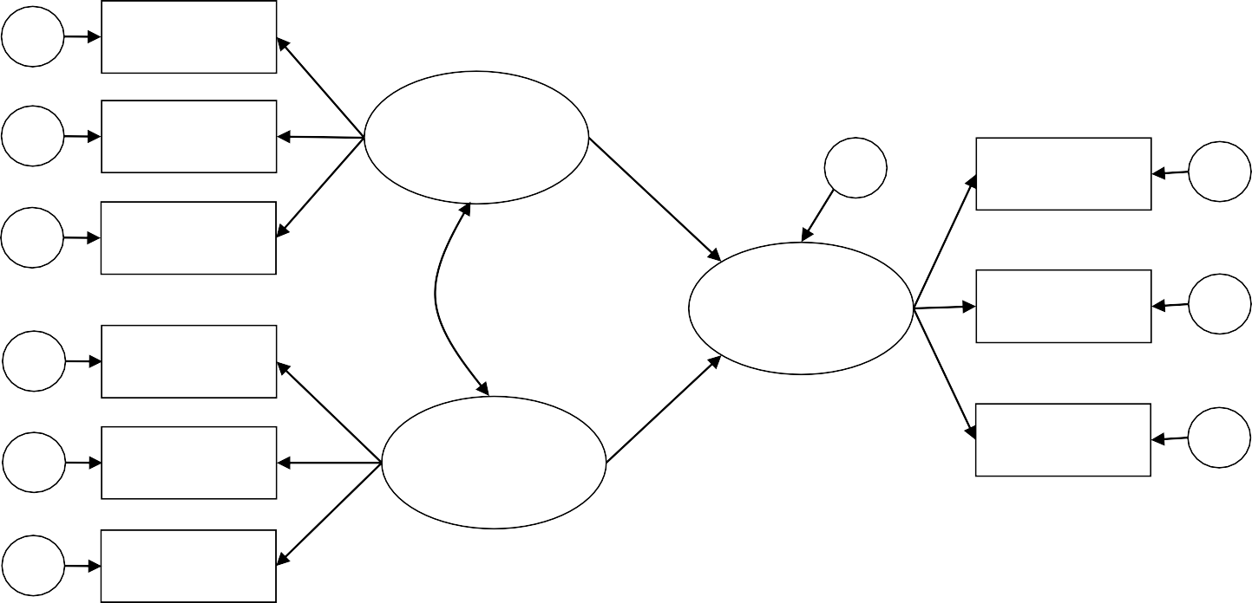
Components of a
Structural Equation Model
structural model
δ
Indicator x₁
1
δ₂
Indicator
x
ξ
2
1
ζ
Indicator y₁
ε₁
δ
Indicator x₃
3
η
Indicator y₂
ε₂
Indicator x₄
1
δ
4
Indicator x₅
ξ₂
Indicator y₃
ε₃
δ
5
δ
Indicator x₆
6
measurement model of the latent exogenous variables
measurement model of the latent endogenous variables

Slide 4

Symbols Used
x₁
indicators (observed variables)
ξ₁
latent variables (unobserved variables)
ε₁
error terms
linear relationships
covariances (or correlations)

Slide 5



The roots of Structural
Equation Modeling
Structural equation modeling (SEM) is a statistical technique for testing and estimating causal relations using a combination of statistical data and qualitative causal assumptions.
(Wikipedia, 2014-08-15)
Structural Equation Modeling
Confirmatory Factor Analysis
Path Analysis
Exploratory Factor Analysis
Multiple Regression
Factor
Analysis
Factor analysis, path analysis and regression all represent special cases of SEM.
Family tree
of SEM
Bivariate Correlation

Slide 6


Why structural equation modeling (SEM)?
Modeling causal relationships within their nomological net
  Representation and testing of entire theories
  Context-sensitive approximation of latent variables
  Inclusion of partial and total effects of factors
Taking measurement error into account
  Assessing measurement reliability/validity
  Correcting for measurement error
Intuitive graphical representation of theory

Slide 7



Representation and testing of entire theories
Which model should be preferred?
Model 1
Model 2
Product attributes
Product attributes
Affect
Behavior
Affect
Behavior
Consumer characteristics
Consumer characteristics
Notes:
With CV-SEM, we can compare the models and determine which one is better using chi-square difference tests. With PLS-SEM, model comparison is possible although it is not as clear cut as it is with CV-SEM.

Slide 8






Context-sensitive approxi- mation of latent variables
Stand-alone
approximation:
Context-sensitive
approximation:
x₁
x₁
ξ
ξ
η
x₂
x₂
ξ = x₁ + x₂
ξ = w₁ x₁ + w₂ x₂
Differing predictive validity of indicators is not accounted for.
The weights w₁ and w₂ are de- termined so that the explained variance of η is maximized.
ξ and η are latent variables, whereas x₁ and x₂ are observed variables.

Slide 9













Inclusion of partial and total effects of factors
Brand image
indirect effect
Marketing communication
Brand sales
direct effect
total effect = direct effect + indirect effect
Notes:
Indrect effect = multiplication of the two path coefficients

Slide 10


Assessing measurement reliability & validity
Variance composition of an observed variable x:
other systematic error
common method variance
ξ (useful
variance)
random error
SEM can quantify the proportions of variance.

Slide 11



Correcting for measurement error
Observed variable x:
other systematic
error common method
variance
random error
ξ (useful variance)
Observed
variable y:
other systematic error
common method variance
variance shared with ξ
unshared variance
η (useful variance)
random error
SEM can determine the proportion of shared variance (R²) of ξ and η.

Slide 12



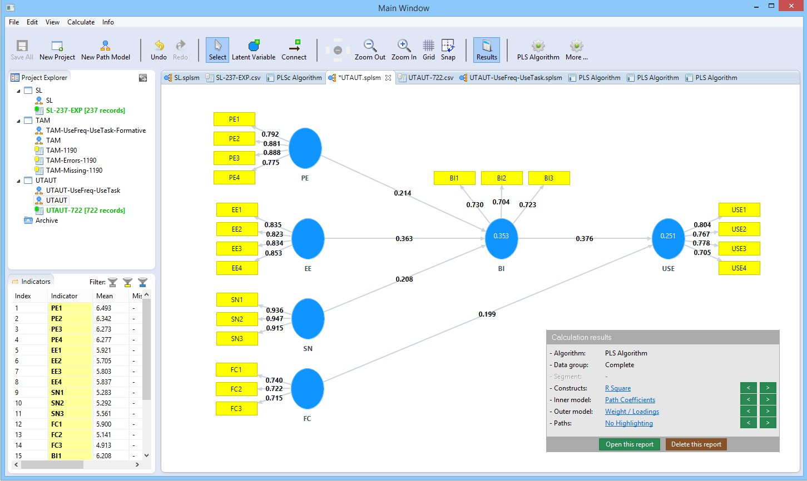
Example for graphical visualization: SmartPLS

Slide 13



Which SEM technique to choose?
Covariance-based
SEM
maximum likelihood
weighted least squares
unweighted least squares
generalized least squares
assumes MV normal distributions
Variance-based SEM
partial least squares path modeling
path analysis with summated scores or factor scores
generalized structured component analysis
makes no distributional assumptions

Slide 14







SEM technique depending
on research question
Covariance- based SEM
PLS
path modeling
Neural
networks
Theory testing
Prediction

Slide 15



sample size
Model complexity versus
+
PLS
complexity
CBSEM
- sample size +
-
Notes:
CB-SEM breaks down when the sample size is either small (<200) or large (>800), in which case PLS-SEM is better. CB-SEM tends to produce good model fit (small chi-square, FTR the null that theorectical distribution of the data are not different from observed distribution of the data) when sample size is large.

Slide 16


Comparing methods to estimate structural equation models
Criterion | PLS | CBSEM
Objective: | Prediction oriented | Parameter oriented
Approach: | Variance based | Covariance based
Assumptions: | Predictor specification (nonparametric) | Typically multivariate normal distribution and independent observations (parametric)
Parameter estimates: | Consistent as indicators and sample size increase (i.e., consistency at large) | Consistent
Latent variable scores: | Explicitly estimated | Indeterminate
Epistemic relationship between a latent variable and its measures: | Can be modeled in either formative or reflective mode | Typically only with reflective indicators
Implications: | Optimal for prediction accuracy | Optimal for parameter accuracy
Model complexity: | Large complexity (e.g., 100 constructs and 1000 indicators) | Small to moderate complexity (e.g., less than 100 indicators)
Sample size: Chin, W.W./ Newsted, P.R. (1999) | Power analysis based on the portion of the model with the largest number of predictors. Recommendations for the minimum number of observations range from 30 to 100 cases. | Ideally based on power analysis of specific model. Recommendations for the minimum number of observations range from 200 to 800.

Slide 17


Formative and reflective
measurement models
Beer
Ability to see
Drunken- ness (formative)
Drunken- ness (reflective)
Wine
Reaction
...
...
Chin, W.W. (1998): The partial least squares approach to structural equation modelling. In: Marcoulides, G.A. (Ed.): Modern methods for business research, Mahwah, 295-336.
Diamantopoulos, A.; Winklhofer, H. (2001): Index construction with formative indicators: An alternative to scale development, Journal of Marketing Research, 38(2), 269-277.
Jarvis, C.B.; MacKenzie, S.B.; Podsakoff, P.M. (2003). A Critical Review of Construct Indicators and Measurement Model Misspecification in Marketing and Consumer Research, Journal of Consumer Research, 30, 199-218.
Gudergan, S.P.; Ringle, C.M.; Wende, S.; Will, A. (2008): Confirmatory Tetrad Analysis in PLS Path Modeling, Journal of Business Research (JBR), 61(12), 1238-1249.

Slide 18


Reflective
Measurement Models
Direction of causality is from construct to measure
ε₁
ε₂
ε₃
Indicators expected to be correlated
x₁
x₂
x₃
Dropping an indicator from the measurement
model does not alter the meaning of the construct
λ₁ λ₂
λ₃
Takes measurement error into account at the item level
ξ
Similar to factor analysis
Typical for consumer research constructs
(e.g. attitudes)
x₁ = λ₁ · ξ + ε₁ x₂ = λ₂ · ξ + ε₂ x₃ = λ₃ · ξ + ε₃
(Churchill 1979; Jarvis, Mackenzie & Podsakoff 2003)
Notes:
Simultaneous solution of the three linear regression model.
PLS-SEM produce standardized values all the time → Ladma is standardized. Thus it is the same as product moment correlation (r). Because we want R squared to be greater than .50, r (and factor loadings) should be large enough (>.70)

Slide 19


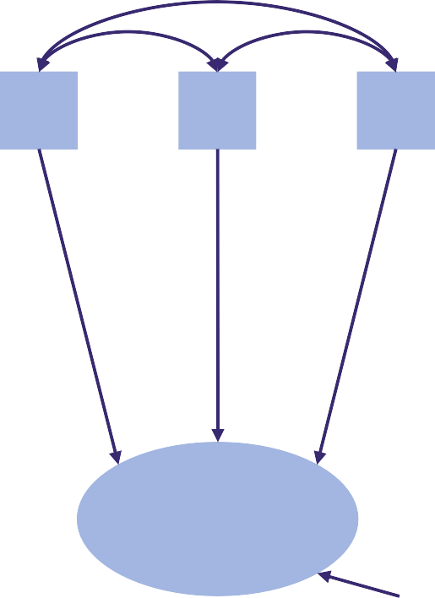
Formative
Measurement Models
Direction of causality is from measure to construct
x₁
x₂
x₃
No reason to expect indicators to be correlated
Dropping an indicator from the measurement model may alter the meaning of the construct
w₁ w₂
w₃
Statistical tests of internal consistency reliability do not make any sense
ξ
Based on multiple regression
→ beware of multicollinearity!
δ
ξ = w ·x +w ·x +w ·x +δ
1 1 2 2 3 3
Typical for success factor research
(Diamantopolous & Winklhofer 2001)

Slide 20



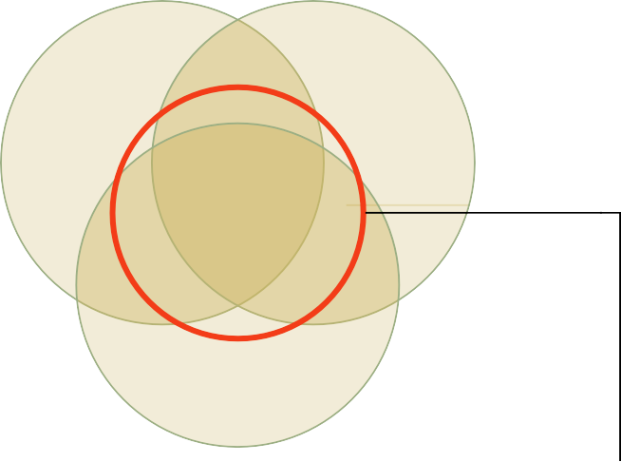
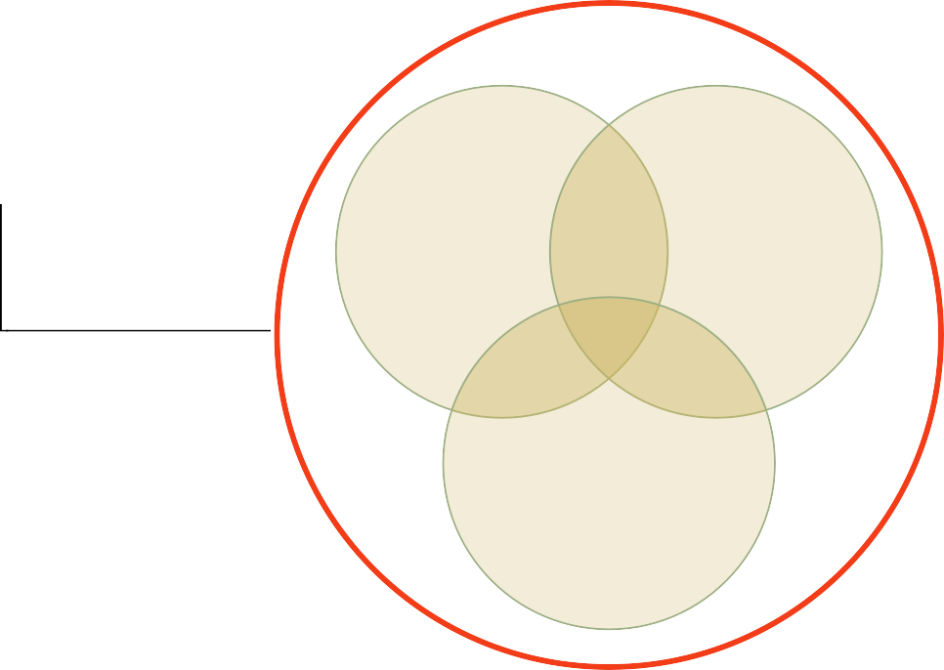
Basic difference between reflective and formative measurement approaches
“Whereas reflective indicators are essentially interchangeable
(and therefore the removal of an item does not change the essential nature of the underlying construct), with formative indicators ‘omitting an indicator is omitting a part of the construct’.” (DIAMANTOPOULOS/WINKLHOFER, 2001, p. 271)
The formative measurement approach focuses on minimizing the overlap between complementary indicators
Construct domain
Construct domain
The reflective measurement approach focuses on maximizing the overlap between interchangeable indicators

Slide 21




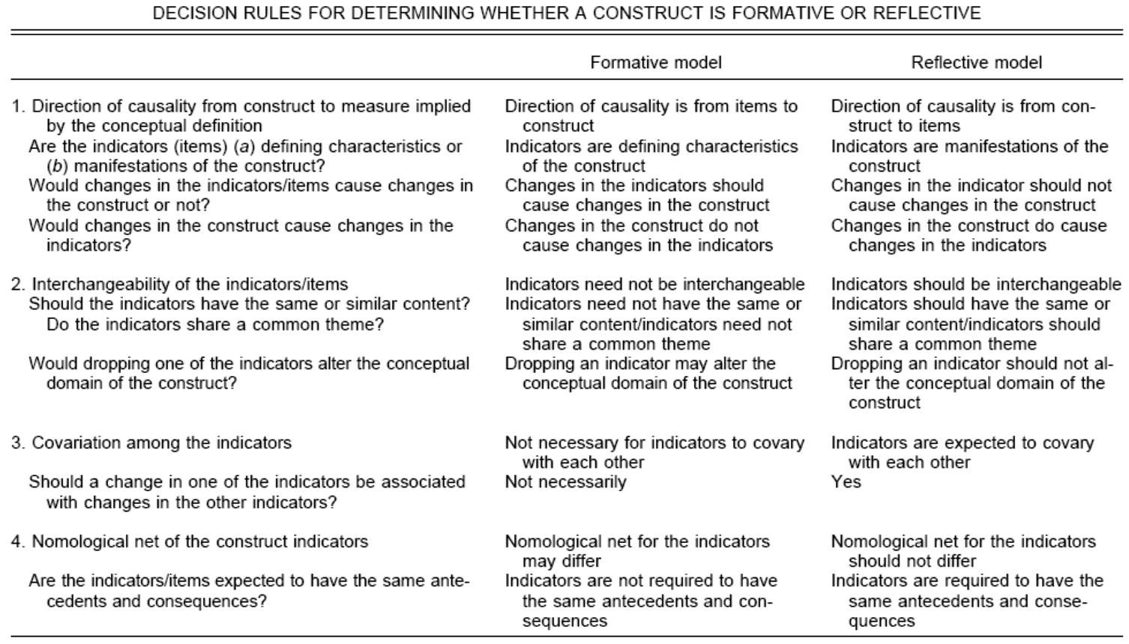
Qualitative Criteria by Jarvis et al. (2003)
Confirmatory Tetrad Analysis in Partial Least Squares Path Modeling (CTA-PLS): Gudergan, S.P.; Ringle, C.M.; Wende, S.; Will, A. (2008): Confirmatory Tetrad Analysis in PLS Path Modeling, Journal of Business Research (JBR), 61(12), pp. 1238-1249.

Slide 22

References
Hair, J.F., Hult, G.T.M., Ringle, C.M., and Sarstedt, M. A Primer on Partial Least Squares
Structural Equation Modeling (PLS-SEM) Sage, Thousand Oaks, 2013.
Gudergan, S.P., Ringle, C.M., Wende, S., and Will, A. "Confirmatory Tetrad Analysis in PLS Path Modeling," Journal of Business Research (61:12) 2008, pp. 1238-1249.
Henseler, J., Ringle, C.M., and Sinkovics, R.R. "The Use of Partial Least Squares Path Modeling in International Marketing," Advances in International Marketing (20) 2009, pp. 277- 320.
Lohmöller, J.-B. Latent Variable Path Modeling with Partial Least Squares Physica, Heidelberg, 1989.
Rigdon, E.E. "Structural Equation Modeling," in: Modern Methods for Business Research, G.A.
Marcoulides (ed.), Erlbaum, Mahwah, 1998, pp. 251-294.
22

