Slide 1
Structural Equation Modeling
Jae Jung

Slide 2
What is SEM?
Structural equation modeling (SEM) is a family of statistical models that seeks to explain the relationships among multiple variables. In doing so, SEM examines the structure of interrelationships expressed in a series of equations, similar to a series of multiple regression equations.
  Estimation of multiple interrelated dependence relationships
  Incorporating latent variables not measured directly
  Combined factory analysis and regression
  Goes back to 1960’s and 1970’s
  Software
    LISREL
    AMOS
    MPlus
    R using lavaan
  Dominant multivariate technique, followed by regression and cluster analysis
Measurement error
Reliability and validity

Slide 3
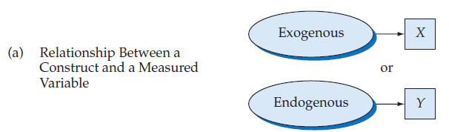
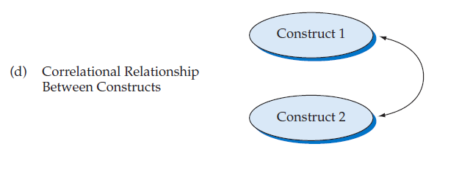
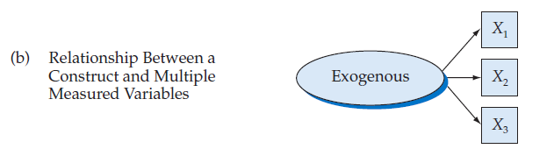
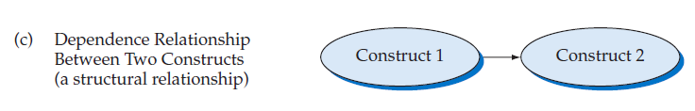
Visual Portrayal of a Model

Slide 4
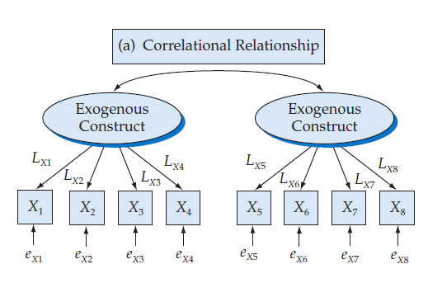
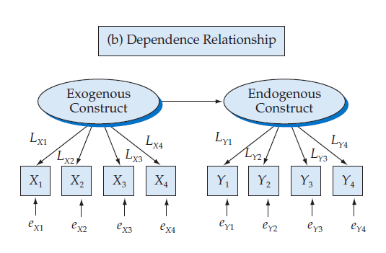
Combining Measurement and Structural Relationships

Slide 5
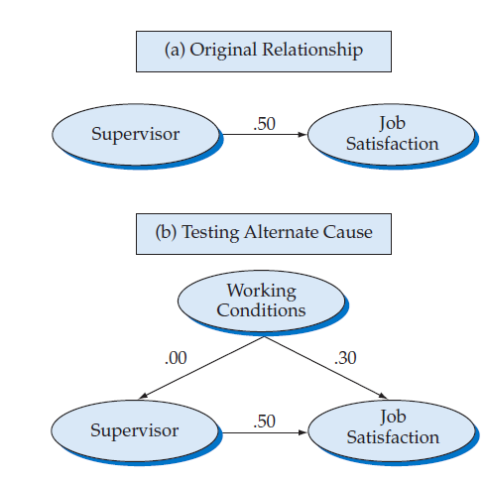
Testing for a non-spurious relationship

