Slide 1
Neural Networks & Deep Learning 3D Object Generation Using GAN’s
Shejal Shankar (G32395894)
Skandana Gowda (G27230881)

Slide 2
Introduction to Generative Adversarial Networks (GANs)
Why GANs?
What is a GAN?
A framework consisting of two neural networks: Generator and Discriminator.
Generator creates synthetic data.
Discriminator distinguishes between real and generated data.
To generate realistic images, videos, and other data.
Applications: Image synthesis, data augmentation, style transfer, and more.

Slide 3
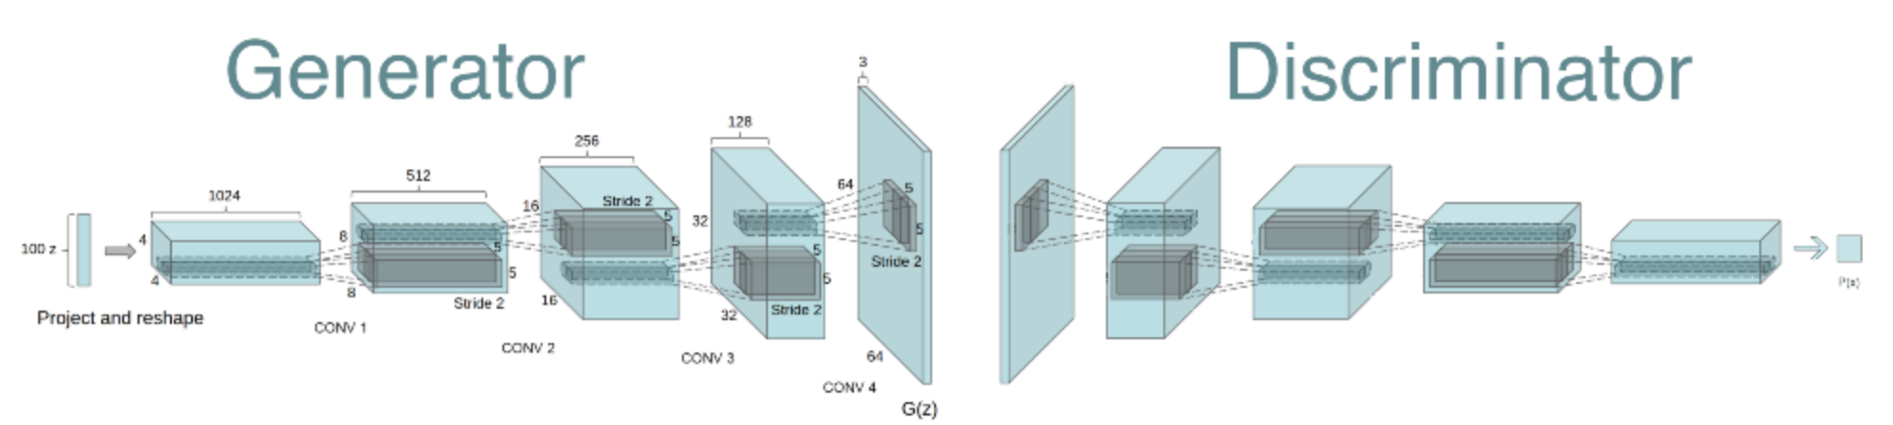
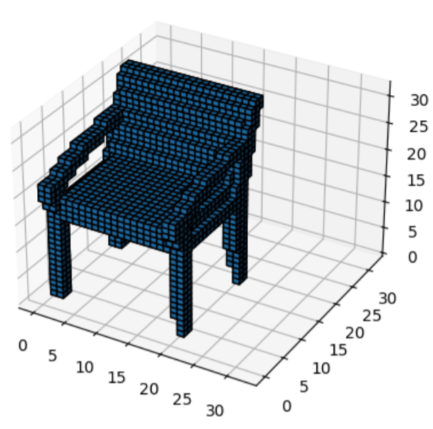
Objective
Generate realistic 3D voxel-based structures using a GAN.
We focus producing high-quality 3D representations of objects in a voxel grid format, which is essential for applications in 3D modeling, gaming, architecture, and medical imaging.
Dataset
Dataset Name: ModelNet10 (from Princeton 3D Object Dataset)
Collection of 3D CAD models in .off format
Part of the ModelNet40 dataset, focused on 10 object categories.
4,899 pre-aligned shapes across 10 object categories.

Slide 4
Project Workflow
Dataset Preparation
( converting .off to voxel )
05
Visualization
01
Thresholding, Matplotlib 3D scatter
Normalize voxel grids, Custom PyTorch Dataset, DataLoader
02
Generator Design
Checkpointing
06
3D Generator, 3D Transposed Convolutions, ReLU activation
Save Model Weights, Evaluation and Sampling
03
Discriminator Design
Sample Generation
07
3D Discriminator, 3D Convolutions, LeakyReLU activation, Binary classification
Latent Vector Sampling, Visualization
04
GAN Training
Discriminator (D), Generator (G): Adversarial Training

Slide 5
GAN Architecture
Generator
Discriminator
Loss Function
Binary Cross-Entropy: Used for both Generator and Discriminator to distinguish between real and fake samples.
The Generator consists of 5 layers for upsampling and generating the 3D voxel grid. These layers are:
The Discriminator consists of 5 layers for downsampling and classifying the 3D voxel grids:
ConvTranspose3d
BatchNorm3d
ReLU activation
Conv3d
Sigmoid activation
Conv3d
LeakyReLU activation
BatchNorm3d
Conv3d (final layer)
Generator: 5 layers (4 ConvTranspose3d + 1 Conv3d)
Discriminator: 5 layers (4 Conv3d + 1 final Conv3d for classification)

Slide 6
Training Methodology
Prepare Dataset
Normalize images: The input voxel grids are normalized to a range of [0, 1] or [-1, 1] (depending on data preprocessing before training).
Use DataLoader: The dataloader is used for batching during training.
Train GAN
Alternate updates between Generator and Discriminator.
Train Discriminator: The Discriminator is updated first, by computing the loss for real and fake samples.
Train Generator: The Generator is updated next, aiming to fool the Discriminator.
Use Adam optimizer
Evaluate loss after each epoch: The losses for both the Discriminator and Generator are printed after each training step.
Risk assessment
Save Model Checkpoints
Save trained generator and discriminator: Model weights are saved after each epoch for both the Generator and Discriminator in the specified checkpoint_dir.

Slide 7
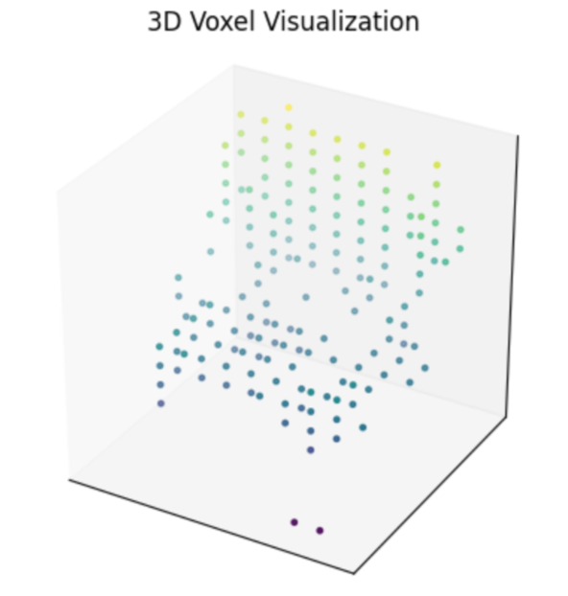
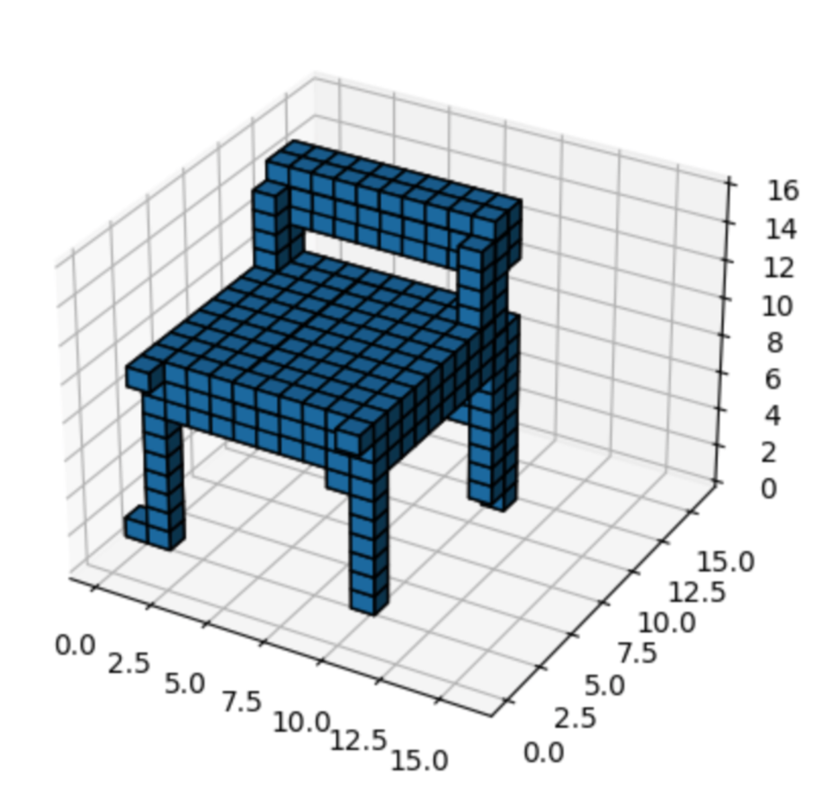
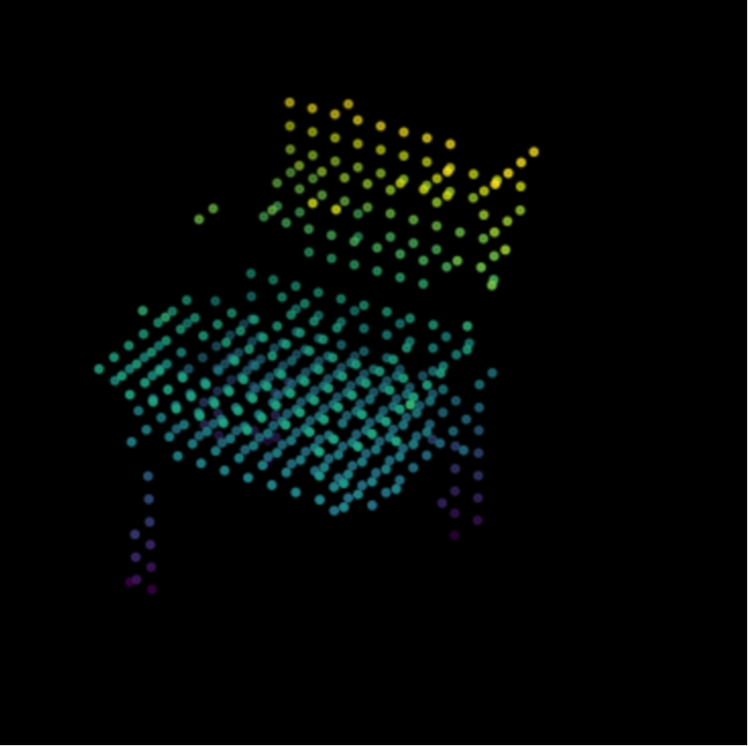
Results

Slide 8
Challenges Encountered
Encountered difficulties when converting .off files to voxels at a 32×32 grid resolution.
Insufficient GPU resources: Memory usage spiked, leading to out-of-memory errors during training and voxel conversion.
Final testing visualization could be improved for better clarity of the generated 3D objects.

Slide 9
Conclusion
This project successfully demonstrates a 3D GAN pipeline—from loading and converting .off models into voxel grids, to training a generator and discriminator for shape synthesis, and finally visualizing the generated results.
Despite challenges with scaling voxel grids to 32×32 and GPU memory constraints the workflow illustrates a solid approach to 3D object generation.

Slide 10
Thank You! Any Questions??

