Slide 1

Fracture Fatigue and Failure Analysis
Sahil Shekh Mansuri (234103222)
M.tech
Department of Mechanical Engineering
IIT Guwahati

Slide 2
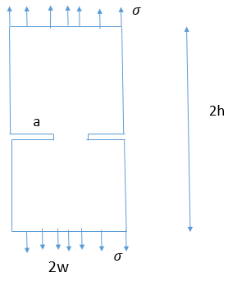
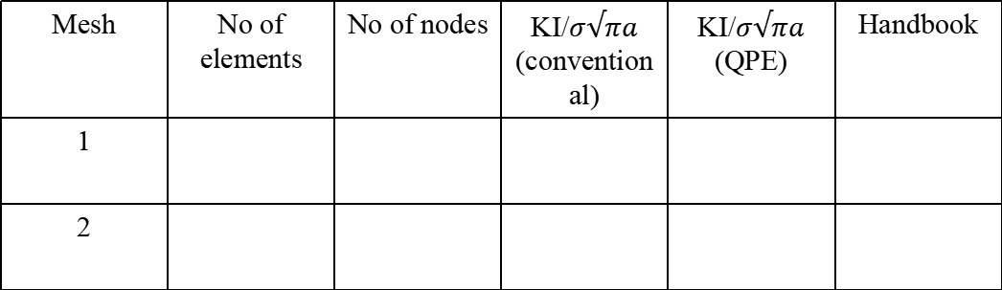
Problem Statement
Assume following for all problems of this assignment (a) Take w = 1.0 (b) Use eight noded isoparametric element (Plane183) for FEA Q1. For the double edge cracked plate as shown in figure determine the normalized SIF for plane stress conditions and conduct a convergence study as follows. Take two meshes of increasing number of elements. Generate first mesh having around 500 numbers of elements. Create second mesh having around 2000 numbers of elements . Compute normalized SIF using each of the above meshes (with quarter point elements at the crack tip) and compare the computed normalized values with that of exact value given in Tada, Paris and Irwin’s Handbook available in the library. Make a table for this purpose as shown in below.
Mesh | No of elements | No of nodes | KI/$σ√πa$ (conventional) | KI/$σ√πa$ (QPE) | Handbook
1
2

Slide 3
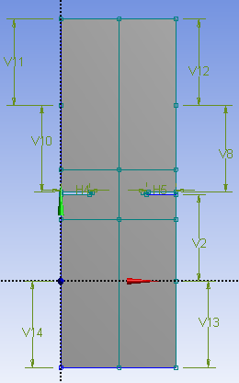
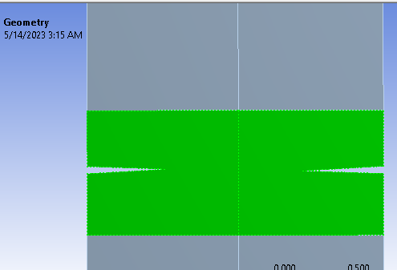
2D model of double edge crack
Face splitting near crack region

Slide 4
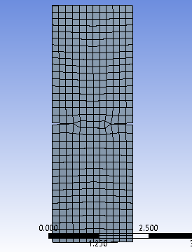
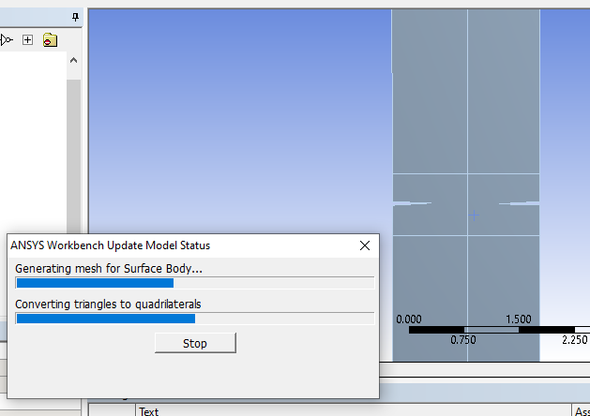
Conventional Mesh

Slide 5
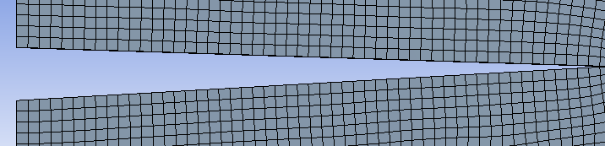
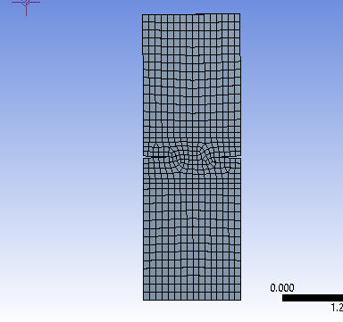
Quarter point element near tip
Quadratic element mesh

Slide 6
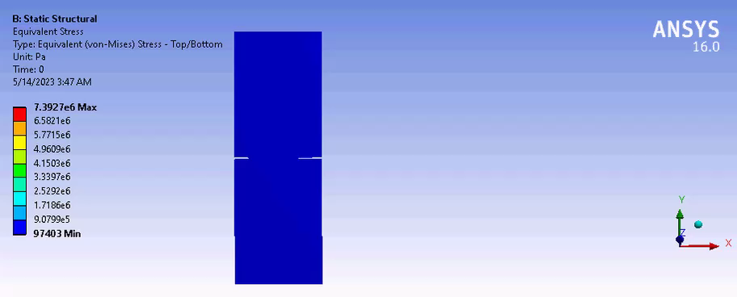
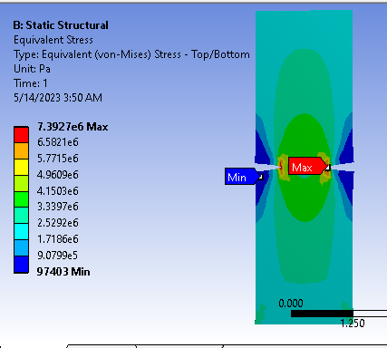

Slide 7



Calculation of KI/$σ√πa$ from Handbook
$$σ$$
a/w = 0.5
2h
a
KI/$σ√πa$ = $\sqrt{(2w}/πa)tan⁡(πa/2b)$
$$σ$$
2w

Slide 8
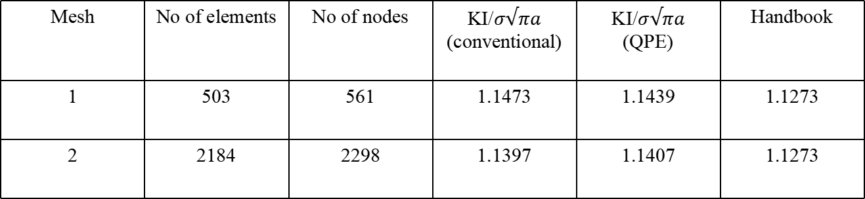
Numerical Results and Comparison
Mesh | No of elements | No of nodes | KI/$σ√πa$ (conventional) | KI/$σ√πa$ (QPE) | Handbook
1 | 503 | 561 | 1.1473 | 1.1439 | 1.1273
2 | 2184 | 2298 | 1.1397 | 1.1407 | 1.1273

