Slide 1








CONSTRAINTS AND THEIR TYPES
Hands-on Exercise
Reference
Questions
Points To Ponder
Coding Standards
Lend A Hand
Summary
Test Your Understanding

Slide 2

OVERVIEW
  Understanding Constraints and their Types
This session will give an overview of Constraints and their types.

Slide 3

OBJECTIVES
  At the end of this session, you will be able to:
  Identify the various SQL constraints that a developer needs to know, in order to work with DBMS.
  Define Data Integrity and Integrity Constraints.
  List the types of Integrity Constraints such as PRIMARY KEY Constraint, FOREIGN KEY Constraint, NOT NULL Constraint, UNIQUE KEY Constraint, and CHECK Constraint.
  Define Entity Integrity.
  Describe Sequence generators.
  Define Referential, Domain, and User Defined Integrity.
  Identify Enabling and Disabling Constraints.

Slide 4
SCENARIO
For the complete understanding of ANSI SQL, we are going to make use of Product Management System (PMS) for ABC Traders.
ABC Traders is a company which buys collectable model cars, trains, trucks, buses, and ships directly from manufacturers and sell them to distributors across the globe. In order to manage the stocking, supply, and payment transactions, the above mentioned software is developed.
As per the requirement of the trading company, an inventory system is developed to collect the information of the products, customers, and their payment processing.
5

Slide 5
DATABASE TABLES
There are many entities involved in Product Management System.
We will be dealing with PMS throughout this session.
Offices
To maintain information of offices, for example, office code, address, city, and so on.
Customer
To maintain customer details, for example, customer name, address, and so on.
Employees
To maintain employee
details, for example, ID,
name, and so on.
Products
To maintain information of products, for example, product id, name, and so on.
Payments
To maintain information of payments done, for example, payment date, amount, and so on.
Orders
To maintain Orders done by customers, for example, order no, date, and so on.
Order Details
To maintain Orders done by customers, for example, order no, date, and so on.

Slide 6
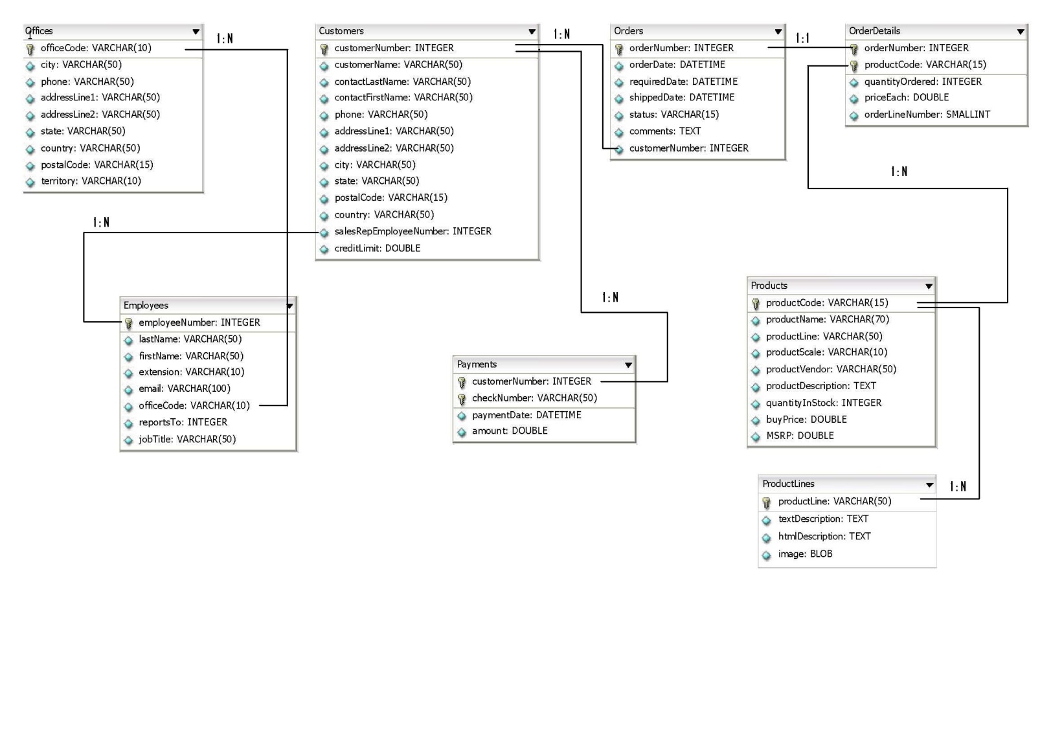
SCHEMA DIAGRAM

Slide 7

SCENARIO
Hi! I am Tim.
I found trouble with the integrity of data. The tables in PMS System allows null values and even duplicate records. I also want to impart relationship constraint between tables.
Let us learn about Data Integrity, which will help us meet Tim’s requirements.

Slide 8

DATA INTEGRITY
What do you understand by Data Integrity?
Data Integrity refers to maintaining and assuring the accuracy and consistency of data over its entire lifecycle.
It is an important feature of a database or RDBMS system.
Having a single, well-controlled, and well-defined data-integrity system increases:
  Stability (one centralized system performs all data integrity operations)
  Performance (all data integrity operations are performed in the same tier as the consistency model)
  Re-usability (all applications benefit from a single centralized data integrity system)
  Maintainability (one centralized system for all data integrity administration)
Data integrity is normally enforced in a database system by a series of integrity constraints or rules.

Slide 9
INTEGRITY CONSTRAINTS
Integrity constraints are used to ensure accuracy and consistency of data in a relational database.
There are many types of integrity constraints that play a role in referential integrity.
Dr. E. F. Codd initially defined two sets of constraints but, in his second version of the relational model, he came up with four integrity constraints. They are:
  Entity Integrity
  Referential Integrity
  Domain Integrity
  User Defined Integrity

Slide 10
ENTITY INTEGRITY
Entity Integrity is an integrity rule which states that every table must have a PRIMARY KEY and that the column(s) chosen to be the PRIMARY KEY should be unique and NOT NULL.
Within relational databases using SQL, Entity Integrity is enforced by adding a PRIMARY KEY clause to a schema definition.
The system enforces Entity Integrity by not allowing operation (INSERT, UPDATE) to produce an invalid PRIMARY KEY.
Any operation that is likely to create a duplicate PRIMARY KEY or one containing nulls is rejected.
The Entity Integrity ensures that the data that you store remains in the proper format and is comprehensible as well.
Let us understand PRIMARY KEY Constraint in detail.

Slide 11
SCENARIO
I wish to impart Entity Integrity on table Products.
Let us learn about the PRIMARY KEY Constraint which will help us meet Tim’s requirements.

Slide 12


PRIMARY KEY CONSTRAINTS
PRIMARY KEY Constraint:
  This constraint defines a column or combination of columns which uniquely identifies each row in the table.
ANSI Syntax:
  The syntax to define a PRIMARY KEY at column level:
    The syntax to define a PRIMARY KEY at table level:
  column_name1, column_name2 are the names of the columns which define the PRIMARY KEY.
  The syntax within the bracket, i.e. [CONSTRAINT constraint_name] is optional.

Slide 13
PRIMARY KEY CONSTRAINTS (CONTD.)
Query:
  Column level:
      CREATE TABLE Products
      (
      productCode VARCHAR(15) PRIMARY KEY,
      productName VARCHAR(70) ,
      productLine VARCHAR(50) ,
      productScale VARCHAR(10) ,
      productVendor VARCHAR(50) ,
      productDescription TEXT ,
      quantityInStock SMALLINT ,
      buyPrice DOUBLE ,
      MSRP DOUBLE ,
      );

Slide 14
PRIMARY KEY CONSTRAINTS (CONTD.)
Query:
  Table level:
      CREATE TABLE Products
      (
      productCode VARCHAR(15),
      productName VARCHAR(70) ,
      productLine VARCHAR(50) ,
      productScale VARCHAR(10) ,
      productVendor VARCHAR(50) ,
      productDescription TEXT ,
      quantityInStock SMALLINT ,
      buyPrice DOUBLE ,
      MSRP DOUBLE ,
      CONSTRAINT productCode_pk PRIMARY KEY(productCode)
      );

Slide 15

SEQUENCE
What is a Sequence?
A sequence is a database object that generates unique numbers, mostly used for PRIMARY KEY values.
The PRIMARY KEY needs a unique value, which needs to come from somewhere.
Sequence will allow you to populate PRIMARY KEY with a unique, serialized number.

Slide 16
ANSI SEQUENCE GENERATORS
A sequence generator is a mechanism for generating successive exact numeric values, one at a time.
A sequence generator is either an external sequence generator or an internal sequence generator.
An external sequence generator is a named schema object, while an internal sequence generator is a component of another schema object.
A sequence generator has a data type, which shall be an exact numeric type with scale 0 (zero), a minimum value, a maximum value, a start value, an increment, and a cycle option.
If a sequence generator is associated with a negative increment, then it is a descending sequence generator. Otherwise, it is an ascending sequence generator.
When a sequence generator is created, its current base value is initialized to the start value.

Slide 17
ANSI SEQUENCE GENERATORS (CONTD.)
Subsequently, the current base value is set to the value of the lowest non-issued value for an ascending sequence generator, or the highest non-issued value in the cycle for a descending sequence generator.
Any time after a sequence generator is created, its current base value can be set to an arbitrary value of its data type by an <alter sequence generator statement>.
Changes to the current base value of a sequence generator are not controlled by SQL-transactions. Therefore, commits and rollbacks of SQL-transactions have no effect on the current base value of a sequence generator.

Slide 18
ANSI SEQUENCE GENERATORS (CONTD.)
A sequence generator is described by a sequence generator descriptor.
A sequence generator descriptor includes:
  The sequence generator name that is a schema-qualified name for an external sequence generator and a zero-length character string for an internal sequence generator.
  The data type descriptor of the data type associated with the sequence generator.
  The increment of the sequence generator.
  The maximum and minimum value of the sequence generator.
  The cycle option of the sequence generator.
  The current base value of the sequence generator.
    If there are multiple instances of <next value expression>s specifying the same sequence generator within a single SQL-statement, then the same value is returned for a given row processed by that SQL-statement.

Slide 19
SEQUENCE GENERATOR COMPLIANCE
Sequence generator compliance by vendor:
Auto Numbering
Database | Complies | Description
PostgreSQL | YES | Complies with SQL 2003. Uses sequences.
DB2 | YES | Complies with SQL 2003. Uses sequences.
MS SQL Server | YES | Complies with SQL 2003. Uses the identity property.
Oracle | YES | Complies with SQL 2003. Uses sequences.
Informix | YES | Complies and extends SQL 2003 using sequences as well as using the SERIAL data type.
MySQL | NO | MySQL has an auto_increment data type to auto increment rows in a table.

Slide 20
REFERENTIAL INTEGRITY
The Referential Integrity constraint is specified between two relations and is used to maintain the consistency among tuples in the two relations.
Informally, the Referential Integrity constraint states that a tuple in one relation that refers to another relation must refer to an existing tuple in that relation.
When one table has a FOREIGN KEY to another table, the concept of Referential Integrity states that you may not add a record to the table that contains the FOREIGN KEY. This is unless there is a corresponding record in the linked table.
Deleting a record that contains a value referred to by a FOREIGN KEY in another table would break referential integrity.

Slide 21
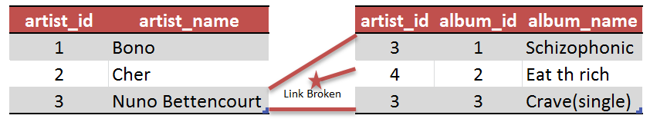
REFERENTIAL INTEGRITY (CONTD.)
Example:
An example of a database that has not enforced referential integrity. In this example, there is a FOREIGN KEY (artist_id) value in the album table that refers to a non-existent artist. In other words, there is a FOREIGN KEY value with no corresponding PRIMARY KEY value in the table referred to.
What happened here was that there was an artist called "Aerosmith", with an artist_id of 4, which was deleted from the artist table. However, the album "Eat the Rich" referred to this artist. With Referential Integrity enforced, this reference would not have been possible.

Slide 22
REFERENTIAL INTEGRITY (CONTD.)
Rules can be defined in order to specify the action that is to be taken on the affected rows of the referencing table when a DELETE operation is performed on it.
These rules can define one of the following triggered actions:
  CASCADE (the affected rows are also deleted)
  SET NULL (the appropriate FOREIGN KEY columns are set to NULL)
  SET DEFAULT (the appropriate FOREIGN KEY columns are set to their default value)
  NO ACTION (which raises an error because the referential constraint would be violated)
Let us understand FOREIGN KEY Constraint in detail.

Slide 23
SCENARIO
Impart Referential Integrity on Employees table’s office code column. This refers to the PRIMARY KEY of Offices table.
Let us learn about FOREIGN KEY Constraint which will help us meet Tim’s requirements.

Slide 24

FOREIGN KEY CONSTRAINT
This constraint identifies any column that refers to the PRIMARY KEY in another table.
It establishes a relationship between two columns in the same table or between different tables.
For a column to be defined as a FOREIGN KEY, it should be defined as a PRIMARY KEY in the table to which it refers. One or more columns can be defined as FOREIGN KEY.
ANSI Syntax:
  Syntax to define a FOREIGN KEY at column level:

Slide 25

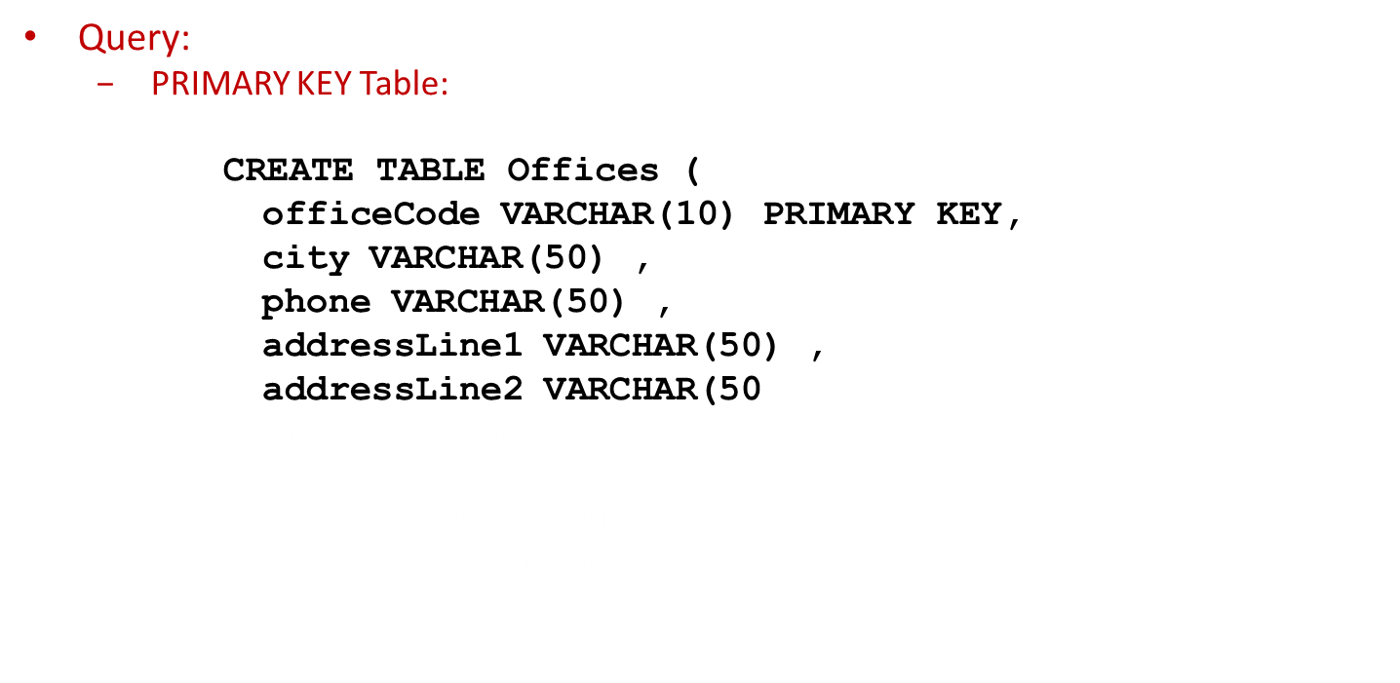
FOREIGN KEY CONSTRAINT (CONTD.)
Syntax to define a FOREIGN KEY at table level:

Slide 26
FOREIGN KEY CONSTRAINT (CONTD.)
Query:
  FOREIGN KEY table or Column Level
        CREATE TABLE Employees (
        employeeNumber INTEGER PRIMARY KEY,
        lastName VARCHAR(50) ,
        firstName VARCHAR(50) ,
        extension VARCHAR(10) ,
        email VARCHAR(100) ,
        officeCode VARCHAR(10) REFERENCES Offices(officeCode) ,
        reportsTo INTEGER ,
        jobTitle VARCHAR(50)
        );

Slide 27
DOMAIN INTEGRITY
Domain Integrity specifies that all columns in relational database must be declared upon a defined domain.
A domain is a set of values of the same type. Domains are therefore, pools of values from which actual values appearing in the columns of a table are drawn.
For example, a database table that has information about people, with one record per person, might have a "gender" column. This gender column might be declared as a string data type, and allowed to have one of two known code values: "M" for male, "F" for female, and NULL for records where gender is unknown or not applicable (or arguably "U" for unknown as a sentinel value). The data domain for the gender column is: "M", "F".
The domain integrity states that every element from a relation should respect the type and restrictions of its corresponding attribute.
A type can have a variable length which needs to be respected. Restrictions could be the range of values that the element can have, the default value if none is provided, and if the element is NULL.

Slide 28
SCENARIO
I want that except addressLine2 and state, the other columns in the Offices table should not allow null values.
Let us learn about NOT NULL Constraint which will help us meet Tim’s requirements.

Slide 29
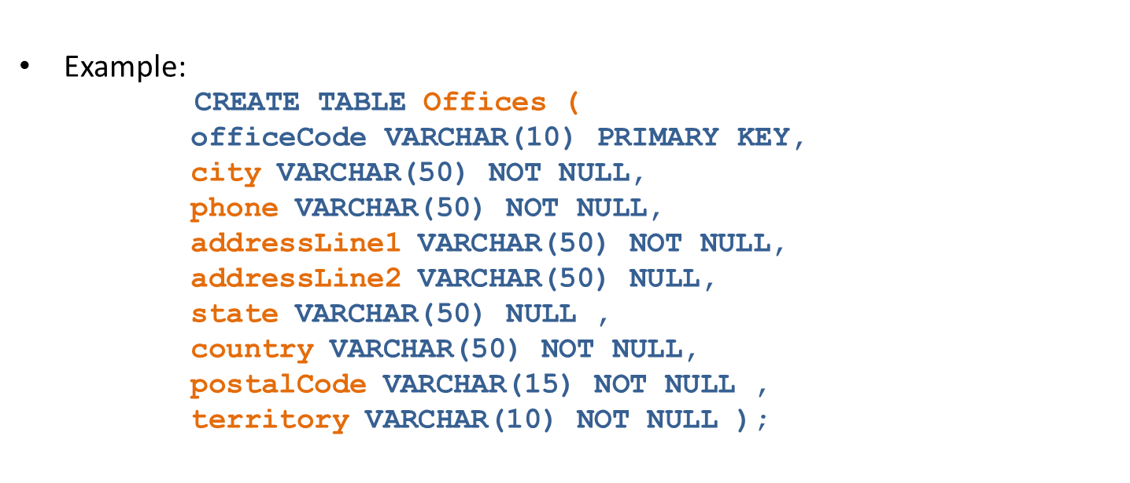
NOT NULL CONSTRAINT
This constraint ensures all rows in the table contain a definite value for the column which is specified as NOT NULL. This means a null value is not allowed.
ANSI Syntax:

Slide 30
SCENARIO
I want that each product should have a unique (no duplicate records should be allowed) description in the Products table.
Let us learn about UNIQUE KEY Constraint which will help us meet Tim’s requirements.

Slide 31



UNIQUE KEY CONSTRAINT
This constraint ensures that a column or a group of columns in each row have a distinct value. A column(s) can have a null value but the values cannot be duplicated.
ANSI Syntax:
  Syntax to define a UNIQUE KEY at column level:
    Syntax to define a UNIQUE KEY at table level:
Rule:
According to the ANSI standards SQL:92, SQL:1999, and SQL:2003, a UNIQUE constraint should disallow duplicate non-NULL values, but allow multiple NULL values.
Microsoft SQL Server allows a single NULL but disallowing multiple NULL values.

Slide 32
UNIQUE KEY CONSTRAINT (CONTD.)
Query:
  CREATE TABLE Products (
  productCode VARCHAR(15) PRIMARY KEY,
  productName VARCHAR(70) ,
  productLine VARCHAR(50) ,
  productScale VARCHAR(10) ,
  productVendor VARCHAR(50) ,
  productDescription TEXT UNIQUE,
  quantityInStock SMALLINT ,
  buyPrice DOUBLE ,
  MSRP DOUBLE ,
  );

Slide 33
SCENARIO
I want that every employee’s extension must start with lower case x in Employees table.
Let us learn about CHECK Constraint which will help us meet Tim’s requirements.

Slide 34

CHECK CONSTRAINT
This constraint defines a business rule on a column. All the rows must satisfy this rule.
The constraint can be applied for a single column or a group of columns.
MySQL parses this constraint, but it is not enforced.
ANSI Syntax:

Slide 35
CHECK CONSTRAINT (CONTD.)
Query:
    CREATE TABLE Employees (
    employeeNumber INTEGER PRIMARY KEY,
    lastName VARCHAR(50) ,
    firstName VARCHAR(50) ,
    extension VARCHAR(10) ,
    email VARCHAR(100) ,
    officeCode VARCHAR(10) REFERENCES Offices(officeCode),
    reportsTo INTEGER ,
    jobTitle VARCHAR(50),
    CONSTRAINT extension_chk CHECK (extension LIKE 'x%')
    );

Slide 36
USER DEFINED INTEGRITY
User Defined Integrity constraints allow database consistency to be maintained as defined by the business rules.
A business rule is a statement that defines or constrains some aspect of the business.
It is intended to assert business structure or to control or influence the behavior of the business. For example, Age>=18 && Age<=60
Business rules may dictate that when a specific action occurs further actions should be triggered. For example, deletion of a record automatically writes that record to an audit table.
Oracle, and some other RDBMSs, will allow storage of the code to manage these rules within the database itself.

Slide 37
SCENARIO
I wish to know if you can disable or enable constraints on tables?
Tim is facing trouble.
When bulk insertion or updating are performed on tables, system consumes a lot of time due to evaluations of every constraint applied on table. Tim would like to know if there is any mechanism through which the user can enable or disable constraints as per his/her requirement.
Let us learn about How to Enable Disable Constraints which will help us
meet Tim’s requirements.

Slide 38

ENABLING AND DISABLING CONSTRAINTS
Why Disable Constraints?
  During day-to-day operations, keep constraints enabled
  In certain situations, temporarily disabling the constraints of a table makes sense for performance reasons
For example:
  When loading large amounts of data into a table using SQL*Loader
  When performing batch operations that make massive changes to a table (such as, changing each employee number by adding 1000 to the existing number)
  When importing or exporting one table at a time
  Temporarily turning off constraints can speed up these operations
  This functionality is vendor specific and hence the syntax too

Slide 39
ENABLING AND DISABLING CONSTRAINTS (CONTD.)
Understanding Enabled and Disabled Constraint:
  An integrity constraint represents an assertion about the data in a database.
  This assertion is always true when the constraint is enabled.
  The assertion might not be true when the constraint is disabled, because the data that violates the integrity constraint can be in the database.
Enabled Constraint:
  When a constraint is enabled, the corresponding rule is enforced on the data values in the associated columns.
  The definition of the constraint is stored in the data dictionary.
Disabled Constraint:
  When a constraint is disabled, the corresponding rule is not enforced.
  The definition of the constraint is still stored in the data dictionary.

Slide 40
ENABLING AND DISABLING CONSTRAINTS (CONTD.)
Guidelines:
  When enabling or disabling UNIQUE, PRIMARY KEY, and FOREIGN KEY constraints, be aware of several important issues and prerequisites.
  UNIQUE KEY and PRIMARY KEY constraints are usually managed by the database administrator.
Fixing Constraint Exceptions:
  If a row of a table disobeys an integrity constraint, then this row is in violation of the constraint and is called an exception to the constraint.
  If any exceptions exist, then the constraint cannot be enabled. The rows that violate the constraint must be updated or deleted before the constraint can be enabled.
  When you try to create or enable a constraint, and the statement fails because integrity constraint exceptions exist, the statement is rolled back.

Slide 41
QUESTIONS

Slide 42
ACTIVITY
Now that we are well versed with commands, let’s test our understanding using a short case study.
Course Management System (CMS) ABC University
Case Study Scenario:
  This case study is to develop a Course Management System (CMS) for ABC University. The following are the two use cases for which the database needs to be designed.
Add Course:
  To add the course details into the course management system.
Retrieve Course:
  Retrieve the courses stored in the system and display it.
The courses to be added will have the following attributes: Course Code, Course Name, Number of participants, Course Description, Course Duration, Course start date, and Course Type.

Slide 43

CHECK YOUR UNDERSTANDING
What is Data Integrity?
What is Integrity Constraint?
What are Integrity Constraint Types?
What is Entity Integrity?
What is Referential Integrity?
What is Domain Integrity?
What is User Defined Integrity?
What is PRIMARY KEY Constraint ?
What is FOREIGN KEY Constraint ?
What is NOT NULL Constraint?
What is UNIQUE KEY Constraint?
What is CHECK Constraint ?
What are Enabling and Disabling Constraints?

Slide 44
LEND A HAND
Requirement 1:
  Create a table named “COURSE_INFO” & “Student_Info” with following column name, data type, data size, and following constraints:
    COURSE_CODE – PRIMARY KEY
    COURSE_NAME – NOT NULL.
    STUDENT_ID –PRIMARY KEY
Column Name | Data Type | Data Size
COURSE_CODE | varchar | 10
COURSE_NAME | varchar | 20
COURSE_DESCRIPTION | varchar | 25
COURSE_START_DATE | Date
COURSE_DURATION | int
NO_OF_PARTICIPANTS | int
COURSE_TYPE | Char(3)
Column Name | Data Type | Data Size
STUDENT_ID | varchar | 10
FIRST_NAME | varchar | 20
LAST_NAME | varchar | 25
ADDRESS | varchar | 150

Slide 45
LEND A HAND: SOLUTIONS
Solution 1:
    CREATE TABLE Course_Info
    (
    Course_code VARCHAR(20) PRIMARY KEY,
    Course_name VARCHAR(20) NOT NULL,
    Course_description VARCHAR(250),
    Course_start_date DATE,
    Course_duration INT,
    No_of_participants INT,
    Course_type CHAR(3)
    );
    CREATE TABLE Student_Info
    (
    Student_id VARCHAR(10) PRIMARY KEY,
    First_name VARCHAR(20),
    Last_name VARCHAR(25),
    Address VARCHAR(150)
    );

Slide 46
LEND A HAND (CONTD.)
Requirement 2:
  Create a table named Student_Courses with the following FOREIGN KEYs:
    Student_Id – FOREIGN KEY referencing Student_Info table’s Student_id column.
    Course Code - FOREIGN KEY referencing Course_Info table’s Course_Code column.
STUDENT_COURSES
Column Name | Data Type | Data Size
STUDENT_ID | varchar | 10
COURSE_CODE | varchar | 20

Slide 47
LEND A HAND: SOLUTIONS
Solution 2:
  CREATE TABLE student_courses
  (
  Student_id VARCHAR (10),
  Course_code VARCHAR (20),
  CONSTRAINT fk_student_id FOREIGN KEY (student_id)
  REFERENCES student_info(student_id),
  CONSTRAINT fk_course_code FOREIGN KEY(course_code)
  REFERENCES course_info(course_code)
  );

Slide 48
LEND A HAND (CONTD.)
Create a table for the CMS application where the course fees are maintained.
Requirement 3:
  Create a table Course_Fees with the following columns and CHECK constraints
  Add the following constraints:
    Course_Code - FOREIGN KEY referencing Course_Info tables Course_Code column.
    Base_Fees should be greater than 15000
    Base_Fees should be greater than Special_Fees.
    Discount should be between 5 and 15 %.
COURSE_FEES
Column Name | Data Type | Data Size
COURSE_CODE | varchar | 10
BASE_FEES | int | 10
SPECIAL_FEES | int | 10
DISCOUNT | int | 5

Slide 49
LEND A HAND: SOLUTIONS
Solution 3:
  CREATE TABLE course_fees
  (
  Course_code VARCHAR (20),
  Base_fees INT (10),
  Special_fees INT(10),
  Discount INT (5),
  CONSTRAINT fk_course_code2 FOREIGN KEY(course_code)
  REFERENCES course_info(course_code),
  CONSTRAINT chk_base_fees CHECK(base_fees > 0 AND base_fees>special_fees),
  CONSTRAINT chk_discount CHECK(discount >=5 AND discount <=15)
  );

Slide 50

SUMMARY
In this session, you have learned the following:
  Data Integrity refers to maintaining and assuring the accuracy and consistency of data over its entire lifecycle.
  Integrity constraints are used to ensure accuracy and consistency of data in a relational database.
  PRIMARY KEY Constraint defines a column or combination of columns which uniquely identifies each row in the table.
A sequence is a database object that generates unique numbers, mostly used for PRIMARY KEY values.
Domain Integrity specifies that all columns in relational database must be declared upon a defined domain.

