Slide 1
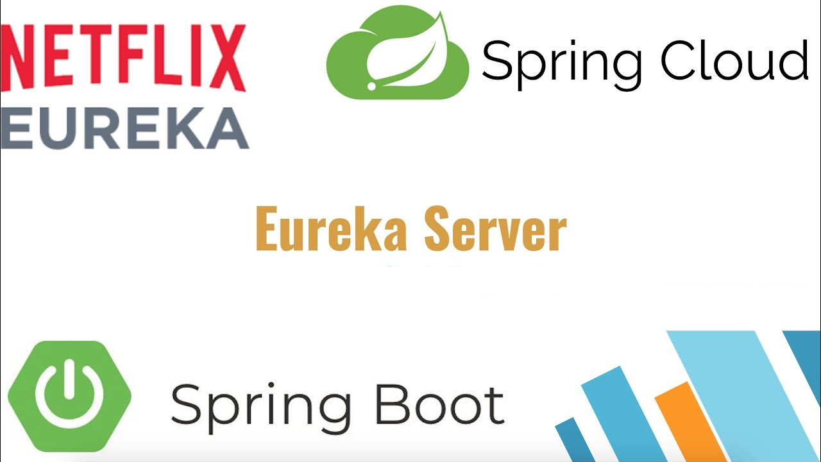
Spring Cloud: Service Discovery With Eureka

Slide 2
One of the main building blocks of a micro-service architecture is service discovery.
Spring cloud provides multiple solutions such as Eureka, Zookeeper, Cloud Foundry and Consul to facilitate the process of service discovery.

Slide 3
What is Service Discovery?
What is Spring Cloud Eureka?
Implementing a Eureka Server and a Client
Inter-Microservice Communication via Eureka
Understanding Eureka Client-Server Communication

Slide 4
What is Service Discovery?
A distributed system typically comprises a large number of services which communicate with each other to perform certain operations.
Service discovery is the process of one service dynamically discovering the network location (IP address and port) of another service to communicate with it.

Slide 5
Imagine a scenario in which one REST service (Service A) is trying to invoke another REST service (Service B).
In order to make a request, Service A needs to know the network location (IP address and port) of Service B.
In a conventional SOA (Service Oriented Architecture) ecosystem, services’ network locations would hardly change, as they are deployed in on-premise data centers. Consequently, you can afford to maintain the network locations of services in configuration files, which will be updated infrequently.
For example, Service A can maintain the IP address and port of Service B in a configuration file and use those values when making a request. Following figure illustrates this flow.

Slide 6
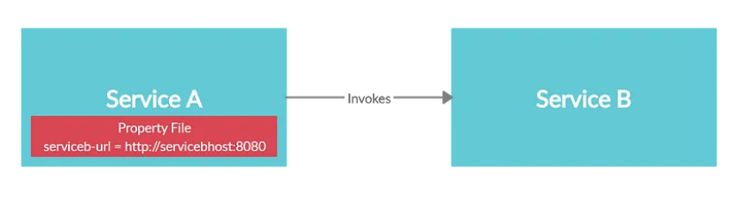
However, this approach is nearly impossible in a cloud based microservice architecture

Slide 7
Increased number of services: As you may well aware, microservice architecture is all about breaking down monoliths into fine grained services.
This results in an increased number of services that forms a complex communication mesh. Therefore, it is difficult for one service to maintain the network locations of all the other services, that it has to communicate with, in a property file.

Slide 8
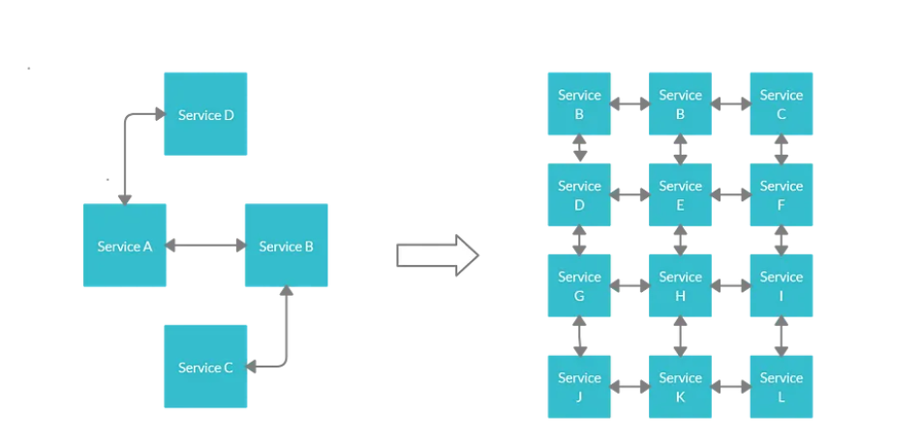

Slide 9
Dynamically assigned network locations:
Microservices are generally deployed in the cloud.
Server instances in cloud have dynamically assigned network locations.
In addition, due to its basic features such as auto scaling, servers just come and go in cloud.
Each time a service is started in a new instance, its network location changes.
Therefore, it is hard to maintain the target IP addresses and port numbers of a particular microservice in a property file, as the values tend to change quite frequently

Slide 10
These complications raised the need to have a more sophisticated mechanism for microservices to dynamically discover the network locations of other microservices for communication.
The concept of service discovery was introduced as a result.
Service discovery mechanism uses a central registry to maintain the network locations of all the microservices.
If for some reason the IP address and the port number of a particular microservice changes, new values will be immediately re-registered in the registry.

Slide 11
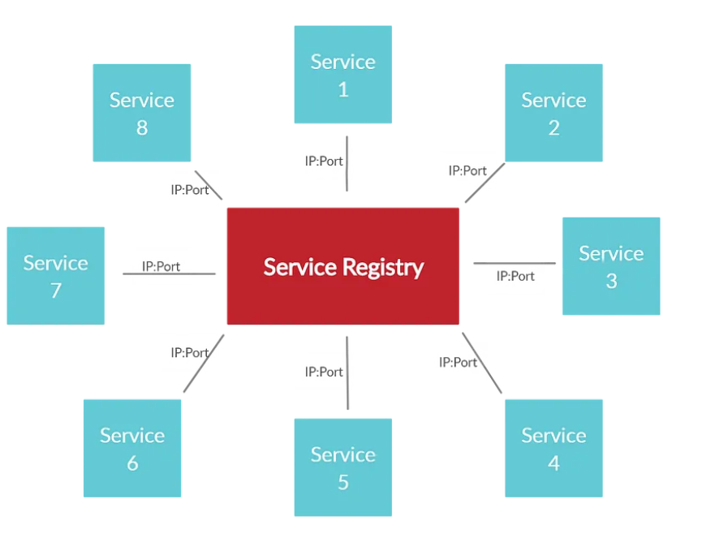

Slide 12
What is Spring Cloud Eureka
Eureka is a REST based service which is primarily used for acquiring information about services that you would want to communicate with.
This REST service is also known as Eureka Server. The Services that register in Eureka Server to obtain information about each other are called Eureka Clients.
Following diagram illustrates how Eureka clients and server fit in together.

Slide 13
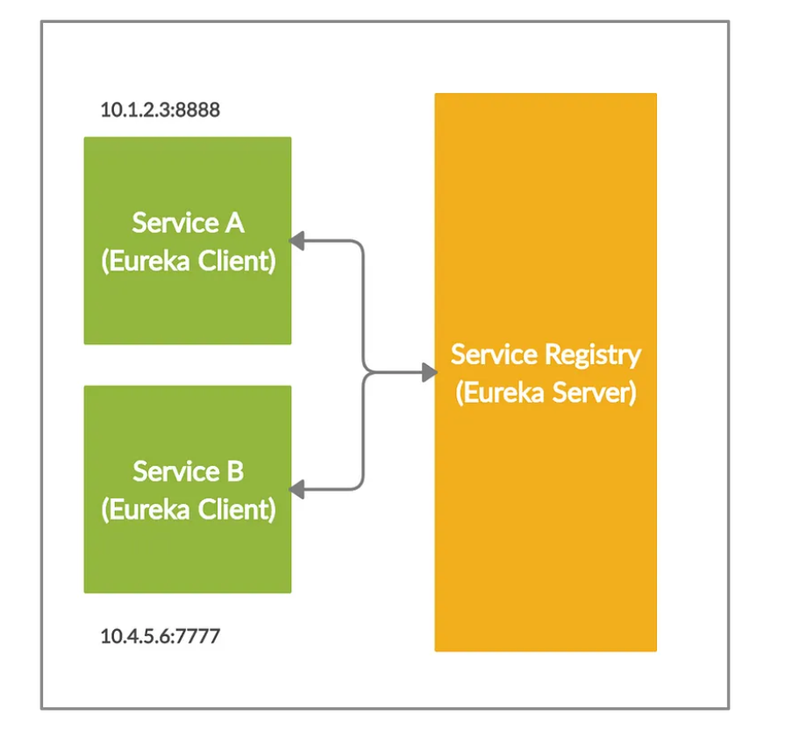

Slide 14
As the above diagram indicates, Service A and Service B are registered in Eureka server.
If any of the these two services want communicate with the other service, it can obtain the target IP address and the port via the Eureka server.

