Slide 1
RESTFul Web Services
Day 1 – Introduction
LEVEL – PRACTITIONER

Slide 2
Srilakshmi Jayaraman (222805)
7+ years of experience in Java / J2EE Role: Facilitator, Academy
1.0 / January 3, 2014

Slide 3
What can you expect from this session?
The objective of this session is to elaborate the features of Web Services, its types and to narrow down to the details of RESTful Web Services.
This presentation is a good kick-starter to create a RESTful Web Service step-by-step.

Slide 4
Intended Audience
The target audience of this presentation includes J2EE developers / Solution Architects / Designers who need to be involved in knowing the “know-hows” of implementing RESTful Web Services.

Slide 5
Agenda
Introduction to SOA
Web Services Overview
Types of Web Services
Implementations
Introduction to SOAP based Web Services (JAX-WS)
Introduction to RESTful Web Services (JAX-RS)
Architecture
Principles of REST
Annotations of JAX-RS API
Introduction to Jersey
Writing my first RESTful Web Service (step-by-step)
Compare and Contrast JAX-WS and JAX-RS
Questions & Answers

Slide 6
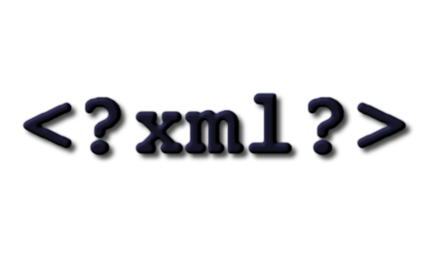


Pre - requisites
For effective understanding of the topic, it will be better if the audience have an idea in the following areas:

Slide 7
Do You Know
Can you distinguish between XML and HTML?
What is the structure of a XML document?
Is HTTP protocol a stateless protocol?
Notes:
XML and HTML are for different purposes. XML – data representation, HTML – data display; HTML uses fixed set of tags, XML – you can create your own tags
a. XML declaration which has the version in the top, b. document type declaration where it has the XSD or DTD specified and 3. XML content, which has the actual data
Yes, because every HTTP request is handled independently without any knowledge of the previous requests serviced.

Slide 8
Objectives
At the end of this session, you can learn the following:
Comprehend the principles of RESTful Web Services
Apply the best practices learned in REST architectural style
Interpret the demonstration of a simple RESTful web service
Can write a new RESTful Web Service by relating the concepts learned

Slide 9
Icebreaker Activity
Voice your choice for the following scenario:
Consider that your application has a good authentication mechanism, appreciated by many of the project stake holders
Client wants to use the same login mechanism / algorithm to all the 10 applications, he is running of.
What solution would you suggest in order to repeat the same algorithm across all the applications?
Note: All 10 applications are written purely in Java & hosted at different servers
Notes:
Instructions to Trainer:
Explain the scenario and ask questions to participants… Give options to make them speak up
Options can be:
Repeat same algorithm in 10 applications
Attach the code / class as a jar file, and make a call to the method
Web Services (system – system interaction), give the benefits like interoperability, reuse etc.
Instructions to Facilitator:

Slide 10
Service Oriented Architecture
“Service” - a self contained unit of business logic
Service Oriented Architecture (SOA) is a software architecture talks about providing the functionality of any application as “services” to other applications
SOA describes how disparate applications interact with each other, irrespective of OS / programming languages / protocols etc.
They share a common registry (storage) to publish (make an entry) and lookup (find) a service over network

Slide 11
Service Oriented Architecture – contd.
Architecture
Benefits of SOA
Reusability of functionality
Better Interoperability
Cost Effectiveness
Increased Responsiveness
Ease of Transformation
Enhanced Optimization
Service Registry
find
register
Service Consumer
network
Service Producer
request
response

Slide 12
Technical Introduction
What is a Web Service?
It can be considered as piece of software that is accessible using standard Internet protocols such as HTTP, XML.
It provides a standard way of interoperating between software applications that are running on different platforms and frameworks.
Component-based development
Black-box functionality
Not a programming language or tool
Not tied to OS / Programming Languages
Notes:
Component Based Development – A “component” manages is reusable and manages its lifecycle on its own (example: a rectangle control in Ms-paint) – like a component, a web service can be consumed – where the lifecycle of the web service is not an overhead of consumer
Black box functionality – the consumer need not know what is the logic or how it provides the response – it’s a black box
Not a Programming language or tool – the software by its behavior, it is called as web service
Not tied to any OS / programming languages – a web service can be written or hosted in any language or OS & consumed from any OS

Slide 13
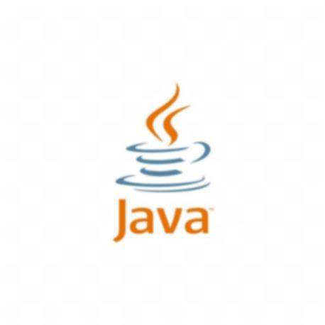



Web Service: To a novice user
Question: What is a web service?
Answer: It is a service (some business logic) available over the internet
scenario
“Amazon” shopping application needs to contact “Paypal” for payment services, during online purchase of products by a customer
1. Order product
4. Payment Status
Amazon Software runs on UNIX server @ New Jersey
(written in Java language)
Customer orders a product from laptop
2. Request for payment service
3. Provide Service
If more than one system need to interoperate with less maintenance cost
Paypal Software runs on Windows 2003 server @ China
(written in .NET language)

Slide 14
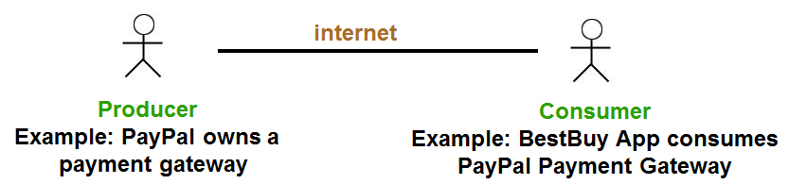
Producer & Consumer of Web Services
A web service will have a producer, who is responsible for writing the business logic & publishing it to the world
A web service will have a consumer, who is responsible for using the service into their own software bundle.
Producer and Consumer will exchange request and response information, in a standard way without knowing the technological capabilities of each other

Slide 15
Web Services – at a glimpse
Web Services
Tested
Published
Text
Described
Consumed
Invoked
Found
Bound
ACTION Verbs associated
15

Slide 16
Need for Web Services
Why do you need web services?
Platform and language independent
Use XML and web based protocols – Pervasive
Simplify the process of making apps talk to each other – less expensive
RPC/CORBA/RMI/DCOM – tightly coupled connections, web services are loosely coupled (to an extent!)
Minimizes impact of changes to the application
Web service interface provides a layer of abstraction
Promotes reuse
Reduces maintenance costs
Promotes 100% interoperability
Notes:
A change in the parameters list of a web service method, will definitely need a change in consumer code. Unless there is a change in service name, parameters or return type (the description part) the loose-coupling is achieved.

Slide 17
Types of Web Services
Web services are classified into two types:
Plain Web Service (or) SOAP based Web Service (or) Big Web Service
RESTful Web Service
Note: The term “Big Web Service” comes from Java EE 6 tutorial of Sun Microsystems
Java Web Services
SOAP based
RESTful

Slide 18
Types of Web Services API
Java API for XML Web Services (JAX-WS)
This API supports to build & consume web services using XML based protocol SOAP, which confirms to a standard format as described in WSDL.
Java API for RESTful Web Services (JAX-RS)
This API supports creating & consuming Web Services according to “REST” architectural pattern. This is an alternative to SOAP / WSDL based web services and hence it has become very simpler to use.
Notes:
These APIs are provided by Sun Micro systems. JAX-RPC is another API used for SOAP based applications, but in recent applications, JAX-WS is widely used.

Slide 19
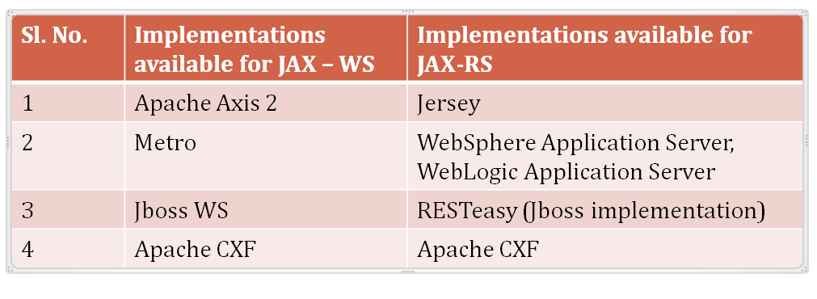
Implementations available on market
Below are some of the popular implementations available in market:

Slide 20
Introduction to SOAP based Web Services – Contd.
SOAP (Simple Object Access Protocol) is a simple XML-based protocol to let applications exchange information over HTTP
It provides a way to communicate between applications running on different operating systems, with different technologies and programming languages
This kind of web services follow the SOA standards and serves enterprise wide web services needs
Uses “Web Services Definition Language (WSDL)” as a contract for exchanging information about web services
Universal Description, Discovery and Integration (UDDI) is the service registry used for registering and look up of services

Slide 21
SOAP based services - architecture
Service Registry
UDDI
WSDL
WSDL
2a.Find Service (SOAP)
1.Publish Service
2b.Return the Service Contract
Network
Service Consumer
Service Provider
Invokes service according to contract (SOAP)
SOAP Request reaches Provider
SOAP

Slide 22
Quiz
Match the following:
Protocol | Web Service Layers
SOAP | Service Transport
UDDI | Messaging
WSDL | Service Discovery
SMTP | Service Description
FTP | Messaging
XML | Service Transport
HTTP | Messaging
Notes:
SOAP - Messaging
UDDI - Service Discovery
WSDL - Service Description
SMTP - Service Transport
FTP - Service Transport
XML - Messaging
HTTP - Service Transport

Slide 23
Introduction to RESTful Web Services
What is REST?
REST is an architectural style developed by W3C
In this architectural style, we consider the data and the business logic as resources that are accessed over internet
These resources will be accessed via URIs (Uniform Resource Identifiers)
REST uses a stateless communication protocol such as HTTP
The architecture will be of type “client-server”
In summary, REST architecture enforces the clients and servers to exchange “representations” of resources via stateless protocols like HTTP.
REST stands for Representational State Transfer

Slide 24
RESTful architecture
Client Application
(could be Java / Python / ASP .NET / Mainframe)
Application Server (could be Tomcat / GlassFish / WAS)
JAX-RS / Jersey Framework
Further Layers of application
XML
Marshaller
&
Unmarshaller
(Jersey)
REST services
(WAR / EAR packaging)
GET
POST
PUT
DELETE
Java
Java
HTTP
JSON
Notes:
XML and JSON data will be passed over HTTP network

Slide 25
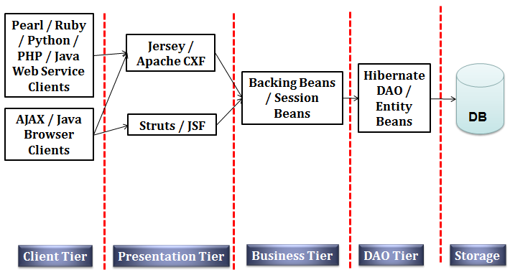
Where RESTful service fits in?
This is how RESTful Web Service will fit in a multi-layered environment:
REST sits in Presentation / Web tier, handles incoming request and delegates to business tier

Slide 26
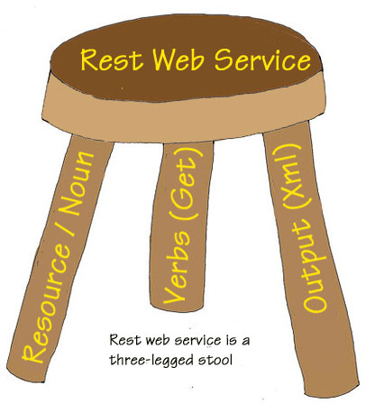
RESTful Web Service – in short
It has 3 major elements which is described below:
Courtesy: http://dotnetslackers.com/Community

Slide 27

Principles of REST
Everything is a “RESOURCE”
Any data and functionality that is planned to expose to outside world as a “service” – is called as a resource

Slide 28
Principles of REST – contd.
Resources are discovered using “URIs”
Uniform Resource Identifiers are used to access any resource in REST
This provides a global addressing space for interaction of client and server
The structure of URI should be easily understood and predictable
Examples:
LoginService – will be available @ http://restcorp.com/get/loginuser
SearchService – will be available @ http://restcorp.com/get/search
URI

Slide 29

Principles of REST – contd.
Guidelines to define a URI in REST:
Use only lowercase
Avoid using query strings
Avoid using spaces, use underscores or hyphens instead. (Example “user login” can be defined as “user-login”
Don't add file extensions to your URIs like “login.xhtml or login.php” Customize your program such that if requested URI is not found, provide a default response back to the user, instead of HTTP 404
Avoid changing the URIs often, because this will return failure when end user access the page using older bookmarks.

Slide 30
Principles of REST – contd.
Behavior of Resource is controlled by HTTP methods
REST developers need to use the typical HTTP methods
This ensures uniform interface exposed to clients
DELETE
GET
PUT
POST

Slide 31
Principles of REST – contd.
Following are the HTTP methods and the corresponding “Request Method Designators” supported by JAX-RS
We can also create our own request method designators – which is an out of scope of this presentation.
Sl. No. | HTTP method | Use | (JAX-RS) supported REST designator
1 | GET | To retrieve resource from server | @GET
2 | POST | To create a resource on server | @POST
3 | PUT | To modify or change the state of any resource | @PUT
4 | DELETE | To delete / remove a resource | @DELETE

Slide 32
Principles of REST – contd.
Case study
A software developer is given with the following requirement:
There is a JAVA application for employees to update their personal information like DOB, Address, Email ID, Phone number etc. The application follows MVC architecture, where the controller is a Servlet.
A user attempts to update his email id, and clicks on update button.
Which method of the servlet will handle this user request? GET / POST?
GET can also get the request parameters and update the database
It is a design flaw according to HTTP protocol

Slide 33
Principles of REST – contd.
Take away from the given case study:
In the given case study, GET method is not used “RESTfully”
No state change transactions like addition / deletion or modification of any data - should be coded in GET method
Always GET operation should be free of side-effects

Slide 34

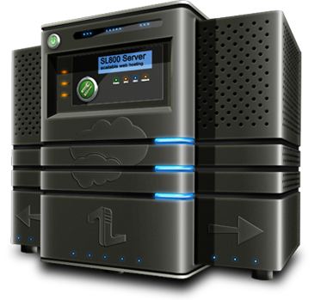

Principles of REST – Contd.
Minimized coupling of data representation between client and server
GET /searchCatalog
Send XML
Receive XML
REST response in XML format
META
+
PDF
JSON
XML
HTML
REST allows clients to get their data in variety of formats
Notes:
Server may process the data from a database or file system
Server may return the data in form of Plain Old Java Object (POJO) or XML or PLAIN TEXT or XHTML or JSON or JPEG or PDF etc.
Client may require the data in any other format irrespective of what server returns back
REST allows clients to get their content in a variety of formats as they require
Meta data will also be available to clients, which can be used for access control, caching, to detect transmission errors etc.

Slide 35

Principles of REST – Contd.
REST is Stateless
Responsibility of Server:
Provides a uniform interface for any client to send a request
Processes the request
Returns the response back
Hence the server is stateless
Responsibility of Client:
Construct the request
Make the service call
Get the response and process
Client is responsible for application state management
Responsibilities
Well-defined
Notes:
One request, should be fully packed and independent of other requests

Slide 36
Principles of REST – Contd.
REST is Stateless – Contd.
Every interaction with a resource is stateless
The HTTP request is self-contained, it will hold all the information about data, context, request parameters etc., that is required by the server to process the request.
The conversational state will be held on the client and transferred to server on “per-request” basis
Simplifies the design of server side components
Very easy to deploy the application in load-balancing servers
If the interaction needs to be stateful, developer need to handle it explicitly (techniques like cookies, hidden form fields etc. can be used)

Slide 37
Advantages of REST world
REST is simplified
Nothing to install, maintain or upgrade
No stubs you have to generate and distribute
No need to pay big bucks to vendors
REST is ubiquitous
Most (? all) applications will have a HTTP library
HTTP is a stable protocol with constrained interface
REST has familiarity
Leverages existing tools and infrastructure
REST is intuitive
We know the various operations supported
REST is predictable
Much easier for clients to access the resources

Slide 38
Useful Annotations of JAX-RS
How to create a RESTful resource?
A RESTful resource (in specific, called as root resource) is a Java Class that is annotated with @Path designator.
A RESTful method is the Java method that is annotated with request method designators like @GET, @POST, @PUT and @DELETE
@Path(“books")
public class SearchBooks {
@GET
List getBooks () {
// return some list
}
}
http://bookstore.com/catalogue/books
this request is handled by getBooks()

Slide 39
Useful Annotations of JAX-RS
@Path
Holds a relative URI, which indicates where the java class will be hosted.
The base path is the application path (which you will give in Servlet Mapping)
@GET
It’s a request method designator, indicates that the annotated Java method will handle all HTTP GET requests.
In the above example, if catalogue is the application path given in deployment descriptor and if application should have been deployed at http://bookstore.com, then
the GET requests for http://bookstore.com/catalogue/books will be handled by getBooks() method

Slide 40
Useful Annotations of JAX-RS
@PathParam
This annotation injects the parameters from the request URI, to the method parameter.
@Path(“books")
public class SearchBooks {
@GET
List getBooks () {
// return some list
}
@Path("{ed}")
@GET
String getBookByEdition(@PathParam(“ed") String edition) {
// return some book name
}
}

Slide 41
Introduction to Jersey
JAX-RS API is used to develop RESTful Web services and their clients in Java.
Jersey RESTful Web Services framework is open source framework for developing RESTful Web Services in Java that provides support for JAX-RS APIs and serves as a JAX-RS Reference Implementation.
Jersey has its own API with additional features to simplify RESTful Web service development
Jersey 2.4.1, that implements JAX-RS 2.0 API is the most recent release of Jersey

Slide 42

Take a Break

Slide 43

Welcome to the world of REST
Writing my first
RESTful Web service
demo

Slide 44

Demo
Software requirements
We use the following software in our demo:
JDK 1.7
Spring Tool Suite 3.4.0 RELEASE
In-built Vmware vFabric tc Server
Developer Edition v2.9
Jersey API

Slide 45
Demo
Software requirements
Jersey in classpath:
jersey-server-1.7.jar
jersey-core-1.7.jar
jersey-servlet-1.11.jar
asm-3.3.jar

Slide 46
Demo
Software requirements
If you are using a mavenized project, below dependencies are required:
<dependency>
<groupId>com.sun.jersey</groupId>
<artifactId>jersey-server</artifactId>
<version>1.17.1</version>
</dependency>
<dependency>
<groupId>com.sun.jersey</groupId>
<artifactId>jersey-core</artifactId>
<version>1.17.1</version>
</dependency>
<dependency>
<groupId>com.sun.jersey</groupId>
<artifactId>jersey-servlet</artifactId>
<version>1.17.1</version>
</dependency>

Slide 47
Demo
Software requirements
Check whether Java 1.7 is installed
Check if JAVA_HOME is set to JAVA 1.7
Check if PATH is set to JDK1.7\bin

Slide 48
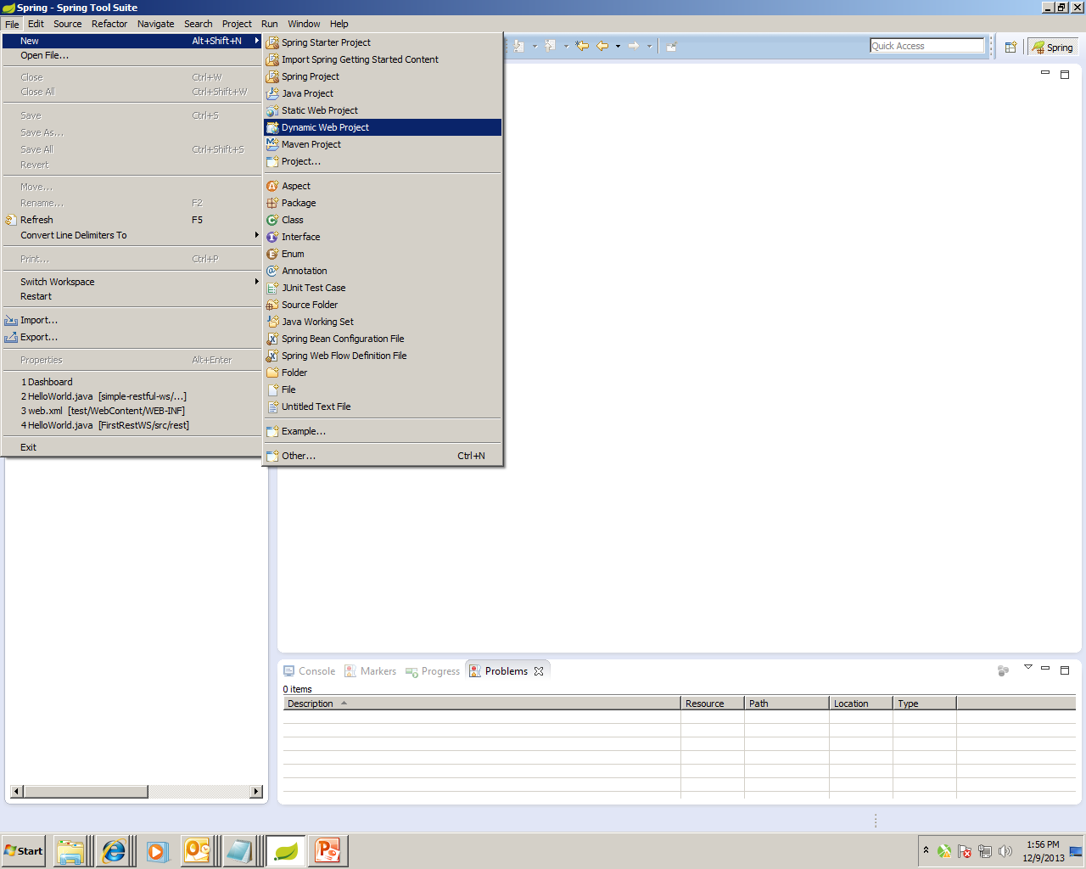
Demo
Create a new Dynamic Web Project

Slide 49
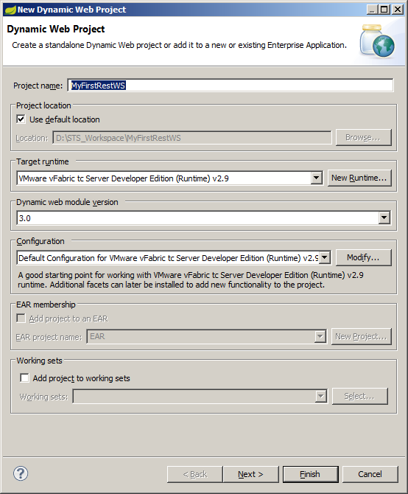
Demo – Contd.
Provide the project name & follow the wizard:
Dynamic Web Module version is 3.0

Slide 50
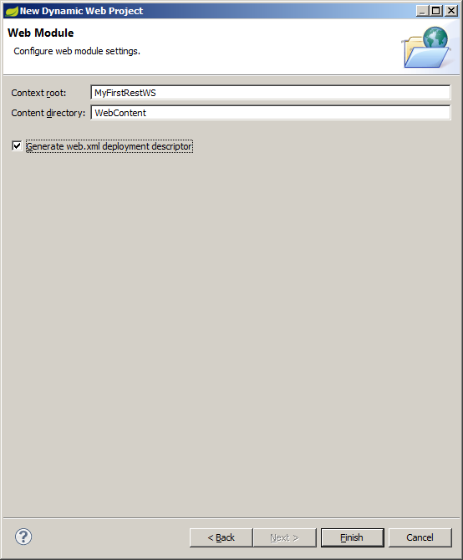
Demo – Contd.
Check the option provided to generate web.xml file & click “Finish”

Slide 51
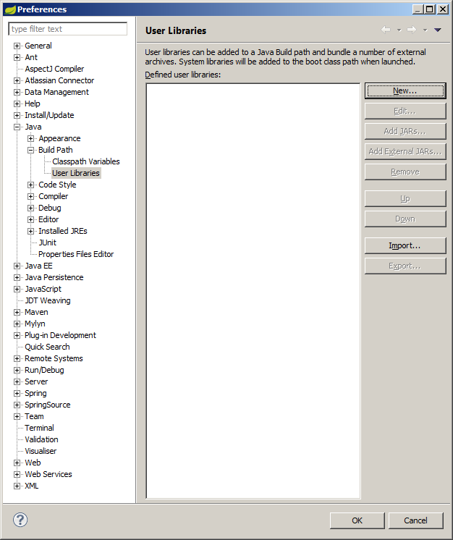
Demo – Contd.
Click on “Window -> Preferences” to create a user library
Click on “New” and provide the library name as “RESTFUL_WS”

Slide 52
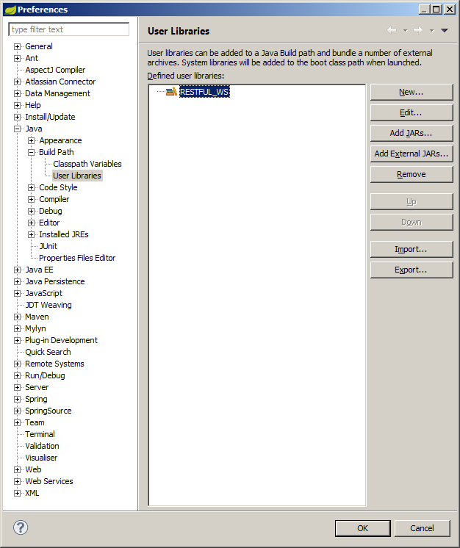
Demo – Contd.
Click on “Add External Jars” to add the Jersey libraries
Jars will be provided in a share path during demo

Slide 53
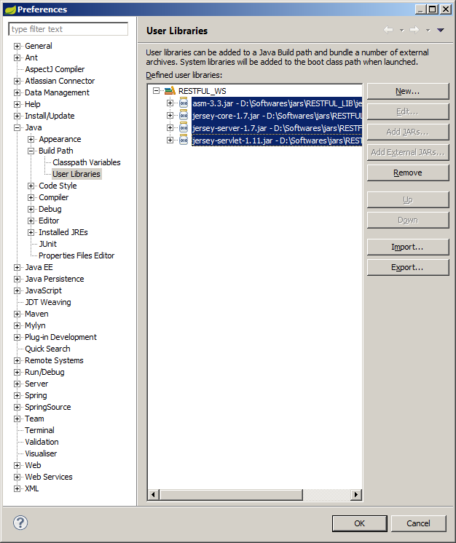
Demo – Contd.
After adding JARS, click OK

Slide 54
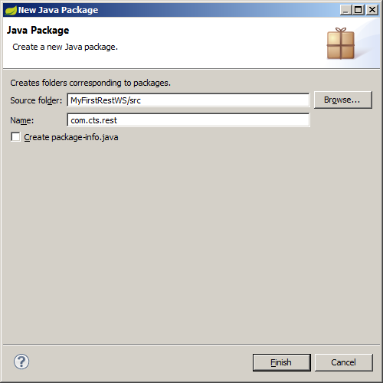
Demo – Contd.
Create a new package “com.cts.rest” under source folder

Slide 55
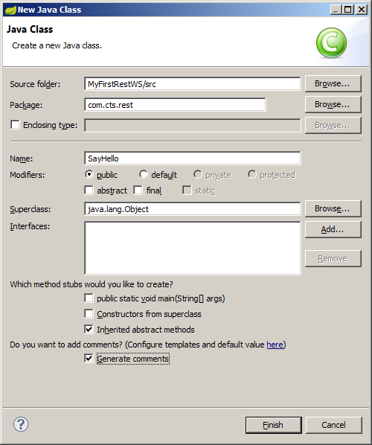
Demo – Contd.
Create a new class “SayHello” under the package “com.cts.rest”

Slide 56
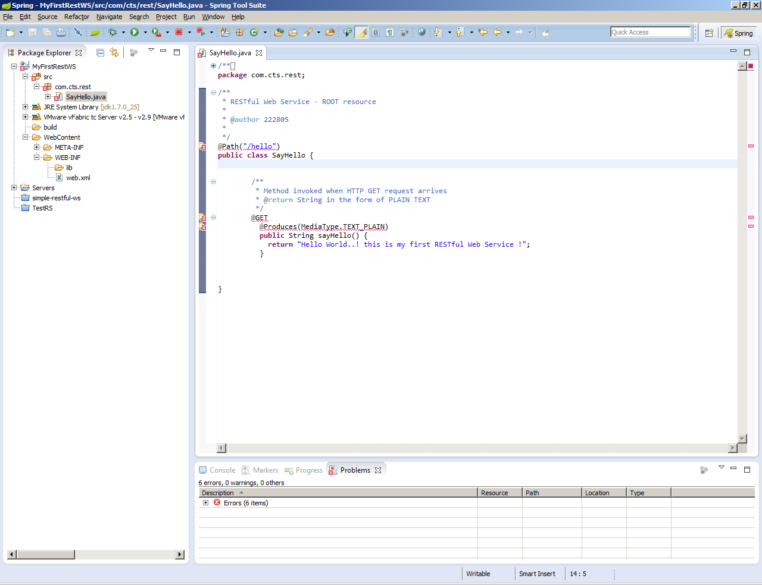
Demo – Contd.
Mark this class as a resource & write a method that handles HTTP GET requests
Note: still dependency jars are not added, hence build path errors exist!

Slide 57
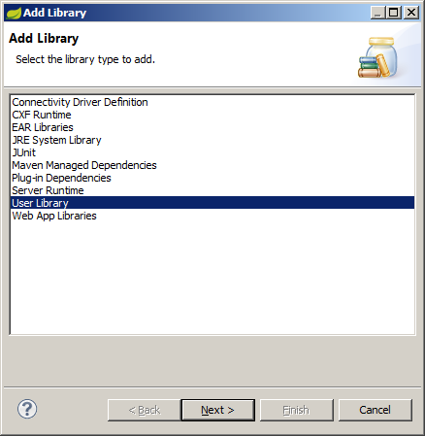
Demo – Contd.
Right Click on the project, select “BuildPath -> Configure BuildPath. Click on “Add Library” option
Select “User Library” and click on “Next”

Slide 58
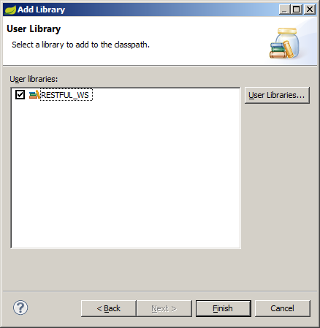
Demo – Contd.
Select the user library which we created in previous steps “RESTFUL_WS” and click on Finish
Note: after adding libraries, organize the imports in the Java Class “SayHello.java” to resolve dependency errors.

Slide 59
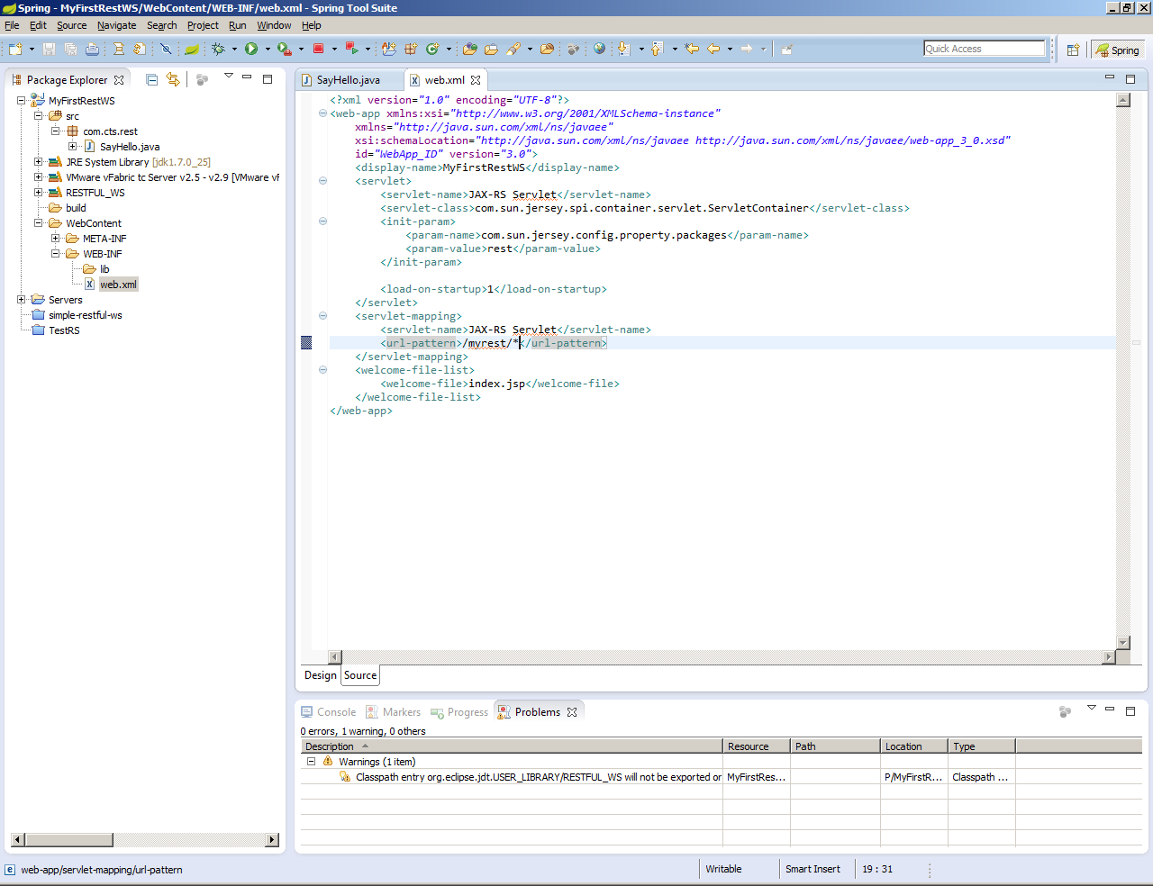
Demo – Contd.
Configure the deployment descriptor to add JAX-RS Servlet (in web.xml)

Slide 60
Demo – Contd.
JAX-RS Servlet configuration:
<servlet>
<servlet-name>JAX-RS Servlet</servlet-name>
<servlet-class>
com.sun.jersey.spi.container.servlet.ServletContainer
</servlet-class>
<init-param>
<param-name>com.sun.jersey.config.property.packages</param-name>
<param-value>com.cts.rest</param-value>
</init-param>
<load-on-startup>1</load-on-startup>
</servlet>
<servlet-mapping>
<servlet-name>JAX-RS Servlet</servlet-name>
<url-pattern>/myrest/*</url-pattern>
</servlet-mapping>
Package name

Slide 61
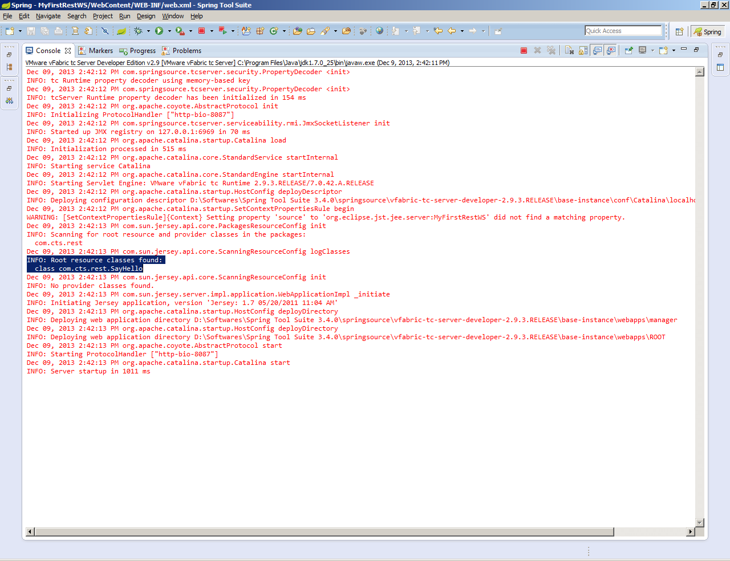
Demo – Contd.
Do a project->clean, followed by build & deploy it in server. Publish the project and start the server. Console should give the following output:

Slide 62
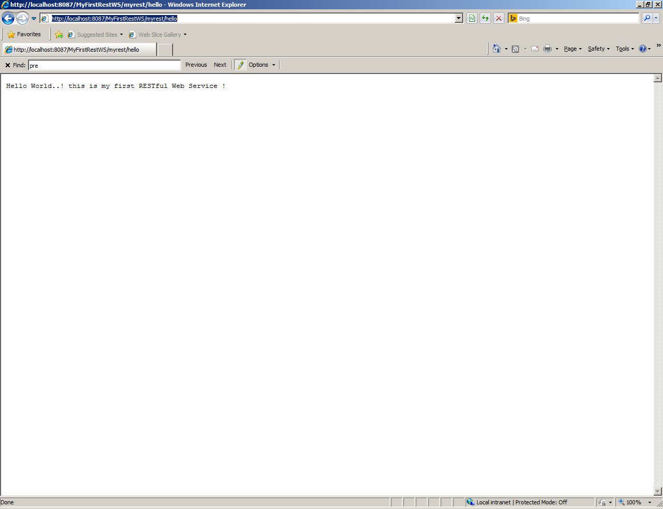
Demo – Contd.
Open the browser and type the below URL:
http://localhost:8087/MyFirstRestWS/myrest/hello
Note:
The port number, project name, URL pattern & resource path should match the data you have given in your project!

Slide 63

Demo – Contd.
You have successfully published and consumed a RESTful Web Service!

Slide 64
Hands-on Exercise 1
Objective: A simple RESTful web service that calculates area and perimeter of circle.
Create a resource called “Circle.java”.
A web method that handles the HTTP GET requests, which accepts radius of a circle and produces area in a PLAIN_TEXT format
A web method that handles the HTTP GET requests, which accepts radius of a circle and produces perimeter in HTML format

Slide 65
Big Web Services vs. RESTful Services
Compare & contrast!
Sl. No. | Big Web Services | RESTful Web Services
1 | Any transport is used (HTTP, HTTPS, SMTP, JMS, TCP, MQ, IIOP etc.) | HTTP, HTTP and HTTP! (also HTTPS)
2 | Can behave stateful or stateless | Purely stateless
3 | Will exchange SOAP messages wrapped in XML (this XML markup makes messages lengthy) | Can exchange almost all type of messages, few of them are: XML, JSON, PDF, JPG etc. (no XML wrap-up)
4 | Complex development | Simple development
5 | Contract definition is important (WSDL) | No formal contract definition
6 | Advanced QoS, as it confirms to WS-* requirements | Developer takes the responsibility to design the application secure
Note: SOAP is a protocol whereas REST is an architectural style!

Slide 66
When to use SOAP?
SOAP is a best choice in the following cases:
When we go for Enterprise Application Integration (EAI)
When asynchronous processing is a mandatory requirement, with guaranteed security and reliability: WS-RM (Reliable Messaging) specification supports this
When the contract is considered vital, both clients and servers will have standard message exchange format for every interaction
If state management is needed, SOAP WS-* specification like Security, Transaction Management, Coordination will support to manage the conversational state between client and server

Slide 67
When to use REST?
REST is a best choice in the following cases:
When we need to integrate over Web
When the bandwidth is limited and resources are scarce!
When stateless CRUD (Create, Read, Update and Delete) operations are needed, REST is the best choice!
When architectural simplicity is aimed (to use off-the-shelf components)
In mobile devices / PDAs where the overheads of processing additional parameters have to be reduced

Slide 68

Q & A
Questions from participants

Slide 69

Test your understanding
1. What could be the business benefits of Web Services that you can think of?
2. What IT benefits that you can think of?
3. Is loose coupling achieved in RESTful Web Services?
4. Is RESTful Web Services an alternative to Big Web Services?
5. Can we call web services as SOA?

Slide 70
Supporting Materials
Jars used
Source Code file

Slide 71
You have successfully completed -
RESTFul Web Services - Introduction

