Slide 1
Tilburg take home assignment Q1 – q3
SHEKHAR NARAYANAN

Slide 2
QUESTION 1

Slide 3
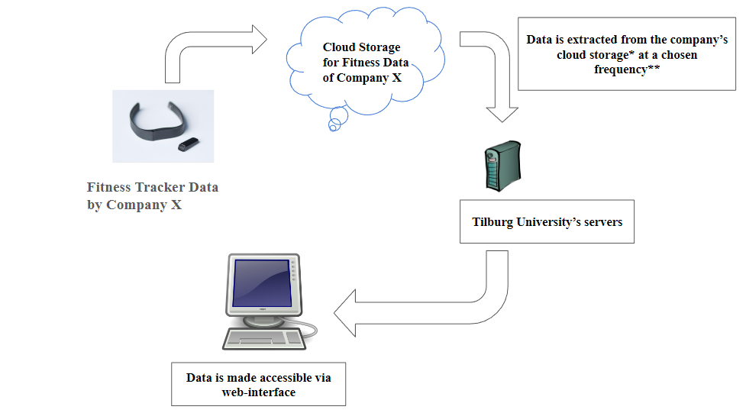
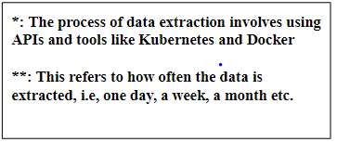
Preparation
questions
Preparation:
Review the data hosting pipeline and prepare a high-level summary
Get a grasp of researcher’s domain and common methods used
Questions:
Inquire about the research goals of this study (understanding variables of interest, which is useful for cleaning the data).
Get info about their technical background, tailor explanations accordingly
Figure 1: High level overview of the data hosting pipeline
Notes:
So the general overview is that:
The research does not know much about the data hosting pipeline and only has the surfdrive file

Slide 4
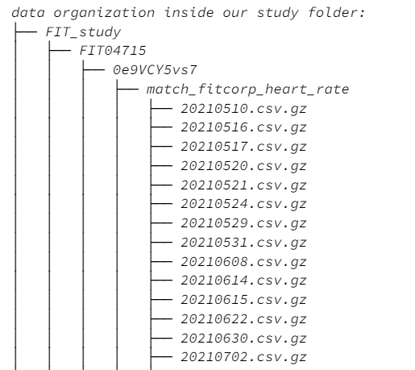
Solutions
For the data hosting pipeline:
Stress on the importance of data extraction frequency to Tilburg’s servers: serves as motivation to look deeper into the hosting pipeline
Schedule another session to explore this, and propose having one folder for each month (instead of day)
For data preparation
One datapoint - One folder: inconvenient and tedious
Recommend learning about numpy, pandas and matplotlib : independence in data handling processes
Giving them the excel/csv file and a python notebook that explains the process in detail
Figure 2: Data organization inside the FIT_study folder: Each sheet (corresponding to a date) has a single data point.
My primary work philosophy would be instilling technical independence through my solutions!

Slide 5
QUESTION 2

Slide 6
DATA PREPARATION pipeline: Overview
Part 1
Part 2
Single participant walkthrough
Data for all participants combined
Import relevant libraries
Make functions from Part 1
Extract zip files and explore data structure
Loop through participants and save final output
Inspect steps and heart rate data*
Minimally preprocess and visualize data*
Have one dataset for both steps and heart rate data
*: See next slide

Slide 7
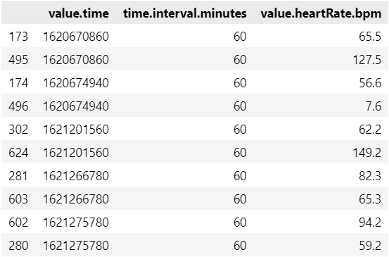
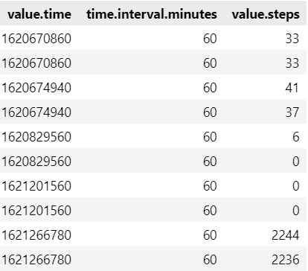
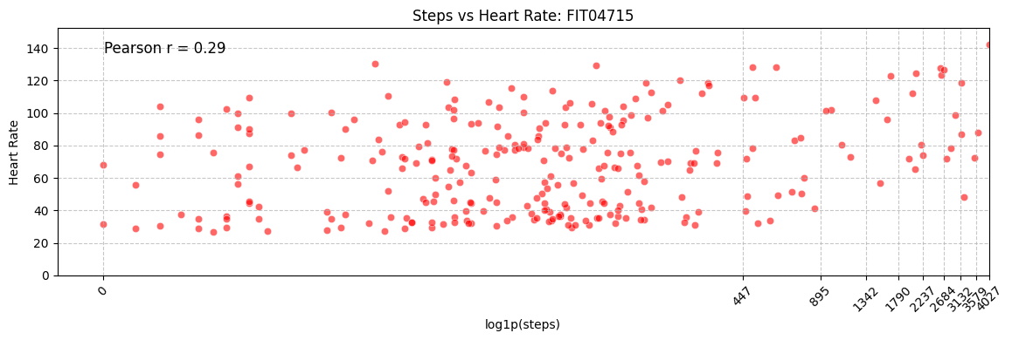
Inspection and preprocessing
Problems:
Repeating instances for value.time corresponding to different steps/hr values
Multiple instances where steps = 0
Solutions:
Figure 3: Parts of the heart rate and steps data sets respectively
Aggregate values (avg over hr values, take sum of steps values) and combine data
Remove rows with steps = 0 after aggregation and combining
Figure 4: Visualizing steps vs heart rate for participant ID FIT04715

Slide 8
QUESTION 3

Slide 9
Speed up data cleaning
1. Optimize existing methods
(for e.g. use in-built functions, vectorize operations)
2.1 Send jobs to a high-performance compute cluster (HPC). (Use parallel computing resources)
2.2 Use batch processing. Automate job scheduling at regular intervals to clean smaller volumes of data at once

Slide 10
THANK YOU!

