Slide 1


Neural Network &Deep Learning Journal On
Deep Voice: Real-time Neural Text-to-Speech
SHEKHAR BALAGONI
700759103

Slide 2
Motivation
The increasing demand for high-quality, natural-sounding text-to-speech (TTS) systems.
Text-to-speech artificial human speech (TTS) synthesis is necessary for a number of applications.
Real-time TTS systems are required for applications like audiobooks, virtual assistants, and accessibility.

Slide 3
Motivation
Traditional TTS systems are complex and require hand-engineered features.
Deep Voice aims to simplify TTS using end-to-end neural networks.
Text-to-speech (TTS) is crucial for human-computer interaction without needing a visual interface

Slide 4
Problem Statement
Traditional TTS systems rely on complex pipelines that are difficult to optimize for both speed and quality.
Existing neural TTS systems are either too slow for real-time applications or do not produce sufficiently high-quality speech.
Improve TTS by replacing traditional components with neural networks.

Slide 5
Problem Statement
Achieve real-time inference for production-quality TTS.
Develop a production-quality TTS system built entirely on deep neural networks.
This system should be simpler and more flexible than traditional TTS.

Slide 6
Objectives
Develop a neural TTS system capable of producing high-quality speech in real-time.
Ensure the system is scalable and can handle large-scale deployment.
Replace grapheme-to-phoneme conversion, phoneme duration prediction, fundamental frequency prediction, and audio synthesis with neural models.
Minimize the need for hand-engineered features and domain expertise
Achieve high-quality speech synthesis.

Slide 7
Contributions
Introduction of the Deep Voice system, which uses a novel neural architecture for TTS.
Five major building blocks: segmentation, grapheme-to-phoneme, phoneme duration, fundamental frequency, and audio synthesis.
Demonstration of real-time speech synthesis capabilities with high-quality output.
Comparison with existing TTS systems, showing improvements in both speed and quality.
Achieved production-quality speech synthesis with real-time inference.

Slide 8
Results
Deep Voice achieves real-time performance with high-quality speech synthesis.
Evaluation metrics and user studies confirming the superior performance of Deep Voice.
The specific results about the size of the training data and the quality achieved are not mentioned in the provided excerpt.
Optimized Wave Net inference kernels achieve up to 400x speedups over existing implementations
The system outperforms traditional TTS pipelines in both speed and naturalness of the generated speech.

Slide 9
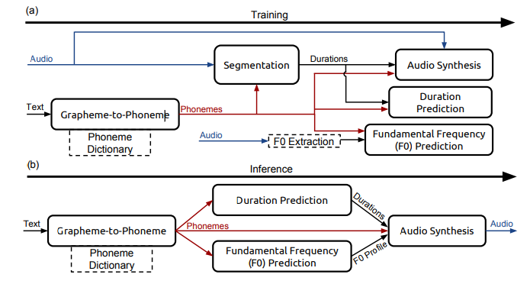
Results
The system outperforms traditional TTS pipelines in both speed and naturalness of the generated speech.

Slide 10
Critical Analysis
Strengths
Innovative architecture enabling real-time synthesis.
High-quality speech output that rivals human speech.
Practical applicability in various real-world scenarios.
Weaknesses
Potential limitations in handling diverse accents and languages.
Computational requirements may still be high for some applications.
Further improvements needed for emotional and prosodic variations in speech.

Slide 11
References
Arik et al. (2017). Deep Voice: Real-time Neural Text-to-Speech. arxiv.org
Boersma, Paulus Petrus Gerardus et al. Praat, a system for doing phonetics by computer. Glot international, 5, 2002.
Bradbury, James, Merity, Stephen, Xiong, Caiming, and Socher, Richard. Quasi-recurrent neural networks. arXiv preprint arXiv:1611.01576, 2016.

Slide 12
THANK YOU
SHEKHAR BALAGONI
700759103

