Slide 1

PRODUCT CASE STUDY · BLINKIT · QUICK COMMERCE
Why do Blinkit's most loyal users never widen their basket?
Four parts: an AI discovery engine over public reviews, primary user research, a problem definition, and a deployed AI-native MVP — the Category Nudge Agent.
THE CUSTOMER BASE WE ARE DESIGNING INTO
DISCOVERY ON BLINKIT TODAY
31.8M
avg. monthly transacting customers
16.9M a year earlier
331M
orders in the quarter
≈ 10.4 orders per customer
2,443
dark stores live
+200 in the quarter
86%
YoY net order value growth
₹17,132 cr NOV
1. Intent-led search and category aisles. AI-assisted search ranking is the primary way a basket gets filled — the customer has to ask first.
2. Home rails tuned to place and time. What is popular nearby, time-of-day sets, past purchases, and offer rails on things the customer already looked at.
3. Complement prompts at cart. Add-on suggestions next to what is already in the basket — adjacent to intent, rarely a new category.
Blinkit segment, Eternal Q1 FY27 (quarter ended 30 Jun 2026) shareholders' letter and earnings call. Growth came from more customers and more orders, not higher basket value — average order value dipped slightly.
The gap this study works in: every surface above ranks what to buy inside a category the customer already trusts. None of them argue why to try a category a bad order taught them to avoid.
Discovery surfaces described from the public app and published reporting, not internal Blinkit documentation.
Notes:
The metric: share of monthly active customers buying from at least one new category that month. Four parts, both artefacts are live and public.

Slide 2
THE GOAL, FRAMED
Heavy repeat buyers keep narrow baskets — and most of them say so themselves
58%
This is a trust problem, not an awareness problem
These customers order weekly or daily. They have already seen the other categories in the app. What stops them is what happened — or what they expect to happen — when the order arrives.
of surveyed users self-report that they mostly stick to the same categories
The company's own growth path runs through this behaviour
Analyst, Eternal Q4 FY26 earnings call (28 Apr 2026): “a large part of our growth narrative from here on depends in some sense on either growing the non-grocery assortment and going outside of the metro cities.”
CFO: “It's a function of assortment expansion, geographical expansion as well as more demand densification in the cities where we are present today.”
Caveat: the call does not discuss product-quality or refund friction. The link to this project's cause is ours, not the company's.
Source: primary survey, 18 of 31 responses. Survey-based; no live interviews.
Notes:
Segment: heavy repeat buyers with narrow baskets. 58% self-report sticking to the same categories. The blocker is trust, not awareness — they have seen the categories, they distrust them.

Slide 3
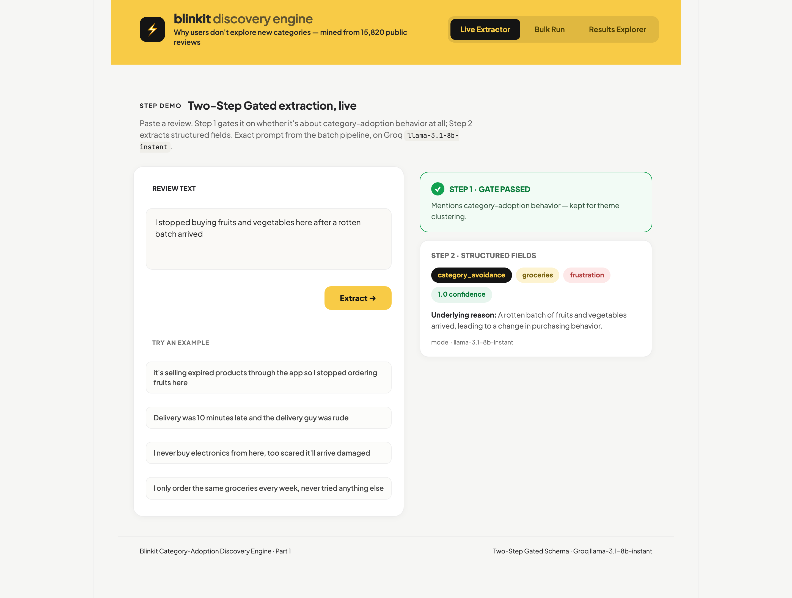
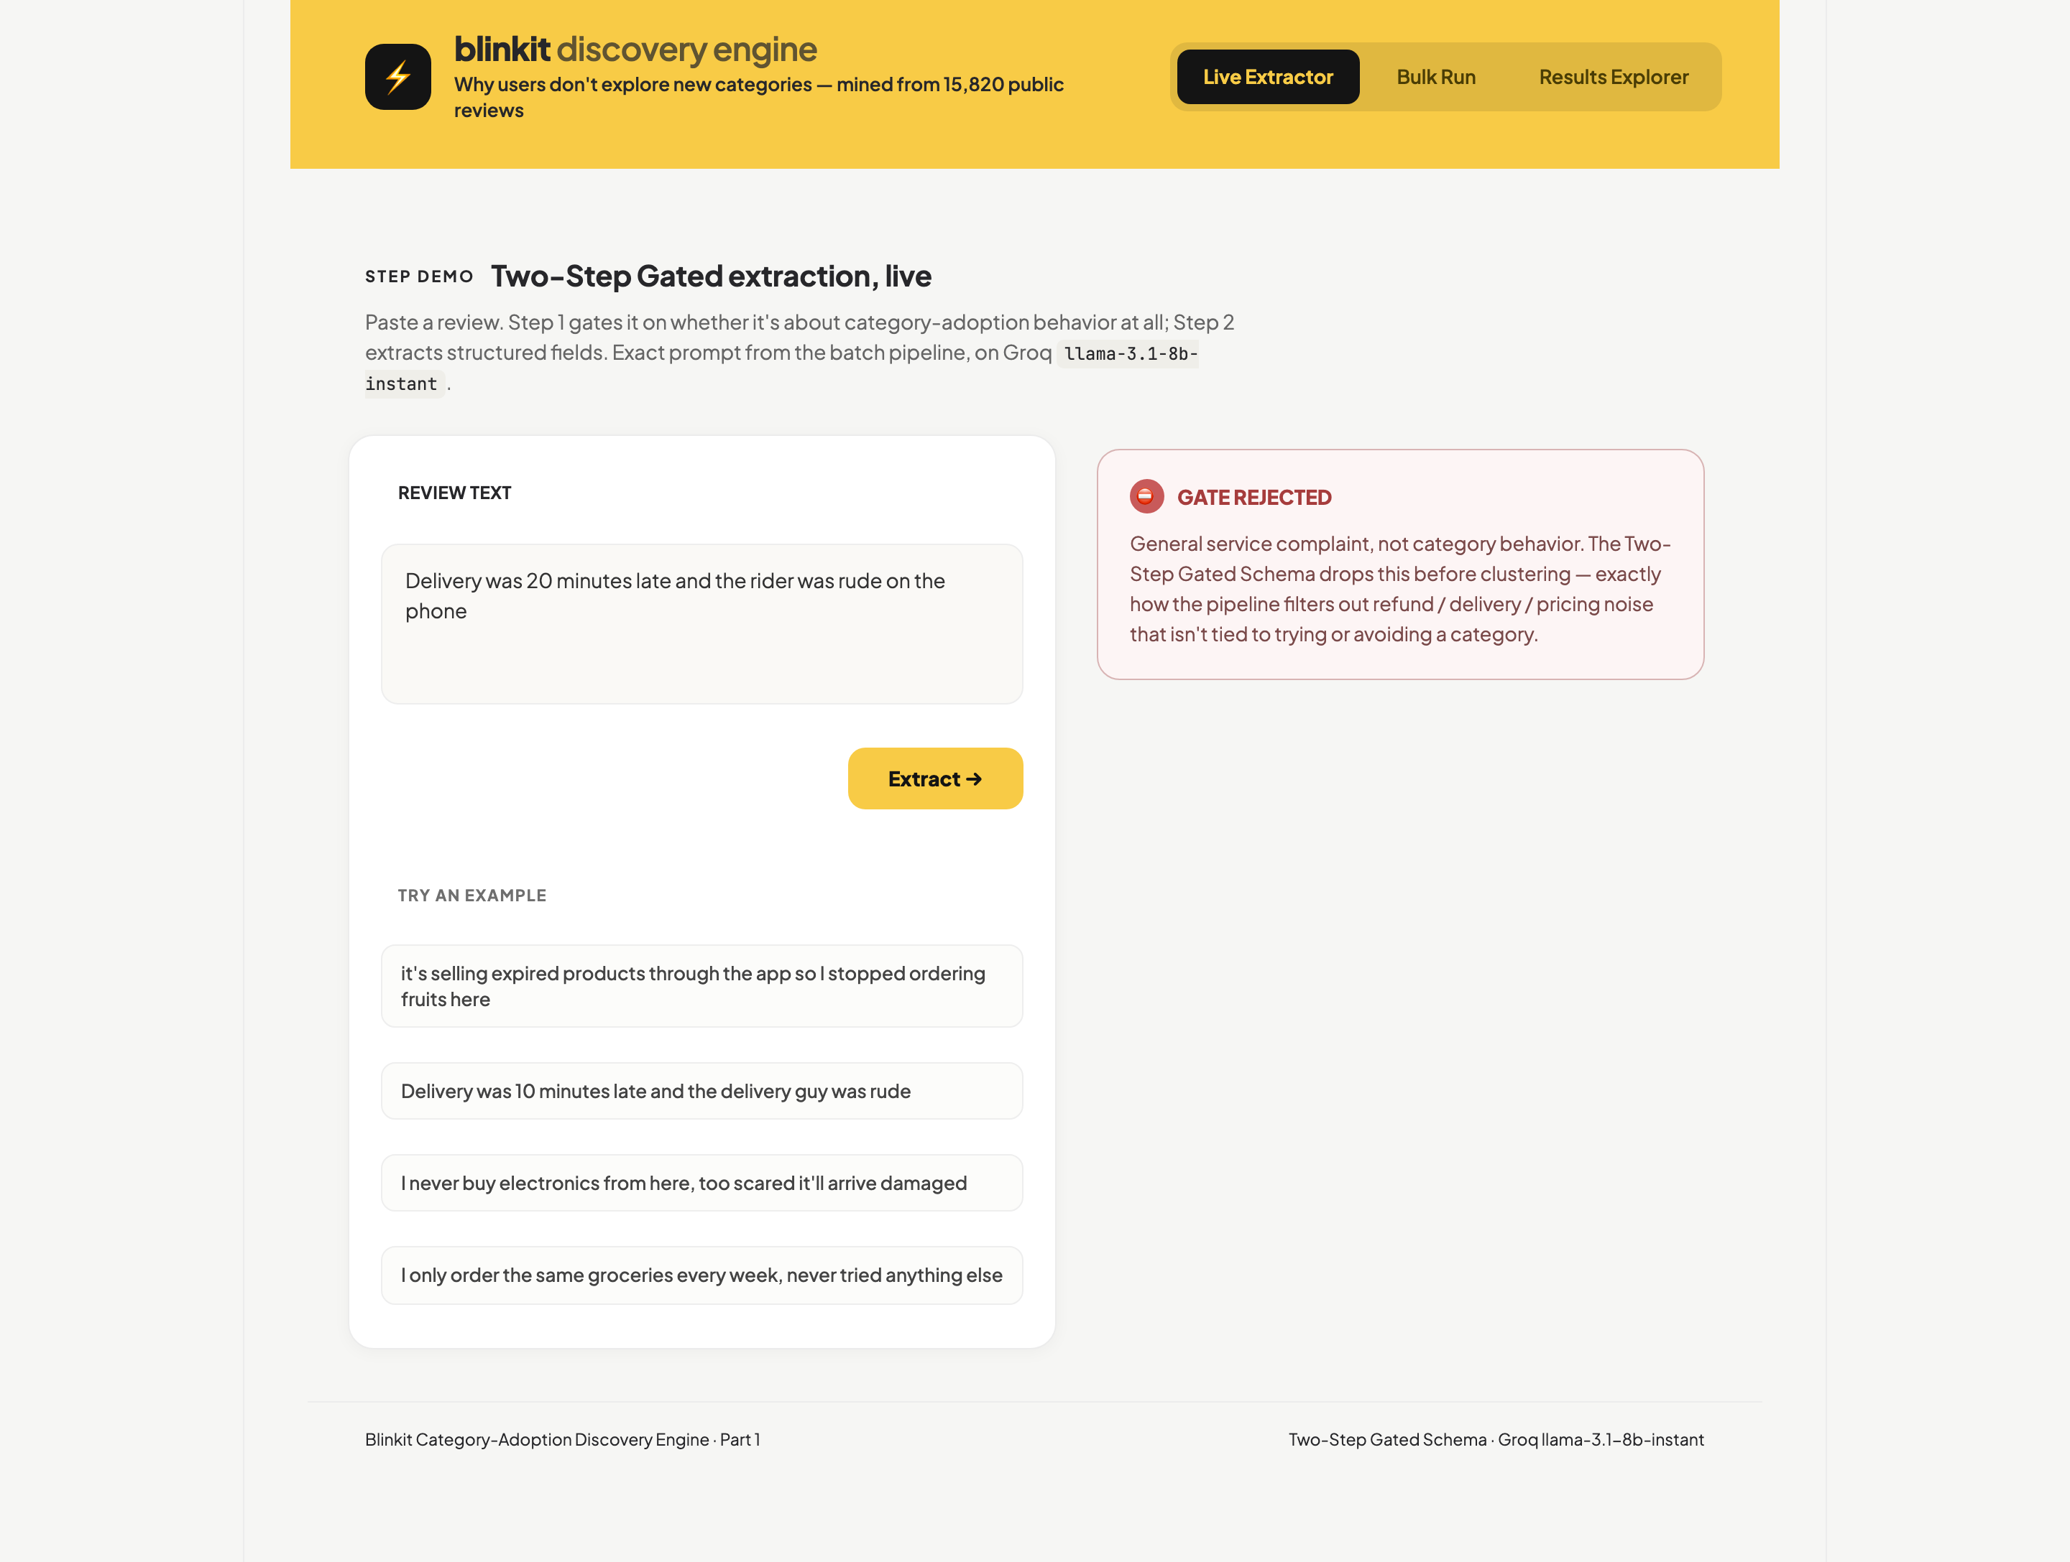
PART 1 · HOW THE ENGINE WORKS
A five-stage pipeline hard-gates on category-adoption relevance before it extracts anything
LIVE · DISCOVERY WORKFLOW
Open the live extractor →
15,820
public reviews ingested
4,740
pass the rule-based prefilter
1,094
gate-passing extractions
Why gate at all? Hand-reading reviews is anecdote, not evidence — an ungated LLM pass returns a complaints dump. The gate forces every kept review through one schema.
→
→
1 Ingest
15,820 reviews
✓ Public app-store reviews
✓ Deduplicated before any model runs
2 Heuristic prefilter
→ 4,740 kept
✓ Drops empty text / under five words
✓ Drops 5-star reviews
✓ Rule-based only — no LLM
3 Gated extraction
→ 1,094 kept
✓ Gate: trying or avoiding a category?
✓ Extract: behaviour, category, friction
✓ Two steps, never one
4 Deterministic clustering
Themes = DB rows
✓ Frequency counted in the database
✓ Never an LLM estimate
✓ 70% land in a single theme
5 LLM-judge validation
Held-out sample
✓ Gate decisions re-checked
✓ Validation dial in the app itself
Design decision · the gate. An early ungated run only surfaced generic service complaints.
What the engine measures: adoption behaviour, category named, friction theme. Groq llama-3.1-8b-instant throughout.
✓ KEPT — CATEGORY BEHAVIOUR
✗ DROPPED — SERVICE COMPLAINT
Notes:
Required deliverable: the workflow explanation. Five stages. The design decision that matters is the relevance gate — an early ungated run only surfaced generic service complaints.

Slide 4
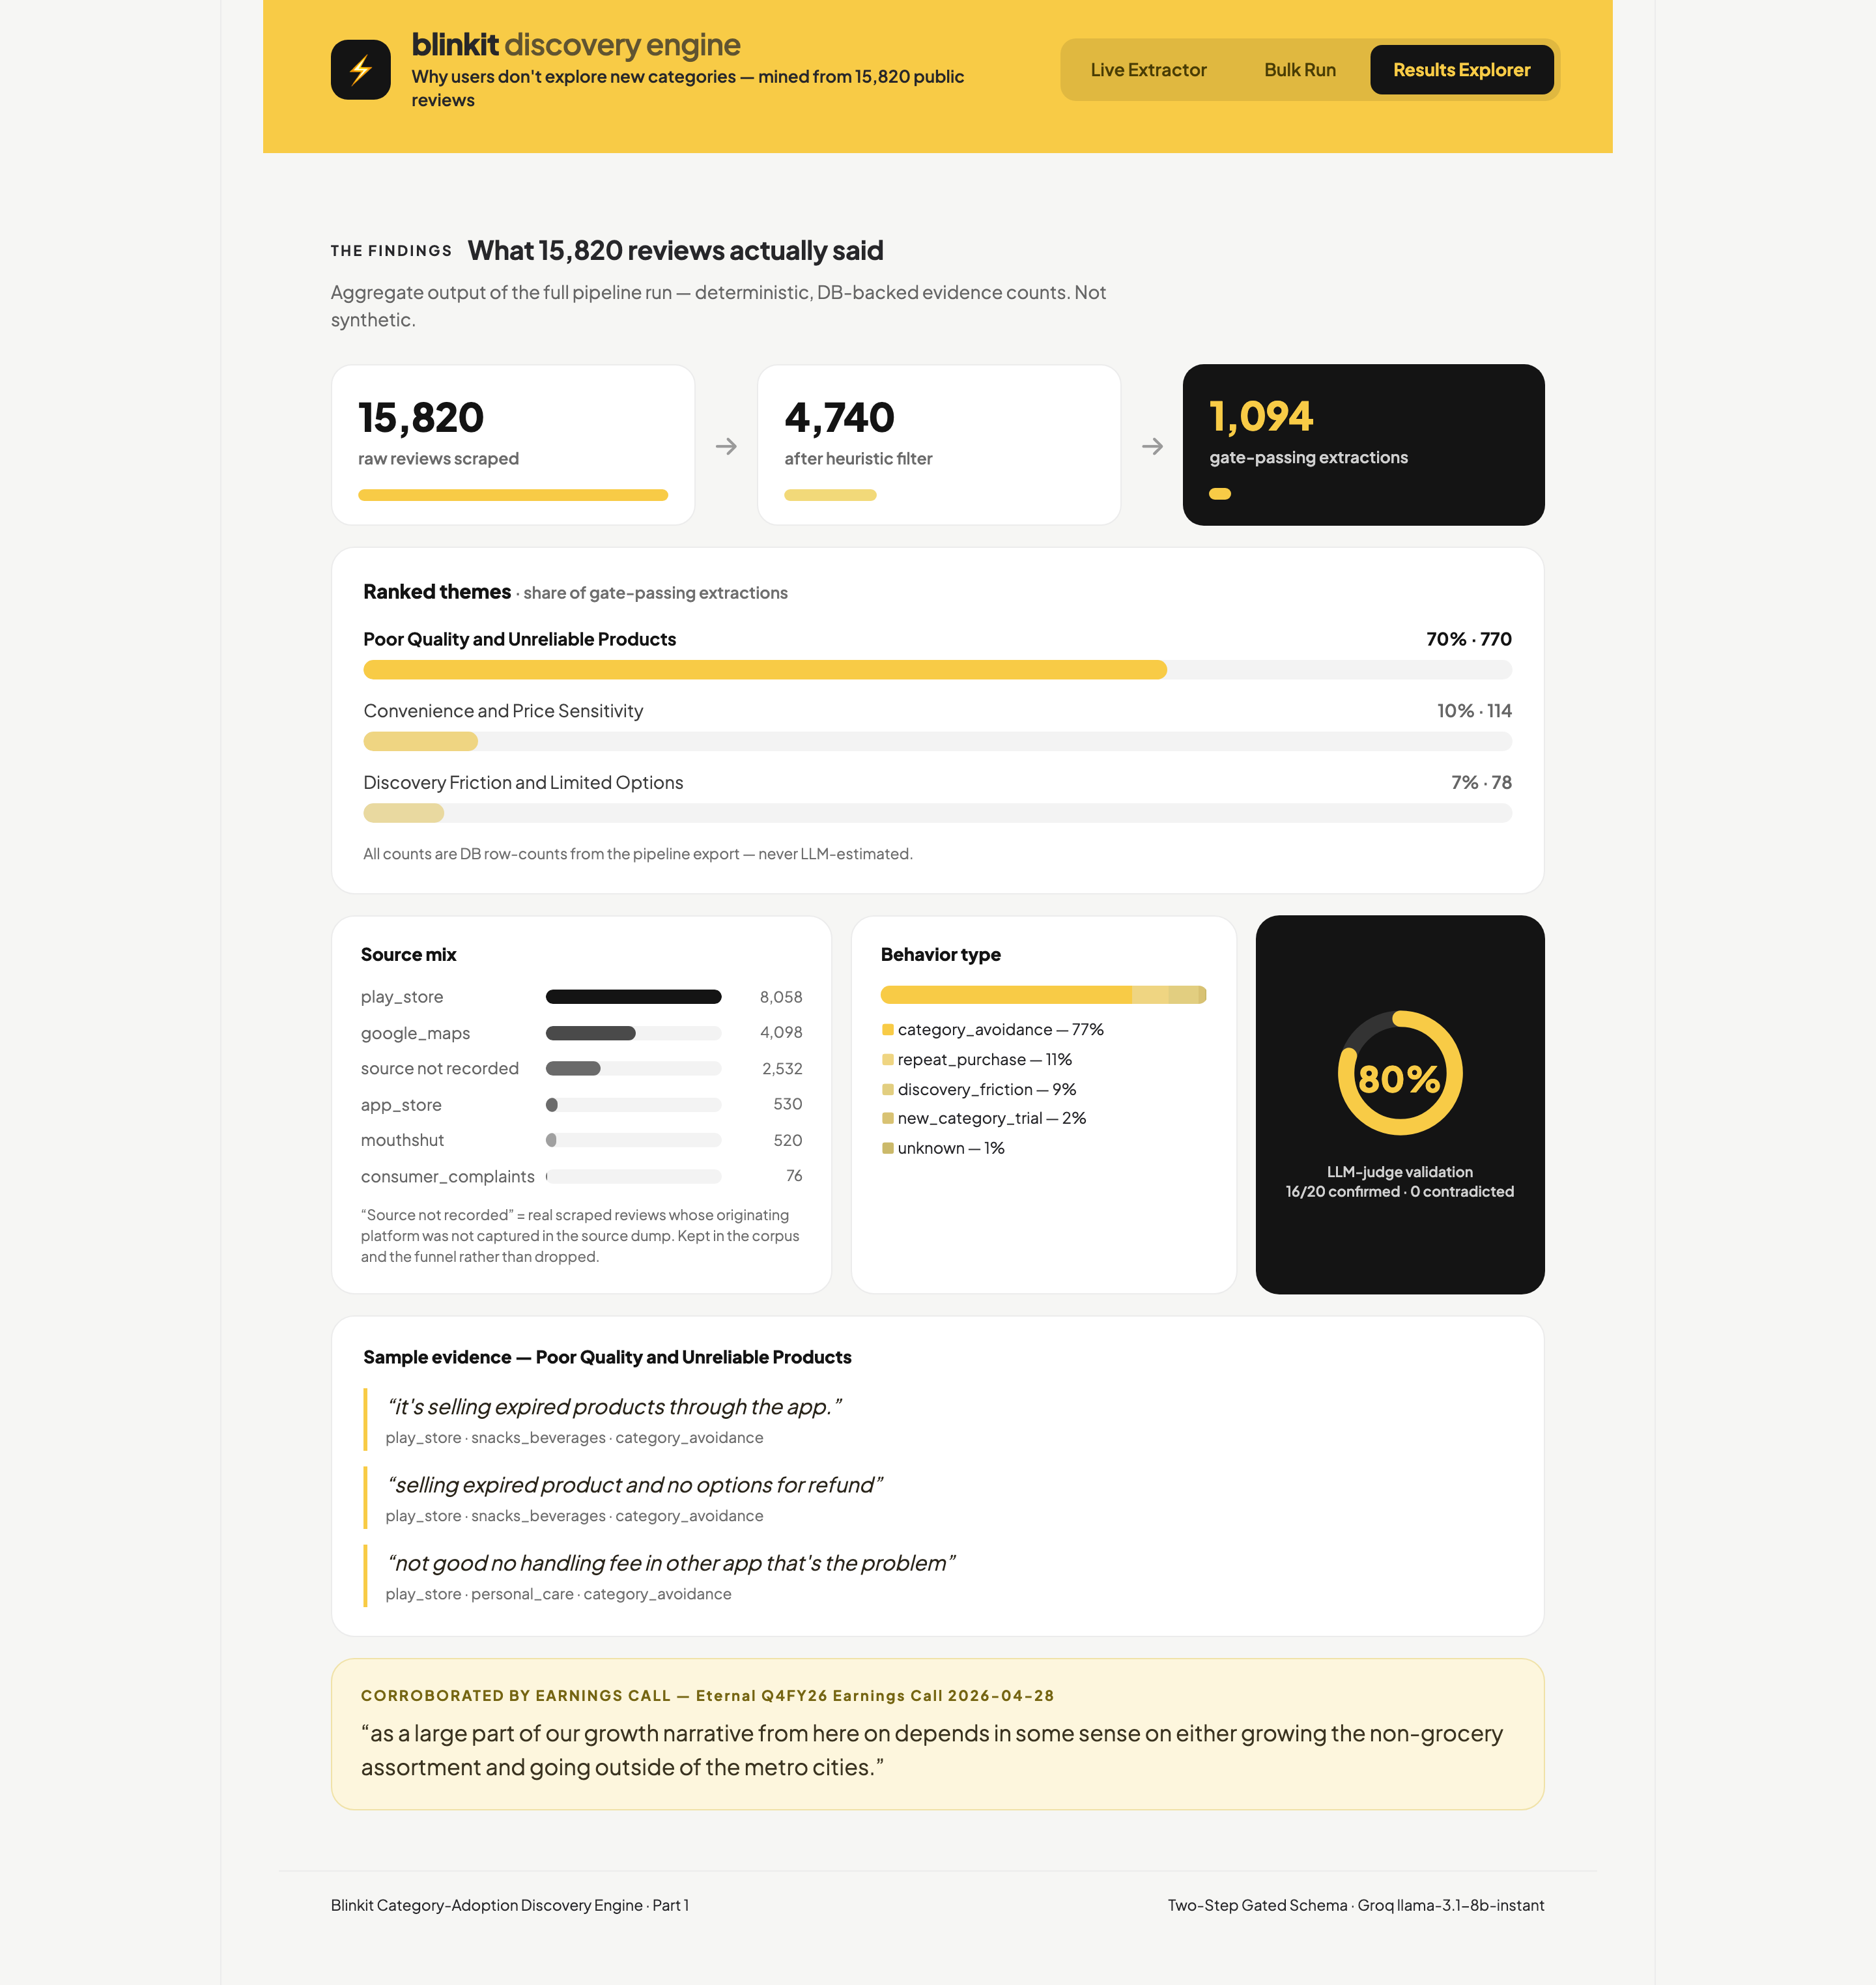
PART 1 · WHAT THE REVIEWS SAID
Poor quality and unreliable products is the dominant reason customers stop widening their baskets
1 One theme carries the segment
Of the 1,094 gate-passing extractions, the dominant friction theme is “Poor Quality and Unreliable Products”.
70% of kept evidence sits in this one theme
2 The steep funnel is the gate working, not data loss
The prefilter drops empty/short/5-star reviews. The gate then removes everything unrelated to trying or avoiding a category.
15,820 → 4,740 → 1,094
3 Where the top theme lands
Groceries: 431
Electronics: 96
Snacks & beverages: 79
Household essentials: 39
Personal care: 27
4 Every count is a database row
Frequencies come from the pipeline export — never an LLM estimate, never a per-user confidence score.
THE CORE PROBLEM Customers are not missing the other categories — they have decided those categories are unsafe to buy here. One damaged, expired or fake item is read as evidence about the whole category.
Results Explorer — funnel, ranked themes, source mix, behaviour split and the LLM-judge validation dial.
Notes:
70% of gate-passing evidence is one theme: poor quality and unreliable products. The steep funnel is the gate working, not data loss.

Slide 5
PART 2 · PRIMARY RESEARCH
SAMPLE, STATED HONESTLY
31 survey responses. No live interviews — a deliberate trade of depth for breadth. Six respondents consented to follow-up calls that were not run.
The survey confirmed the AI's cause — and challenged how far it reaches
% Quantitative validation
58% Stick to the same categories
18 of 31
48% Had a bad order in 3 months
15 of 31
73% Of those, fully refunded
11 of 15
Asked directly, 1–5: mean 3.0
■ 11 agree ■ 9 neutral ■ 11 disagree
Does a bad experience in one category make you hesitant to try others?
! What the survey challenged
The behaviour change is an even split, not a rule.
Of 15 bad orders: 7 changed behaviour, 7 didn't, 1 ambiguous — even split held as the sample grew.
Half the “stuck” group had no incident at all.
8 of 18 “stuck” users had no bad order — low intent, not lost trust.
Some churn instead of narrowing.
“I have started using Zepto more” — platform switching, not category avoidance.
Packaging is a distinct sub-cause.
A fulfilment failure, not product sourcing — written in unprompted.
2 respondents raised pricing versus competitors unprompted.
✓ Confirmed, in their words
“I have stopped exploring new categories on Blinkit. I only order the essential items now if anything urgent.”
Unresolved puja-item complaint
“yes I am skeptical of buying electronic products from Blinkit and other similar applications”
Damaged electronics
“I avoid buying any fresh products dairy or perishables items from quick commerce apps.”
Expired dairy — generalised beyond Blinkit
The 15 bad orders: 11 damaged · 2 expired · 1 fake/duplicate · 1 other. Resolution: 11 full refunds · 3 replacements · 1 unresolved.
THE VERDICT Confirmed: a quality failure does generalise into avoiding the whole category. Challenged: it does not do so for everyone — so the fix is scoped to the trust-driven share.
Notes:
Mandatory slide: the research both confirmed and challenged the AI. Sample is 31 survey responses, zero live interviews — a deliberate trade of depth for breadth.

Slide 6
PART 3 · PROBLEM FRAMING CANVAS
One quality failure generalises into permanent avoidance of an entire category
01 · WHO IT'S FOR
Heavy, habitual repeat buyers.
High-frequency customers who default to the same narrow set of categories every month. 18 of 31 surveyed describe themselves this way.
02 · THE ROOT CAUSE
Trust, not discovery.
A damaged, expired or fake item teaches the customer that a category is unsafe to buy here — so they retreat to essentials, or leave for another app.
03 · HOW THEY COPE TODAY
Two workarounds, both costly.
Retreat to essentials only, or switch platforms outright. The first suppresses category adoption silently; the second is active share loss.
04 · WHY IT'S WORTH IT FOR THE USER
They want to consolidate — they just can't risk it.
27 of 31 named at least one concrete change that would let them — only 4 said “nothing in particular” — led by a refund guarantee (13) and a visible quality signal (10).
05 · WHY IT'S WORTH IT FOR THE BUSINESS
Basket width is the growth lever the company has named.
Restoring trust re-opens non-grocery categories for customers who already order frequently — no new acquisition required.
SCOPE LIMIT · STATED UP FRONT
This addresses only the quality- and trust-driven share of stagnation.
Roughly half the stuck segment reported no incident at all. Those customers are low intent; no trust fix will move them, and we do not claim it will.
Evidence base: 1,094 gate-passing review extractions (70% quality-driven) and 31 survey responses (15 with a recent bad order) point at the same failure.
Notes:
Five required framing elements: segment, root cause, workarounds, user value, business value — plus the scope limit.

Slide 7
PART 4 · SOLUTION CHOICE
A trust-led nudge wins because it answers the blocker customers actually named
OPTIONS CONSIDERED
CHOSEN SOLUTION
The Category Nudge Agent
A per-user nudge into an adjacent category that leads with the refund or return guarantee, then the quality and freshness signal — in that order, because that is the order customers ranked them.
Why not a discount
A discount pays a customer to repeat the experience that broke their trust. It does not change the expected outcome of the order.
Option | Pain it solves | Whole segment? | Differentiated?
Discount or intro offer on a new category | Price hesitation only — 2 respondents raised pricing | ✗ No — misses the trust blocker | ✗ No — every rival can copy it
Better merchandising and category placement | Awareness — ranked 3rd at 7% of evidence | ✗ No — these buyers already see the categories | ✗ Partly only
Let users inspect before accepting delivery | Pre-purchase doubt — now the 3rd-ranked driver, 7 of 31 | ✗ Partly — helps at the door, not at the moment of choosing | ✗ No — an ops change any rival can match
Trust-led category nudge ← chosen | The top two named blockers: refund certainty 13/31, then quality 10/31 | ✓ Yes for the trust-driven share | ✓ Yes — per-user, per-friction copy
Ranked survey drivers, Q15 (pick up to 2), N=31: no-questions-asked refund or return guarantee 13 · visible quality/freshness guarantee 10 · inspect before accepting 7 · item reviews/ratings 5 · intro offers 5 · nothing in particular 4 · human support agent 3 · safer packaging 1 (write-in).
Notes:
Options considered and why the trust-led nudge wins. Grounded in the ranked survey drivers: refund guarantee 13, quality/freshness 10.

Slide 8
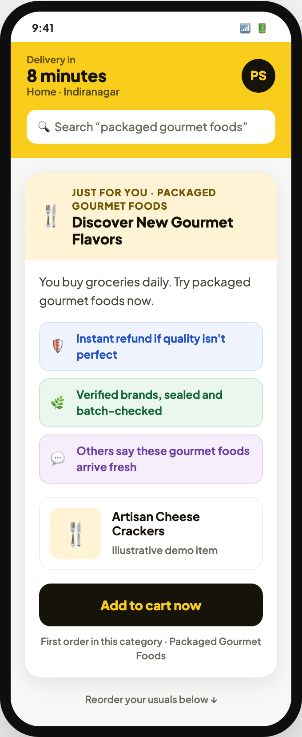
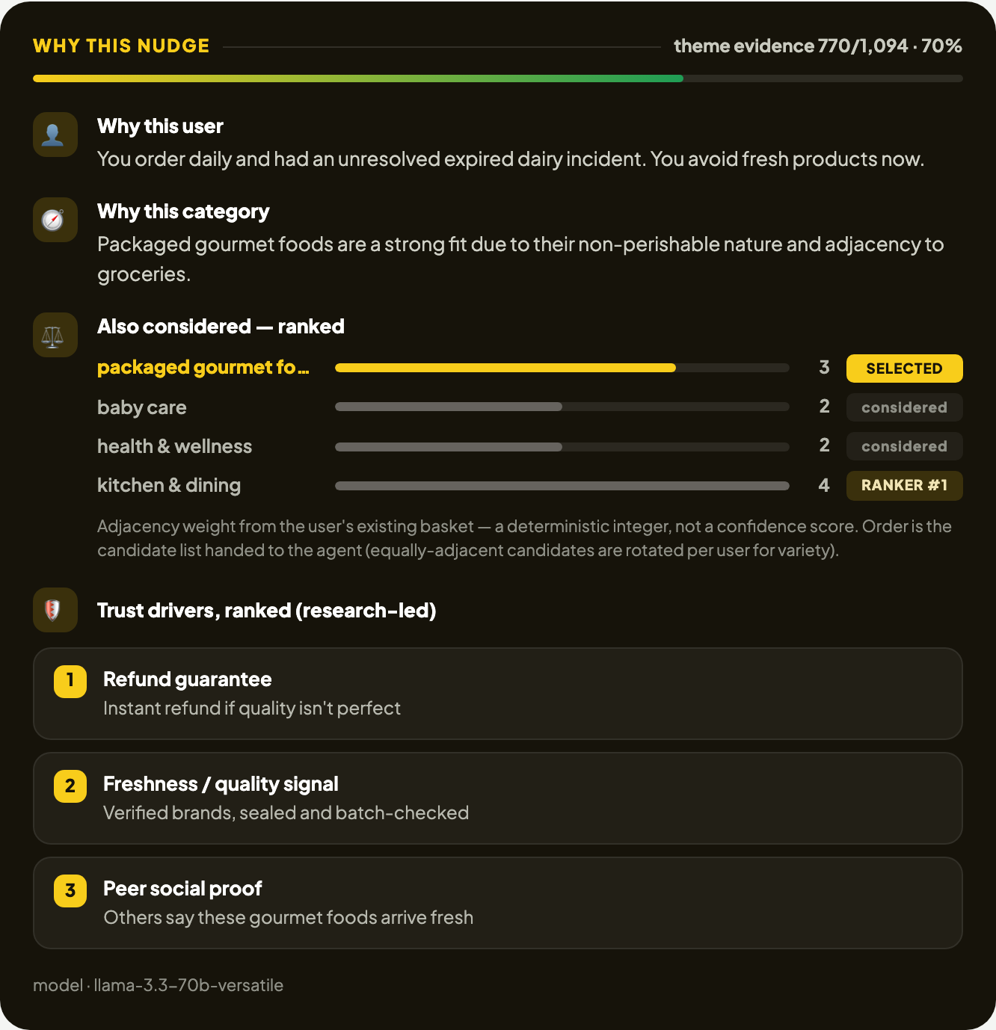
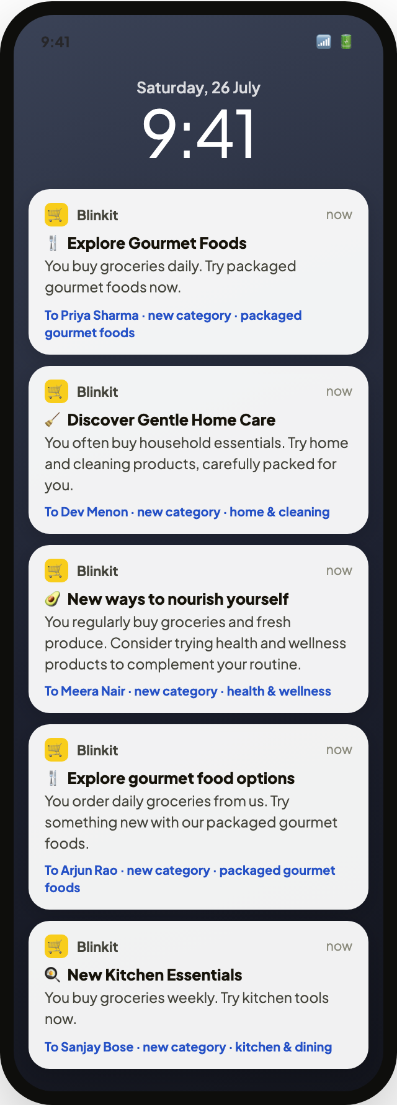
PART 4 · THE MVP, DEPLOYED
The agent runs today: a shopper-facing nudge, its reasoning, and the push queue behind it
DATA DISCLOSURE
8 synthetic user profiles, labelled SYNTHETIC in the product UI itself. No real customer data was available.
Open the live agent →
Leads with the two research-ranked trust drivers
No invented pricing — labelled illustrative
Deterministic ranker, integer weights — not model confidence
Copy generated live per user, not templated
Five users, four different categories — no collapse to one suggestion
The shopper's view — a trust-led nudge into one adjacent category.
The agent's reasoning panel — why this user, why this category, and what else was considered.
Push payloads from the auto-nudge queue.
Notes:
Annotated teardown of the deployed agent. All profiles are synthetic and labelled as such in the product UI.

Slide 9
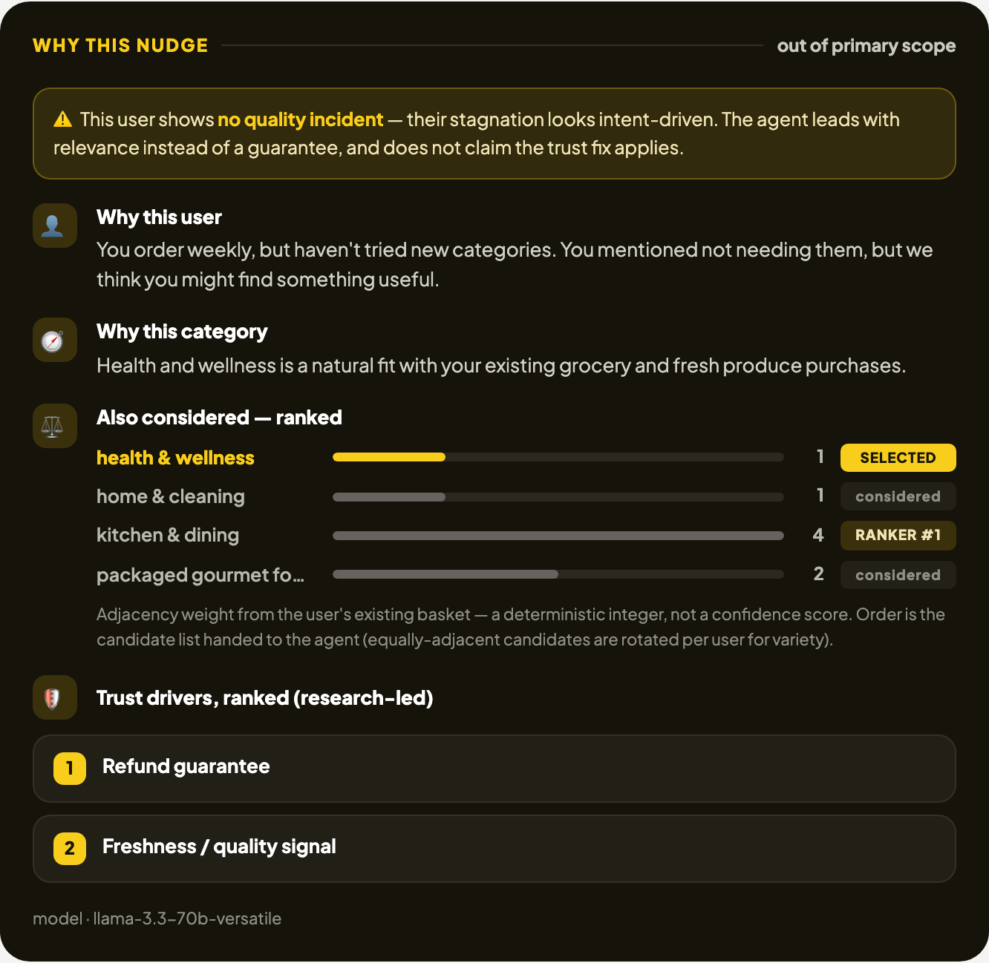
PART 4 · ARCHITECTURE AND LIMITS
Deterministic logic decides what to nudge; the LLM only writes the words
RUNTIME FLOW
Input User profile — cadence, tenure, category history, prior incident
Rule-based Friction match — profile to a Part 1 theme, no LLM
Rule-based Adjacency ranker — integer weights produce the candidate list
LLM Nudge generation — live Groq call writes copy and reasoning
Output Rendered nudge — refund guarantee first, then quality and freshness
Two integrity rules, enforced in the prompt
Never invent statistics. No ratings, buyer counts or success rates may appear in nudge copy.
Never overclaim to low-intent users. With no incident on file, the agent states the trust fix does not apply.
The product itself says when the fix does NOT apply. Amber banner, top of the panel — a low-intent user is told the trust fix isn't theirs.
Where it breaks: synthetic profiles, not real history · refund promise inherits fulfilment risk · packaging failures need an ops fix, not a message · switched-platform users may never see the nudge.
Notes:
Deterministic where correctness matters, LLM only for language. The product itself states when the fix does not apply.

Slide 10
MEASUREMENT · PROPOSED, NOT YET MEASURED
We would judge this on new-category adoption, in three tiers, with trust guardrails
Plan only. No experiment has been run and the MVP has never been shipped to real users, so no result numbers appear on this slide.
PRIMARY METRIC
% of monthly active customers who purchase from at least one new category that month
Measured against the nudged segment's own prior month, not against a headline average.
MEASUREMENT LADDER
Tier | What we would watch | Reads as
1 · Outcome | New-category purchase rate among nudged trust-blocked users | Did the behaviour change
2 · Mechanism | Nudge shown → opened → category browsed → item added | Which step leaks
3 · Durability | Repeat purchase in the newly tried category the following month | Trust restored, not just tested
HONEST SCOPE LIMIT
This moves the trust-driven share of stagnation only.
Around half the stuck segment reported no incident. Their stagnation is low intent, and a trust message is the wrong instrument for it. Any evaluation must report the two sub-segments separately or it will read as a failure of the wrong thing.
GUARDRAILS
Return and refund rate in nudged categories must not rise — a nudge into a genuinely bad category is a trust loss, not a win.
Complaint rate among nudged users, tracked against their own baseline.
Order frequency and nudge fatigue — reorder rate must not fall; opt-outs capped per user.
Copy audit sampled nudges checked for invented statistics; any hit is a release blocker.
WHAT WE'D BUILD NEXT
1 · Let users inspect before accepting
2 · A relevance-led nudge for the low-intent half
3 · Real behavioural data instead of synthetic profiles
Notes:
This is a plan. No experiment has been run, so there are no results on this slide — say that out loud.

