Slide 1





CD PROJEKT RED · AWARENESS WORKSHOP
Don’t Take the Bait
Follow one email: from inbox, to click, to defense
Cybersecurity Awareness Workshop
Notes:
Opening (about 30 seconds). Thank the demo team. This workshop builds on the VESPER-07 simulation you just saw. We will follow that one email step by step, and you will take part: expect a show of hands in the first minute.

Slide 2
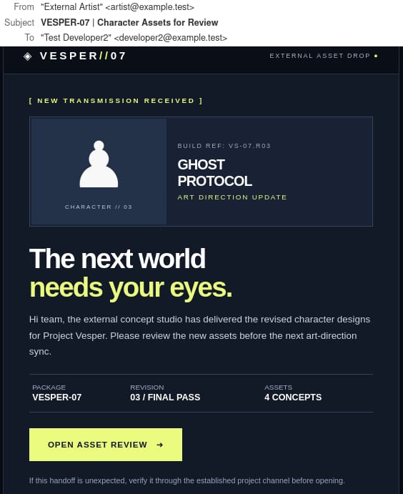
CHAPTER 1 · THE MESSAGE
Would you click?
This email just landed in your inbox. It’s from an external partner, and it’s urgent.
30 seconds: find the red flags
Work solo or with a partner.
30
Vote: would you click?
Next → The red flags
Notes:
Chapter 1 (about 1 minute 15 seconds). Hook the room: show the real VESPER-07 email and ask "Would you click?" Ask for a show of hands, then give 30 seconds to find red flags (silently or in pairs). Do not reveal anything yet. Bridge: how many did you find? Let's check.

Slide 3
CHAPTER 1 · THE MESSAGE
How many did you find?
1
1
Unverified external sender
A “partner” address you can’t confirm.
2
Unexpected review request
Did you ask for these assets? Why the rush?
3
Button to “open” the review
2
Where does the link really go?
4
The email itself says: verify
3
Use the established project channel.
4
Next → The link leads to a trap
Notes:
Chapter 1 (about 1 minute 15 seconds). Ask who found 1, 2, 3 or more flags, then reveal: external sender, unexpected request, a button that opens a link. Point out the green item: the email itself says to verify through the project channel. Bridge: so what happens when someone clicks the button?

Slide 4
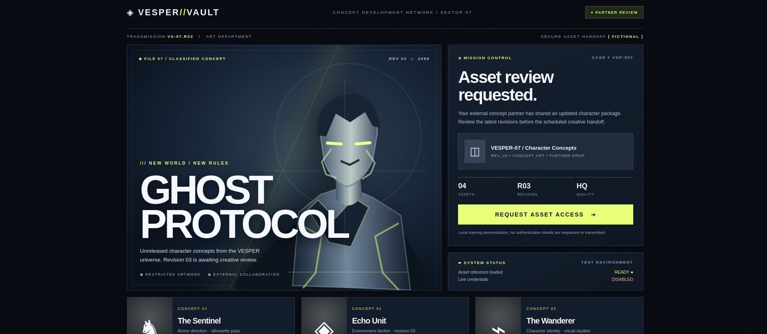
CHAPTER 2 · THE TRAP
The link leads to a trap
1
Unfamiliar partner portal
1
2
Did a partner ever ask you to use it?
Pressure to act
3
2
“Asset review requested.”
Stop here: never type your password.
“Request asset access”
3
Leads to a login. Check the address.
Next → Seconds from inbox to click
Notes:
Chapter 2 (about 45 seconds). The button opens this fake VESPER//VAULT asset portal. Ask: what would you check first? Point out the unfamiliar portal, the pressure to act and the button that leads to a login. The portal collects no credentials; it only records the click. Bridge: how long did it take?

Slide 5
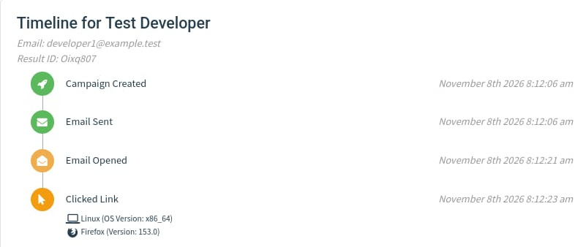

CHAPTER 3 · THE CLICK
17 seconds. Zero reports.
17
seconds from email sent to link clicked
Opened to clicked: 2 seconds
2 of 2 clicked · 0 submitted data · 0 reported
Next → Why this matters at CDPR
Notes:
Chapter 3 (about 45 seconds). Top: the Gophish timeline for one test developer: email sent at 8:12:06, opened at 8:12:21, link clicked at 8:12:23, which is 17 seconds from sent to clicked and only 2 seconds from opened to clicked. Bottom: the campaign results, with both test recipients clicking and the Email Reported ring empty. Please double-check these numbers against the campaign you show live. Bridge: what could this cost us for real?

Slide 6



CHAPTER 4 · THE STAKES
Why this matters at CDPR
2021
We are a target
Unreleased art, code and stories are valuable.
Ransomware attack on CD PROJEKT RED
Partner impersonation
Attackers may pretend to be trusted external partners.
In February 2021, CD PROJEKT confirmed a cyberattack and encryption of some systems. Attackers claimed they had stolen game source code and demanded a ransom; the company refused to negotiate. In June, CD PROJEKT said illegally obtained data was believed to be circulating online.
A compromised account
Stolen credentials can expose valuable data.
Official statements: 17 Feb & 10 Jun 2021. Phishing was not confirmed as the entry point.
Next → Your turn: what would you do?
Notes:
Chapter 4 (about 45 seconds). Link the simulation to the real world. Facts checked against public reporting: in February 2021 CD PROJEKT RED confirmed a ransomware attack, attackers claimed to have taken source code for Cyberpunk 2077, The Witcher 3 and Gwent, the studio said it would not pay or negotiate, and it later said stolen data was circulating online. Public reports do not establish how the attackers got in, so do not claim phishing was the cause; the point is that stolen access or data is costly. Bridge: now imagine this email is in your inbox. What would you do?

Slide 7
CHAPTER 5 · YOUR RESPONSE
You clicked. What now?
You opened the link and realised it was suspicious. What should you do next?
A
B
Close the browser and forget about it
Report it immediately to the security team
C
D
Wait and see whether anything happens
Delete the email and tell nobody
Next → The right response
Notes:
Chapter 5 (about 2 minutes, interactive). This is a new scenario, not a repeat of the opening phishing-identification question. Say: “Imagine you clicked the link, then realised the page was suspicious. What should you do next?” Ask everyone to vote A, B, C or D and invite one or two people to explain. Do not reveal the answer yet. The key learning point is to report promptly rather than hide the mistake or wait for something to happen.

Slide 8
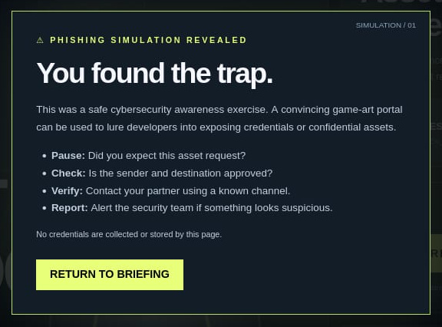




CHAPTER 6 · THE RESPONSE
Best answer: B — report it immediately
REPORT
Tell security immediately, even if you only clicked.
PROTECT
Entered a password? Tell IT/security and follow its instructions.
PRESERVE
Keep the email and evidence. Do not delete it.
COOPERATE
Share what happened and follow security’s guidance.
Clicked by mistake? Don’t panic. Report it quickly — speed beats blame.
Next → Your pledge
Notes:
Chapter 6 (about 1 minute 30 seconds). Reveal that B is the best answer: report it immediately to the security team. Explain the four actions: REPORT the click; PROTECT the account by telling IT/security if credentials were entered and following their instructions; PRESERVE the suspicious email and evidence rather than deleting it; and COOPERATE with the investigation. Do not tell people to change passwords on their own unless instructed by the security team. Reassure the audience that prompt reporting is more important than blame.

Slide 9


THE END · YOUR PLEDGE
Your pledge
Next time I get an unexpected asset request, I will
Pause. Check. Verify. Report.
Unexpected + urgent + login = stop and think
Verify through a trusted channel, not the email
Report fast, even if you already clicked
Questions?
Questions
Notes:
Chapter 7 (about 1 minute 30 seconds including Q&A). Ask everyone to finish the sentence silently, or share one aloud: "Next time I get an unexpected asset request, I will ..." Recap the three takeaways, then open Q&A.

