Slide 1
ReadMe
‘Article Reading Service’
By
Ben Rochlin @BenjaminRochlin
Shelby El-rassi @theartydev

Slide 2

What is ReadMe?
ReadMe is an 'article reading service' in which a user inputs a link to an article and ReadMe website converts the text from the article to audio and outputs a file that can either be downloaded or streamed directly from the site.
Purpose? It is convenient service for article reading, whether on the go, driving, public transport, or simply prefer listening over reading. It is also is useful as filters out any unnecessary text and ads.

Slide 3
Initial Idea/Plans
Utilising a web scraper for any news article/blog/post
Amazon Polly for text to speech
Amazon s3 for file storage of mp3
Service for emailing the file to user
File be available for download
Instant streaming

Slide 4
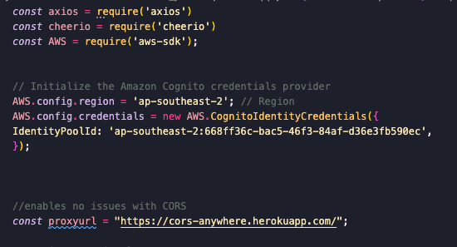
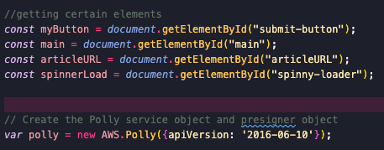
Implementation
Amazon Identity Pool houses the AWS creds
NPM modules used, with the help of Browserify Module which enabled these modules to be used client-side for this project
Heroku Cors Anywhere proxy
Instantiating a new AWS polly

Slide 5
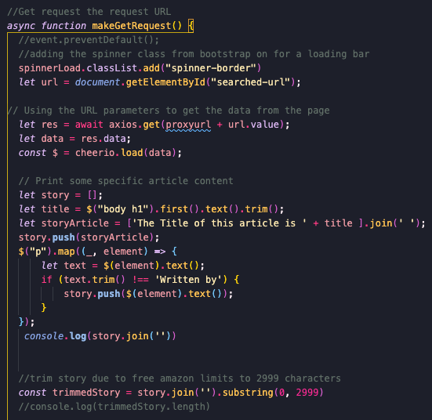
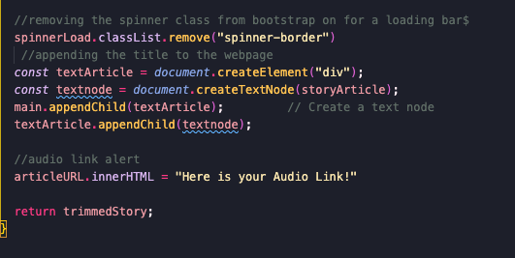
User can input a URL into the search
Starts an Async function
When loading a loading bar will appear
Axios will then get the URL
Cheerio will scrape the article headings and text from the page and input them into a variable (initially looked at Puppeteer, but that can only be used server side)
Trimmed the story length using substring due to character limits on free AWS
Loading stops once that article title has appended to the page and link alert appended

Slide 6
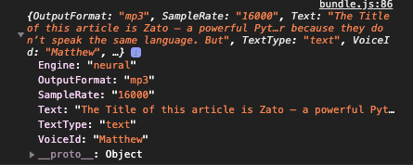
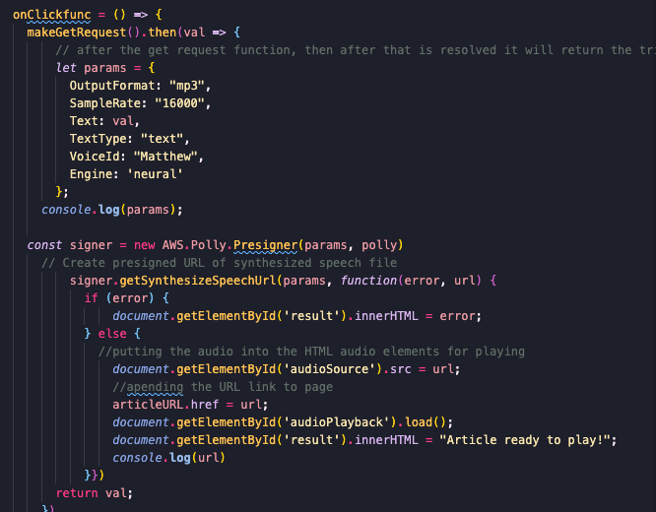
On the user clicking search the get request is made then..
Using parameters given (including the text) Amazon Polly will then Synthesize the text into a URL
Amazon Polly will also process the URL into a clickable link and feed into audio element
(we preferred to use a Speech Task with Polly to allow for more character limits, due to time frame we kept it simple with just Speech URL method.
The Article Title Will Output for reference and play notification

Slide 7
Future Plans
User being able to input their email address for the file to be sent to them
Fine tuning of the text scraping so most articles would be compatible(Node Module Puppeteer would allow for this, however can only be used with a server)
The output file being a downloadable audio file
Settings Page: Choose Voice, speaking speed and other optional parameters
Fine tuning validation- Url validator, errors for invalid etc

Slide 8
Thank you!

