Slide 1


Shelby El-rassi
Portfolio

Slide 2



Inspiration

Slide 3
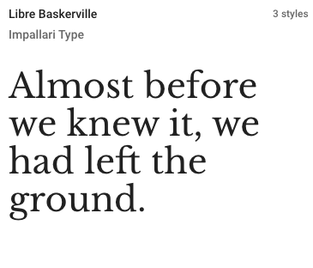
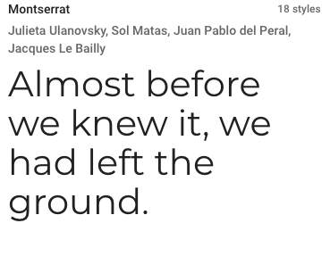
Typography

Slide 4
Sitemap
Home
About
My Work
Blog
Contact
Blog 1
Blog 2
Blog 3
Blog 4
Blog 5

Slide 5
Navigation

Slide 6
Features Site-Wide

Slide 7
Features

Slide 8
Home

Slide 9
About

Slide 10
My Work

Slide 11
Blog Posts

Slide 12
Contact

