Slide 1
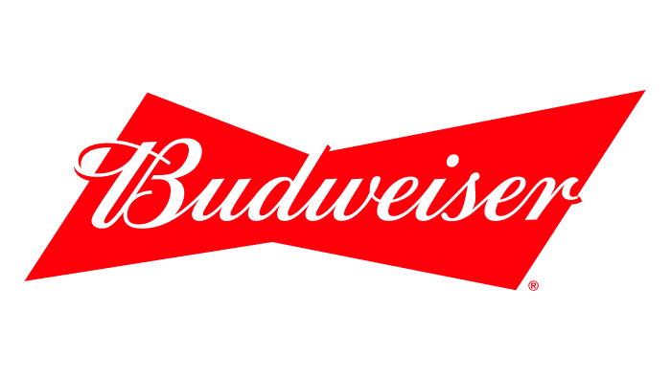
Budweiser
Case Study 1

Slide 2
Executive Summary
Colorado has the most craft breweries of any state in the data, despite making up less than 2% of the U.S. population.
States with high craft breweries per capita can be targeted with craft beer promotions..
There appears to be a strong correlation between alcoholic content (ABV) and bitterness (IBU).
Within the data, ABV and IBU are roughly 99% accurate in predicting whether a beer is an India Pale Ale (IPA) or an Ale other than an IPA.

Slide 3
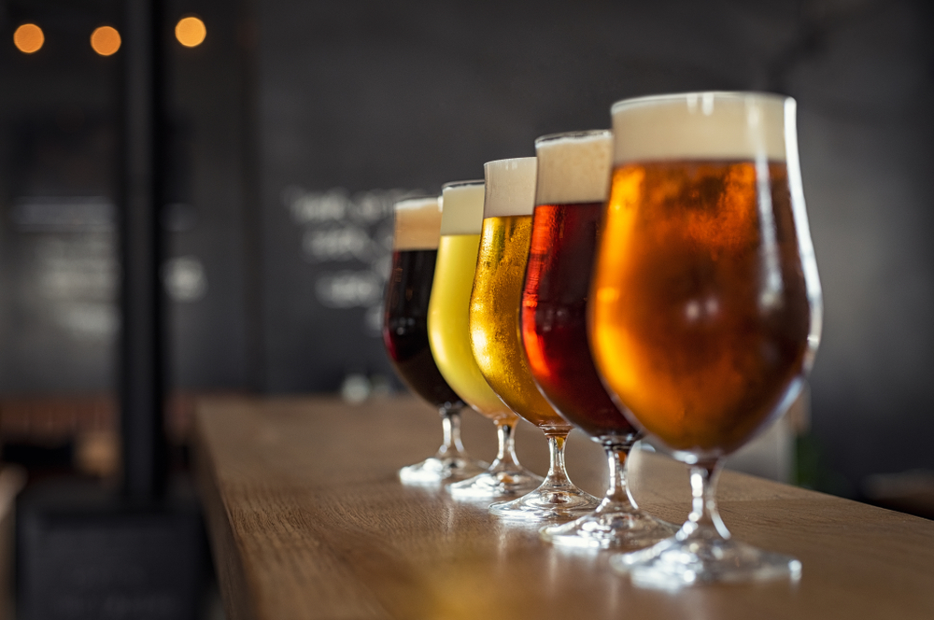
Data Introduction
The dataset used for this analysis contains a list of 2,410 U.S. craft beers, produced by 558 unique breweries
The data contains brewery names, brewery locations as well as numeric measures for each beer such as alcoholic content and bitterness
Of the 10 unique variables in this study, two have missing values:
Alcoholic Content (ABV) – 62 Missing Values / 2.6% of the Dataset
International Bitterness Score (IBU) – 1005 Missing Values / 41.7% of the Dataset

Slide 4
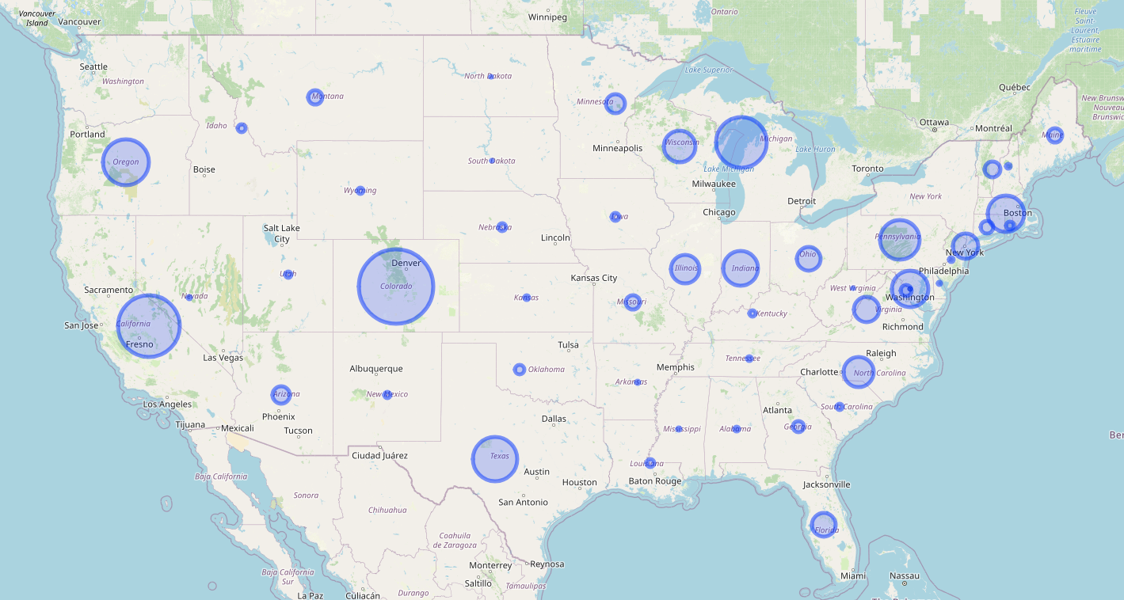
Visualizing Breweries By State – (SIZE Represents Number of Breweries)
States With Most Breweries:
Colorado (47)
California (39)
Michigan (32)
Oregon (28)
Texas (27)
States With Least Breweries:
District Of Columbia (1)
North Dakota (1)
South Dakota (1)
West Virginia (1)

Slide 5
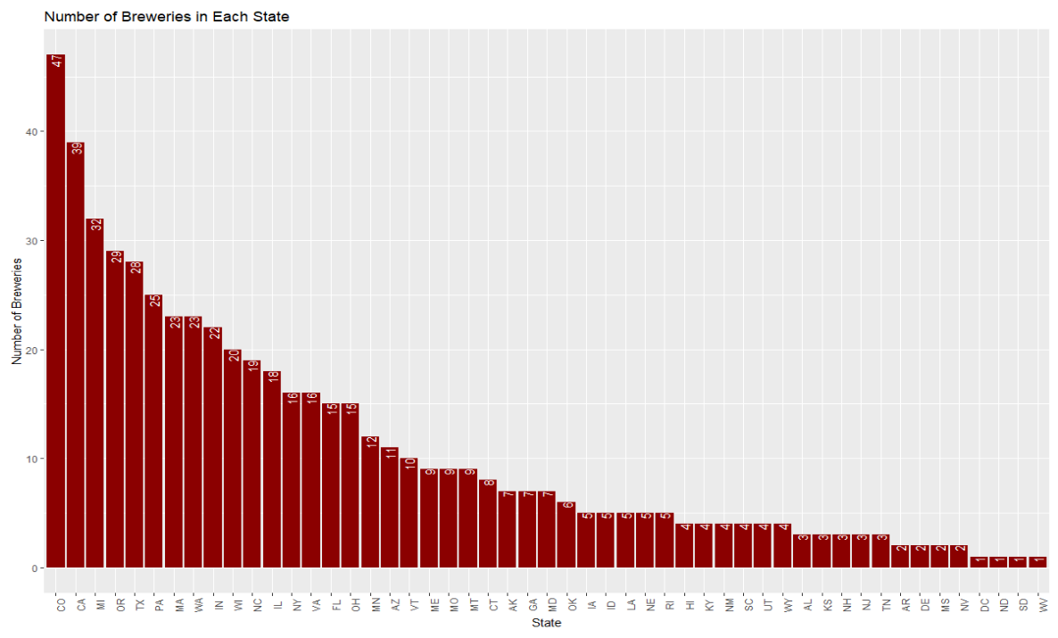
Investigating Breweries By State
Colorado accounts for roughly 1.8% of the U.S. population but is home to the most breweries, accounting for 8.4% of all the breweries in the data

Slide 6
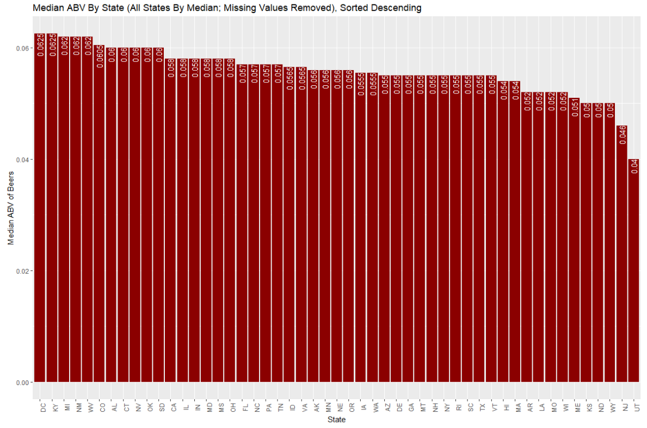
Examining Median ABV By State
Overall median ABV = 0.056 or 5.6%

Slide 7
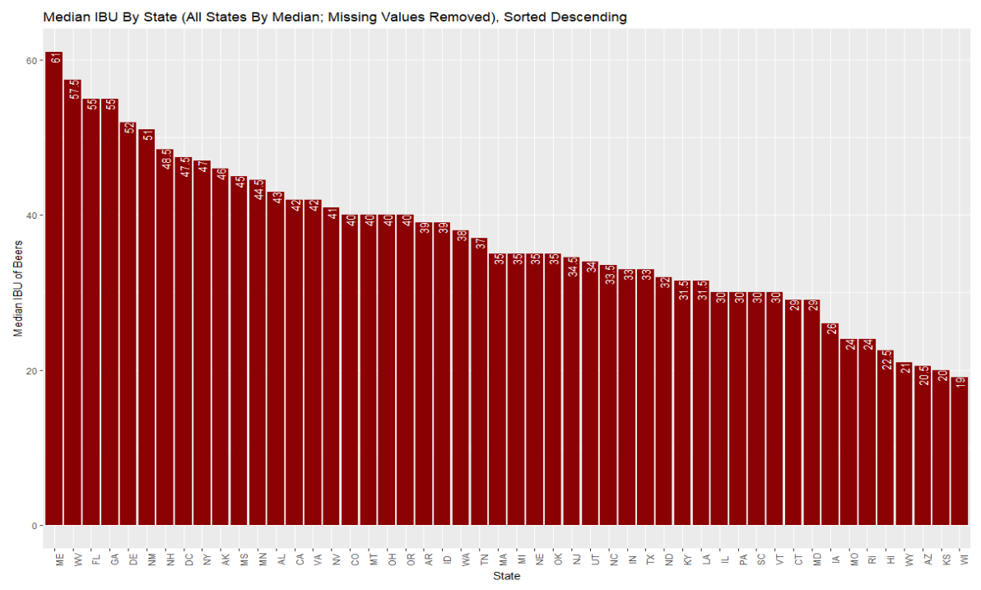
Examining Median IBU By State
Overall median IBU = 35

Slide 8
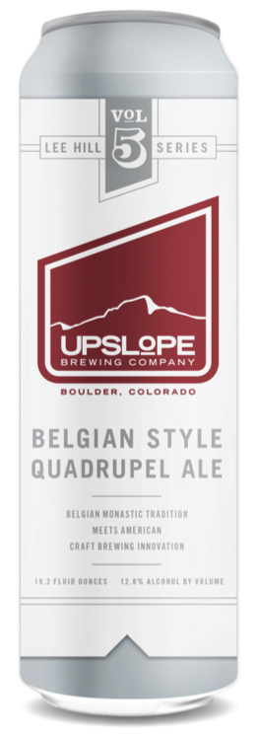
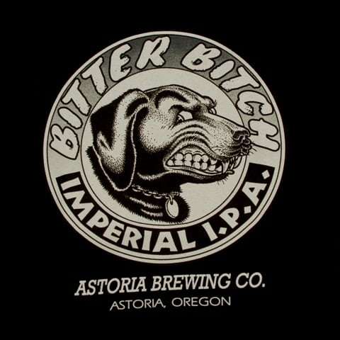
Most Bitter & Most Alcoholic Beers
Colorado has the maximum alcoholic beer (ABV): (Lee Hill Series Vol. 5 - Belgian Style Quadrupel Ale, Upslope Brewing Company, ABV = 12.8%)
Oregon has the most bitter beer (IBU): (Bitter Bitch Imperial IPA, Astoria Brewing Company, IBU = 138)

Slide 9
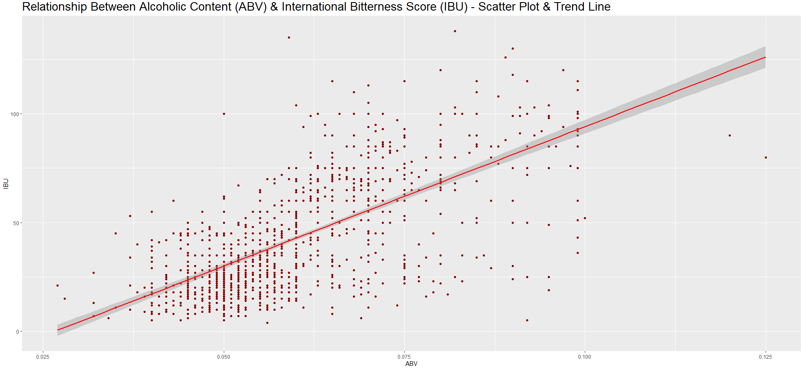
Visualizing the relationship Between ABV & IBU
There seems to be a clear relationship between ABV & IBU
The superimposed trend line shows the relationship is quite strong: as one rise, the other does as well
IBU = -34.1 + 1282.037(ABV)

Slide 10
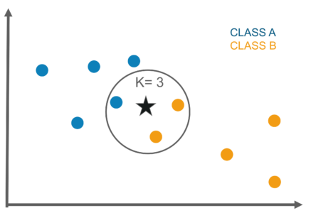
Leveraging Machine Learning – IPA Predictions
The KNN (K Nearest neighbors) algorithm looks at the ‘k’ closest points to a new point
‘k’ is specified by the analyst and different values of ‘k’ can have different results
New data points are evaluated by the class of the points closest to them.

Slide 11
Classification Accuracy
IPA’s
All Ales other than ipa’s
This model is 98.93% accurate in predicting whether a beer is an IPA using ABV and IBU. We are 95% confident that the true accuracy is between 96.91% and 99.78%.
This model is 98.93% accurate in predicting whether a beer is an Ale other than IPA using ABV and IBU. We are 95% confident that the true accuracy is between 96.91% and 99.78%.

Slide 12

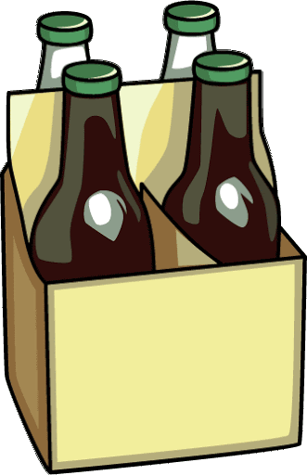

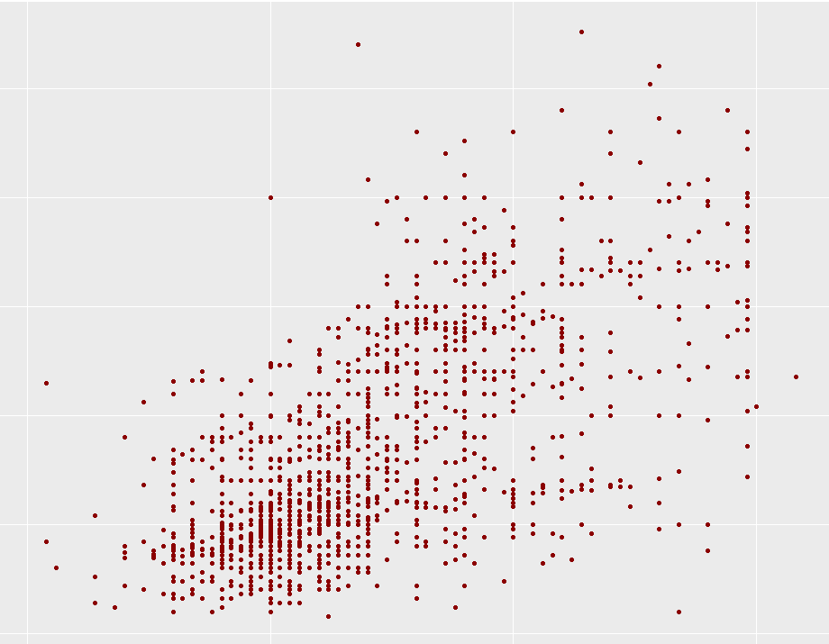
Leveraging Machine Learning – IBU Prediction Engine
Almost 42% of all beers are missing an IBU value
Using machine learning techniques, is It possible to build an automated prediction engine, based on beer type
ABV & IBU After ML-Based Predictions
2%
4%
IBU
6%
Beer Type
ABV
Location
Machine Learning Pipeline
ABV
IBU Predictions

Slide 13
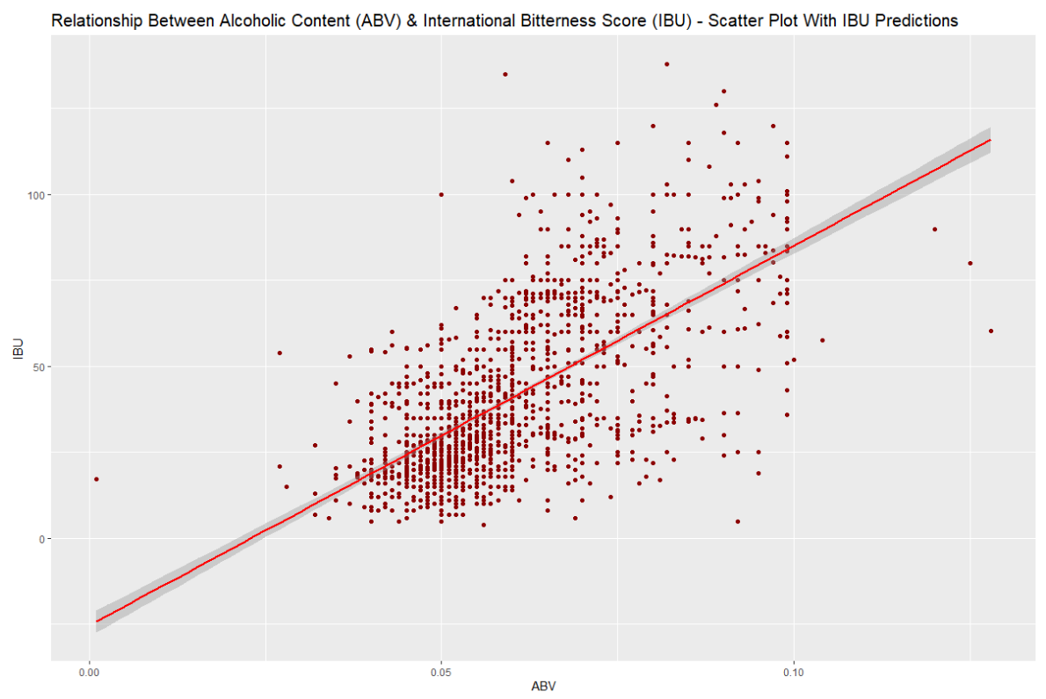
Relationship between ABV and Ibu with predictions from Random Forest

Slide 14
Potential Next Steps
Augment IBU predictions via expanded data set
Untapped customer reviews / key word parsing
Pull in relative popularity of beers as a predictor of bitterness
Pilot an IPA campaign in state with high craft breweries per capita
Leverage machine learning pipeline to predict ibu’s missing from the dataset and analyze this data for deeper insights

Slide 15
YouTube Video Link
https://youtu.be/eZxd4WhOxTw

