Slide 1
Knowledge Graph Database for COVID-19 Drug Discovery
Joey (Aryaman) Dubey
Guided by: Reynold Cheng and Xiaodong LI

Slide 2
Motivation
Very relevant topic. SARS-CoV-2 outbreak (COVID-19) has become a pandemic
No effective COVID-19 drug treatment known yet
Discovery of new drugs very time consuming + expensive
Repurposing of existing drugs using network based strategies effective

Slide 3
Knowledge Graph Method
Combining different types of related data: higher prediction making accuracy
Network-based data models: Heterogenous Information Networks (HINs)
HINs used in various link prediction applications
Eg of HIN: Knowledge Graph – used for our COVID-19 drug prediction

Slide 4
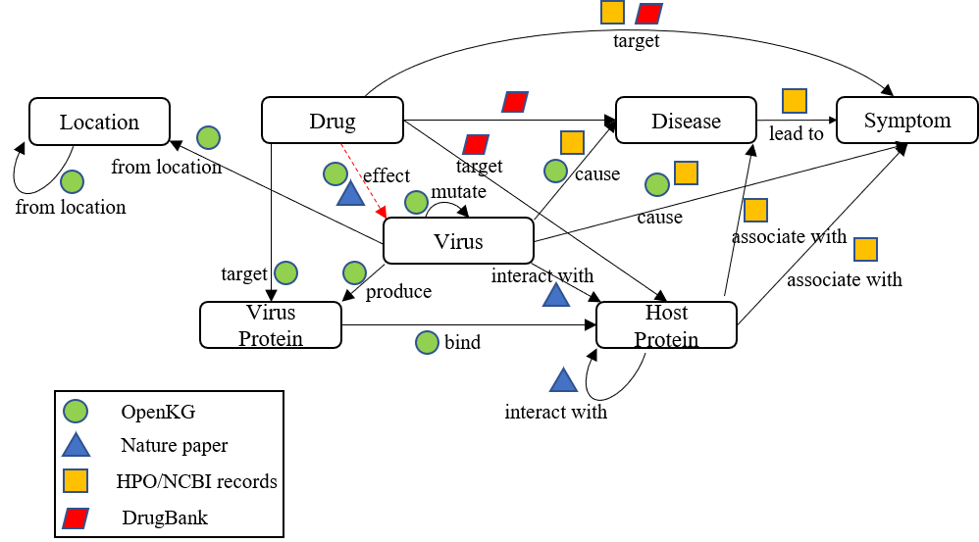
KNOWLEDGE GRAPH SCHEMA

Slide 5
1. Motif Matching
Knowledge Graph too complex & large (several thousand nodes + edges)
Decompose recursively into small subgraph patterns of size k nodes: called motifs
For small values of k, some fast and efficient motif enumeration algorithms exist
We generate motifs with k = {1, 2, 3, 4}. *(k = 5 to be implemented in future)

Slide 6
MOTIF Types (3-node)
i. Triangle
ii. 3-Star

Slide 7
ALGORITHM (Motif MATCHING)
get seed node i for node i: get neighbours j, k of i if edge(j, k) exists: return triangle else: return 3-star
3 node motifs:

Slide 8
MOTIF Types (4-node)
i. 4-Path
iii. Tailed Triangle
v. Diamond
ii. 4-Star
iv. Rectangle
vi. 4-Clique

Slide 9
ALGORITHM (Motif MATCHING)
if maxDegree == 3: get seed node i for node i: get neighbours j, k, p of i if edge(j, k) exists: if edge(j, p) exists: if edge(k, p) exists: return 4-clique else: return diamond else: return tailedTriangle else: return 4-star else: get first seed node i get neighbours j, k of i get neighbour p of second seed j: if edge(k, p) exists: return rectangle else: return 4-path
4 node motifs

Slide 10
ALGORITHM (Motif MATCHING)
A
B
A
B
Motifs can have multiple labels of same kind
Overcounting risk
Example: Rectangle motif with labels A & B, triangle motif with labels A & B
A
B
B

Slide 11
Algorithm (Motif Matching)
C
The configuration of label A nodes remains same, if swapped. Same orbit. Overcounting risk.
B
Too avoid overcounting risk, we use concept of orbits
Nodes whose configuration (degree, neighbours) remain same if swapped with each other, are considered in same orbit
Example: consider tailed triangles with labels A, B, C as shown
A
A
A
The configuration of label A nodes changes, if swapped. Different orbits. No overcounting risk.
B
A
C

Slide 12
2. Motif based linked prediction
Predict which link is likely to appear in graph
Prediction made by studying topological features of graph edges & nodes
Most features rely on neighbourhood of nodes
Higher order motifs (k > 3) ➔ higher prediction accuracy
Motif feature vector generation

Slide 13
2. Motif based linked prediction
Drug
Nodes in knowledge graph: Drug, Disease, Host Protein, Symptom, Virus, VirusProtein, Strain, Location
Link to be predicted: Drug (?) <===> Virus (SARS-CoV-2)
Host Protein
Link to find
Virus Protein
Virus
Hypothetical motif for visualisation

Slide 14
Link Prediction
Symptom
Virus
Current approach: manually select “interesting motifs” (must contain “Drug” node & “Virus” node)
Higher motif score ➔ greater chance of Drug-Virus link existence
Present algorithm: measure frequency of particular drugs in “interesting” motifs; higher frequencies → better candidate drugs
Drug
Symptom

Slide 15
Link Prediction
Symptom
Virus
Consider the rectangle motif depicted in previous slide.
Occurs 174 times in KG
Check frequencies of drugs occurring in motif: Drug A frequency: 164 Drug B frequency: 10
Algorithm predicts higher likelihood of Drug-Virus link for Drug A.
Drug
Symptom

Slide 16
LINK PREDICTION
Previous step gives some interesting results for further use
Present algorithm, next step:
use “interesting” motifs to generate motif feature vector
For each drug, sum all the corresponding motif feature vector elements
Resulting sum is drug’s score
Higher sum > greater chance of Drug-Virus link

Slide 17
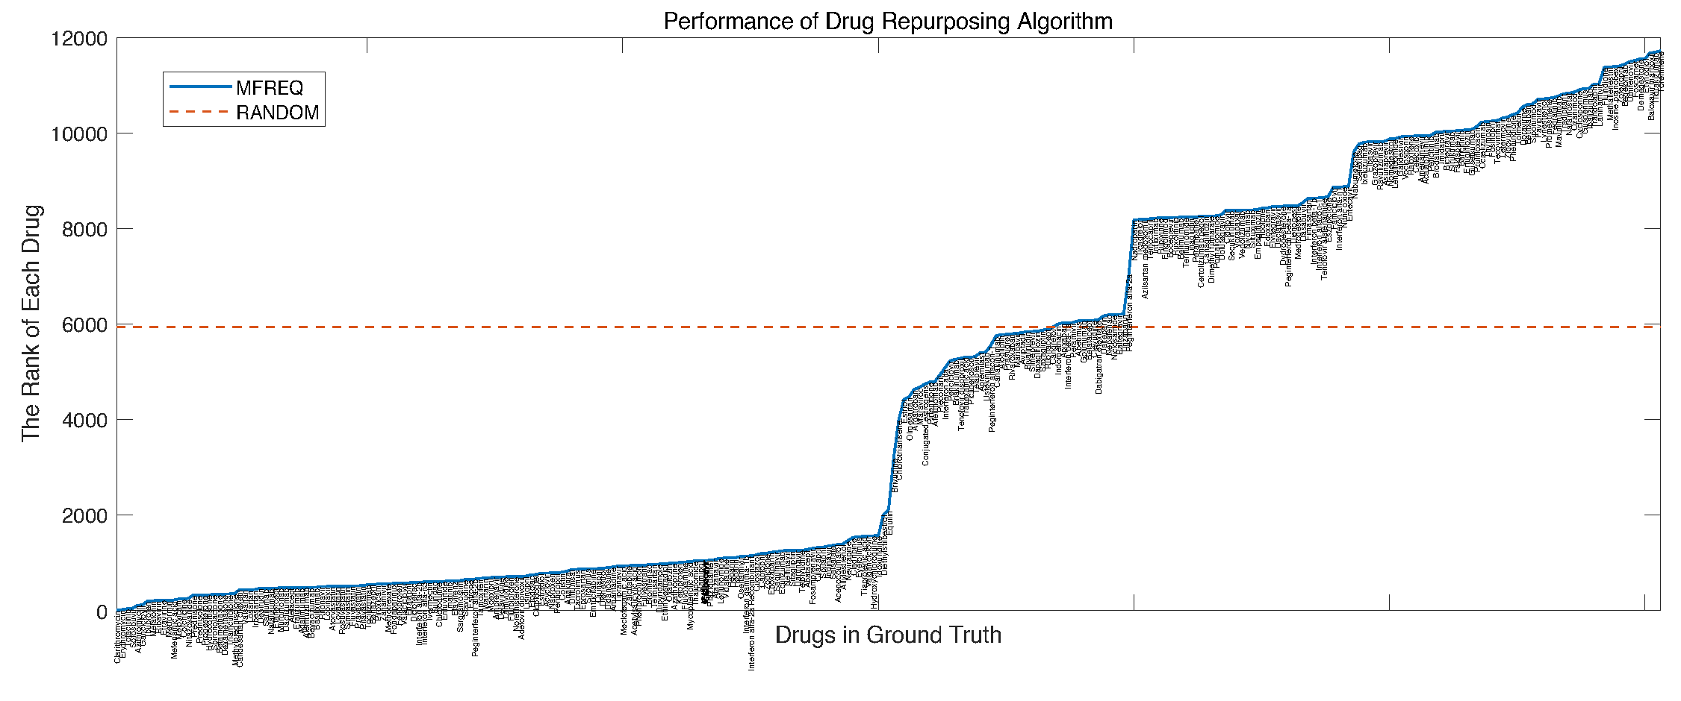

Slide 18
LINK PREDICTION
Future plan:
Motif Frequency algorithm outperforms random algorithm
But can be more accurate
Develop another algorithm
Apply deep learning models using KG motifs to train new algorithm

Slide 19
THANK YOU

