Slide 1
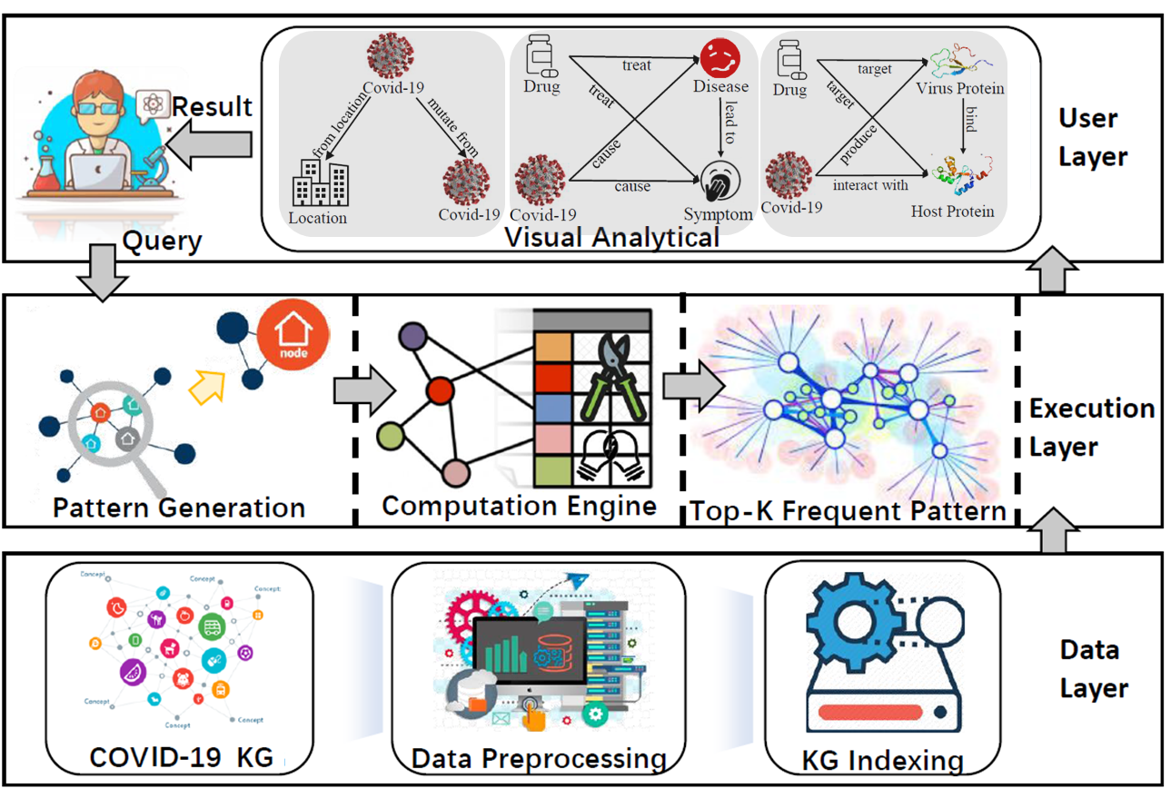


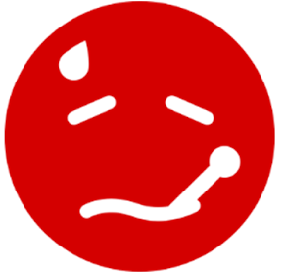
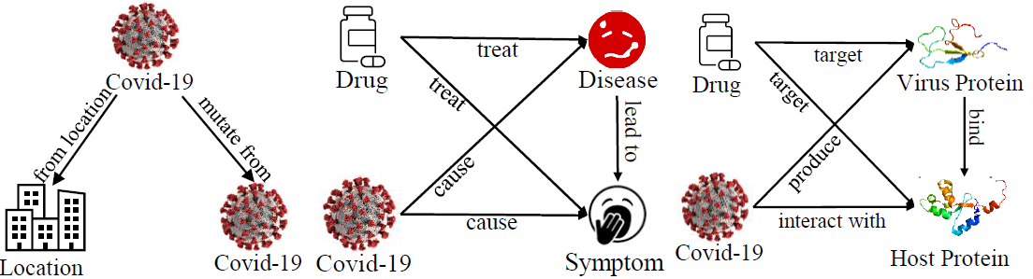

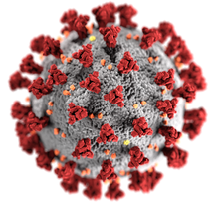
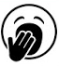
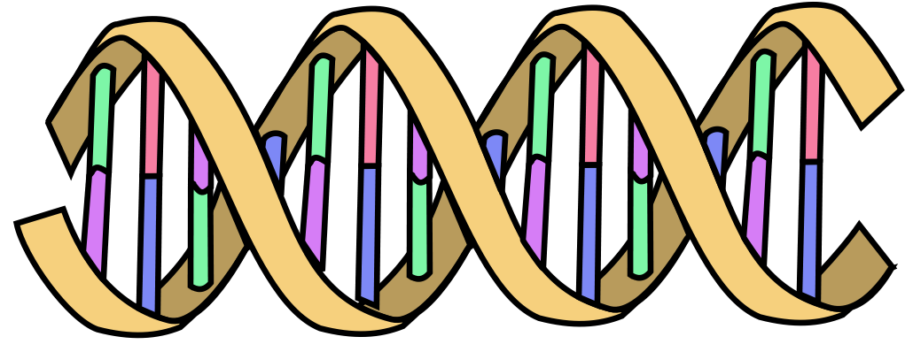
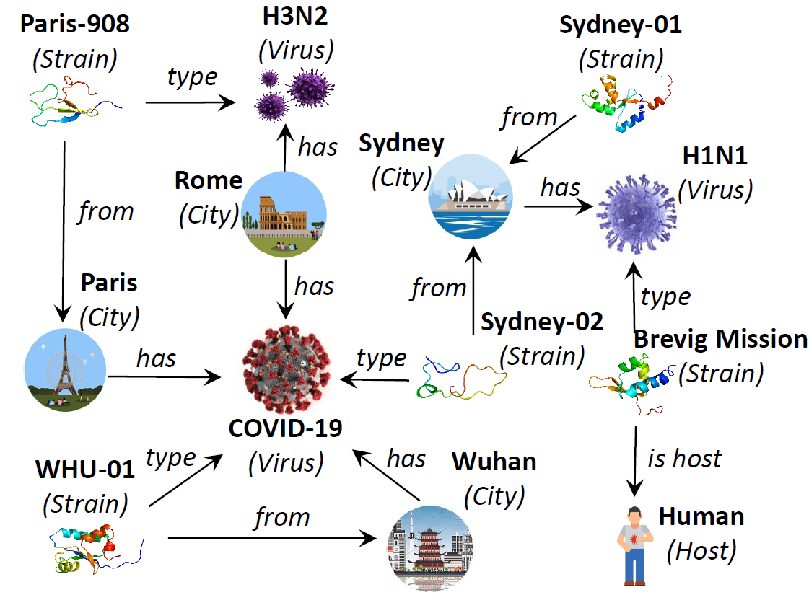
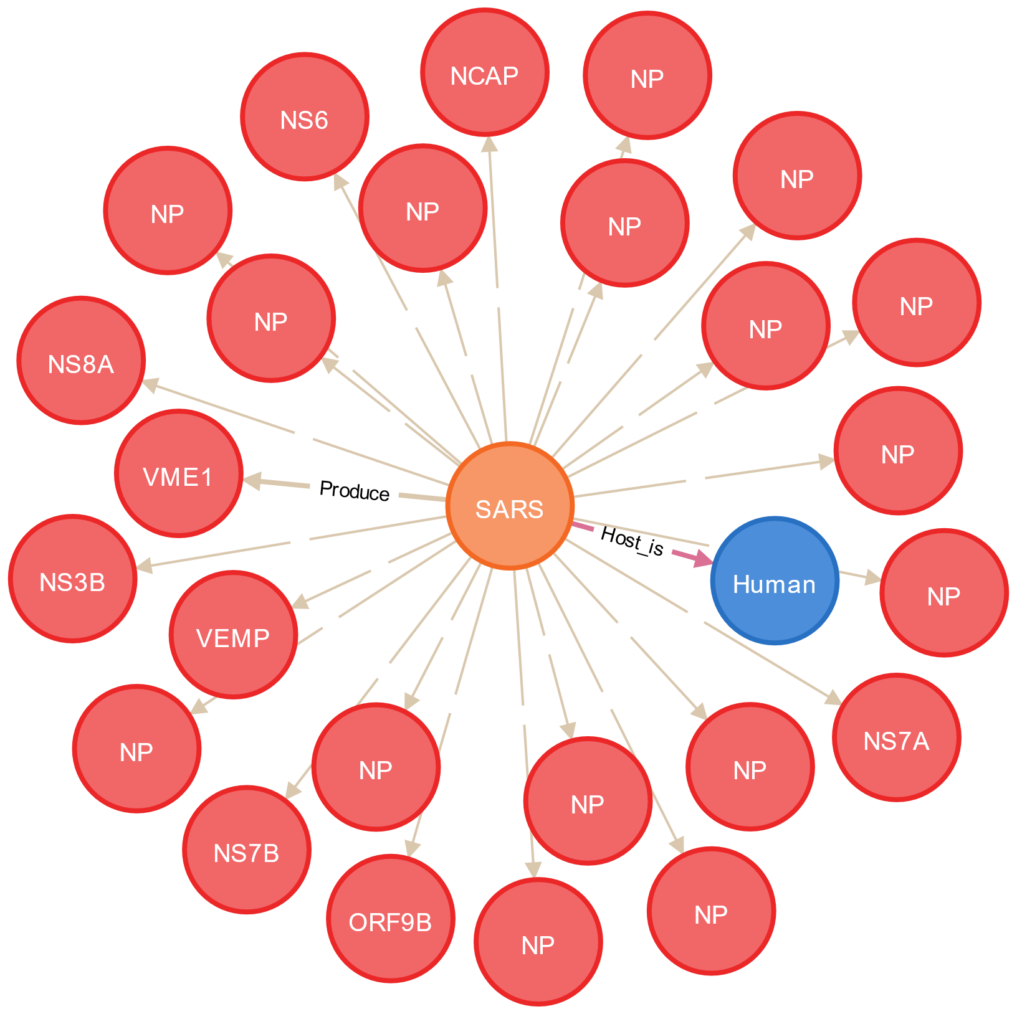


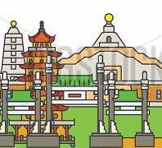
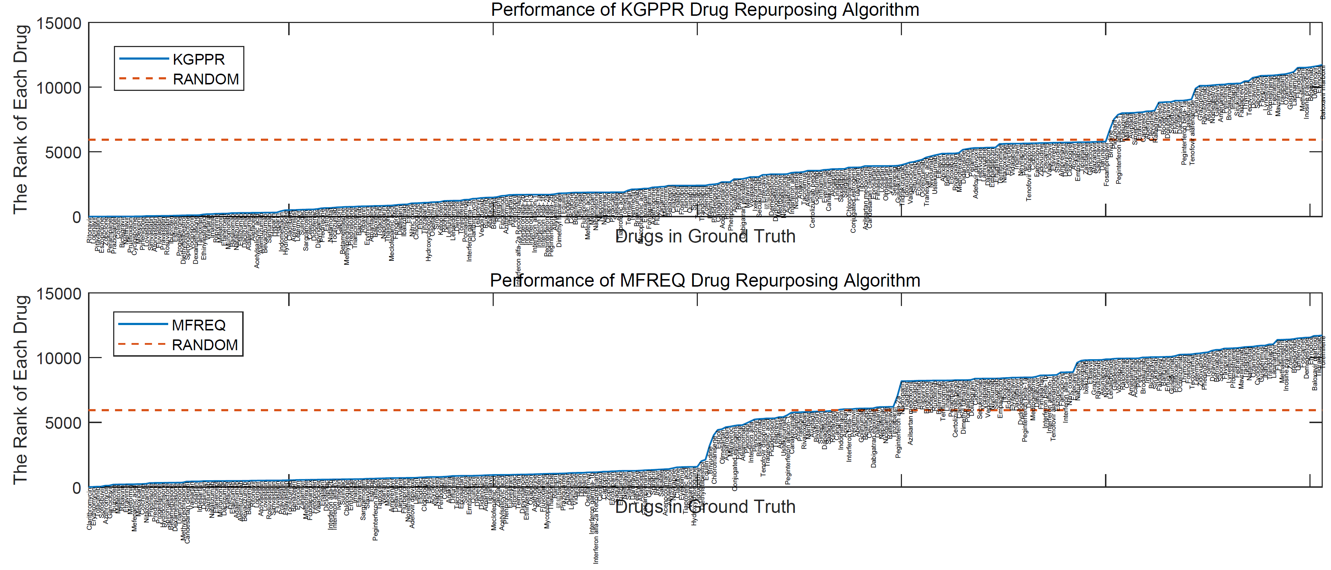
Section | Group No.
Postgraduate | PG05
Drug Repurposing for COVID-19: A Knowledge Graph Approach
建立用於新冠肺炎藥物開發的知識圖譜平台
Xiaodong Li, Min Ou, Xuxiao Chris Ye, Wenya Sun
Supervisors: Prof. Reynold Cheng, Dr. Ruibang Luo, Dr. Esther Chan
Department of Computer Science & Pharmacology and Pharmacy
The University of Hong Kong
Motivations
Knowledge Graph Schema
System Architecture
SARS-CoV-2 outbreak (Covid-19) has become a global pandemic.
No known effective Covid-19 drug treatment.
Discovery of new drugs is time consuming + expensive.
Traditional drug-repurposing methods (e.g., protein docking) does not consider complex interrelationship of drugs, proteins, genes, symptoms, diseases, etc.
Therefore, we repurpose existing drugs using network-based strategies.
Drug
treat
Disease
Location
from location
mutate
from
target
treat
cause
lead to
associate with
from location
target
cause
Symptom
associate with
Virus Gene
express
Covid-19
interact with
produce
Host Gene
translate
Virus Protein
produce
bind
Host Protein
host is
host is
interact with
interact with
Host
Integrated from OpenKG, HPO, NCBI, and DrugBank.
Over 48K nodes and 815K edges!
M-Cypher: powerful tool to analyze knowledge graph
Queries
Covid-19
mutate from
mutate from
mutate from
from location
Covid-19
M-Cypher parser
interact with
VM-2493
Covid-19
Branch 1749
Sweden-01
Jönköping
from location
mutate from
Java
Cypher
JavaScript
Visualization
Host Protein
host is
Human
from
location
mutate from
Covid-19
Branch 1707
mutate from
from location
Location
Covid-19
JVM
Neo4j
JS Engine
Cytoscape
Hong Kong
from location
TW-02
Kaohsiung
Result
Graph Filter
MATCH (m:M)
WHERE s.Virus = “SARS-CoV-2”
RETURN COUNT(m)
HKPU-20,42,48,53,54,61
MATCH (s:Location)-[m:M*]->(t:Location)
WHERE s.name = “Hong Kong”
RETURN t.name
M-Cypher framework
The top virus protein in SARS-CoV is NP!
Hong Kong, Kaohsiung and Jonkoping have identical branch 1707!
Drug Repurposing Algorithms
Alg.2 Motif based Link Prediction
Alg.1 Knowledge graph Personalized Page Rank
Source node
Host
Human
Virus
SARS-CoV-2
Knowledge Graph too complex & large (hundreds of thousands of edges).
Motifs: small & frequent graphlets of size k nodes, k = 1, 2, 3, 4, 5.
Use “interesting” motifs M to generate Motif Feature Vector (MFV). For each drug D, MFV describes the frequency of M that contains s and SARS-CoV-2. Train a classifier with input (MFVs) to predict if the link (D, SARS-CoV-2) exists.
Greater chance of D to serve in covid-19 treatment if the link has higher existential probability.
Personalized Page Rank (PPR) is used by Twitter to present users with recommendations of other accounts that they may wish to follow.
We adapt PPR into a knowledge graph version.
Source node (SARS-CoV-2), target node (Each drug), with parameters: damping factor 0.85, iteration 2M.
Drug
nelfinavir
Target node
Disease
Acute respiratory coronavirus infection
Symptom
Virus
SARS-CoV-2
Protein
ORF8
Protein
SPIKE
Protein
Nsp3
Link to find
Virus
Bat SARS-CoV
Drug
Symptom
Virus
SARS-CoV
Drug Repurposing Results
Highlighted Drug Candidates for Repurposing
Knowledge graph personalized page rank.
Drug_name | Clinical_trial | Drug_type | Rank
Ritonavir | Y | Antiviral agents | 0.01%
Lopinavir | Y | Antiviral agents | 0.02%
Pitavastatin | N | Statins | 0.03%
Moexipril | N | ACEIs | 0.12%
Lovastatin | N | Statins | 0.35%
Simvastatin | N | Statins | 0.36%
Atorvastatin | N | Statins | 0.37%
Fluvastatin | N | Statins | 0.44%
Pravastatin | N | Statins | 0.46%
Rosuvastatin | N | Statins | 0.47%
Dexamethasone | Y | Corticosteroids | 0.84%
Sarilumab | Y | immunosuppressants | 2.60%
Hydrocortisone | Y | Corticosteroids | 4.10%
Prednisone | N | Corticosteroids | 5.42%
Tocilizumab | Y | immunosuppressants | 5.81%
A Random Algorithm to recommend drugs.
Motif-based drug recommendation.
Almost all drugs currently in clinical trial are recommended by our algorithms in top 10% from 11865 candidates in DrugBank!
Potential drugs for covid-19 treatment but not currently considered in trial are also discovered: statins, ACEIs and corticosteroids, with literature support!
Gheblawi, Mahmoud, et al. Angiotensin-converting enzyme 2: SARS-CoV-2 receptor and regulator of the renin-angiotensin system: celebrating the 20th anniversary of the discovery of ACE2. Circulation research 126.10 2020; 1456-1474.
Lee KCH, Sewa DW, Phua GC. Potential role of statins in COVID-19. Int J Infect Dis. 2020;96:615-617.
Zhou F, Liu YM, Xie J, et al. Comparative Impacts of ACE (Angiotensin-Converting Enzyme) Inhibitors Versus Angiotensin II Receptor Blockers on the Risk of COVID-19 Mortality. Hypertension. 2020;76(2):e15-e17.
Zhang P, Zhu L, Cai J, et al. Association of Inpatient Use of Angiotensin-Converting Enzyme Inhibitors and Angiotensin II Receptor Blockers With Mortality Among Patients With Hypertension Hospitalized With COVID-19 [published correction appears in Circ Res. 2020 Aug 28;127(6):e147. Rohit, Loomba [corrected to Loomba, Rohit]]. Circ Res. 2020;126(12):1671-1681.
WHO Rapid Evidence Appraisal for COVID-19 Therapies (REACT) Working Group, Sterne JAC, Murthy S, et al. Association Between Administration of Systemic Corticosteroids and Mortality Among Critically Ill Patients With COVID-19: A Meta-analysis [published online ahead of print, 2020 Sep 2]. JAMA. 2020;10.1001/jama.2020.17023.
RECOVERY Collaborative Group, Horby P, Lim WS, et al. Dexamethasone in Hospitalized Patients with Covid-19 - Preliminary Report [published online ahead of print, 2020 Jul 17]. N Engl J Med. 2020;NEJMoa2021436.
UK Government press release. World first coronavirus treatment approved for NHS use by government. (Accessed on June 16, 2020).

