Slide 1
Drug repurposing for COVID-19: a knowledge graph approach
Xiaodong Li, Min Ou, Xuxiao Chris Ye, Wenya Sun
Supervisors: Prof. Reynold Cheng, Dr. Ruibang Luo, Dr. Esther Chan
Department of Computer Science & Pharmacology and Pharmacy
The University of Hong Kong
Section: Postgraduate, Group No. PG05
Special acknowledgement to Mr. Vincent Yan for the help and advice!

Slide 2
Drug repurposing: Motivation
SARS-CoV-2 outbreak (Covid-19) has become a global pandemic. No known effective Covid-19 drug treatment.
Discovery of new drugs is time consuming + expensive.
Traditional drug-repurposing methods (e.g., protein docking) does not consider complex interrelationship of drugs, proteins, genes, symptoms, diseases, etc.
Therefore, we repurpose existing drugs using network-based strategies

Slide 3


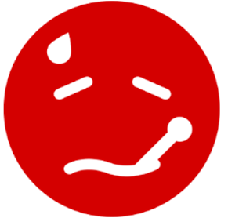
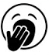
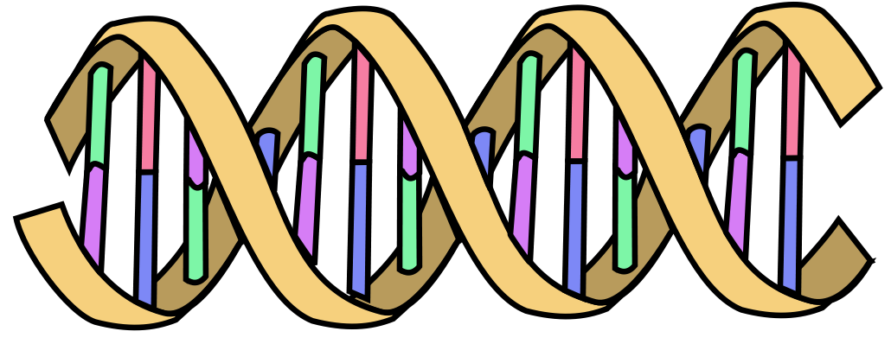

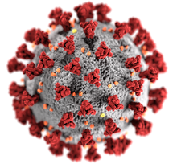
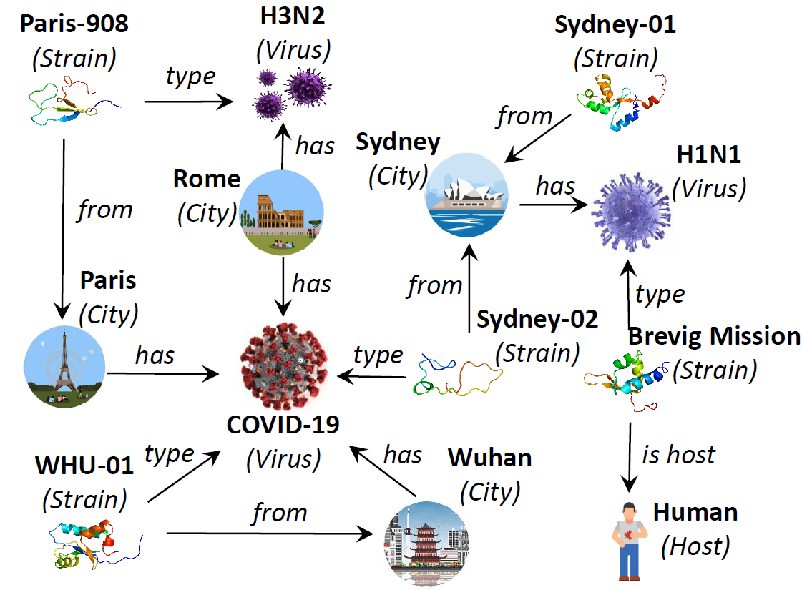
KNOWLEDGE GRAPH SCHEMA
treat
Disease
Drug
Location
target
treat
lead to
from location
mutate
from
associate with
cause
from location
target
Symptom
express
cause
associate with
Virus Gene
Covid-19
Host Gene
interact with
produce
host is
translate
produce
bind
Host Protein
host is
Virus Protein
Host
interact with
interact with
Integrated from OpenKG, HPO, NCBI, and DrugBank; over 48K nodes and 815K edges!

Slide 4
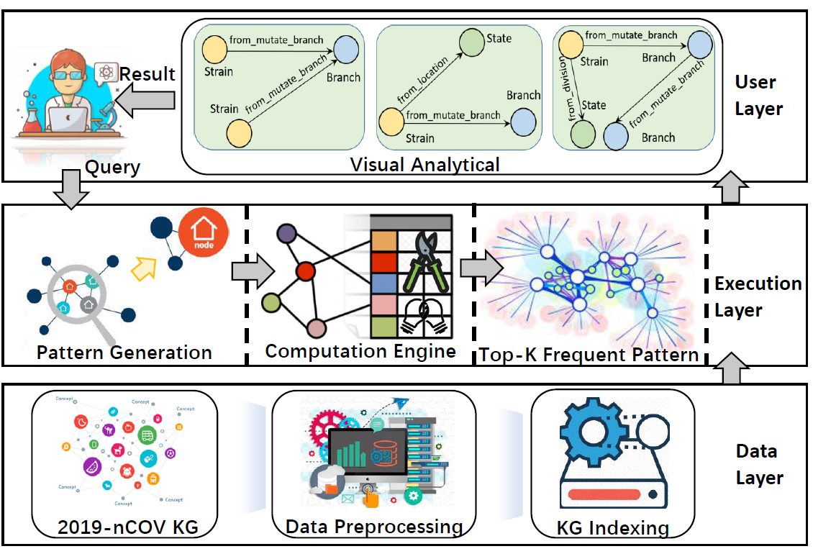
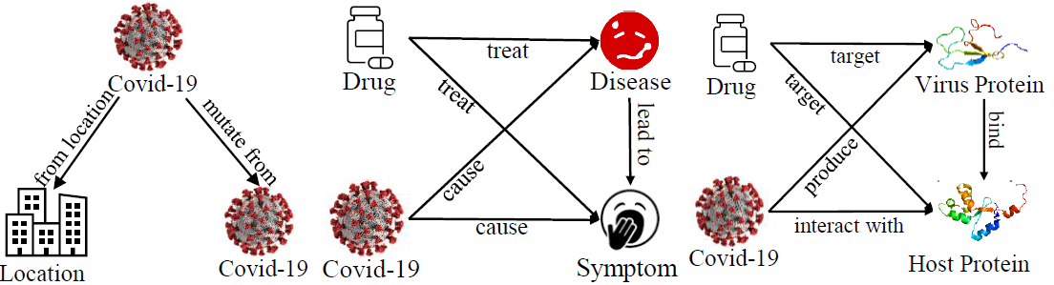
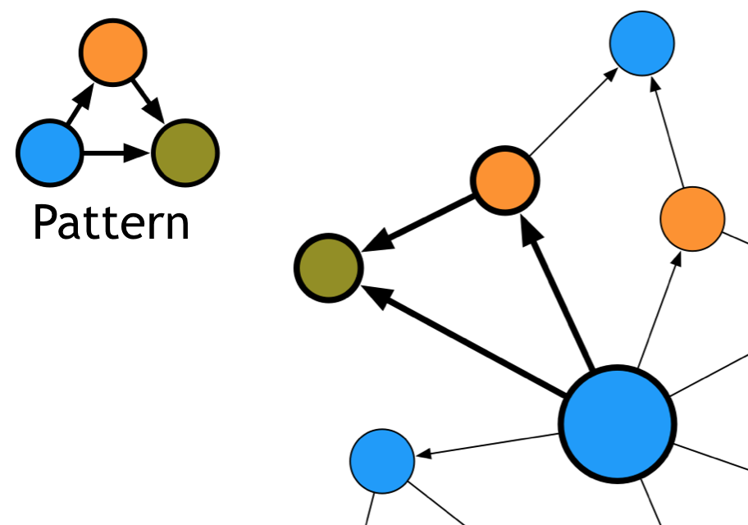
System Architecture

Slide 5
Alg.1 Knowledge graph PPR
Source node
Host
Human
Virus
SARS-CoV-2
Personalized Page Rank (PPR) is used by Twitter to present users with recommendations of other accounts that they may wish to follow.
We adapt PPR into a knowledge graph version.
Source node (SARS-CoV-2), target node (Each drug), with parameters: damping factor 0.85, iteration 2M.
Disease
Acute respiratory coronavirus infection
Drug
nelfinavir
Target node
Protein
ORF8
Protein
SPIKE
Protein
Nsp3
Virus
Bat SARS-CoV
Virus
SARS-CoV

Slide 6
alg.2 Motif-based link predication
Knowledge Graph too complex & large (hundreds of thousands of edges).
Motifs: small & frequent graphlets of size k nodes, k = 1, 2, 3, 4, 5.
Use “interesting” motifs M to generate Motif Feature Vector (MFV). For each drug D, MFV describes the frequency of M that contains s and SARS-CoV-2. Train a classifier with input (MFVs) to predict if the link (D, SARS-CoV-2) exists.
Greater chance of D to serve in covid-19 treatment if the link has higher existential probability.
Notes:
small: For small values of k, some fast and efficient motif enumeration algorithms exist
frequent: significant

Slide 7
alg.2 Motif based Link Prediction
Symptom
Virus
SARS-CoV-2
Consider the rectangle motif
Occurs 174 times in KG
Check frequencies of drugs occurring in motif: Drug DB05777 frequency: 10 Drug DB00479 frequency: 1
Algorithm predicts higher likelihood of Drug-Virus link: DB05777.
Link to find
Drug
Symptom

Slide 8
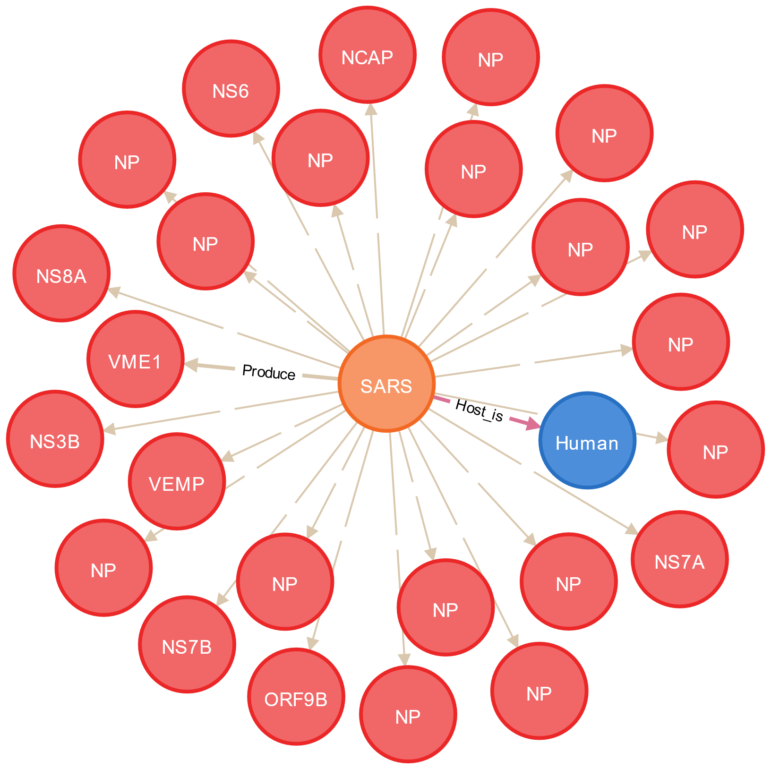


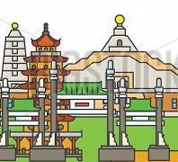
Queries
Covid-19
M-Cypher parser
interact with
Visualization
Java
Cypher
JavaScript
host is
Host Protein
Human
JVM
Neo4j
JS Engine
Cytoscape
Result
Graph Filter
MATCH (m:M)
WHERE s.Virus = “SARS-CoV-2”
RETURN COUNT(m)
M-Cypher framework
The top virus protein in SARS-CoV is NP!
from location
mutate from
mutate from
mutate from
Covid-19
VM-2493
Covid-19
Branch 1749
Sweden-01
Jönköping
from location
mutate from
from
location
Covid-19
Branch 1707
mutate from
mutate from
from location
Location
Covid-19
from location
Hong Kong
HKPU-20,42,48,53,54,61
TW-02
Kaohsiung
MATCH (s:Location)-[m:M*]->(t:Location)
WHERE s.name = “Hong Kong”
RETURN t.name
Hong Kong, Kaohsiung and Jonkoping have identical branch 1707!

Slide 9
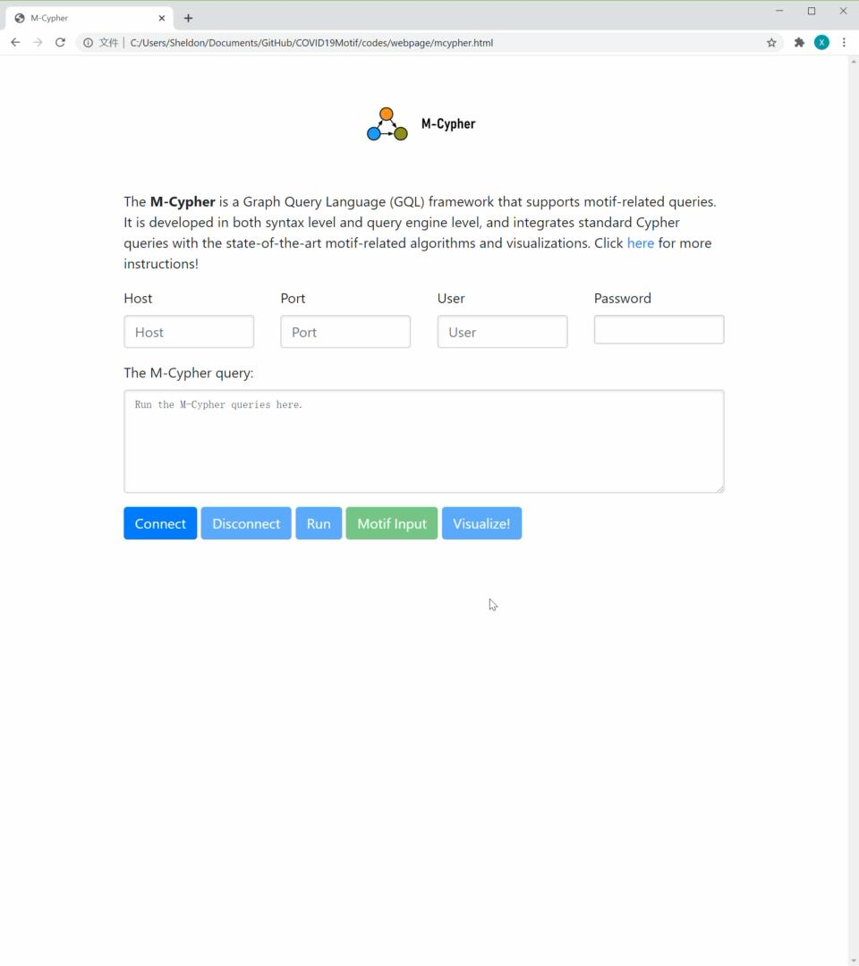
M-Cypher: powerful tool to analyze knowledge graph
M-Cypher: An efficient Graph Query Language, to help non-programmer users to explore the knowledge graph!
M-Cypher efficiently collects statistics for drug re-purposing, using concept of orbits to avoid overcounting risk:
which motif is frequent?
which node/edge/path is interesting?
which subgraph worth exploration?
[Li X., et al. M-Cypher: A GQL Framework Supporting Motifs, Demonstrated by Covid-19 Knowledge Graph Analysis, CIKM, 2020.]
Notes:
Nodes whose configuration (degree, neighbours) remain same if swapped with each other, are considered in same orbit

Slide 10
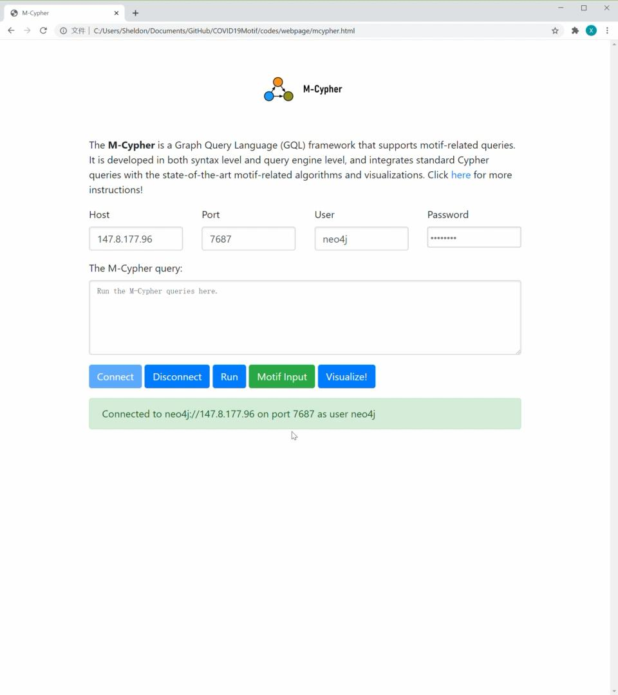
M-Cypher: powerful tool to analyze knowledge graph
M-Cypher: An efficient Graph Query Language, to help non-programmer users to explore the knowledge graph!
M-Cypher efficiently collects statistics for drug re-purposing, using concept of orbits to avoid overcounting risk:
which motif is frequent?
which node/edge/path is interesting?
which subgraph worth exploration?
[Li X., et al. M-Cypher: A GQL Framework Supporting Motifs, Demonstrated by Covid-19 Knowledge Graph Analysis, CIKM, 2020.]
Notes:
Nodes whose configuration (degree, neighbours) remain same if swapped with each other, are considered in same orbit

Slide 11
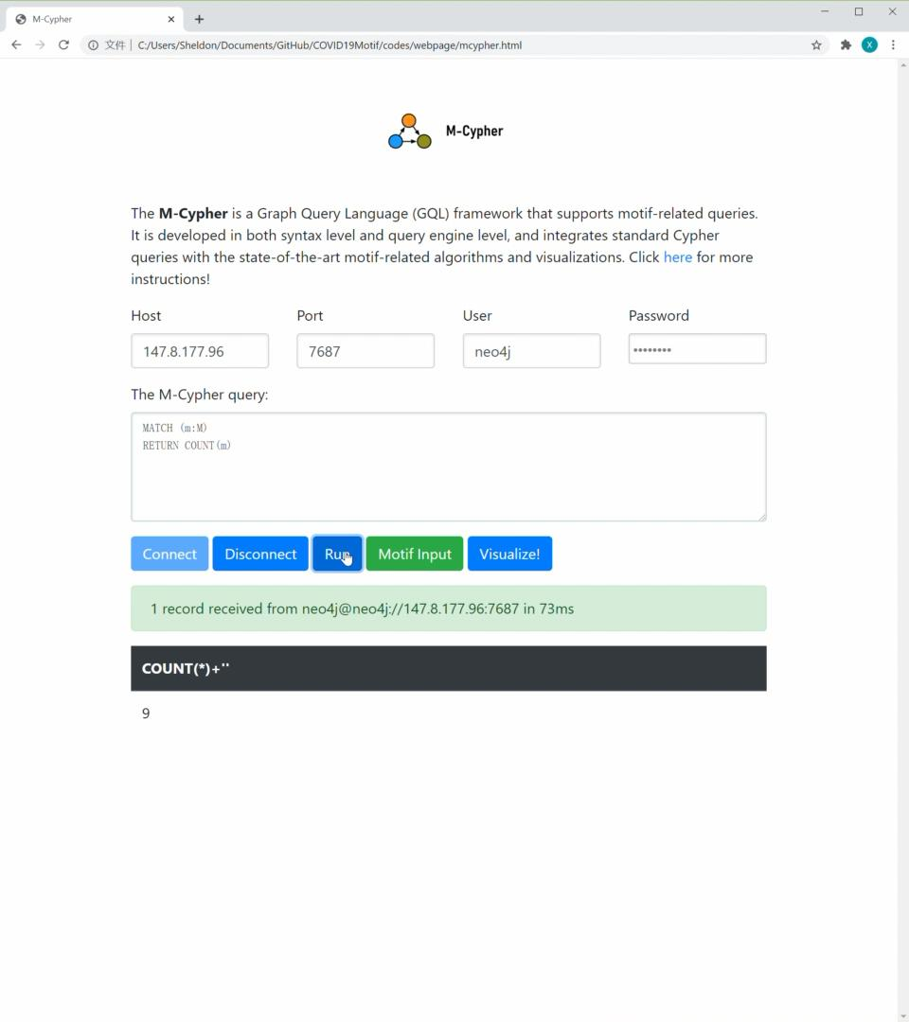
M-Cypher: powerful tool to analyze knowledge graph
M-Cypher: An efficient Graph Query Language, to help non-programmer users to explore the knowledge graph!
M-Cypher efficiently collects statistics for drug re-purposing, using concept of orbits to avoid overcounting risk:
which motif is frequent?
which node/edge/path is interesting?
which subgraph worth exploration?
[Li X., et al. M-Cypher: A GQL Framework Supporting Motifs, Demonstrated by Covid-19 Knowledge Graph Analysis, CIKM, 2020.]
Notes:
Nodes whose configuration (degree, neighbours) remain same if swapped with each other, are considered in same orbit

Slide 12
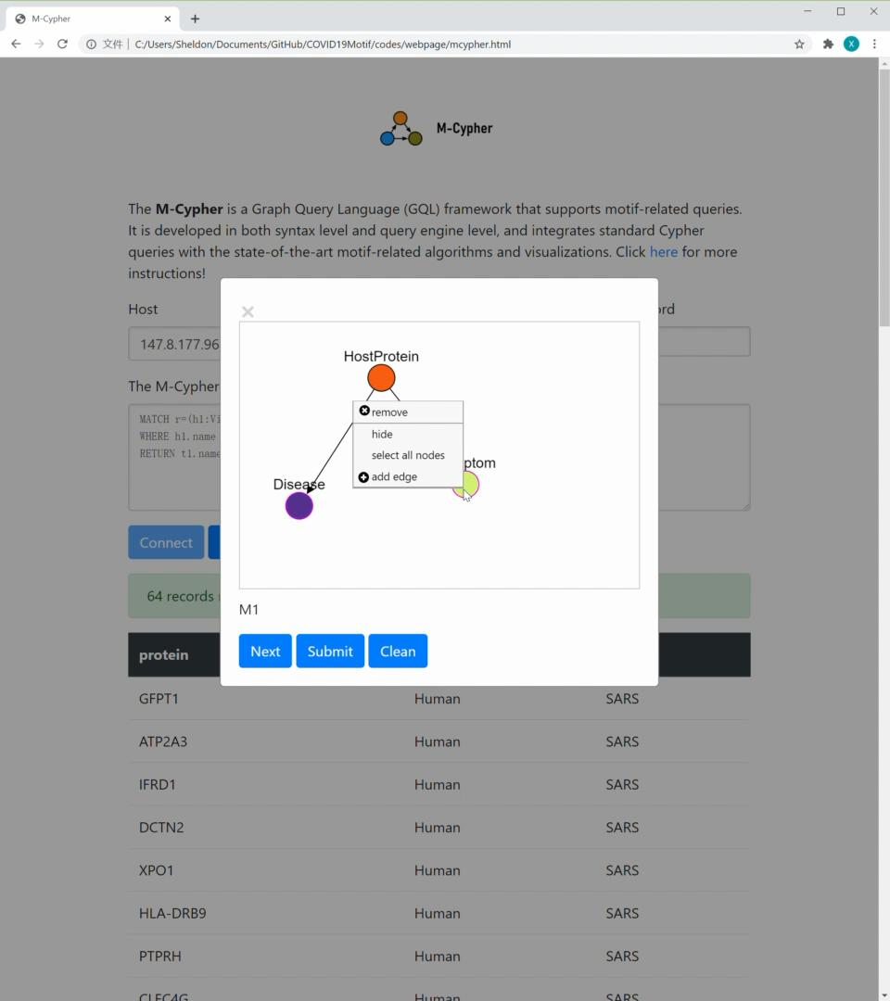
M-Cypher: powerful tool to analyze knowledge graph
M-Cypher: An efficient Graph Query Language, to help non-programmer users to explore the knowledge graph!
M-Cypher efficiently collects statistics for drug re-purposing, using concept of orbits to avoid overcounting risk:
which motif is frequent?
which node/edge/path is interesting?
which subgraph worth exploration?
[Li X., et al. M-Cypher: A GQL Framework Supporting Motifs, Demonstrated by Covid-19 Knowledge Graph Analysis, CIKM, 2020.]
Notes:
Nodes whose configuration (degree, neighbours) remain same if swapped with each other, are considered in same orbit

Slide 13
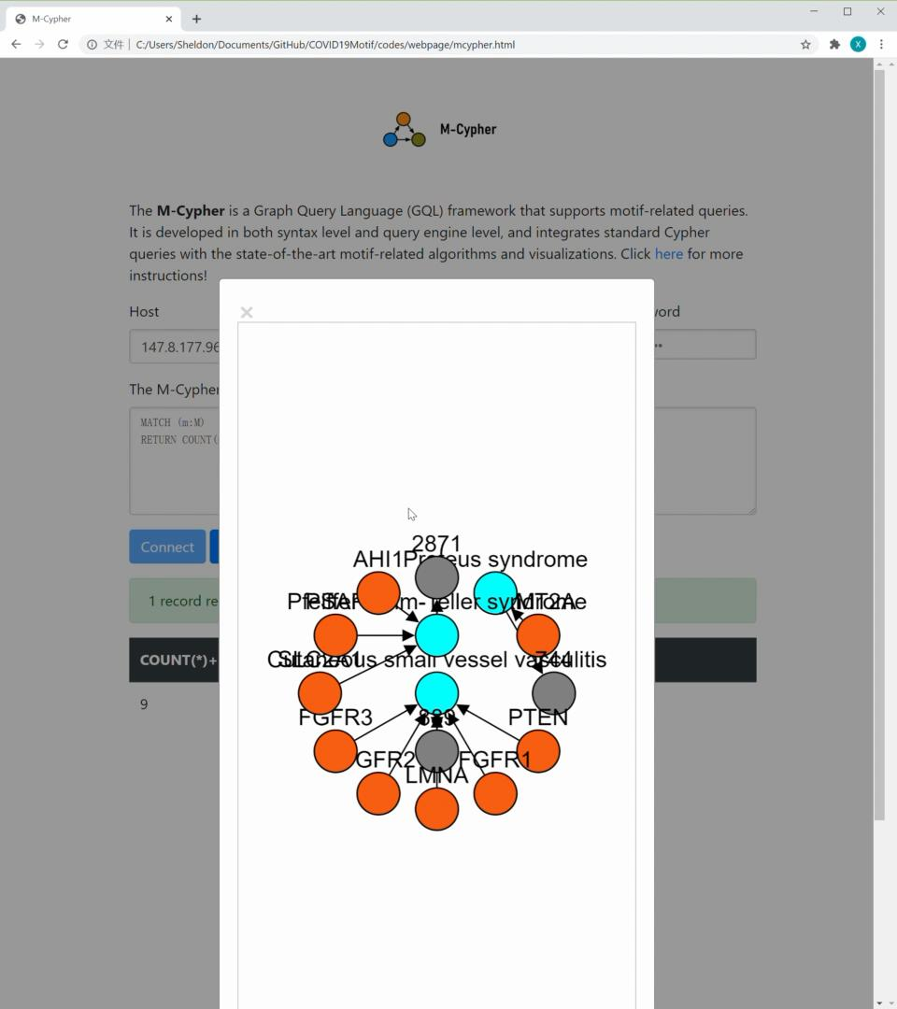
M-Cypher: powerful tool to analyze knowledge graph
M-Cypher: An efficient Graph Query Language, to help non-programmer users to explore the knowledge graph!
M-Cypher efficiently collects statistics for drug re-purposing, using concept of orbits to avoid overcounting risk:
which motif is frequent?
which node/edge/path is interesting?
which subgraph worth exploration?
[Li X., et al. M-Cypher: A GQL Framework Supporting Motifs, Demonstrated by Covid-19 Knowledge Graph Analysis, CIKM, 2020.]
Notes:
Nodes whose configuration (degree, neighbours) remain same if swapped with each other, are considered in same orbit

Slide 14
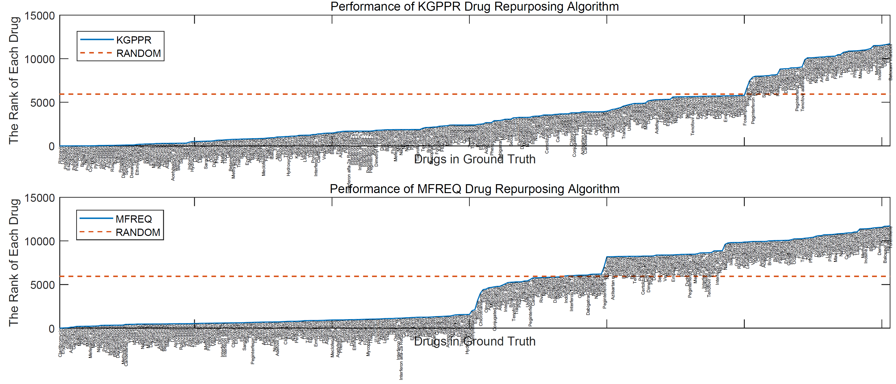
Knowledge graph personal page rank.
A Random Algorithm to recommend drugs.
Motif-based drug recommendation.

Slide 15
Highlighted drug candidates for repurposing
Drug_name | Clinical_trial | Drug_type | Rank
Ritonavir | Y | Antiviral agents | 0.01%
Lopinavir | Y | Antiviral agents | 0.02%
Pitavastatin | N | Statins | 0.03%
Moexipril | N | ACEIs | 0.12%
Lovastatin | N | Statins | 0.35%
Simvastatin | N | Statins | 0.36%
Atorvastatin | N | Statins | 0.37%
Fluvastatin | N | Statins | 0.44%
Pravastatin | N | Statins | 0.46%
Rosuvastatin | N | Statins | 0.47%
Dexamethasone | Y | Corticosteroids | 0.84%
Sarilumab | Y | immunosuppressants | 2.60%
Hydrocortisone | Y | Corticosteroids | 4.10%
Prednisone | N | Corticosteroids | 5.42%
Tocilizumab | Y | immunosuppressants | 5.81%
Almost all drugs currently in clinical trial are recommended by our algorithms in top 10% from 11865 candidates in DrugBank!
Notes:
Potential drugs from literature
Top 10% from 11865 candidates in drug bank detected antiviral agents and immunosuppressants that are currently under clinical trial and mechanically promising statins, ACEIs and corticosteroids!
Drugs with potential MOA for covid-19 treatment but not current considered in trial are also discovered by the KG: statins, ACEIs and corticosteroids.

Slide 16
Future plan
Enrich the covid-19 knowledge graph & collect more drugs which are recommended by domain experts.
Apply deep learning algorithms to train new models.
Analyse drugs recommended high but without evidence from literatures, e.g., neuropsychiatric drugs.
Develop an user interface for medical experts to find personalized drugs.

Slide 17
THANK YOU

