Slide 1
Schema
Drug
Disease
lead to
HPO ID
(Symptom)
effect
target
cause
Virus gene
express
Virus
SARS-CoV, MERS-CoV, IBV, MHV, HCoV- 229E, HCoV-NL63
cause
associate with
target
interact with
associate with
translate
produce
Virus Protein
bind
Host Protein
produce
NCBI
gene ID
host is
OpenKG
interact with
Host
Human
Literature
HPO/NCBI records
DrugBank

Slide 2
Schema_V2
Location
Drug
Disease
lead to
Symptom
from location
effect
target
mutate
cause
Virus gene
express
Virus
cause
associate with
target
interact with
associate with
translate
produce
Virus Protein
bind
Host Protein
produce
Gene
host is
OpenKG
interact with
Literature
Host
HPO/NCBI records
DrugBank

Slide 3
Schema after merging genes and proteins
target
Location
Drug
Disease
lead to
Symptom
from location
effect
target
cause
from location
mutate
Virus
cause
associate with
target
produce
interact with
associate with
Virus Protein
bind
Host Protein
OpenKG
interact with
Nature paper
HPO/NCBI records
DrugBank

Slide 4

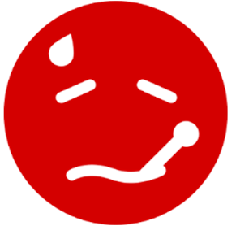
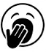
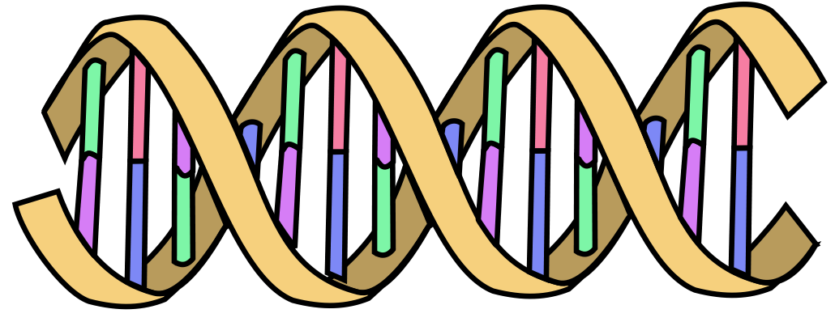

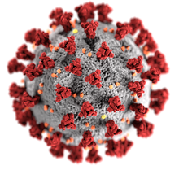
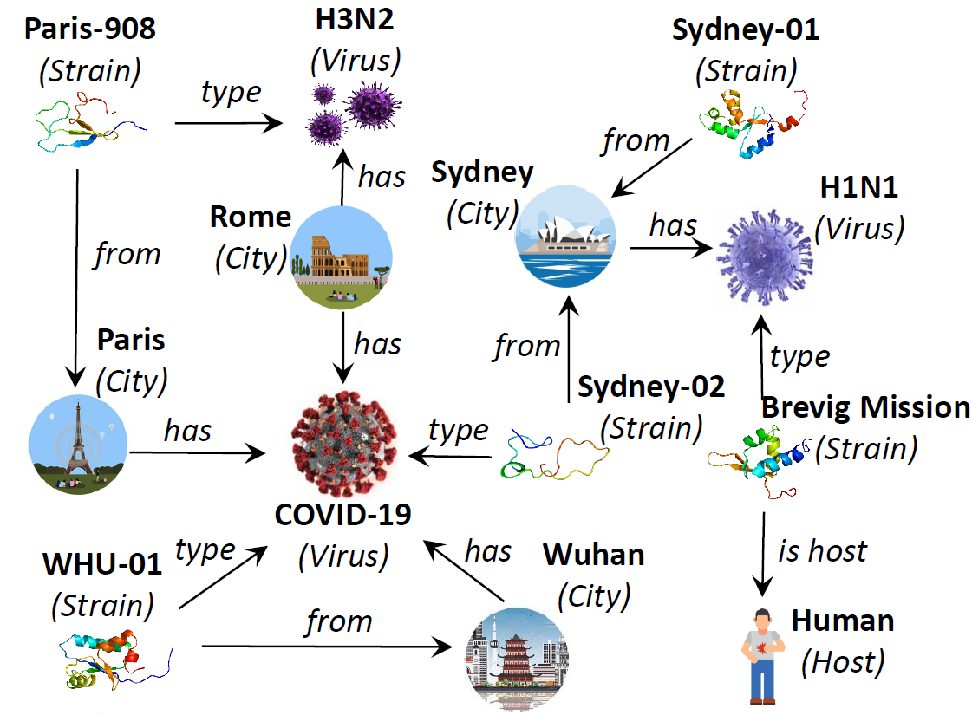
Schema
Edges | Datasets
Drug – Virus | OpenKG, Literature
Drug – Virus Protein | OpenKG
Drug – Disease | HPO, Drugbank
Drug – Symptom | HPO, Drugbank
Disease – Symptom | HPO
Host Gene – Host Protein | NCBI, Literature
Host Gene – Disease | Disgenet
Host Gene – Symptom | HPO
Host Protein – Host Protein | Uniprot, Biogrid
Virus Protein – Virus Protein | Biogrid
Virus Protein – Host Protein | OpenKG
Virus – Disease | OpenKG, HPO
Virus – Symptom | OpenKG, HPO
Virus – Host Protein | Literature
Virus – Virus Protein | OpenKG
Virus – Virus Gene | OpenKG
Virus Gene – Virus Protein | OpenKG
treat
Disease
Drug
target
treat
lead to
associate with
mutate
from
cause
target
Symptom
express
cause
associate with
Host Gene
Virus Gene
Covid-19
interact with
produce
host is
translate
produce
bind
Host Protein
host is
Virus Protein
Host
interact with
interact with

