Slide 1
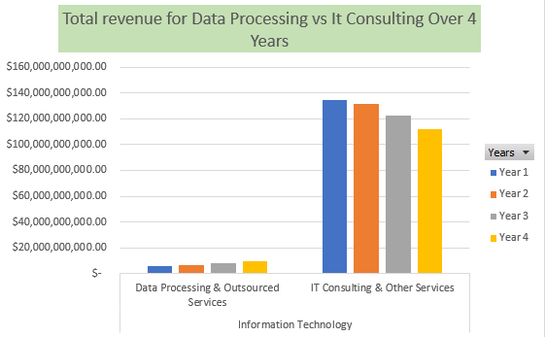
IT Outsourcing generates favourable revenue in comparison to data outsourcing
Clustered column showing the comparison of revenue generated from outsourcing Data Processing firm in comparison to IT outsourcing firms.
We see that year by year IT outsourcing generates at least 600% more income than Data outsourcing.
The Total mean revenue for It consulting is $125,243,891,250 whilst the Total mean revenue for data Processing is 7,576,291,500. This shows that the average revenue generated by IT consulting is over 10X that of Data Processing.
Total Median Revenue for IT consulting is $127,031,173,500.00 in comparison to Data processing which is $7,474,978,500.00. This shows that at least 50% of the companies in It consulting generate far more revenue than those of Data Processing.
Total Standard deviation for IT consulting is 10,090,536,972.62 comparison to Data Processing 1,446,631,658.63 this shows that the data is more accurate to the Total median in data processing than that of IT consulting .
Total range for It consulting is 22,509,218,000.00 and Data is 3,320,583,000 this shows that the data in IT consulting is more spread out in terms of the revenue than that of data processing.
If you are looking at the Tech Outsourcing field we can conclude that the skills of those in It Outsourcing generates more financial gains that those of data.

