Slide 1

Cloud-First Approach: Engineering a Solution for Efficient On-Premises Data Migration to Cloud Platforms
BIRLA INSTITITUE OF TECHNOLOGY & SCIENCE, PILANI (RAJASTHAN)
April 2024
SE ZG628T - DISSERTATION
By
SHELKE AKSHAY NANDKUMAR 2022MT93331

Slide 2
Agenda
Introduction
Background
Problem Definition
Project Objective
Overview of Architectural Design
Implementation & Working
Cloud Resources
Code Snippets
Github code repository
PowerBI Dashboards
Demo video of working solution
Future Scope and Limitations

Slide 3
Introduction
Background:
Cloud computing's evolution has revolutionized IT infrastructure, offering scalable resources on-demand via the internet.
Organizations migrate databases to the cloud for cost reduction, scalability, flexibility, security enhancement, and disaster recovery benefits.
Challenges include data security, compliance, compatibility, and downtime mitigation during migration.
Mitigation strategies involve thorough planning, data encryption, network optimization, and leveraging cloud migration tools.
Best practices include infrastructure assessment, cloud model selection, provider evaluation, detailed migration planning, and rigorous testing for data integrity and application functionality.

Slide 4
Introduction
Problem Definition :
The problem entails the need to efficiently and securely migrate on-premises databases to the cloud, balancing the benefits of scalability and flexibility with challenges such as data security, compliance, compatibility, and potential downtime, thereby ensuring seamless operations and preserving data integrity throughout the migration process.
In this dissertation report I have created end-to-end Azure cloud based solution for data migration from on-premises to cloud infrastructure.

Slide 5
Introduction
Project Objective :
Assess the current on-premises database infrastructure.
Select the appropriate cloud service model and provider.
Develop a comprehensive migration plan addressing security, compliance, and downtime.
Execute the migration process while ensuring data integrity and minimal disruption.
Validate the functionality of migrated databases in the cloud environment.

Slide 6
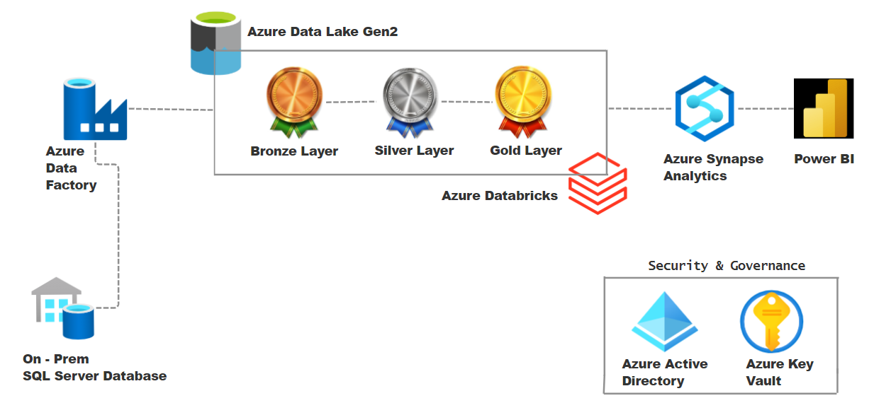
Overview of Architectural Design

Slide 7
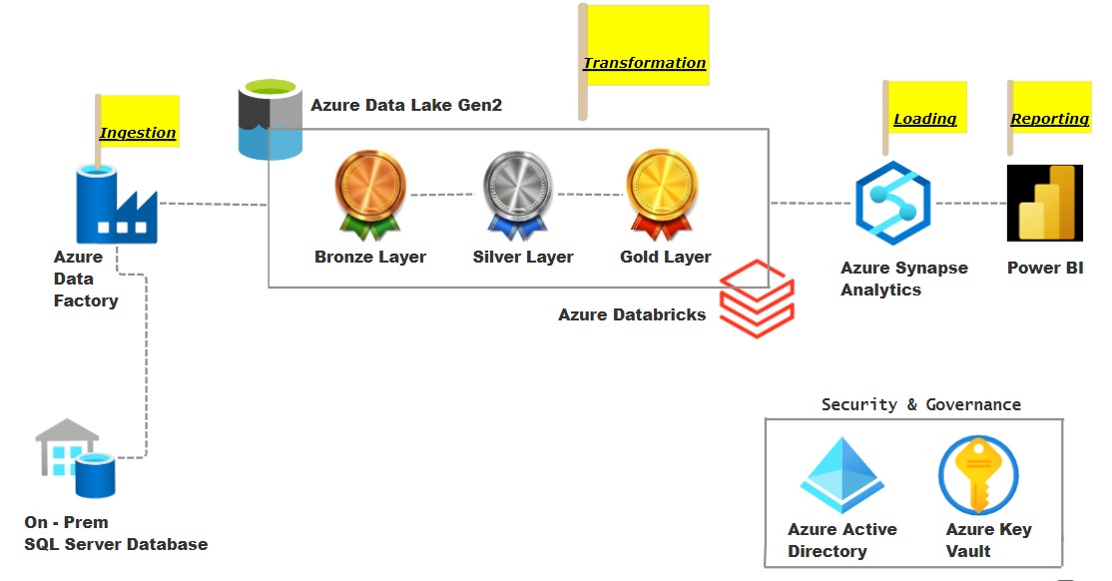
Overview of Architectural Design

Slide 8
Implementation & Working
Cloud Resources
Azure Data Factory
Azure Data Lake Storage (Gen2)
Azure Databricks
Azure Synapse Analytics
Azure Key vault
Azure Active Directory
Microsoft PowerBI

Slide 9
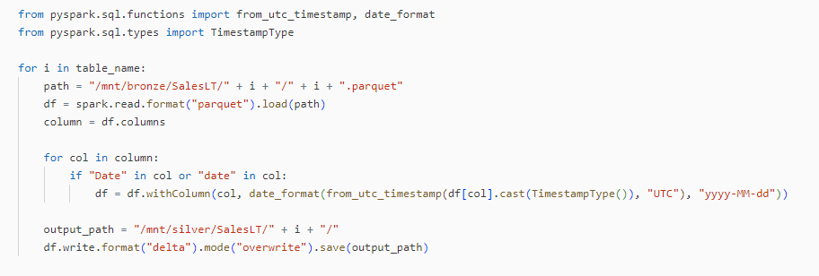
Implementation & Working
Code Snippets

Slide 10
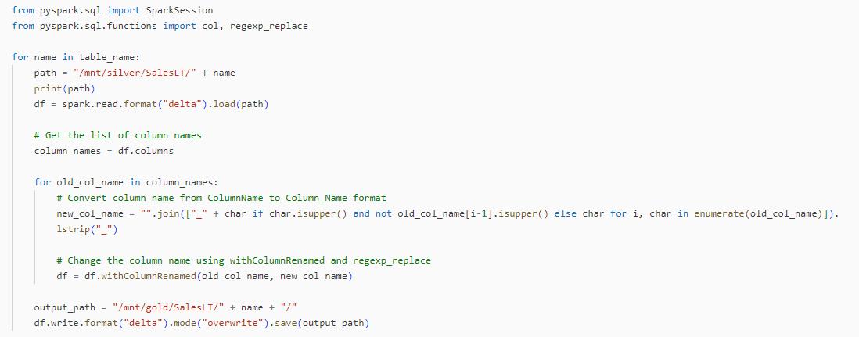
Implementation & Working
Code Snippets

Slide 11
Implementation & Working
Github code repository
Link : https://github.com/ShelkeAkshay-2022mt93331/dissertation

Slide 12
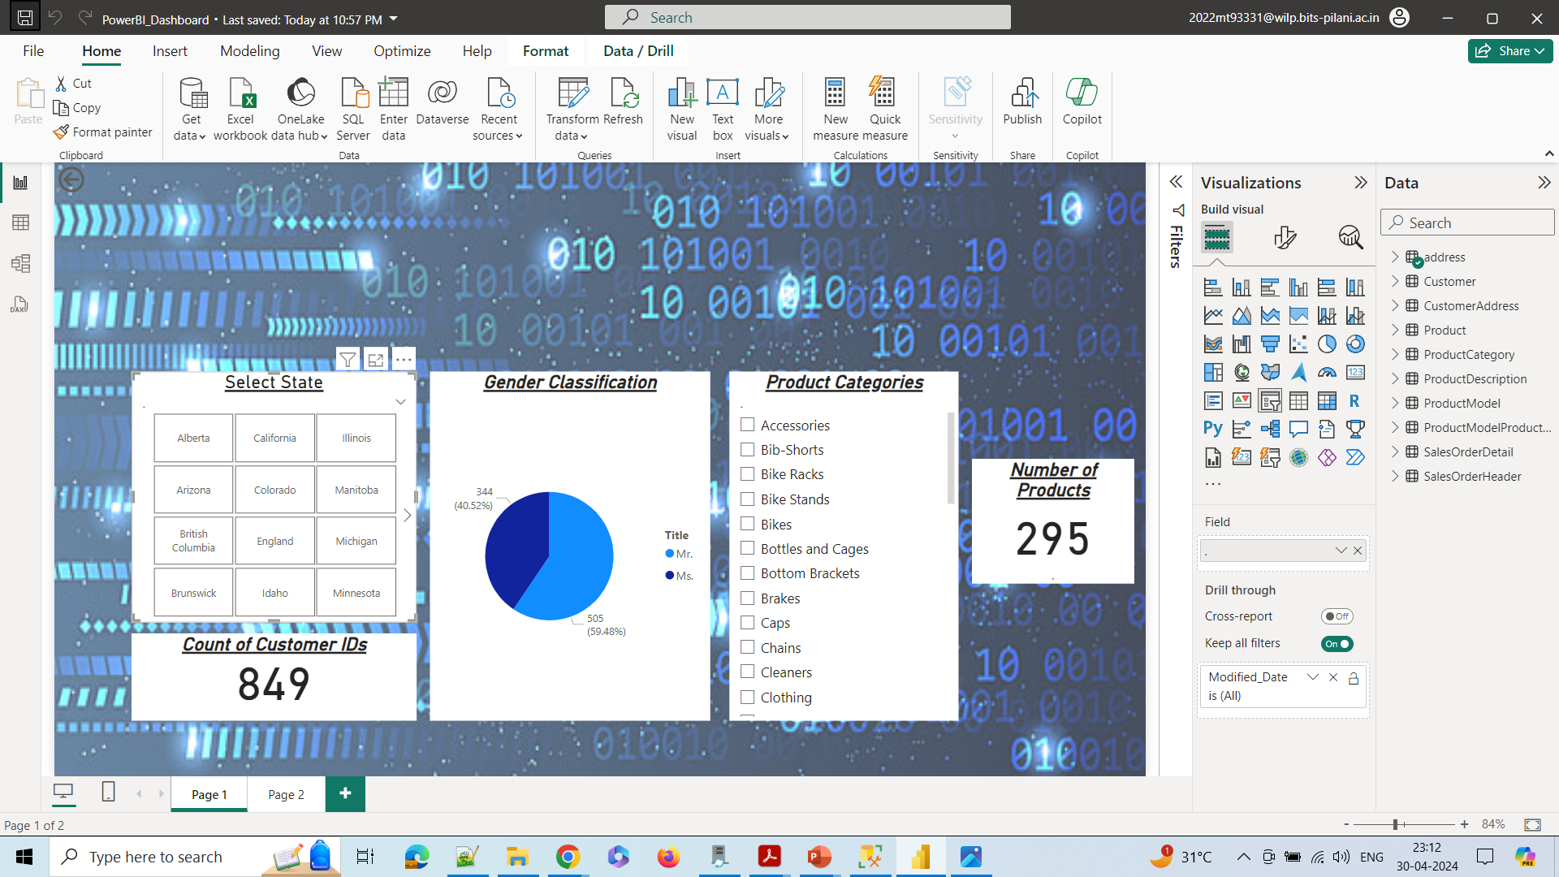
Implementation & Working
PowerBI Dashboards

Slide 13
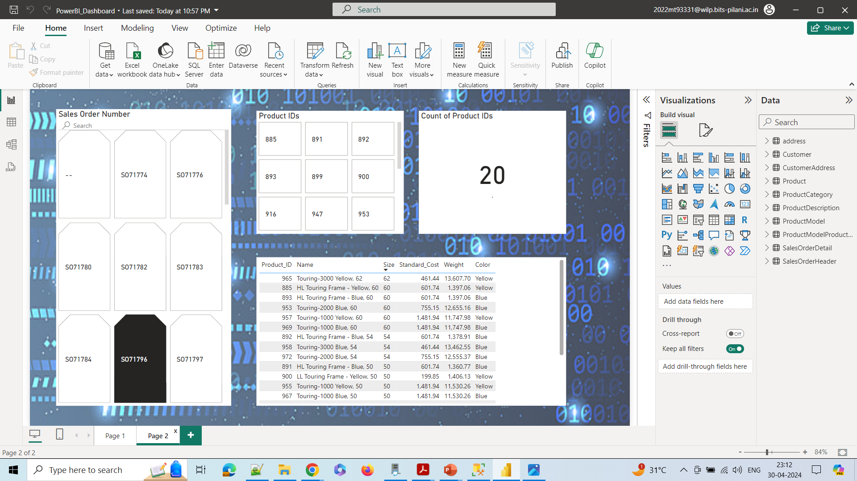
Implementation & Working
PowerBI Dashboards

Slide 14
Implementation & Working
Demo video of working solution
Google Drive Link : https://drive.google.com/drive/folders/1qEwP5DDKlXF6vuxXq-6B8rs8iA8jmczB?usp=drive_link
Google Drive Video Link : https://drive.google.com/file/d/1F5PeEJjorfrCm4q3jTkJCXk6tYbLfKPZ/view?usp=sharing

Slide 15
Future Scope & Limitations
Future Scope :
Extending the solution to support real-time data streaming and processing for low-latency analytics.
Incorporating advanced machine learning and AI capabilities for predictive analytics and automated decision-making.
Enhancing the solution to handle multi-cloud environments and hybrid architectures.
Implementing advanced data governance and lineage tracking mechanisms for improved compliance and auditing.
Exploring serverless computing options for increased scalability and cost optimization.

Slide 16
Future Scope & Limitations
Limitations :
The solution is primarily focused on data migration and may require additional components for advanced use cases like real-time analytics or IoT data processing.
While the solution demonstrates data migration from on-premises SQL Server, additional connectors and adaptations may be required for other data sources or formats.
The project scope is limited to the Microsoft Azure ecosystem, and additional work may be required for integrating with other cloud platforms or on-premises systems.
Advanced data governance and lineage tracking features may require further development and integration with external tools or services.
The solution does not cover aspects of performance optimization, cost optimization, or autoscaling, which may be relevant for large-scale deployments.

Slide 17
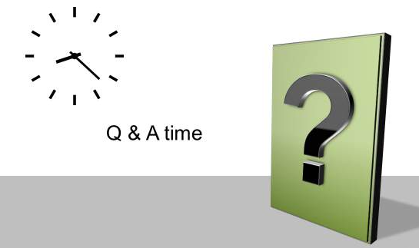
Q & A

Slide 18

Thank You !

