Slide 1
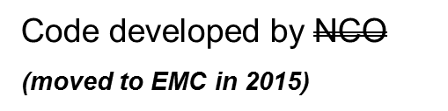
GTS
BUFR
Tanks
/dcom
Code
developed
by
NCO & EMC
NCO/PMB
NCO/SIB
tranjb
Gather data
decode
dumpjb
NWSTG/TOC
“Gateway”
Satellite ingest scripts
“Katz” scripts/EMC
tranjb
Dump Files
LDM
TNC
Code developed by EMC
Conventional data
Non-conventional Data
GSD
LDM
PREPDATA
Prevents
SYNDATA
CQCBUFR
PROFCQC
CQCVAD
PREPACQC
ACARSQC
OIQCBUFR
PREPBUFR
SMS job queries NESDIS servers for new data
Analysis
Parm cards
Radar
ROC
BUFR mnemonic table
Global Guess (perhaps relocated)
Obs error
NESDIS
FTP
tcvitals
Outside NCEP
Inside NCEP

