Slide 1



Team Name: Pepega
Team Nomenclature: HSC4_PS_10

Slide 2

Team Name: Pepega
Team Members -
Yash Chavan
Pranav Kulkarni
Ishan Gala
Shreya Ekande

Slide 3
Domain: Artificial Intelligence/ Machine Learning
Problem Statement:
Now a days, Sarcasm is being used everywhere
Predominant use of sarcasm is in the customer reviews
Develop a Sarcasm Detection model using Customer Reviews Data
Important use case for the VOCA project

Slide 4

Idea/Approach
Sarcasm, a sharp and ironic utterance designed to cut or to cause pain, is often used to express strong emotions, such as contempt, mockery or bitterness
Reviews on e-commerce websites can be wrongly classified due to the sarcastic comments.
Sarcastic text might appear as a regular text.

Slide 5

Idea/Approach
Detection of sarcasm in language- challenging
Using traditional opinion mining techniques can lead to incorrect classification of the reviews
Sarcastic comments are difficult to detect as they appear as normal and positive comments without the context.
A sarcastic review written in the view to mock a product will have low ratings

Slide 6
Implementation Details:
Dockerized Flask App is used for the backend along with Tailwind CSS for styling the Frontend. Docker helps it to become highly scalable via container mechanism, deployed using docker-compose.
We have used a Bidirectional LSTM model with Fast Text embeddings to perform a binary classification and provide a probabilistic inferences.

Slide 7

Stack/Technologies used:
Flask
TailwindCSS
Docker
Python
TensorFlow
Jupyter

Slide 8
Flowchart of ML model
Cleaning & reformatting
Fasttext vectors
Embedding matrix
Input Data
Dropout + Dense FCN
Embedding layer
Output
Bi-LSTM

Slide 9
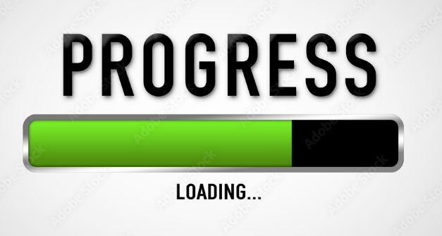
Day 1 Progress
Tested out different transformer configurations
Built a custom language model
Developed a base framework for hosting our front-end

Slide 10
Day 2 Progress
Frontend and fully functional web application along with deployment.

Slide 11
Future Scope
Make an API for other websites to filter out sarcastic comments
This idea can be further monetized via Pay-per API Model. There are many use cases for this application.
Provide a context based filtering approach for reviews or any textual data.

