Slide 1
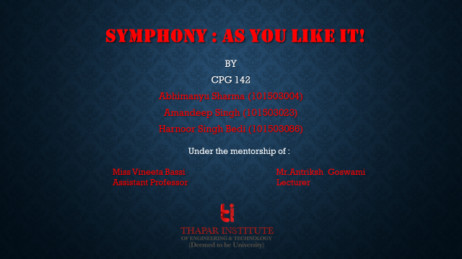
CPG 142
Mentors
Miss Vineeta Bassi
Assistant Professor
Mr. Antriksh Goswami
Lecturer
Team Member
Abhimanyu Sharma
101503004
Team Member
Team Member
Harnoor Bedi
101503086
Amandeep Singh
101503023

Slide 2


Slide 3
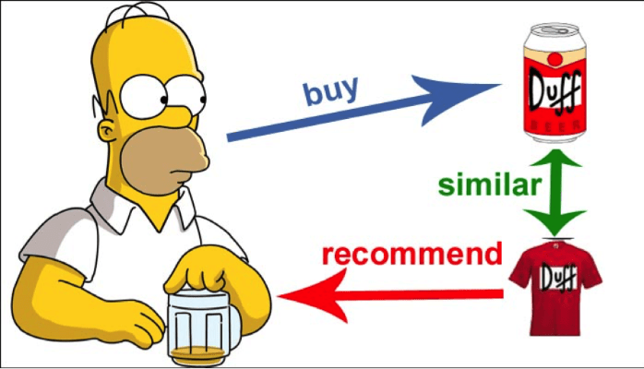
Content Based Recommendation

Slide 4

Methodology
.
Based on principle of item-item similarity.
Songs are compared on the basis of their technical values like loudness, tempo and mode.
The Million Song dataset is used.

Slide 5
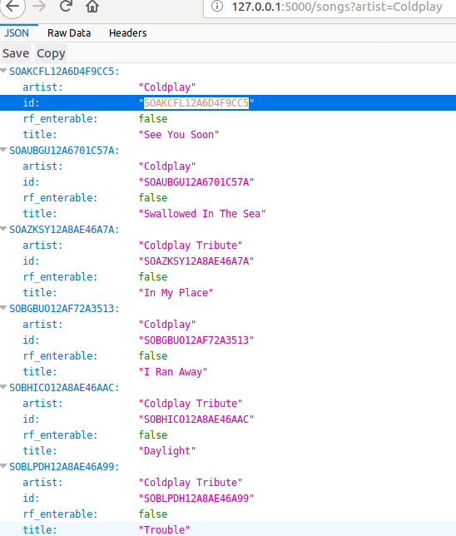
Artist Search

Slide 6
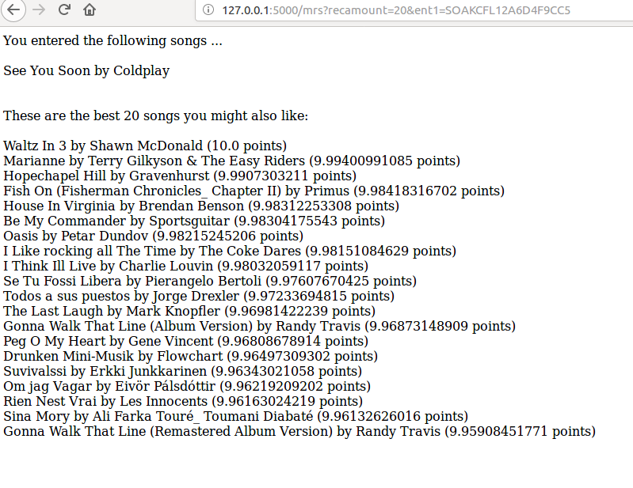
Recommendation Results

Slide 7
Work Plan
February
March-April
May-July
Aug-Sept
Oct-Nov
Dec
Identification, formulation and planning of project.
Study of various algorithms.
Testing of algorithms on dataset.
Design Optimization.
Front end development.
Result Evaluation.

Slide 8
THANK YOU!
CONTACT US AT:
Abhimanyu Sharma
sharmaabhimanyu07@gmail.com
8196910026

