Slide 1
RFID AND BLUETOOTH BASED BANK LOCKER SYSTEM

Slide 2
PROJECT CONCEPT
THIS PROJECT IT IS BASED ON DOUBLE SECURITY AUTHENTICATION.
IT USES BOTH RFID & BLUETOOTH TECHNOLOGY FOR IT’S IDENTIFICATION AND AUTHENTICATION.
RFID TAG WILL BE USED FOR ACCESS GRANTING, AND BLUETOOTH CONTROLLED PASSWORD INPUT FROM SMARTPHONE WILL ACCESS THE SECURITY DOOR.
IT IS SAFE FAST AND USER FRIENDLY SECURITY SYSTEM WITH DOUBLE AUTHENTICATION.

Slide 3
BLOCK DIAGRAM
LCD(16x2)
RFID READER
ARDUINO MICROCONTROLLER
BLUETOOTH HC-05
MOTOR

Slide 4
RFID
RFID(RADIO FREQUENCY IDENTIFICATION) IS A WIRELESS NON-CONTACT USE OF RADIO-FREQUENCY ELECTROMAGNETIC FIELDS TO TRANSFER DATA, FOR THE PURPOSES OF AUTOMATICALLY IDENTIFYING AND TRACKING TAGS ATTACHED TO OBJECT.
RFID CARDS ARE ALSO KNOWN AS “PROXY” OR “CONTACTLESS CARDS” AND COME IN TWO GENERAL TYPES
ACTIVE TAG (has battery power supply)
PASSIVE TAG (no power supply, Current get induced when contacts with RFID reader)

Slide 5
BLUETOOTH (HC-05)
HC-05 Bluetooth module is a Bluetooth to serial converter that connects microcontrollers (like Arduino) to other Bluetooth enabled devices.
This allows the devices to communicate wirelessly with each other.
HC-05 is a Bluetooth SPP (Serial Port Protocol) module designed for wireless communication. It can also be operated as a master or slave configuration.
Frequency: 2.4GHz ISM band
Supply Voltage / Current = +3.3v to 6.0v / 30mA
Range is around 10meter

Slide 6
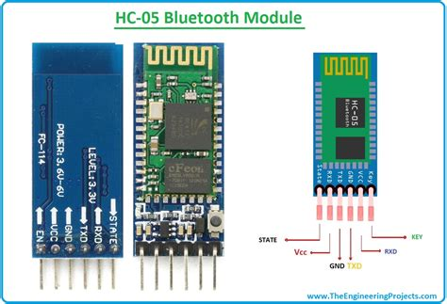
HC-05 PIN DESCRIPTION
KEY/EN=This pin is used to bring the Bluetooth module in AT commands mode / Data mode
Data mode = 0
Command mode=1
VCC = Give 5v / 3.3v to this pin.
GND = Apply GND On this pin.
TXD = Connect this pin with the RXD pin of the Microcontroller. This pin transmits Serial data
RXD = Connect this pin to the TXD pin of the Microcontroller. The HC-05 Bluetooth module receives the data from this pin and then transmits it wirelessly.
STATE = It is used to check if the module is connected or not. It acts as a status indicator.

Slide 7
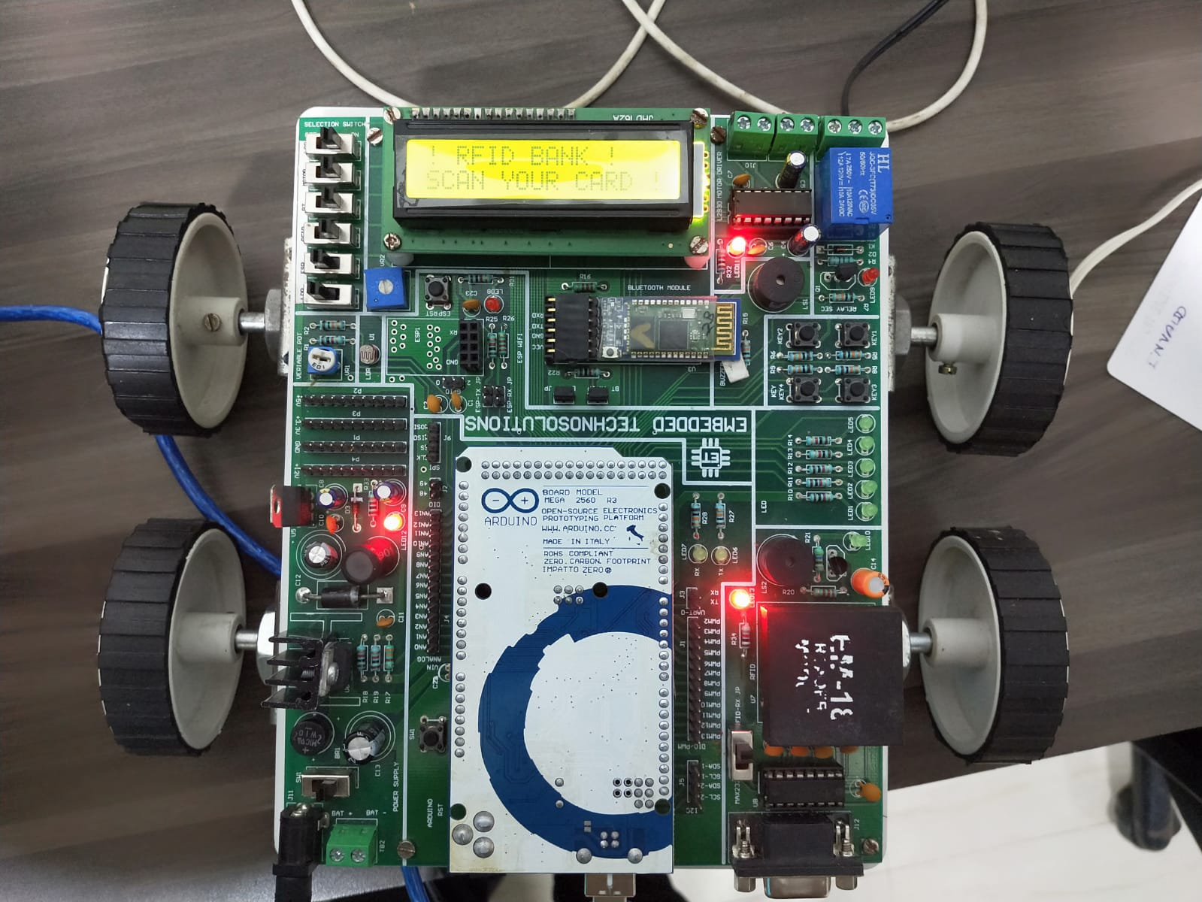
LAYOUT PICTURE
LCD(16x2)
MOTOR
BLUETOOTH (HC-05)
RFID READER
ARDUINO MEGA 2560R3
MICROCONTROLLER

Slide 8
THANK YOU
-SHAHID HASHMI

