Slide 1

Exploratory Data Analysis of Industry Dataset

Slide 2
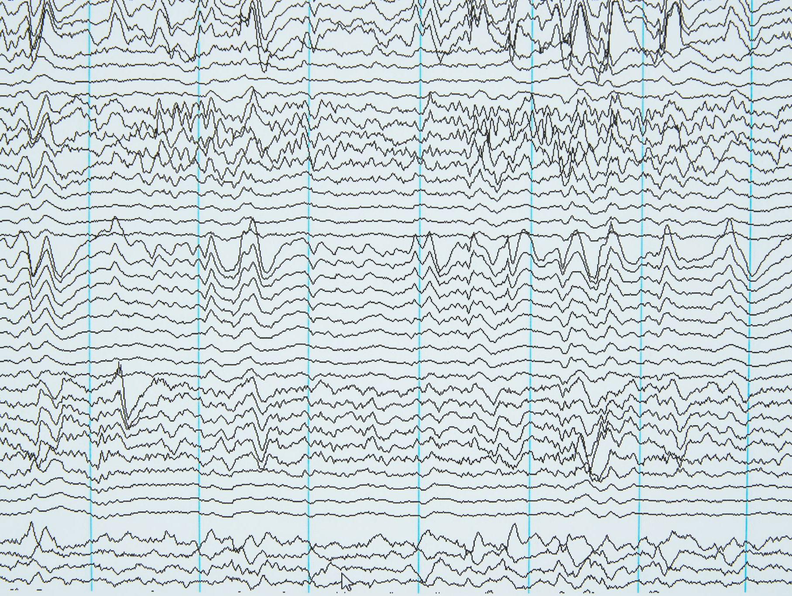
Project Overview
EDA of Large-Scale Industry Performance Dataset (15,000 records, 12 variables).

Slide 3

Objectives
Univariate, Bivariate, Multivariate Analysis, Outlier Detection, Correlation, Skewness & Kurtosis.

Slide 4
Dataset Description
Features include industry, country, region, revenue, employee count, customer count, market rating and dates.

Slide 5
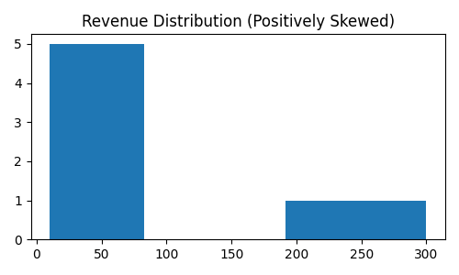
Univariate Analysis
Summary statistics, distributions, skewness and kurtosis for numerical variables.

Slide 6
Outlier Detection
Boxplots, IQR and Z-score methods used. Large enterprises retained as valid outliers.

Slide 7
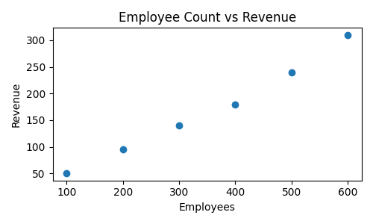
Bivariate Analysis
Revenue vs Employees, Revenue vs Customers, Market Rating vs Profit Margin.

Slide 8
Correlation Analysis
Strong positive relationships between revenue, employees and customers.

Slide 9
Multivariate Analysis
Industry × Revenue × Employee Count; Region × Rating × Profit Margin.

Slide 10
Skewness & Kurtosis
Revenue and employee count show positive skewness and high kurtosis.

Slide 11
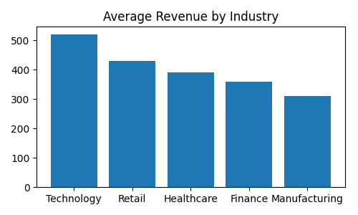
Key Business Insights
Technology dominates revenue; Retail handles large customer bases; employee count drives revenue.

Slide 12
Conclusion
EDA supports business intelligence, benchmarking and strategic decision-making.

