Slide 1
NEXTHIKES IT SOLUTIONS | ROSSMANN PHARMACEUTICALS
Rossmann Sales Forecasting
End-to-end EDA, ML/DL modeling, and a serving dashboard for a six-week store-sales forecast
Task 1: Exploratory Data Analysis | Task 2: Machine Learning & Deep Learning | Task 3: Web Serving

Slide 2
OVERVIEW
What this deck covers
01
The business problem
Why 1,115 stores forecasting sales by hand doesn't scale, and the two data traps that shape everything downstream.
02
Task 1 — What the data says
Three findings from 14 EDA questions that changed the model's design.
03
Task 2 — Building the models
Pipeline architecture, RMSPE, Random Forest vs LightGBM, and an LSTM forecaster.
04
Task 3 — Serving it
A Flask dashboard a finance analyst can use directly.
05
Recommendations
What the finance team should do with this, model and non-model.
Rossmann Sales Forecasting | NextHikes IT Solutions
2

Slide 3
CONTEXT
The business problem
• Rossmann Pharmaceuticals runs 1,115 drug stores across Germany; sales forecasting today means asking each store manager to guess.
• That doesn't scale, isn't auditable, and ignores the interacting effects of promotions, competition, holidays and seasonality.
• Goal: an end-to-end pipeline that cleans 2.5 years of daily history, engineers predictive features, compares tree-based and deep-learning models, and serves the result through a dashboard — no notebook required.
1,115
stores across Germany
2.5 yrs
of daily sales history
1.02M
daily records
48 days
forecast horizon
Two data traps shaped the pipeline:
• Customers (r = 0.82 with Sales) doesn't exist at forecast time — using it leaks the answer.
• Open = 0 always means Sales = 0 — a business rule, not a pattern to learn.
Rossmann Sales Forecasting | NextHikes IT Solutions
3

Slide 4
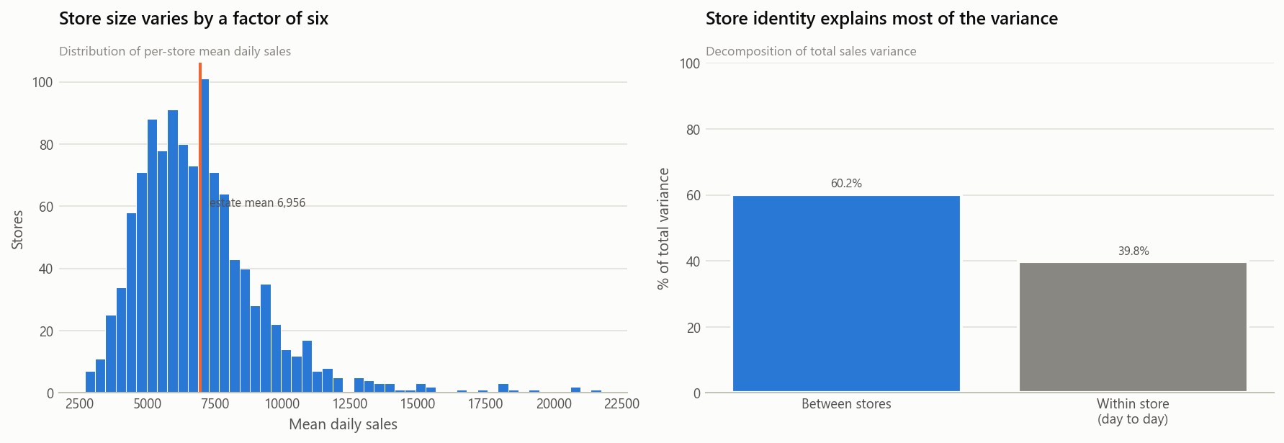
TASK 1 · FINDING 1
Store identity dominates
• 60% of total sales variance sits between stores, not within a store's own day-to-day swings.
• Store size varies sixfold across the estate.
Decision 1: per-store historical aggregates (mean/median sales, weekday & month baselines) became the highest-value feature family.
Decision 2: RMSPE — a relative, scale-invariant metric — was chosen over RMSE so large stores don't dominate the loss and small stores don't get ignored.
Rossmann Sales Forecasting | NextHikes IT Solutions
4

Slide 5
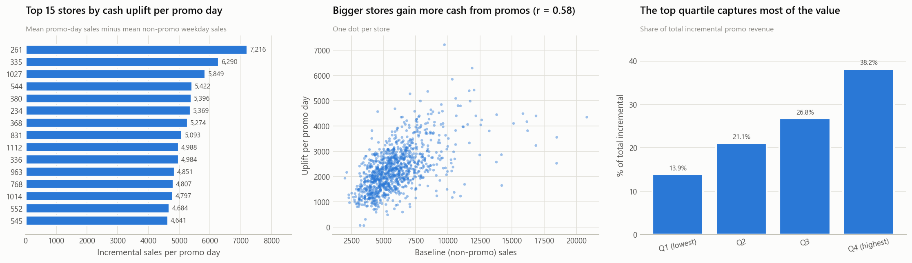
TASK 1 · FINDING 2
Promos work through both channels, roughly equally
• Weekday promo days deliver a 38.8% sales lift.
• That splits into a 19.8% footfall increase and a 15.3% basket-size increase — genuinely more customers and bigger baskets.
• But response is wildly uneven: the top quartile of stores captures 38% of incremental promo revenue; the bottom quartile just 14%.
Actionable now: retarget promo spend toward the stores that actually respond — no model required.
Rossmann Sales Forecasting | NextHikes IT Solutions
5

Slide 6
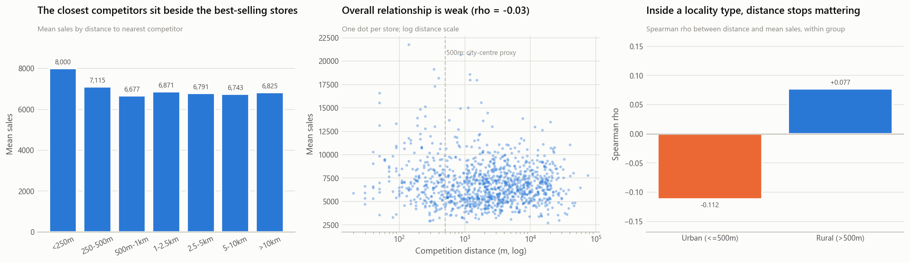
TASK 1 · FINDING 3
Competitor distance measures urbanity, not competition
• Counter-intuitively, stores with a competitor within 250m sell more than stores with no nearby competitor at all.
• Resolution: competitors cluster where customers are — distance is mostly a proxy for how central a location is.
• Splitting on a 500m city-centre proxy collapses the correlation to near zero within each locality type.
Kept as: a log-transformed feature plus an explicit city-centre flag, so the model separates the two readings.
Rossmann Sales Forecasting | NextHikes IT Solutions
6

Slide 7
TASK 2 · ARCHITECTURE
One pipeline, trained and served identically
Raw CSVs
Cleaning
Feature
Engineering
Scaling /
Encoding
Model
Prediction
• The whole chain is one sklearn.pipeline.Pipeline (src/pipeline.py) — the exact code that trains the model is the code that serves it in production. No duplicated preprocessing between training and the Flask app.
• Features beyond the brief's calendar asks: cyclical sin/cos day encodings, a decoded IsPromo2Active flag (parsed from strings like "Feb,May,Aug,Nov"), months-since-competitor-opened, and per-store historical aggregates.
Validation: the final 6 weeks of the training window (804,056 train / 40,282 valid rows) — not a random split, matching the brief's real forecast horizon and avoiding leakage.
Loss function: RMSPE (Root Mean Square Percentage Error) — a 10% miss on a corner store counts as seriously as a 10% miss on the flagship, and it's directly interpretable to a non-technical stakeholder.
Rossmann Sales Forecasting | NextHikes IT Solutions
7

Slide 8
TASK 2 · RESULTS
Random Forest vs. LightGBM
Model | RMSPE | RMSE | MAE | MAPE | R² | Fit time | Size
Random Forest (150 trees, depth 14) | 0.1395 | 1,060.7 | 721.8 | 10.41% | 0.879 | 180 s | 89.7 MB
LightGBM (600 trees, 63 leaves) | 0.1294 | 929.7 | 635.8 | 9.45% | 0.907 | 106 s | 4.3 MB
LightGBM wins on every metric — lower error, faster to train, ~20x smaller on disk — and is the default model the Flask app serves.
Engineering lesson: the first Random Forest config (min_samples_leaf=2, no depth cap) trained to RMSPE 0.1314 but serialized to a 3.08 GB pickle — unfit to ship. Capping min_samples_leaf=25 / max_depth=14 cost 0.008 RMSPE and bought a 34x smaller, 3.4x faster model.
Confidence intervals: Random Forest's 150 trees give per-row prediction spread for free. Empirical 95%-interval coverage measured at 78.1% — under-covering as expected; useful for ranking which forecasts to trust least, not a calibrated bound.
Feature importance: computed via permutation importance (unbiased vs. high-cardinality features) — confirms Store, Promo, Date and CompetitionDistance as top drivers, matching Task 1's findings independently.
Rossmann Sales Forecasting | NextHikes IT Solutions
8

Slide 9
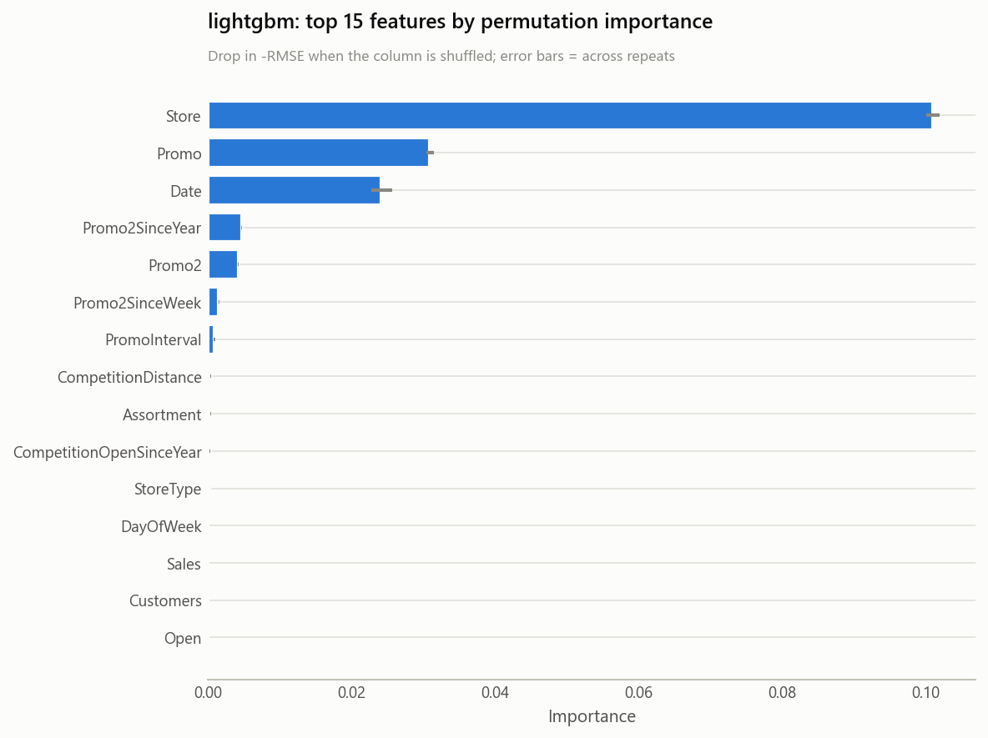
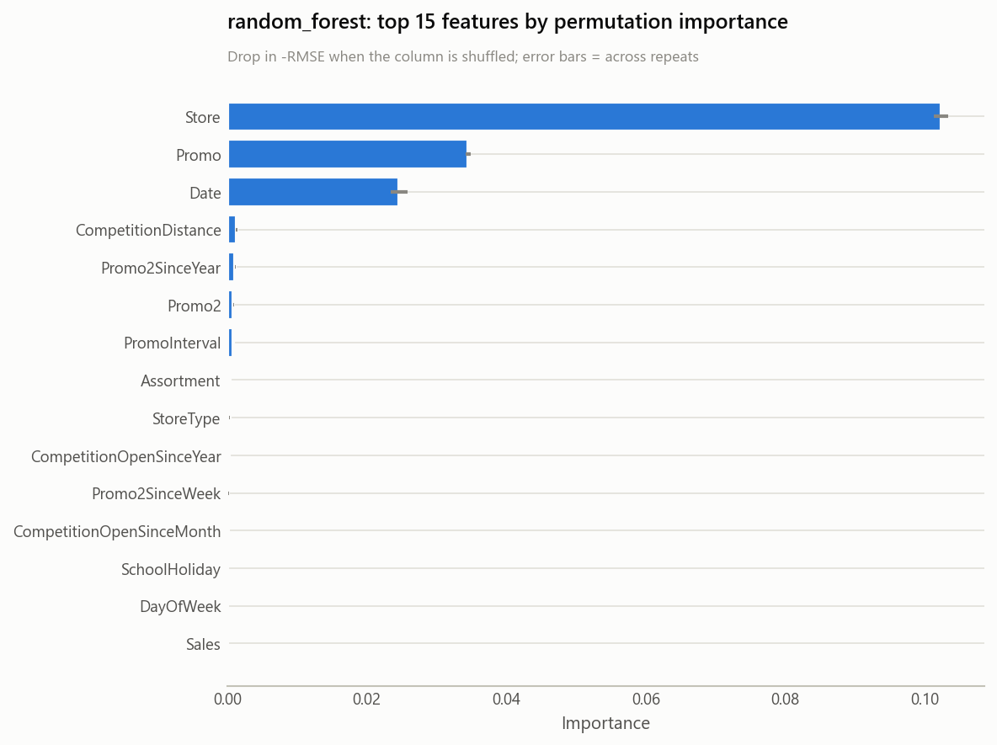
TASK 2 · RESULTS
What drives the forecast
Both models independently confirm Task 1's store-identity and calendar dominance finding.
Rossmann Sales Forecasting | NextHikes IT Solutions
9

Slide 10
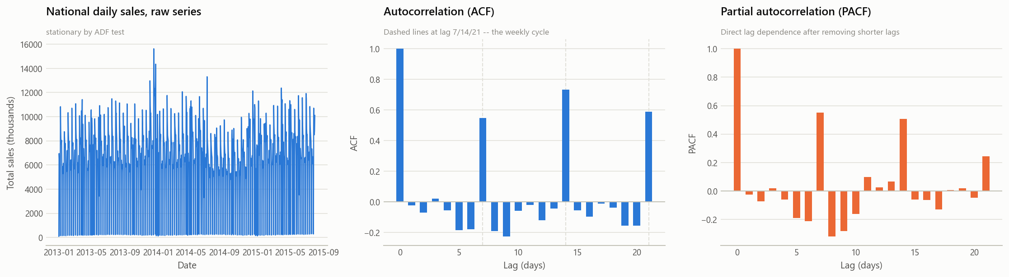
TASK 2.6 · DEEP LEARNING
An LSTM forecaster, built the brief's way
• Seven-step process: isolate series → ADF stationarity test → difference if needed → ACF/PACF → sliding windows → scale (-1,1) → train.
• National series tested stationary (ADF stat -4.76, p = 6.4×10⁻⁵) — no differencing needed.
• ACF/PACF show sharp spikes at lags 7/14/21 → 14-day lookback window (two full weekly cycles).
• 83,954 sequences built per-store (120 stores), each with its own MinMaxScaler so no store dominates the loss.
• 18,433-parameter network (LSTM 50 → LSTM 25 → Dense), 72 KB, trained in 338s on CPU.
Model | RMSPE | RMSE | MAE | R²
LSTM (14-day window, 120 stores) | 0.1606 | 1,092.8 | 766.3 | 0.886
Behind both tree models — the LSTM is univariate (past sales only, no store identity). R² = 0.886 is still a solid result from sales history alone.
Rossmann Sales Forecasting | NextHikes IT Solutions
10

Slide 11
TASK 2.7 · MLOPS
Tracked, versioned, reproducible
MLflow
Every run (Random Forest, LightGBM, LSTM) logged with params, metrics and artefacts to a SQLite-backed tracking store — 3 clean FINISHED runs kept, stale runs soft-deleted.
DVC
Raw CSVs and the processed/engineered training frame are data-versioned against a local remote, independent of git history.
Git
Full source history for the pipeline, EDA, training scripts and Flask app.
Serialization
Models saved with a timestamp (model_DD-MM-YYYY-HH-MM-SS-CC.pkl) plus a sibling metadata JSON — supports daily retraining with full traceability.
Rossmann Sales Forecasting | NextHikes IT Solutions
11

Slide 12
TASK 3 · SERVING
A dashboard the finance team can use directly
• Flask app (app/) — a finance analyst picks a store, uploads a CSV of dates to forecast (with optional holiday/promo flags).
• Returns a chart of predicted sales with a confidence band where the model supports it, plus an estimated customer count.
• Results downloadable as CSV to feed the analyst's own planning process.
No duplicated logic: the app calls the exact same fitted pipeline object validated in Task 2 — the model that's tested is the model that's served.
• JSON API (/api/predict) and a model-listing endpoint (/api/models) support programmatic access alongside the UI.
Routes
GET /
upload form
POST /predict
multipart CSV upload → chart + table
GET /download/<token>
CSV export of a prior run
GET /sample-csv
starter template for analysts
GET /api/models
list available serialized models
POST /api/predict
JSON in, JSON predictions out
GET /healthz
liveness check for deployment
Rossmann Sales Forecasting | NextHikes IT Solutions
12

Slide 13
RECOMMENDATIONS
What the finance team should do with this
1
Retarget promo spend
toward the top-quartile-responding stores identified in Task 1 — actionable immediately, no model required.
2
Treat competitor distance with caution
in any manual override — it mostly encodes location type, not competitive threat.
3
Adopt the model for the 6-week cycle
it was built for; the current validation window can't yet confirm accuracy through the December peak — worth a dedicated check after a full year of live forecasts.
4
Retrain regularly
using the existing pipeline and timestamped serialization — daily retraining with full MLflow tracking is already in place.
Rossmann Sales Forecasting | NextHikes IT Solutions
13

Slide 14
Thank you
Full write-up: reports/blog_post.md | Notebook: notebooks/Rossmann_Sales_Forecasting.ipynb | App: app/
NextHikes IT Solutions × Rossmann Pharmaceuticals

