Slide 1
Disaster Tweet Classification
An NLP project: from raw tweets to a deployed web classifier
Digicrome AI Course · Submission 15 Oct 2026

Slide 2
The problem
Telling real emergencies from metaphors on social media
• Relief agencies and newsrooms want automated Twitter monitoring for disasters.
• Keywords alone fail: "this song is fire" is not a wildfire.
• Goal: high precision (few false alarms) and good recall, robust to slang and noise, fast enough to scale.
Same word, different intent
Forest fire near La Ronge Sask. Canada → disaster
On top of the hill, I can see a fire in the woods → disaster
My car is so fast → not a disaster
I'm flooded with work → not a disaster

Slide 3
Workflow at a glance
Four parts of the brief, one reproducible pipeline
1
2
3
4
Explore & prepare
Features & models
Evaluate & validate
Deploy
EDA, cleaning, tokenising, split
TF-IDF, extras, 5 models, grid search
Metrics, ROC/PR, overfit & robustness
Pickle + Flask web UI
Code: pipeline.py (analysis & training) · app/ (Flask) · make_ppt.py (this deck)

Slide 4
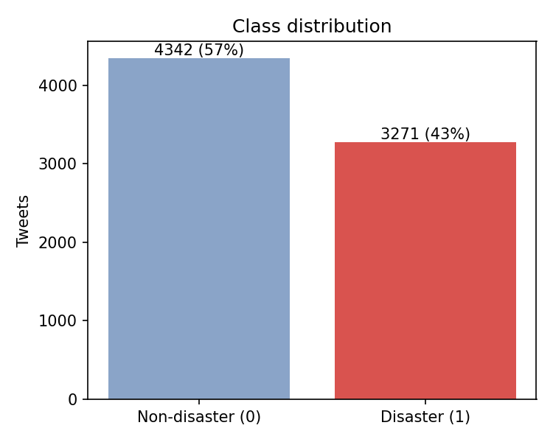
Data exploration
tweets.csv: id, keyword, location, text, target
7,613
• Keyword missing in 61 rows, location in 2534 (34%), so location is dropped.
• Mild imbalance (43/57), so F1 and PR curves are tracked, not just accuracy.
• Exact duplicate texts removed (keep first) to prevent train/test leakage: 7,503 rows remain.
labelled tweets (brief says ~10k)
43%
disaster (target = 1)
110
duplicate texts; 18 with conflicting labels

Slide 5
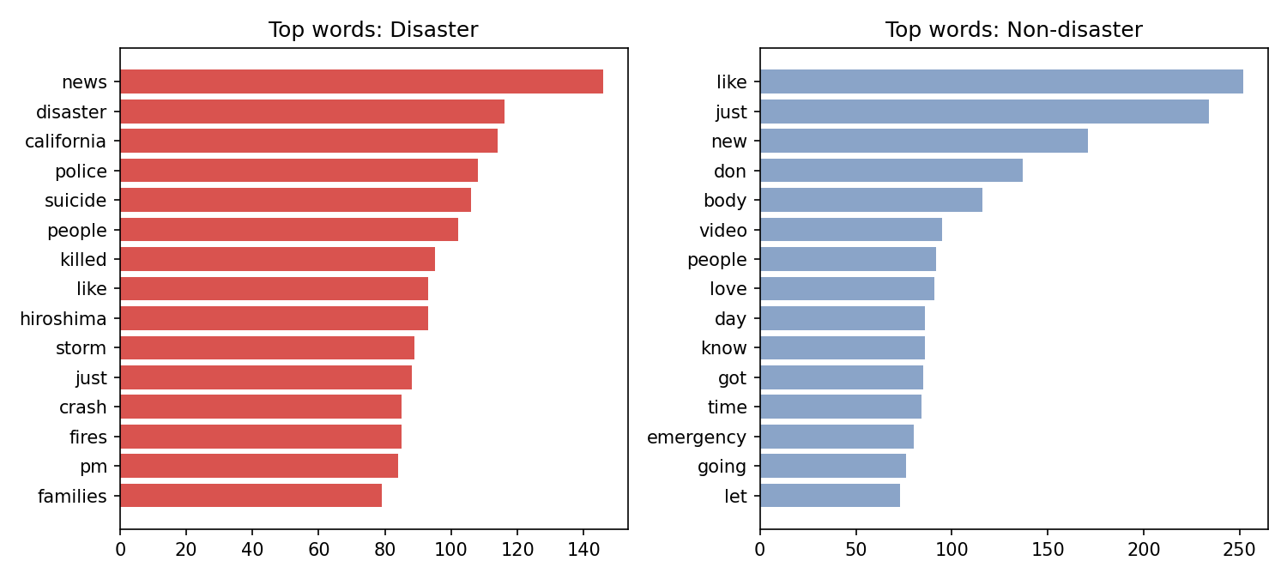
Which words signal a disaster?
Top non-stop-words per class after cleaning
• Disaster: killed, california, suicide (bombers), police, fire, flood, disaster, news, storm.
• Non-disaster: everyday chatter (like, love, new, just).
• Many words (fire, burning, bomb) appear in both classes, which is why context features matter.

Slide 6
Data preparation
• Lowercase; strip URLs, @mentions, '#', HTML entities, digits, punctuation.
• Tokenise into words (len ≥ 2), used for frequency analysis and extra features.
• Labels already numeric: 0 = non-disaster, 1 = disaster.
• Stratified 80/20 split (random_state=42): 6,002 train / 1,501 test.
• All vectorisers, scalers and SVD are fit on train only, so there is no leakage.
Before → after
#RockyFire Update => California Hwy. 20 closed in both directions due to Lake County fire - #CAfire #wildfires
↓
rockyfire update california hwy closed in both directions due to lake county fire cafire wildfires

Slide 7
Feature engineering
5-fold CV F1 of logistic regression on the training set
Feature set | CV F1
Tweet-statistics only (length, #, @, URL, !, ?, caps, sentiment) | 0.558
LSA vectors (150-d SVD, semantic embedding stand-in) | 0.675
TF-IDF words (1-2 grams) + keyword | 0.741
+ character 2-5 grams (slang, typos) | 0.757
+ tweet statistics (chosen) | 0.760
• TF-IDF is the strongest single signal; char n-grams add robustness to slang and misspellings.
• Tweet statistics help only slightly alone, but add a small gain on top.
• Word2Vec/GloVe need extra downloads (no gensim installed), so LSA is the semantic-vector substitute here. Pretrained GloVe is the obvious next step.
• Sentiment is a small lexicon score (positive minus negative words).

Slide 8
Model selection and tuning
Five candidates, 5-fold CV grid search optimising F1
Model | Best params | CV F1 | Train F1
Logistic Regression | C=3 | 0.760 | 0.923
Linear SVM | C=0.3 | 0.760 | 0.927
Naive Bayes | alpha=0.3 | 0.742 | 0.848
Random Forest | max_depth=None, n_estimators=400 | 0.683 | 0.996
Neural Net (MLP on LSA) | alpha=0.0001, hidden_layer_sizes=(128, 64) | 0.712 | 0.749
• Linear models on sparse TF-IDF lead (CV F1 ≈ 0.76); Random Forest and the MLP on dense LSA are weaker on short, sparse text.
• Train F1 far above CV F1 for LR, SVM and RF shows overfitting, addressed in validation.

Slide 9
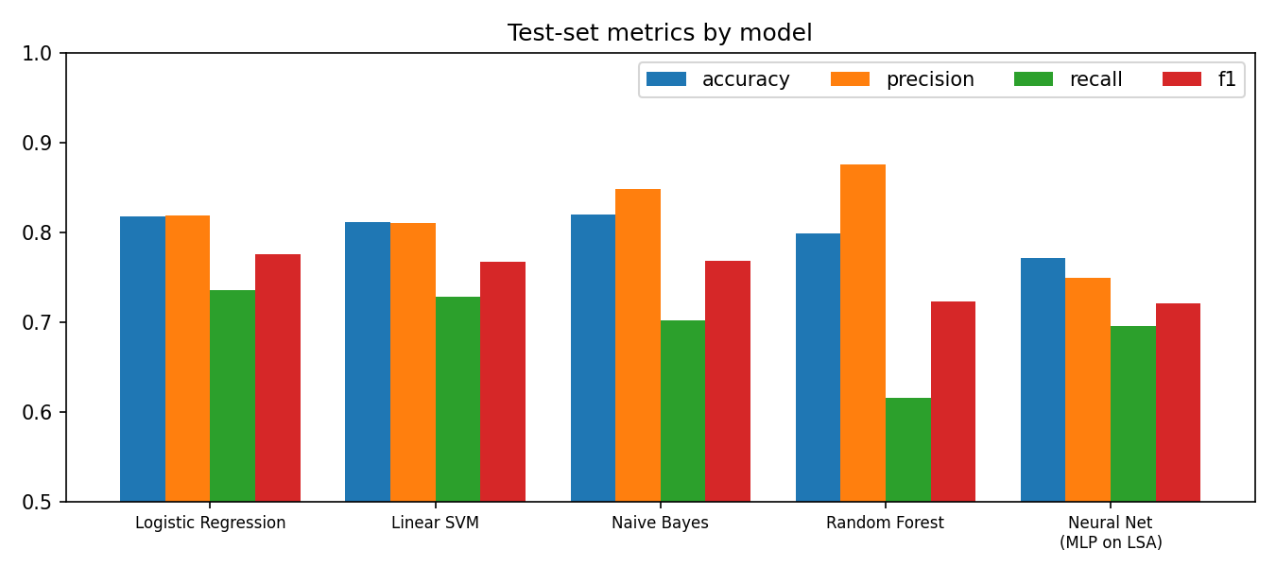
Model evaluation on the held-out test set
1,501 unseen tweets
Model | Accuracy | Precision | Recall | F1 | ROC-AUC
Logistic Regression | 0.818 | 0.819 | 0.736 | 0.775 | 0.868
Linear SVM | 0.811 | 0.810 | 0.728 | 0.767 | 0.866
Naive Bayes | 0.819 | 0.849 | 0.702 | 0.768 | 0.858
Random Forest | 0.799 | 0.876 | 0.616 | 0.723 | 0.853
Neural Net (MLP on LSA) | 0.771 | 0.749 | 0.695 | 0.721 | 0.834
• Winner: Logistic Regression (F1 0.775, accuracy 0.818).
• Random Forest has the highest precision (0.876) but misses 38% of disasters; choose by cost of false alarms vs misses.

Slide 10
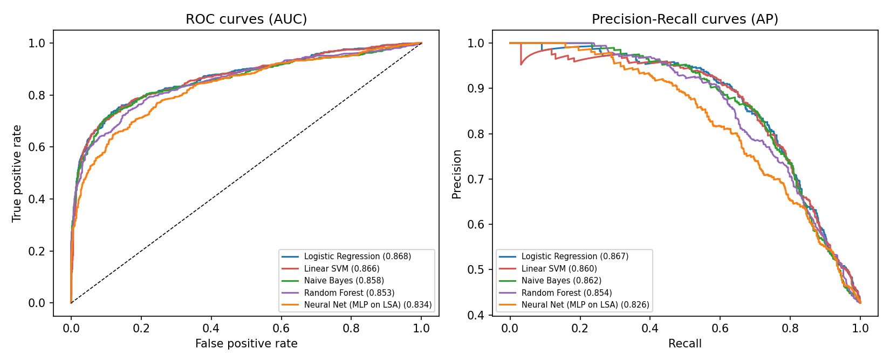
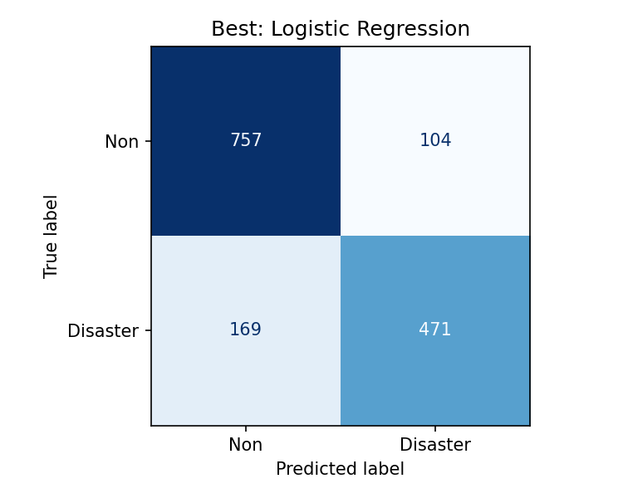
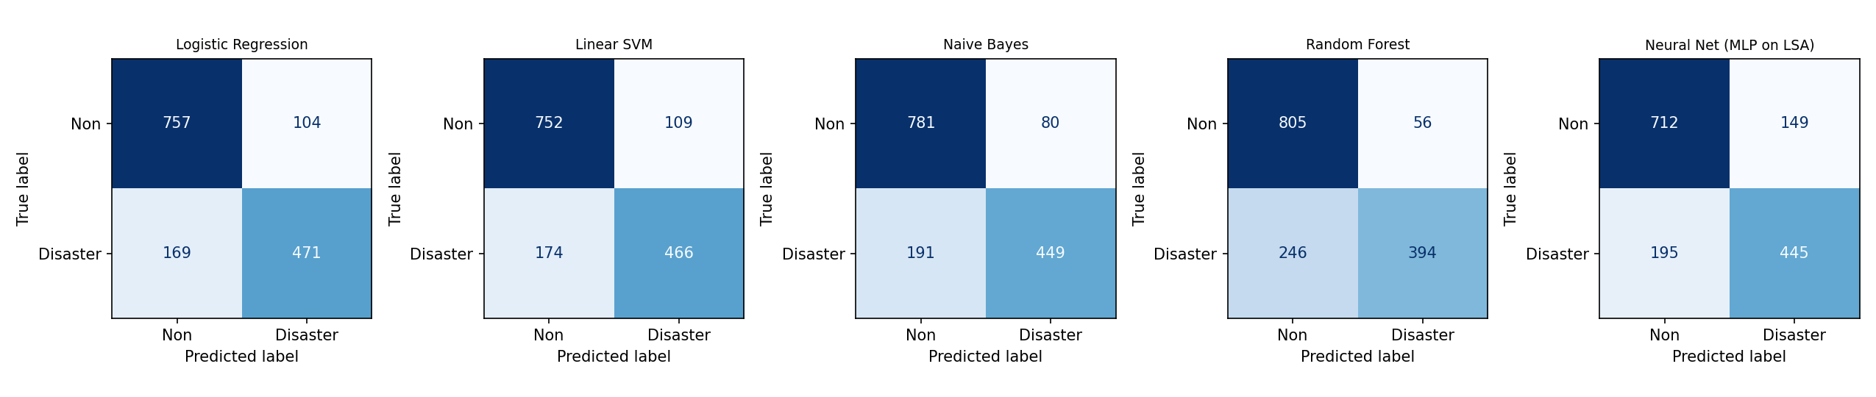
ROC, precision-recall and confusion matrices
Best model: 471 true alerts, 104 false alarms, 169 missed disasters, 757 correct rejections.

Slide 11
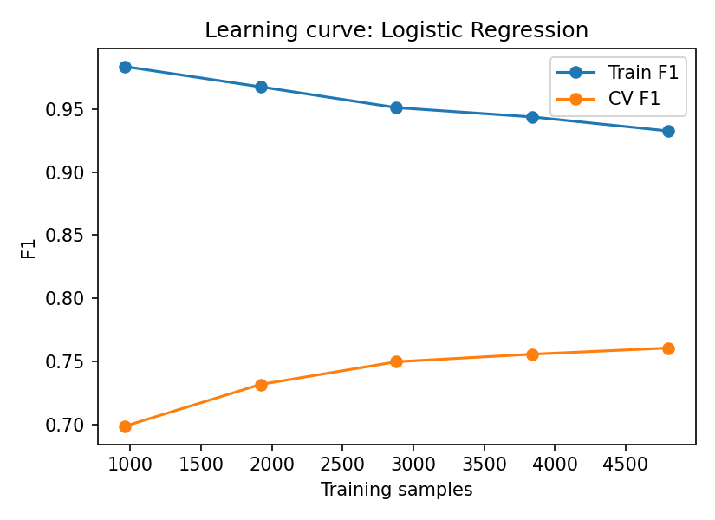
Model validation
Generalisation, over/underfitting and robustness
• Test F1 0.767 matches CV F1 0.760: the estimate is stable on unseen data.
• Overfitting is real: train F1 0.93 vs validation 0.76. Regularisation (C) was tuned; the CV curve still rises with more data, so more labelled tweets is the best fix.
• Noise test (caps, repeated letters, junk URL/hashtag/mention added): F1 0.767 → 0.735, a drop of only 0.031.
• Not underfitting: it beats the extras-only and LSA baselines clearly.
Caveat: labels are noisy (some errors are arguably mislabelled), which caps achievable accuracy near the low 80s.

Slide 12
What the model learned, and where it fails
Strongest disaster words
Strongest non-disaster words
Metaphor probes (P disaster)
fires (+2.5)
earthquake (+2.3)
hiroshima (+2.3)
distance (+2.3)
bombing (+2.1)
japan (+2.1)
shot (+2.1)
near (+2.0)
head (-2.1)
new (-2.0)
demolish (-1.8)
jobs (-1.7)
art (-1.6)
finally (-1.6)
wants (-1.6)
cake (-1.6)
Forest fire near my house, evacuation ordered → 0.99
Your new song is fire lol → 0.01
Earthquake of magnitude 6.1 hits the coast, buildings collapsed → 0.98
I'm flooded with work this week → 0.27
Massive flood waters rising, people trapped on rooftops → 0.89
That concert was a total bomb haha → 0.69
Wildfire smoke covers the city, residents told to evacuate → 0.97
Just ate a burning hot curry, my mouth is on fire → 0.72
• Errors cluster in political/war talk, sports-riot comments, and promotional spam that reuses disaster vocabulary.
• Figurative uses ("on fire", "bomb") are still sometimes over-scored; contextual embeddings (BERT) are the planned upgrade.

Slide 13
Deployment: model + Flask web app
Part 4 of the brief
• Final model: one scikit-learn Pipeline (clean → word+char TF-IDF → logistic regression, C=3), pickled with joblib as app/model.pkl. It takes raw text only, so it skips the extra tweet statistics (test F1 0.767 vs 0.775 with them).
• Flask backend: POST /predict takes JSON text and returns label and probability; GET / serves the UI.
• UI: text box, Classify button, colour-coded verdict with probability bar, one-click examples, empty-input error.
• Run locally: pip install -r app/requirements.txt, then python app/app.py.
• Cloud: gunicorn app:app on Heroku, Render or AWS Elastic Beanstalk (Procfile / requirements provided). Not deployed to a live host from here.
Web UI
[ Paste a tweet here… ]
[ Classify ]
Real disaster, probability 98.8%
████████████████░
Tested via Flask test client: / → 200, valid text → 98.8%, empty → 400.

Slide 14
Scalability, limits and next steps
Scalability
Next steps
• Inference is a sparse linear dot product: thousands of tweets/sec per core.
• Stateless app: scale horizontally behind gunicorn workers.
• Batch endpoint and streaming ingestion are straightforward additions.
• Fine-tune a transformer (DistilBERT) to resolve metaphors.
• Use pretrained GloVe/Word2Vec features.
• Tune the decision threshold for the agency's false-alarm tolerance.
• Add location/time and retweet-spike signals; monitor drift.
Result: an end-to-end classifier with 81% accuracy, 80% precision and F1 0.77 on unseen tweets (deployed model), deployed behind a working web UI.

