Slide 1

Philips Hue

Slide 2
Connect with Philips Hue from API – Steps (1)
Send a GET Request:
Use a tool like Postman to send a GET request to the following URL
Interpreting the Response
The response will be a JSON array containing information about the discovered Hue Bridges on the network
Each object in the array contains
id: A unique identifier for the Hue Bridge
internalipaddress: The local IP address of the Hue Bridge
port: The port number the bridge uses (usually 443)
https://discovery.meethue.com/

Slide 3
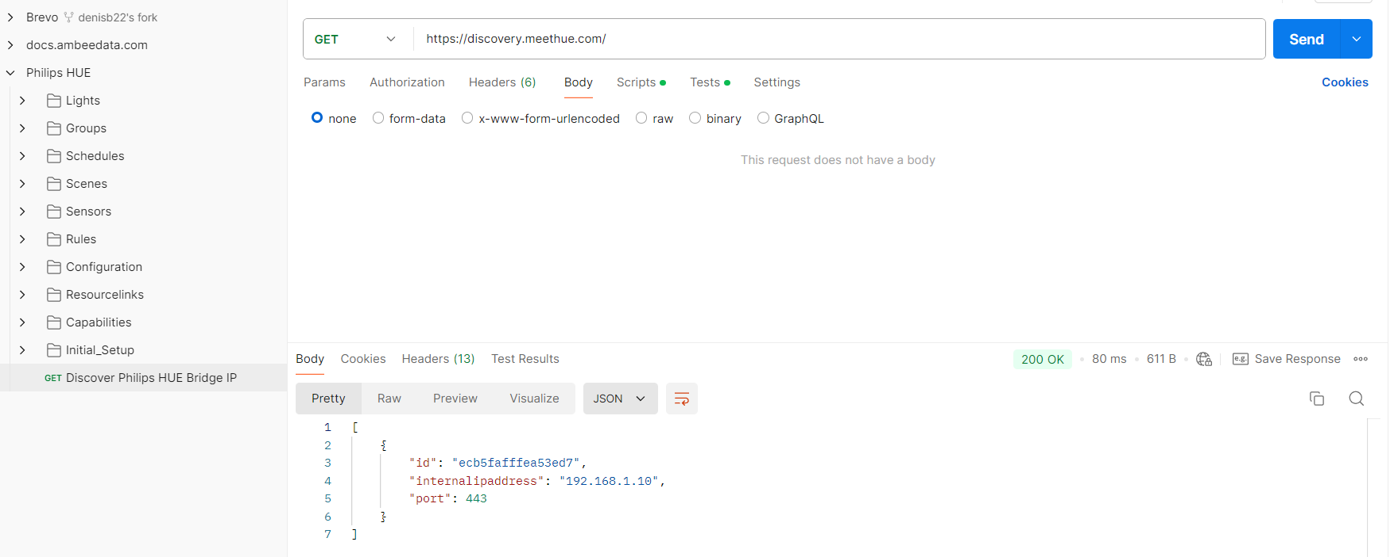
Connect with Philips Hue from API – Steps (2)
Request and Response
*The resources will be uploaded with the lecture

Slide 4
How to Develop for Hue? (1)
The fastest way to learn how to build apps which control the hue system is to use the simple test web app built into every bridge
This lets you directly input commands and send them to the lights
Follow 3 Easy Steps:
First make sure your bridge is connected to your network and is functioning properly
Then you need to discover the IP address of the bridge on your network
Once you have the address load the test app by visiting the following address in your web browser:
https://<bridge ip address>/debug/clip.html

Slide 5
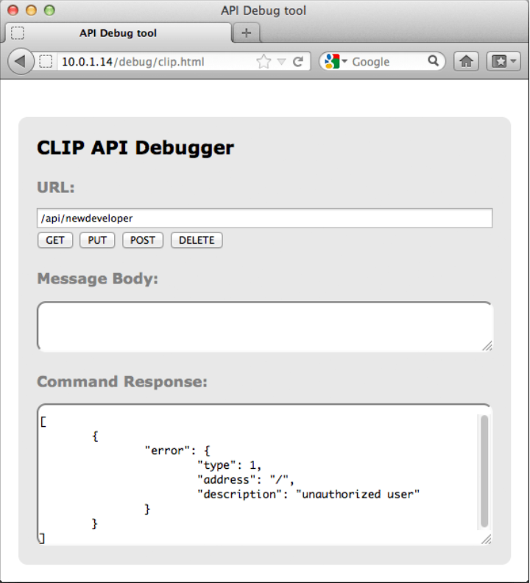
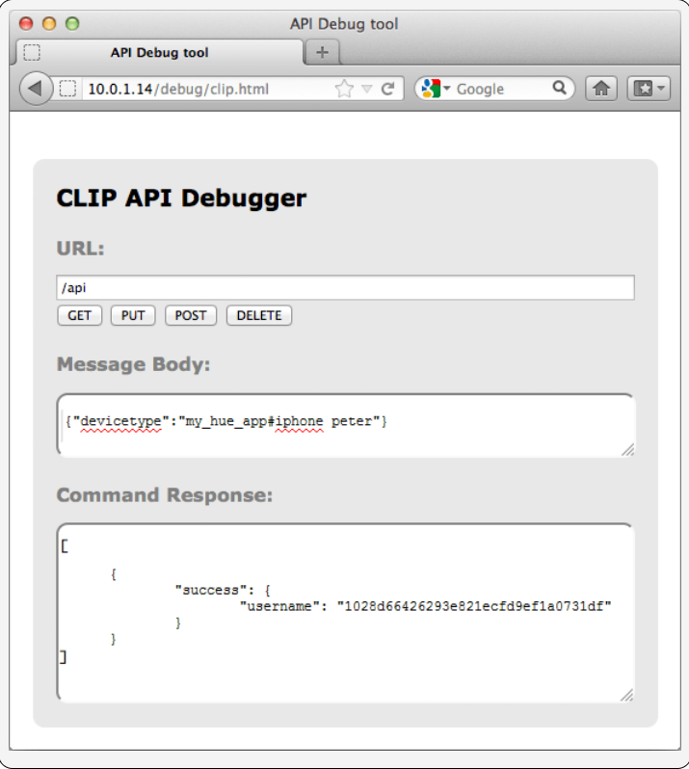
How to Develop for Hue? (2)
You should see a response like this
Go and press the button on the bridge and then press the POST button and you should get a success response

Slide 6
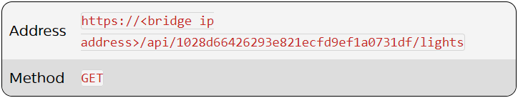
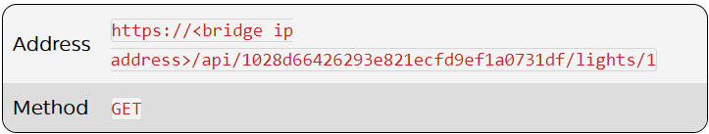
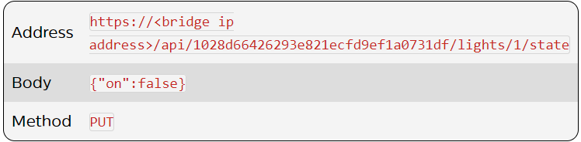
Example HTTP Requests (1)
Get information about all the lights in your system and their names
Get information about a specific light - The light with id 1
Turn the light off

Slide 7
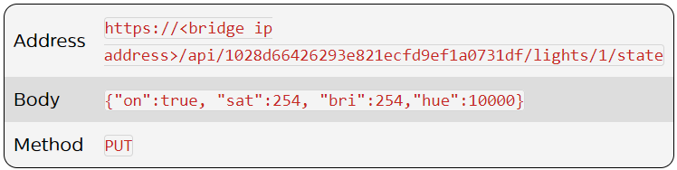
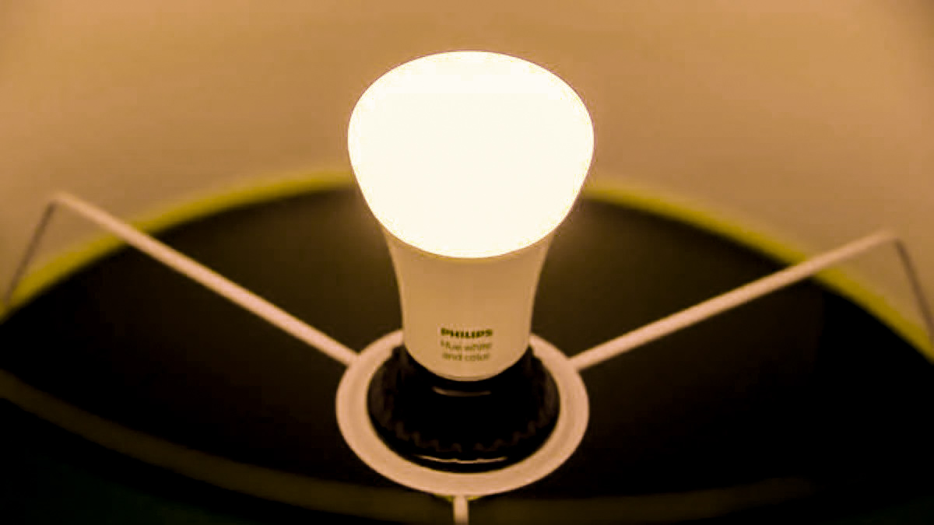
Example HTTP Requests (2)
We can do something a bit more fun and start changing some colors.

