Slide 1



Count of Records by URL
View in Power BI
Last data refresh:
09/11/2021 17:41:43 UTC
Downloaded at:
09/11/2021 18:11:06 UTC

Slide 2
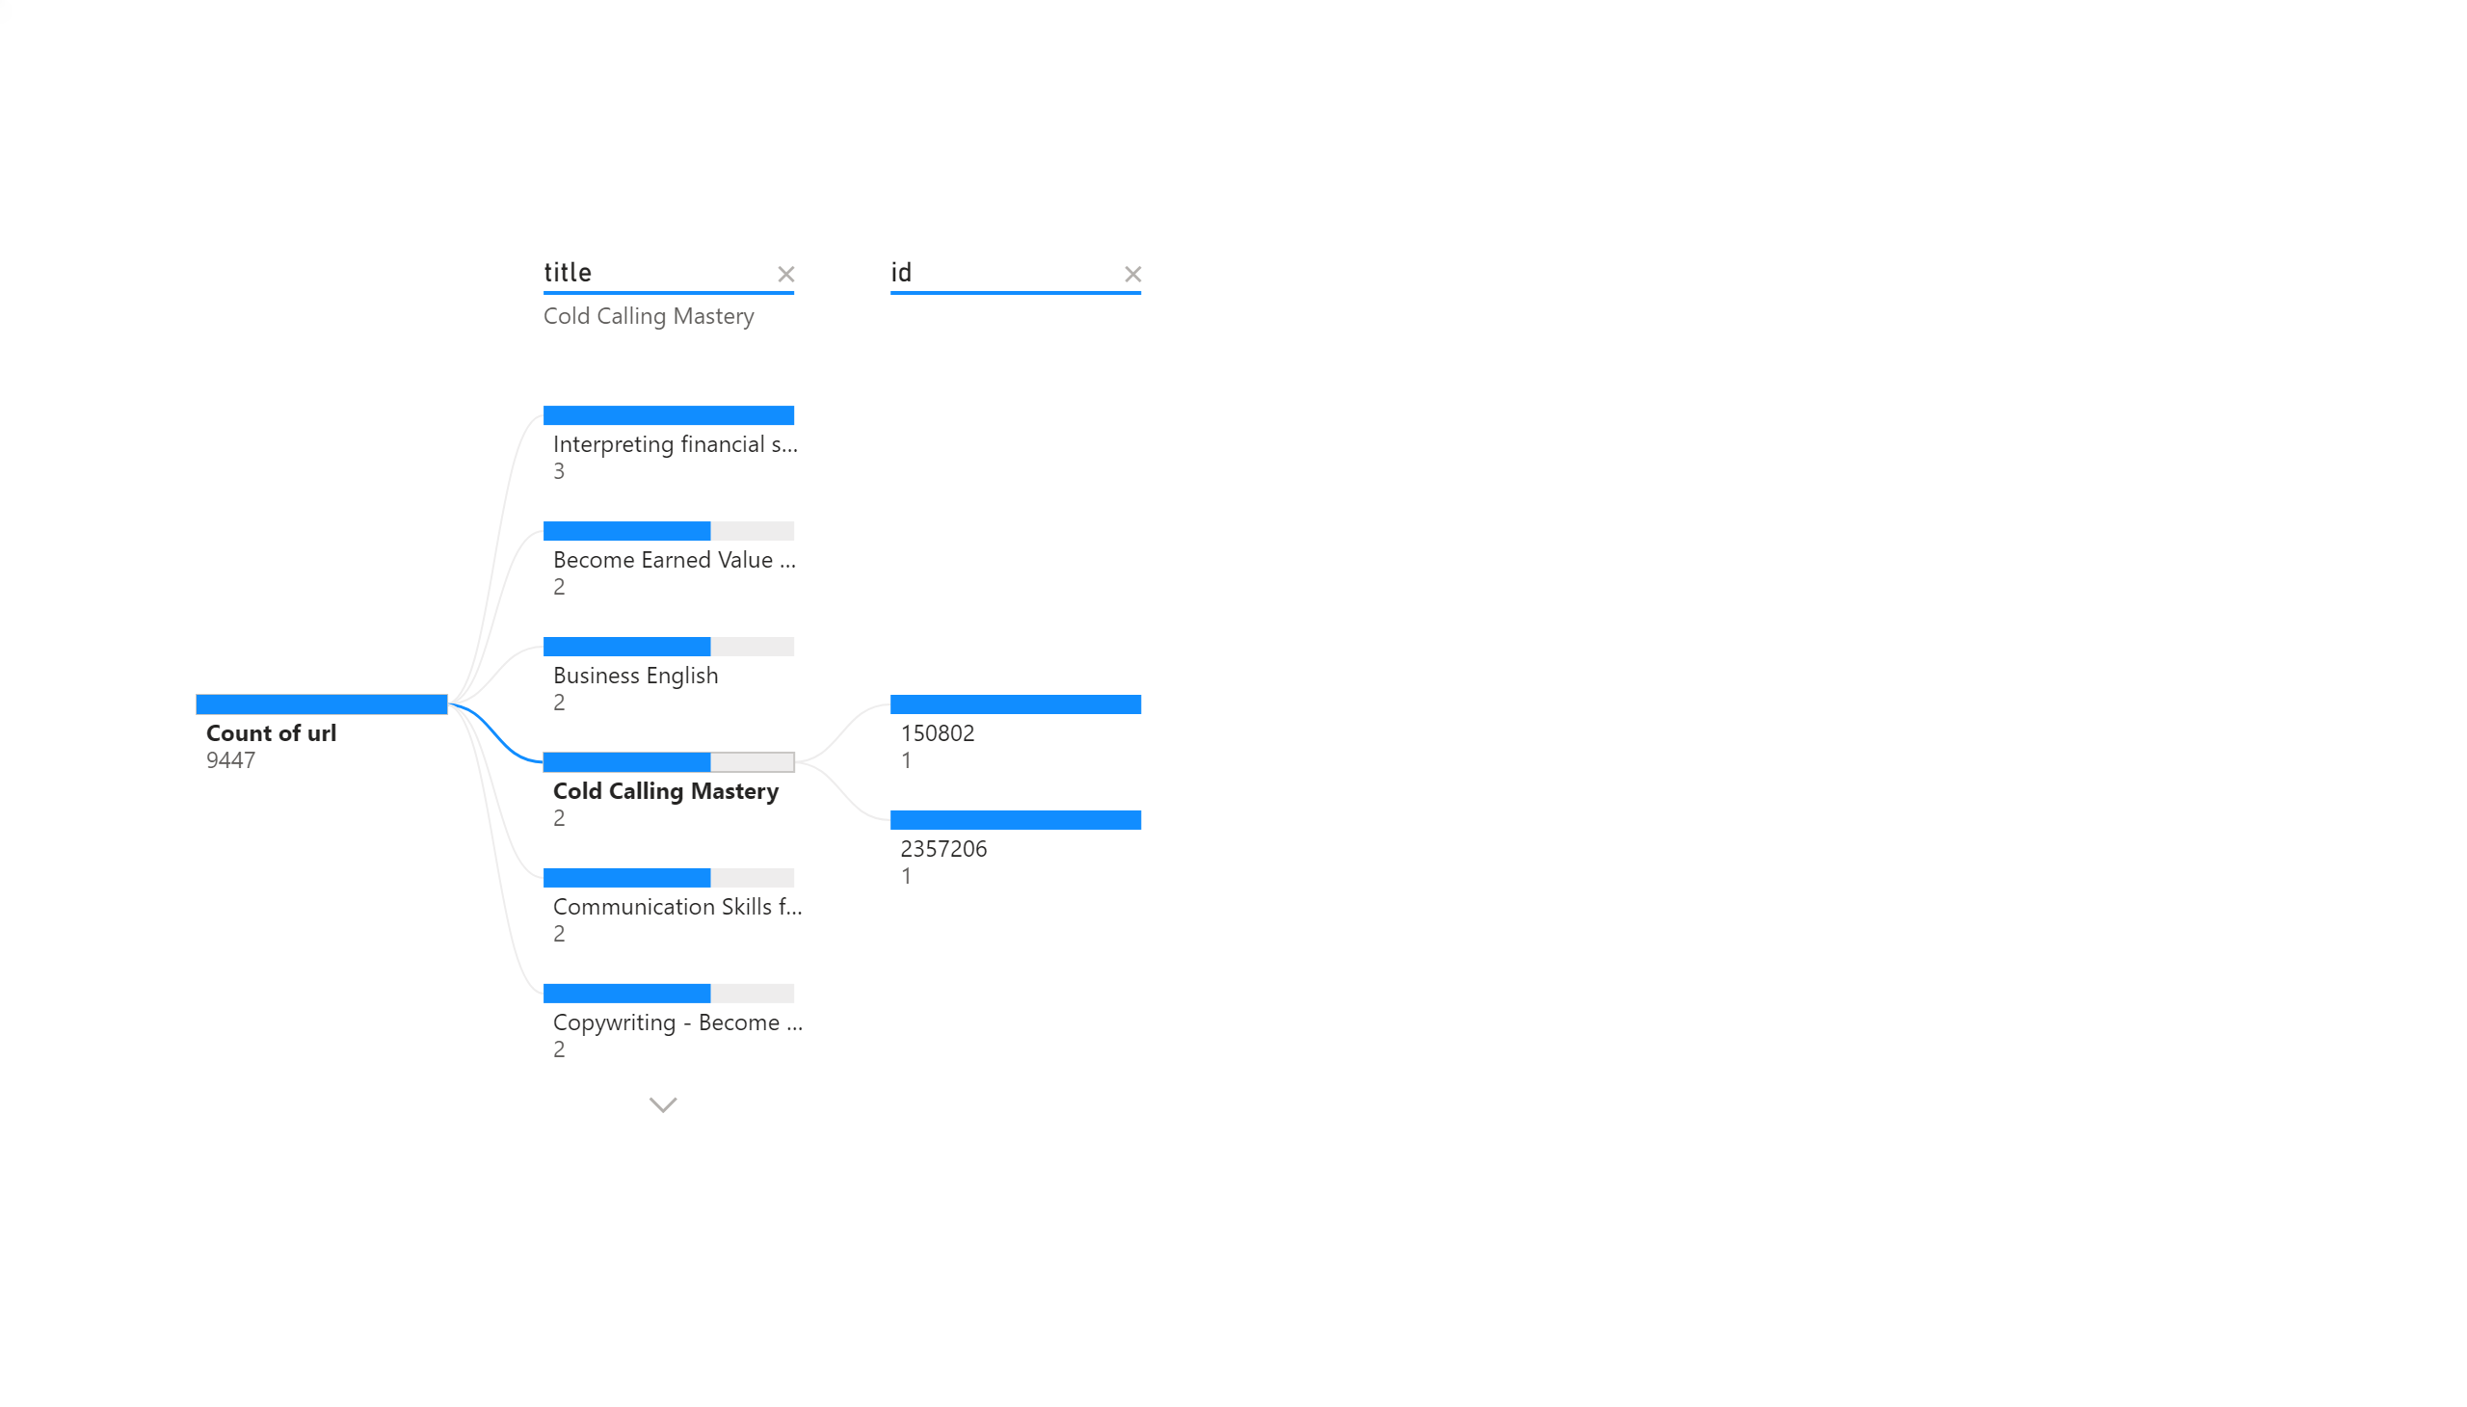
Page 1
Count of URL by ID and Title
Notes:
decompositionTreeVisual
No alt text provided.
textbox
No alt text provided.

