Slide 1
Price range for highest and lowest numbers of available courses
Udemy 10 k courses data

Slide 2
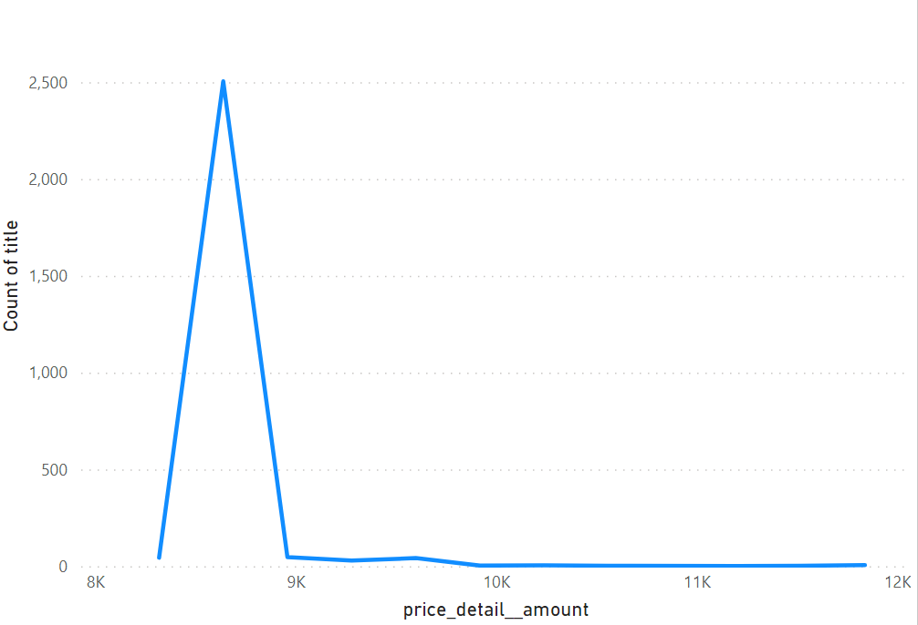
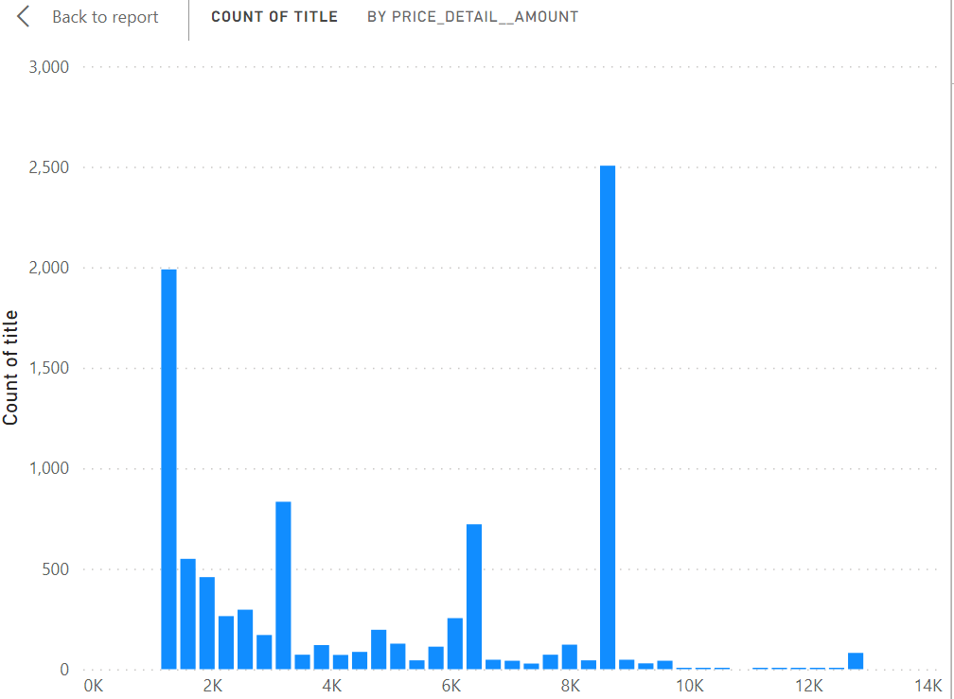
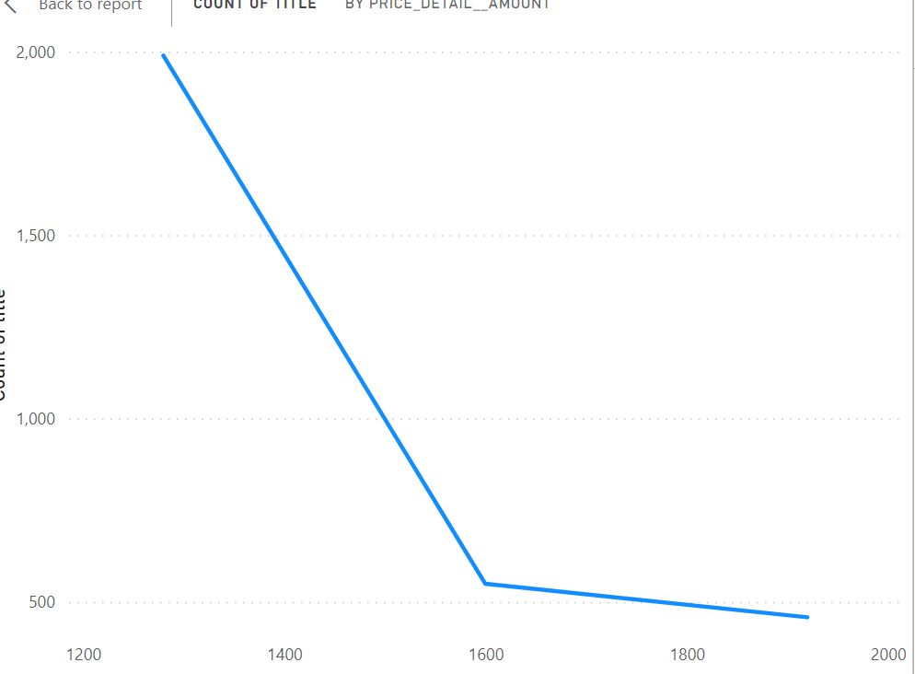
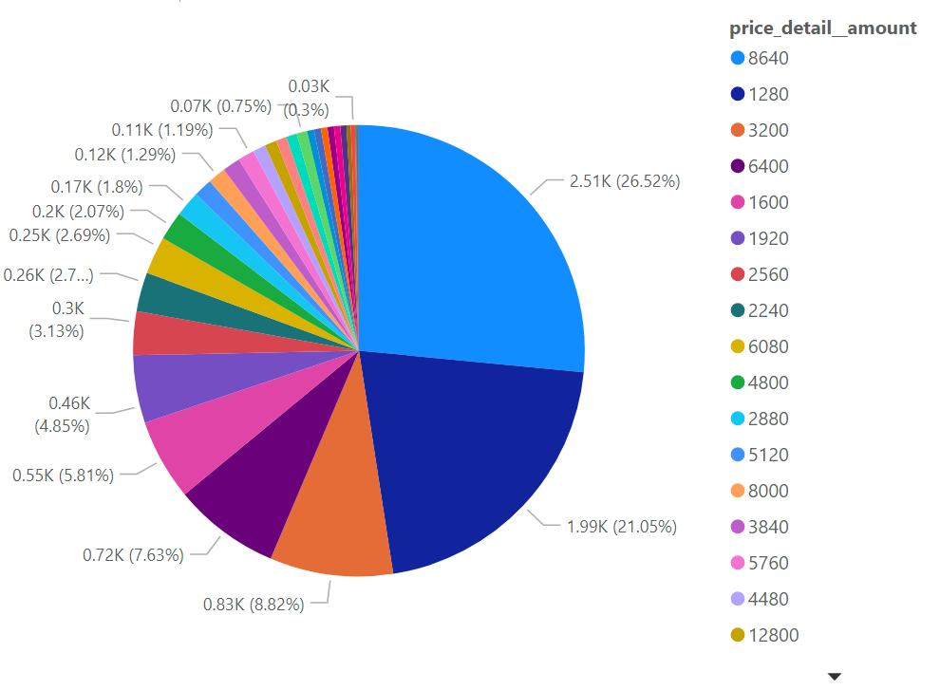
The visuals here are displaying the counts of courses with high price original range and low original price range.
On the top, the stacked column chart displays the higher count of courses with price range lower than 2k.
And the highest count of courses in between price 8k-9k and gradually the count of courses are lowering when the price gets higher.
Line graph also shows higher counts of available courses are below the price range 1400 and highest counts of courses available in the price range8000-9000.
The pie chart visuals displays the most available courses belong to the price range INR 8640 and 1280.

