Slide 1
Count of courses based on rating 4.2-4.6
Udemy courses Data

Slide 2
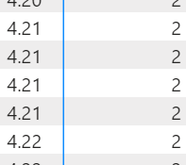
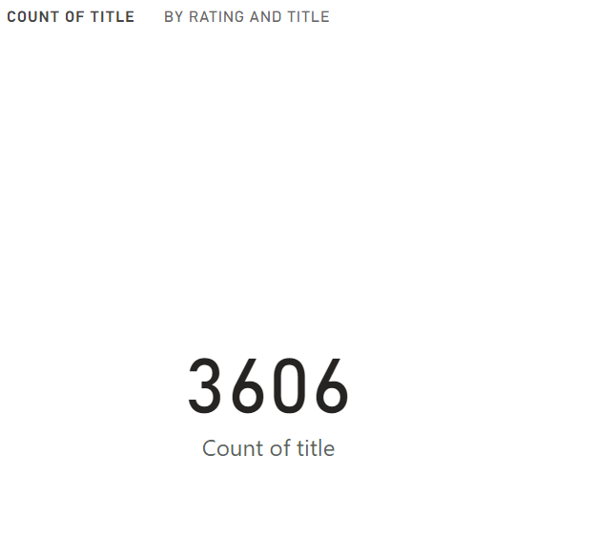


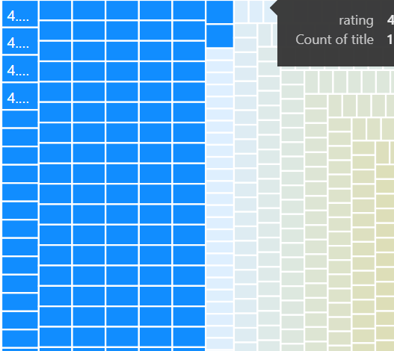
The visuals of this dashboard are representing data from the 10 k Udemy courses under business category.
The visuals on the right are matrix visual followed by tree maps. On the extreme right, card visual , table visual which are representing the total count of the courses and course title per rating.
The tree map visual represents color code. Such as, the deep blue exhibits highest rating and light grey with lowest rating.
The matrix visual represents only count of courses the per rating .

