Slide 1
Relationships Found
General fractal
Hamoltonian matrix is of size (num_of_sites x num_of_sites)
2D seperinski observations:
num_of_bonds = 3^n, where n is the fractal dimension
num_of_sites = 2 + sum(3^x) for 0<x<n

Slide 2
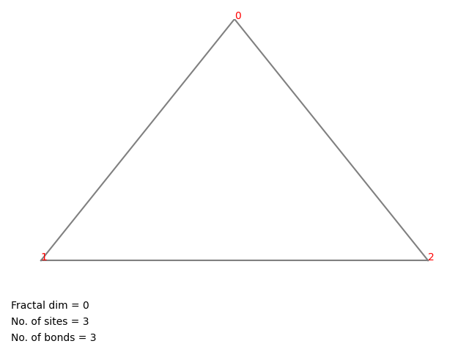

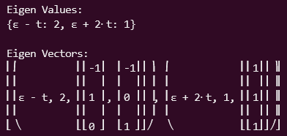
N=0

Slide 3
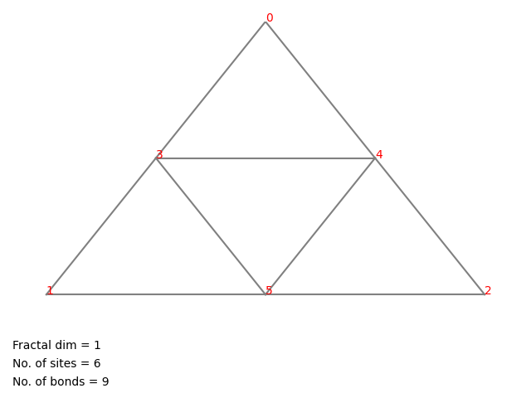
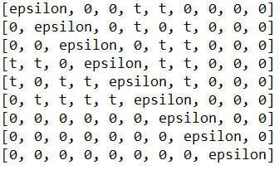

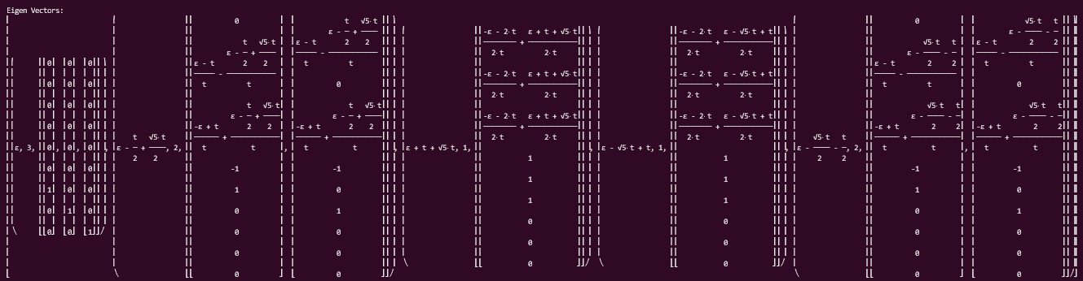
N=1

Slide 4
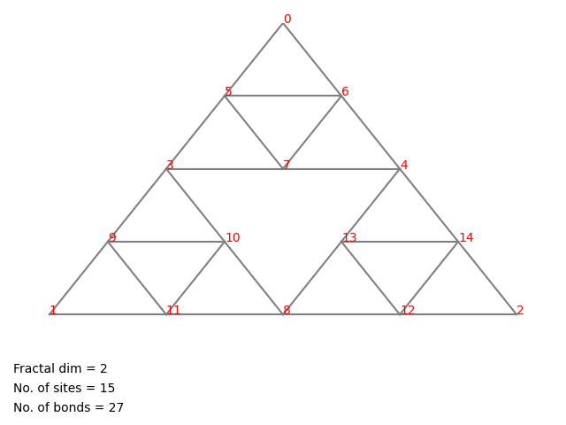
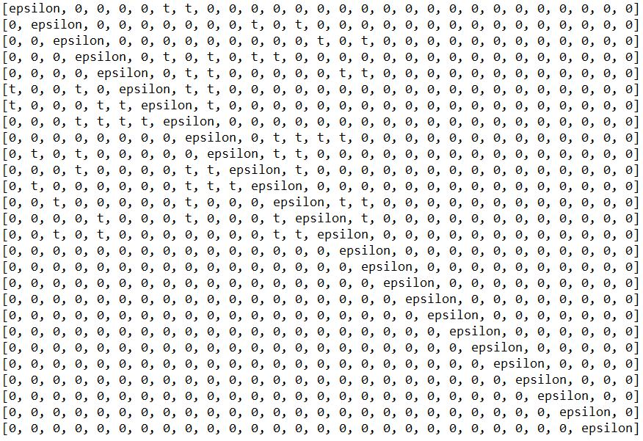
N=2

Slide 5
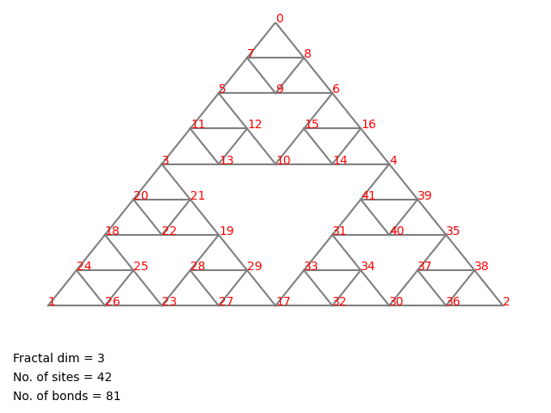
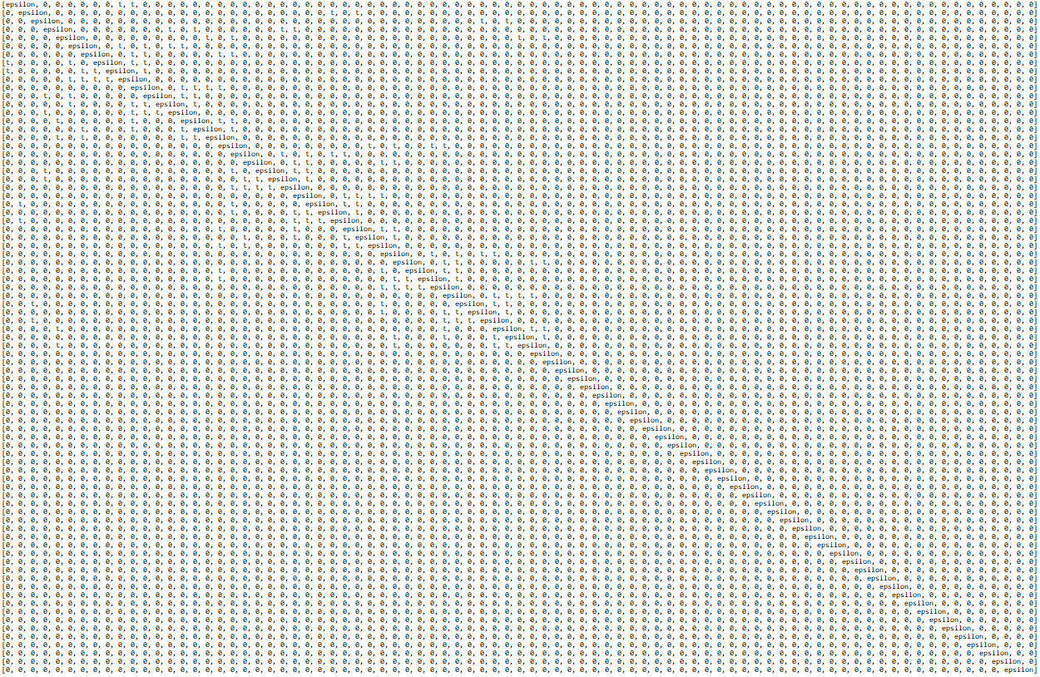
N=3

Slide 6
In Progress
Completely construct hamoltian in python
Eigen values seems to break/crash at n >= 2

