Slide 1

AfricaR Initiative
29/09/2019
Shelmith N. Kariuki
Ibadan R User Group Launch

Slide 2
Who are we?

Slide 3
Mission:
To achieve improved representation and empower the African population of all genders, who are underrepresented in the global R community.
Support already existing R User Groups (RUGs) across Africa, and R enthusiasts to embrace the full potential of R programming.
Through fostering a collaborative continental network of R gurus, mentors, learners, developers and leaders, to help facilitate individual and collective progress worldwide.

Slide 4
Why AfricaR?

Slide 5
Why AfricaR?
Many R users in Africa, who did not know of the larger global #rstats community.
Lack of awareness about R Conferences that we can apply for, and attend, through diversity scholarships.
People learning R, but are not aware of where/how to apply the skills they learn.
Education system is lacking. Some campuses teach R, but the curriculum is not exhaustive.
“Battle” between R and Python:
  Employment JDs prioritize Python over R
  Python communities stronger than R community.
    Data Science Africa
    Pycon
    IndabaX

Slide 6
What ideas do we have for AfricaR?

Slide 7
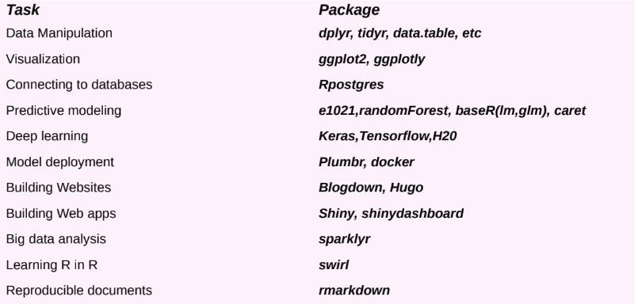
Why AfricaR?
Amazing things that R can do

Slide 8

01: Adoption and nurturing of young African RUGs by developed RUGs
Notes:
Developed R User Groups mentoring/supporting new R User Groups

Slide 9

02: Seek remote internships / jobs for students fresh from school

Slide 10
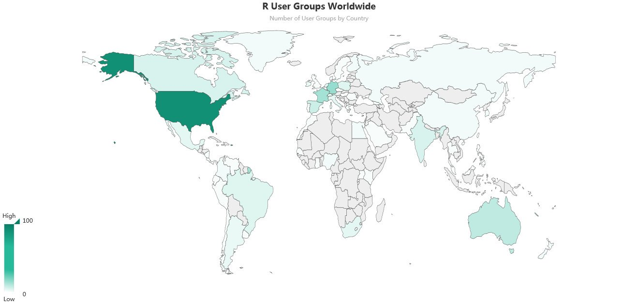
03: Spring up as many African RUGs

Slide 11
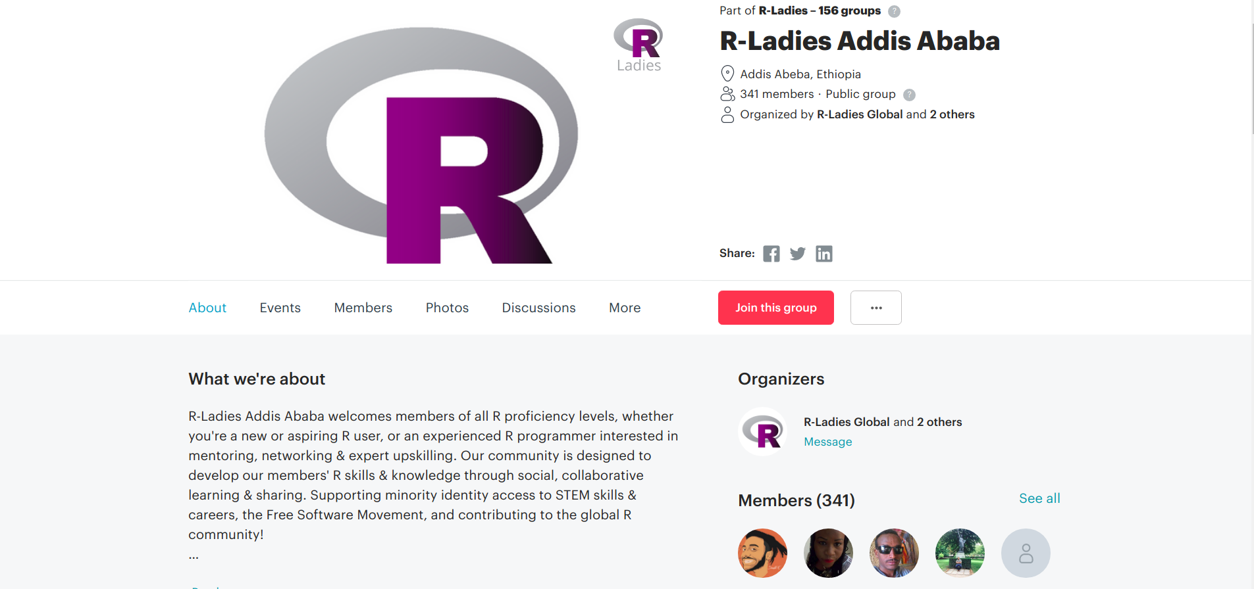


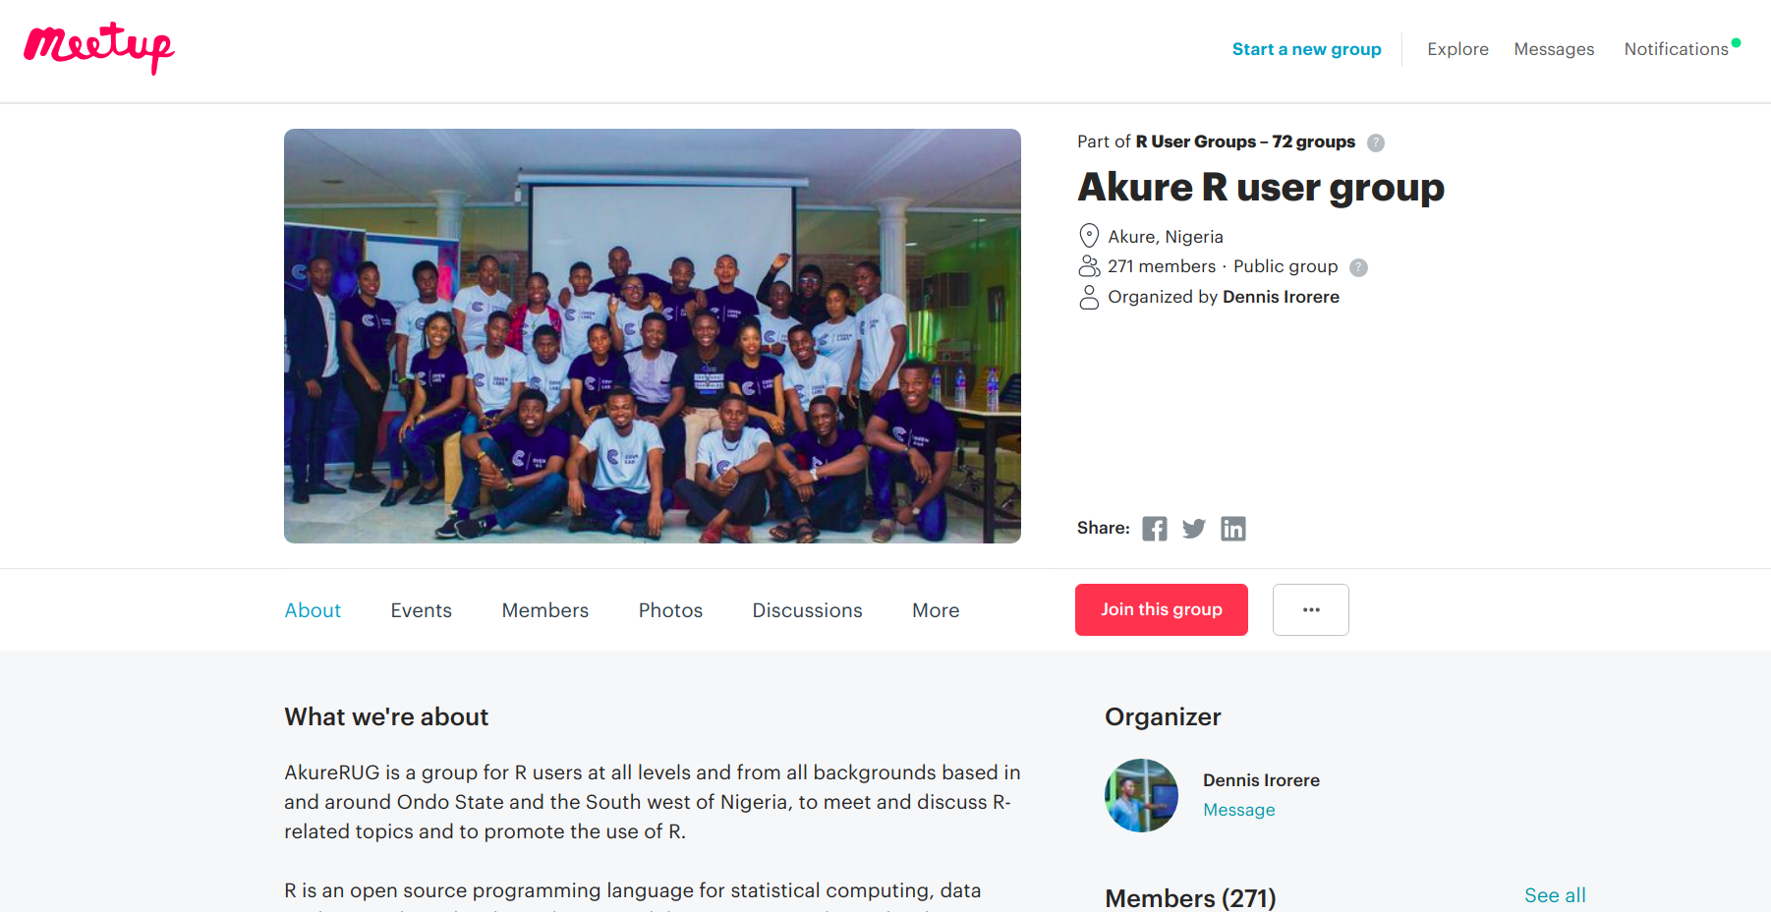
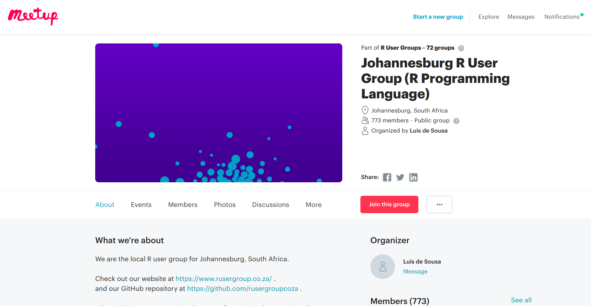


Slide 12
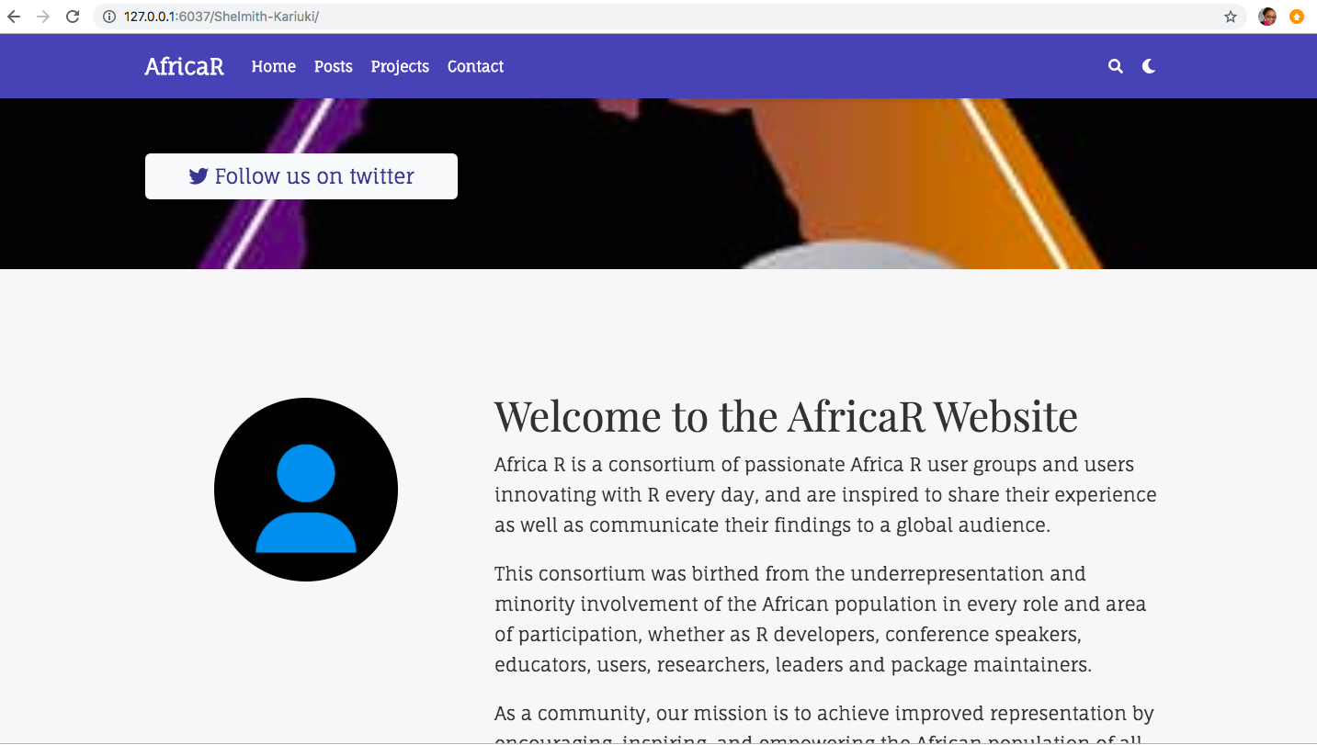
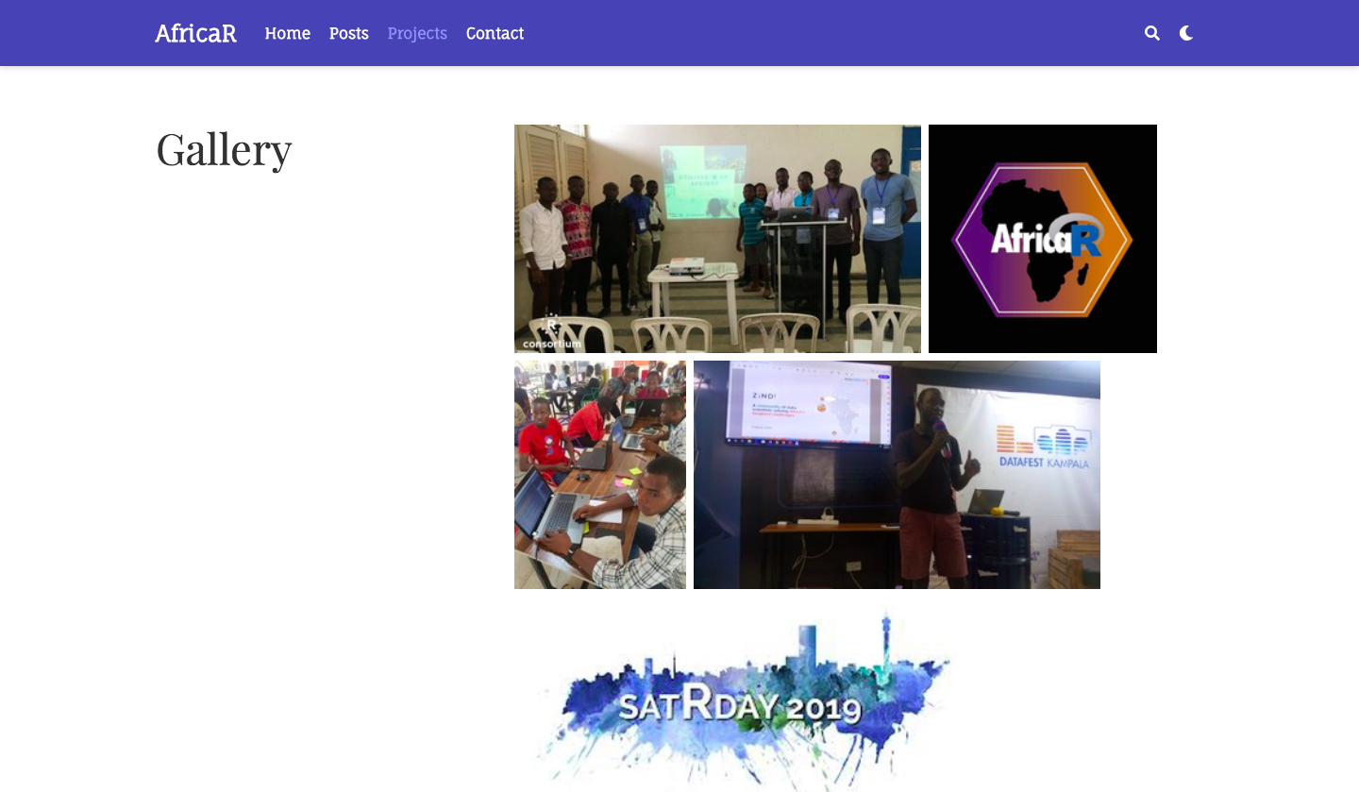
04: Develop a website

Slide 13

05: Set up R Clubs in Campuses

Slide 14

06: AfricaR Monetary Fund

Slide 15

07: Have a grand AfricaR Conference
Notes:
African version of erum
3 days summer school, 2 days workshop
Venue should be a country with lenient travel rules (visas and passports)

Slide 16
Quick Wins …

Slide 17

African RUGS
Notes:
Immense support from the #rstats community, for SatRday Kampala
Invitation to travel to France

Slide 18
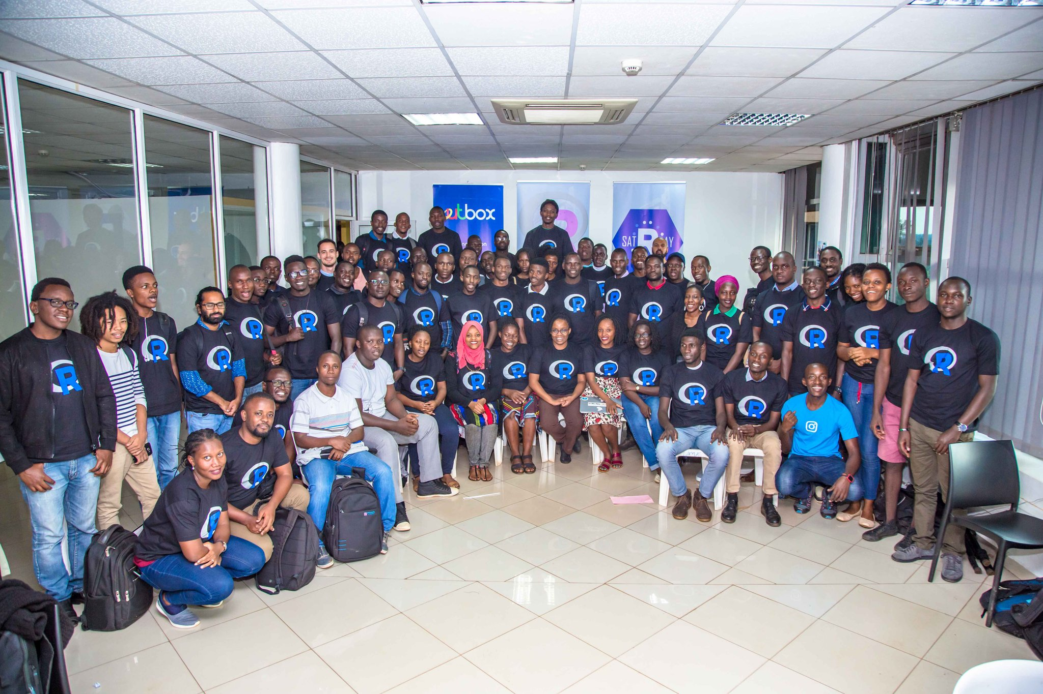

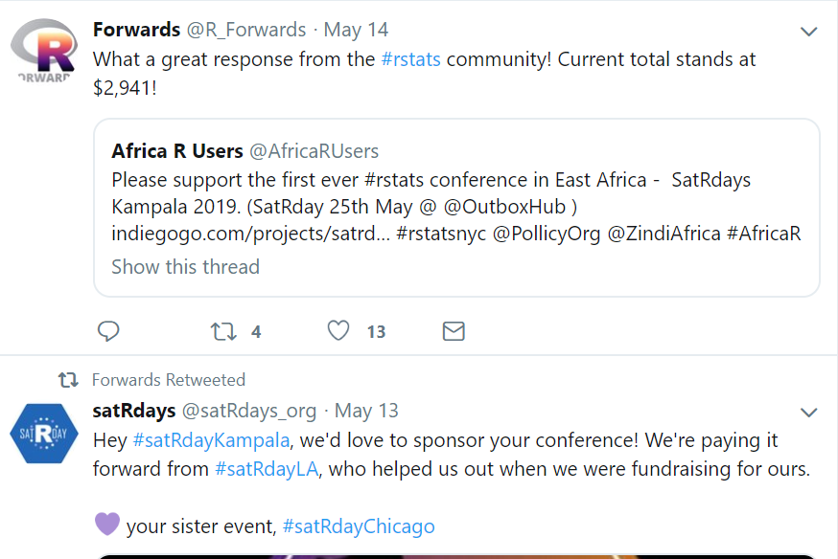


Notes:
Immense support from the #rstats community, for SatRday Kampala
Invitation to travel to France

Slide 19


Twitter: @AfricaRUsers
Gmail: africarusers@gmail.com
Website: https://africa-r.org/
Notes:
African version of erum
3 days summer school, 2 days workshop
Venue should be a country with lenient travel rules (visas and passports)

