Slide 1
Deep Learning, Chapter 7
Working with Keras: A Deep Dive into Neural Networks
杨扬骁
江西师范大学计算机信息工程学院
shelpam@jxnu.edu.cn
2024年8月12日14:00

Slide 2
Preamble
You’ve now got some experience with Keras—you’re familiar with the Sequential model, Dense layers, and built-in APIs for training, evaluation, and inference ---- compile(), fit(), evaluate(), and predict(). You even learned in chapter 3 how to inherit from the Layer class to create custom layers, and how to use the TensorFlow GradientTape to implement a step-by-step training loop.
In the coming chapters, we’ll dig into computer vision, timeseries forecasting, natural language processing, and generative deep learning. These complex applications will require much more than a Sequential architecture and the default fit() loop. So let’s first turn you into a Keras expert! In this chapter, you’ll get a complete overview of the key ways to work with Keras APIs: everything you’re going to need to handle the advanced deep learning use cases you’ll encounter next.

Slide 3
Agenda
A spectrum of workflows
Different ways to build Keras models
Using built-in training and evaluation loops
Writing your own training and evaluation loops
Summary

Slide 4
A spectrum of workflows
The design of the Keras API is guided by the principle of progressive disclosure of complexity: make it easy to get started, yet make it possible to handle high-complexity use cases, only requiring incremental learning at each step. Simple use cases should be easy and approachable, and arbitrarily advanced workflows should be possible: no matter how niche and complex the thing you want to do, there should be a clear path to it. A path that builds upon the various things you’ve learned from simpler workflows. This means that you can grow from beginner to expert and still use the same tools—only in different ways.

Slide 5
A spectrum of workflows
As such, there’s not a single “true” way of using Keras. Rather, Keras offers a spectrum of workflows, from the very simple to the very flexible. There are different ways to build Keras models, and different ways to train them, answering different needs. Because all these workflows are based on shared APIs, such as Layer and Model, components from any workflow can be used in any other workflow—they can all talk to each other.

Slide 6
Different ways to build Keras models
There are three APIs for building models in Keras (see figure 7.1):
The Sequential model, the most approachable API—it’s basically a Python list. As such, it’s limited to simple stacks of layers.
The Functional API, which focuses on graph-like model architectures. It represents a nice mid-point between usability and flexibility, and as such, it’s the most commonly used model-building API.
Model subclassing, a low-level option where you write everything yourself from scratch. This is ideal if you want full control over every little thing. However, you won’t get access to many built-in Keras features, and you will be more at risk of making mistakes

Slide 7
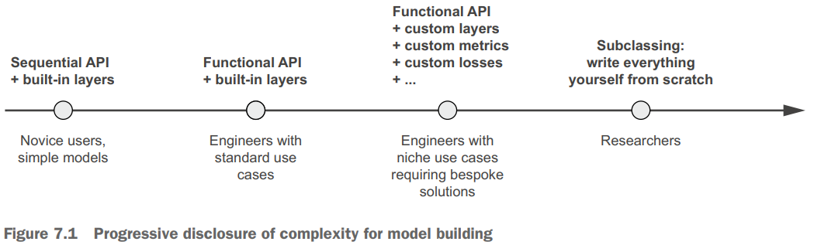
Different ways to build Keras models

Slide 8
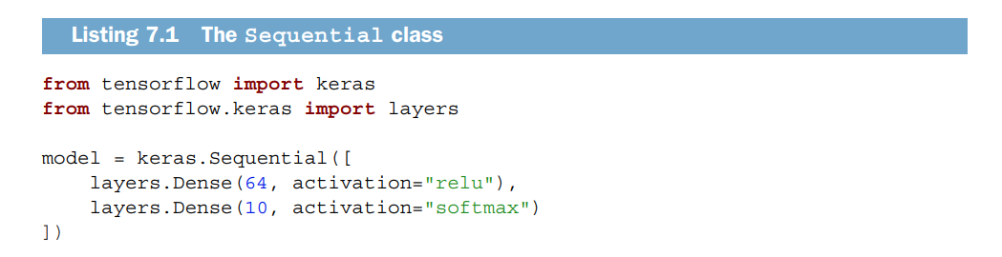
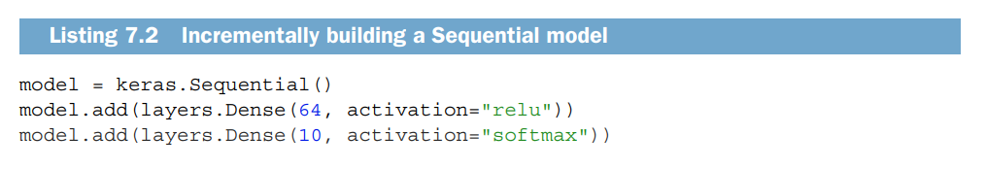
The sequential model
The simplest way to build a Keras model is to use the Sequential model, which you already know about.
Note that it’s possible to build the same model incrementally via the add() method, which is similar to the append() method of a Python list.

Slide 9
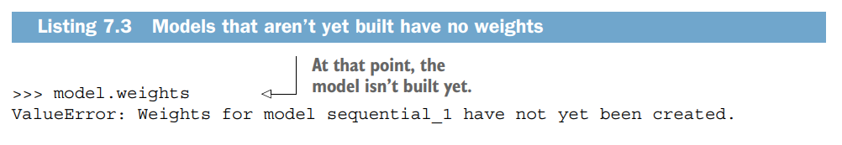
The sequential model
You saw in chapter 4 that layers only get built (which is to say, create their weights) when they are called for the first time. That’s because the shape of the layers' weights depends on the shape of their input: until the input shape is known, they can’t be created. As such, the preceding Sequential model does not have any weights (listing 7.3) until you actually call it on some data, or call its build() method with an input shape (listing 7.4).

Slide 10
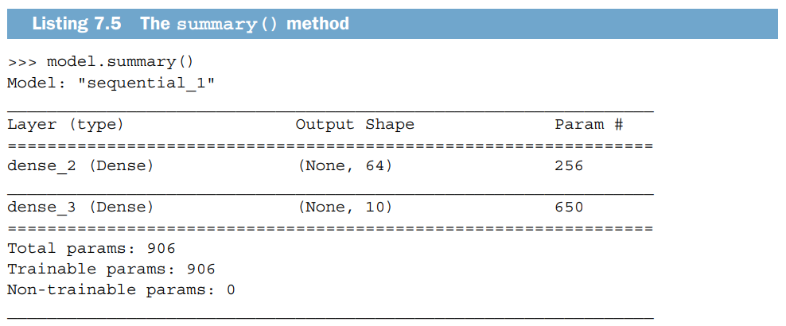
The sequential model
After the model is built, you can display its contents via the summary() method, which comes in handy for debugging.

Slide 11
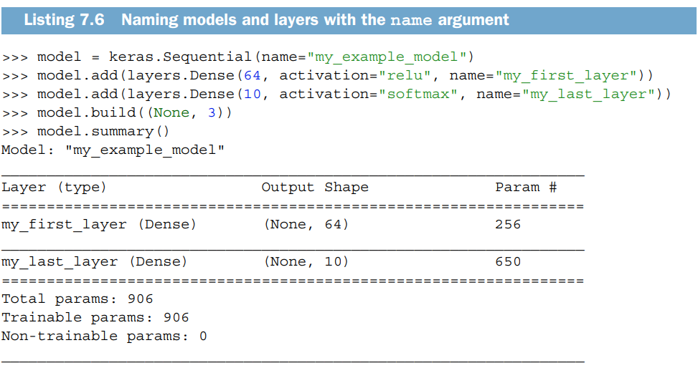
The sequential model
As you can see, this model happens to be named “sequential_1.” You can give names to everything in Keras—every model, every layer.

Slide 12
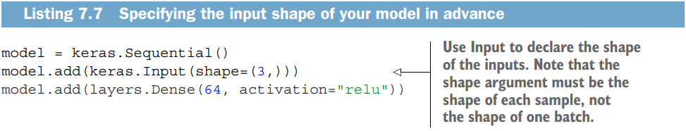
The sequential model
When building a Sequential model incrementally, it’s useful to be able to print a summary of what the current model looks like after you add each layer. But you can’t print a summary until the model is built! There’s actually a way to have your Sequential built on the fly: just declare the shape of the model’s inputs in advance. You can do this via the Input class.

Slide 13
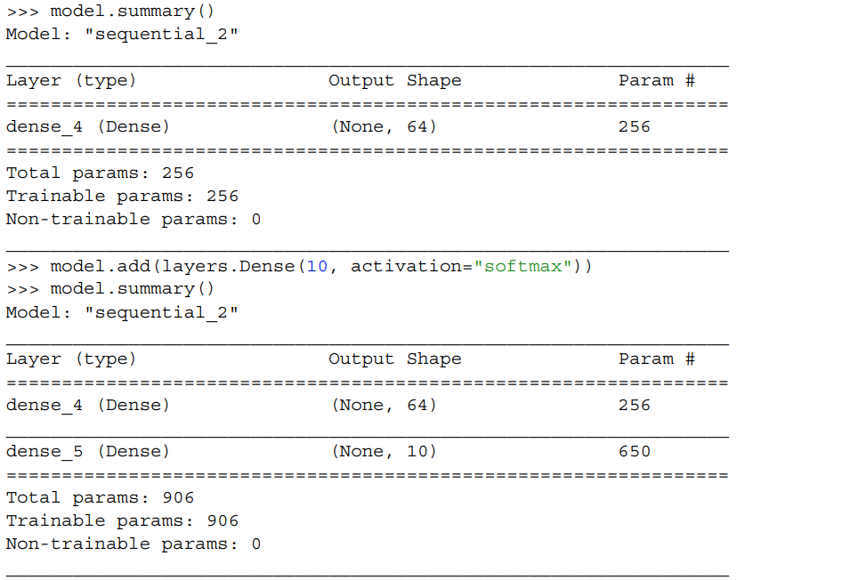
The sequential model
Now you can use summary() to follow how the output shape of your model changes as you add more layers:

Slide 14
The sequential model
This is a pretty common debugging workflow when dealing with layers that transform their inputs in complex ways, such as the convolutional layers you’ll learn about in chapter 8.

Slide 15
The functional API
The Sequential model is easy to use, but its applicability is extremely limited: it can only express models with a single input and a single output, applying one layer after the other in a sequential fashion. In practice, it’s pretty common to encounter models with multiple inputs (say, an image and its metadata), multiple outputs (different things you want to predict about the data), or a nonlinear topology. In such cases, you’d build your model using the Functional API. This is what most Keras models you’ll encounter in the wild use. It’s fun and powerful—it feels like playing with LEGO bricks

Slide 16
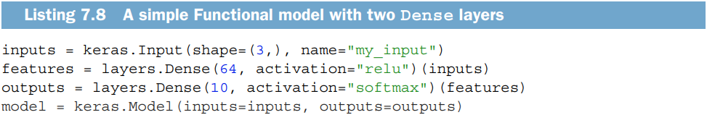
The functional API: a simple example
Let’s start with something simple: the stack of two layers we used in the previous section. Its Functional API version looks like the following list.
Let’s go over this step by step.
We started by declaring an Input (note that you can also give names to these input objects, like everything else):

Slide 17
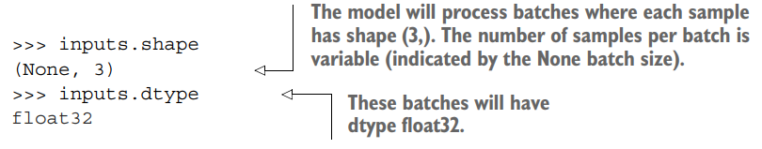
The functional API: a simple example
This inputs object holds information about the shape and dtype of the data that the model will process:
We call such an object a symbolic tensor. It doesn’t contain any actual data, but it encodes the specifications of the actual tensors of data that the model will see when you use it. It stands for future tensors of data.

Slide 18

The functional API: a simple example
Next, we created a layer and called it on the input:
All Keras layers can be called both on real tensors of data and on these symbolic tensors. In the latter case, they return a new symbolic tensor, with updated shape and dtype information:

Slide 19
The functional API: a simple example
After obtaining the final outputs, we instantiated the model by specifying its inputs and outputs in the Model constructor:

Slide 20
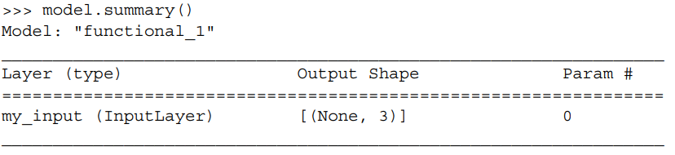
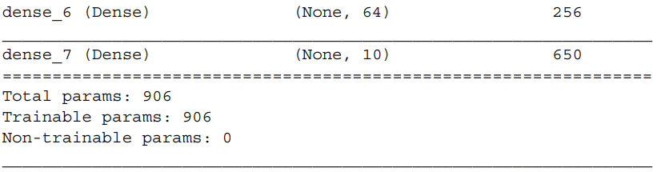
The functional API: a simple example
Here’s the summary of our model:

Slide 21
The functional API: multi-input, multi-output models
Unlike this toy model (previous model), most deep learning models don’t look like lists—they look like graphs. They may, for instance, have multiple inputs or multiple outputs. It’s for this kind of model that the Functional API really shines.

Slide 22
The functional API: multi-input, multi-output models
Let’s say you’re building a system to rank customer support tickets by priority and route them to the appropriate department. Your model has three inputs:
The title of the ticket (text input)
The text body of the ticket (text input)
Any tags added by the user (categorical input, assumed here to be one-hot encoded)
We can encode the text inputs as arrays of ones and zeros of size vocabulary_size (see chapter 11 for detailed information about text encoding techniques).

Slide 23
The functional API: multi-input, multi-output models
Your model also has two outputs:
The priority score of the ticket, a scalar between 0 and 1 (sigmoid output)
The department that should handle the ticket (a softmax over the set of departments)
You can build this model in a few lines with the Functional API. (In next slide)

Slide 24
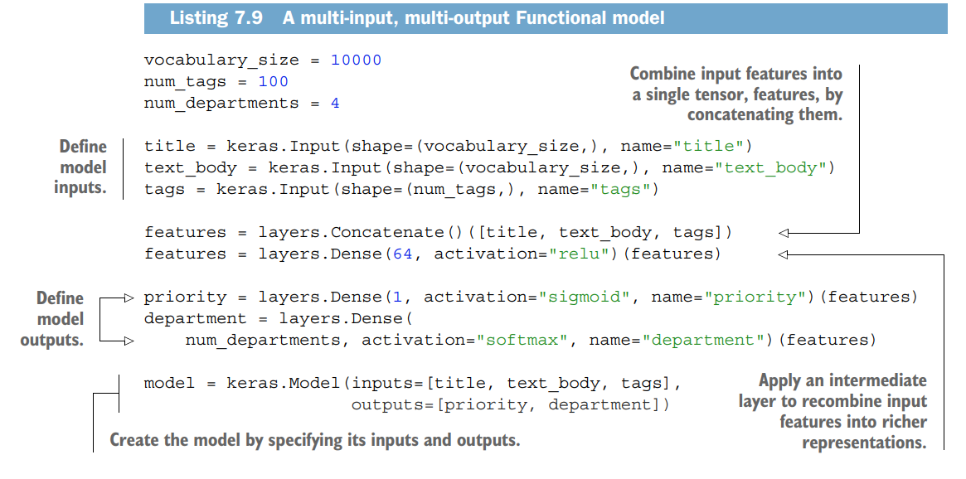
The functional API: multi-input, multi-output models

Slide 25
The functional API: multi-input, multi-output models
Your model also has two outputs:
The priority score of the ticket, a scalar between 0 and 1 (sigmoid output)
The department that should handle the ticket (a softmax over the set of departments)
You can build this model in a few lines with the Functional API. (In next slide)

Slide 26
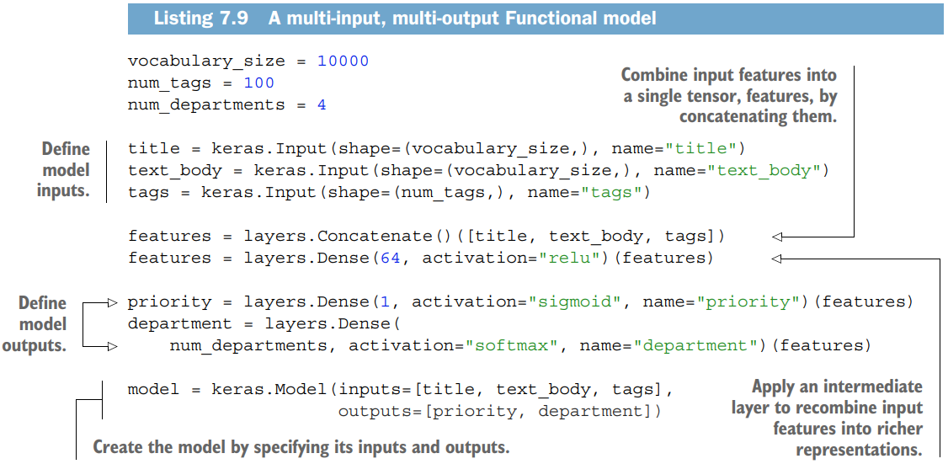
The functional API: multi-input, multi-output models

Slide 27
The functional API: multi-input, multi-output models
The Functional API is a simple, LEGO-like, yet very flexible way to define arbitrary graphs of layers like these.

Slide 28
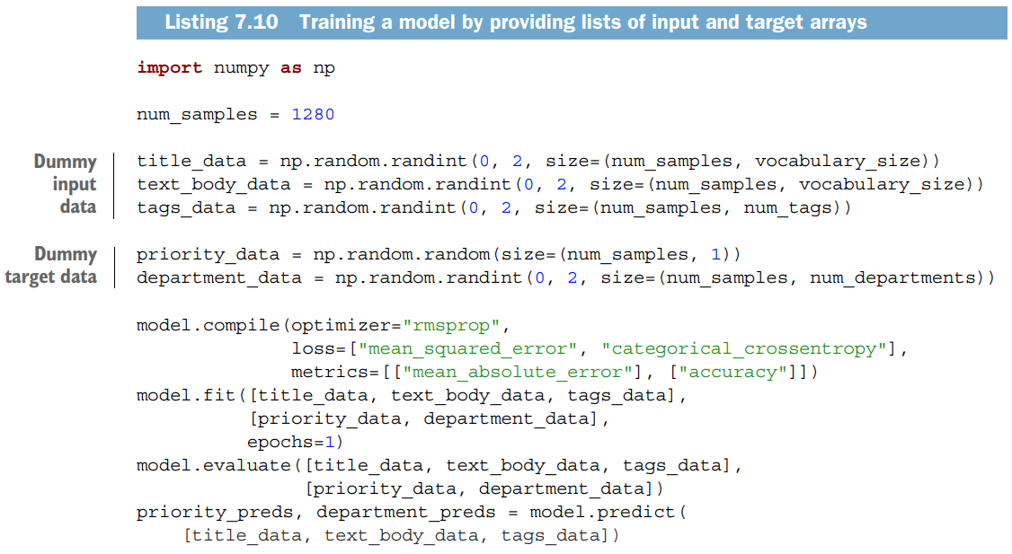
The functional API: multi-input, multi-output models
You can train your model in much the same way as you would train a Sequential model, by calling fit() with lists of input and output data. These lists of data should be in the same order as the inputs you passed to the Model constructor.

Slide 29
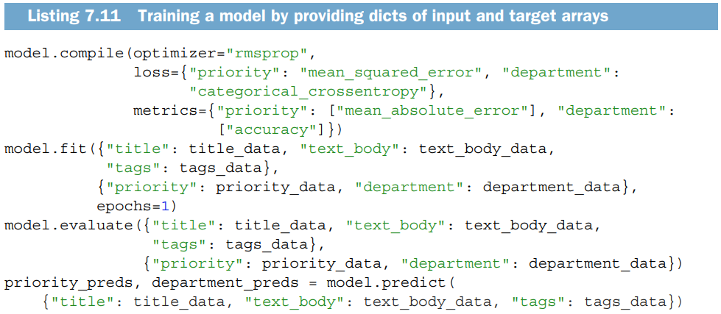
The functional API: multi-input, multi-output models
If you don’t want to rely on input order (for instance, because you have many inputs or outputs), you can also leverage the names you gave to the Input objects and the output layers, and pass data via dictionaries.

Slide 30
The power of functional API: access to layer connectivity
A Functional model is an explicit graph data structure. This makes it possible to inspect how layers are connected and reuse previous graph nodes (which are layer outputs) as part of new models. It also nicely fits the “mental model” that most researchers use when thinking about a deep neural network: a graph of layers. This enables two important use cases: model visualization and feature extraction.
Let’s visualize the connectivity of the model we just defined (the topology of the model). You can plot a Functional model as a graph with the plot_model() utility (see figure 7.2).

Slide 31
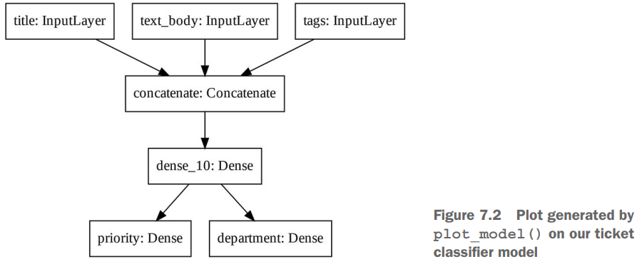
The power of functional API: access to layer connectivity

Slide 32
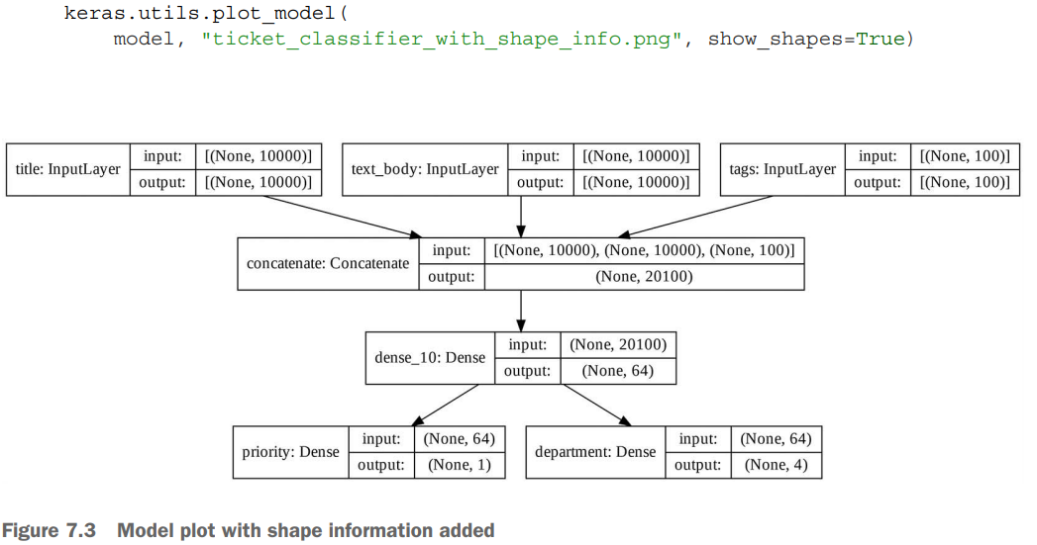
The power of functional API: access to layer connectivity
You can add to this plot the input and output shapes of each layer in the model, which can be helpful during debugging (see figure 7.3).

Slide 33
The power of functional API: access to layer connectivity
The “None” in the tensor shapes represents the batch size: this model allows batches of any size.

Slide 34
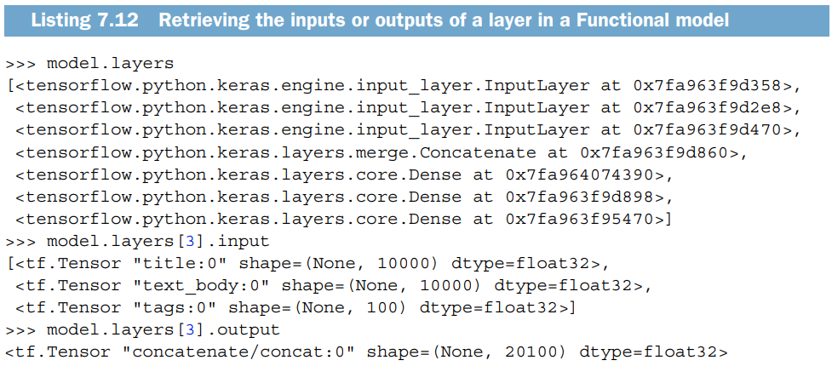
The power of functional API: access to layer connectivity
Access to layer connectivity also means that you can inspect and reuse individual nodes (layer calls) in the graph. The model.layers model property provides the list of layers that make up the model, and for each layer you can query layer.input and layer.output.

Slide 35
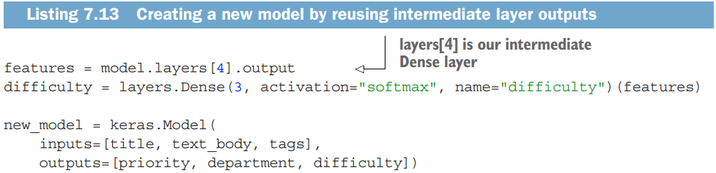
The power of functional API: access to layer connectivity
This enables you to do feature extraction, creating models that reuse intermediate features from another model.
Let’s say you want to add another output to the previous model—you want to estimate how long a given issue ticket will take to resolve, a kind of difficulty rating. You could do this via a classification layer over three categories: “quick,” “medium,” and “difficult.” You don’t need to recreate and retrain a model from scratch. You can start from the intermediate features of your previous model, since you have access to them, like this.

Slide 36
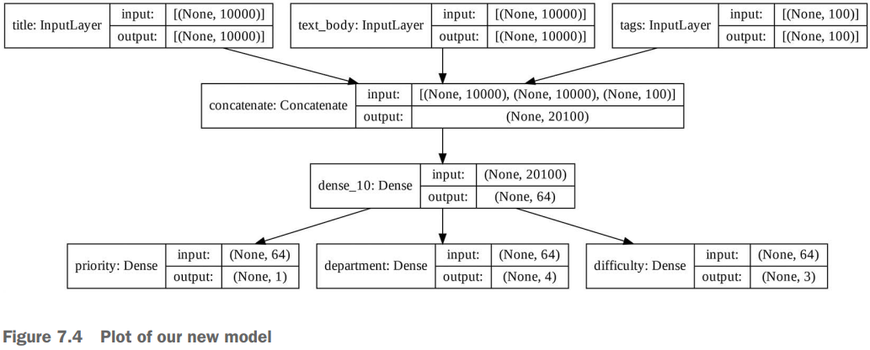
The power of functional API: access to layer connectivity
Let’s plot our new model (see figure 7.4):

Slide 37
Subclassing the model class
The last model-building pattern you should know about is the most advanced one: Model subclassing. You learned in chapter 3 how to subclass the Layer class to create custom layers. Subclassing Model is pretty similar:
In the __init__() method, define the layers the model will use.
In the call() method, define the forward pass of the model, reusing the layers previously created.
Instantiate your subclass, and call it on data to create its weights.

Slide 38
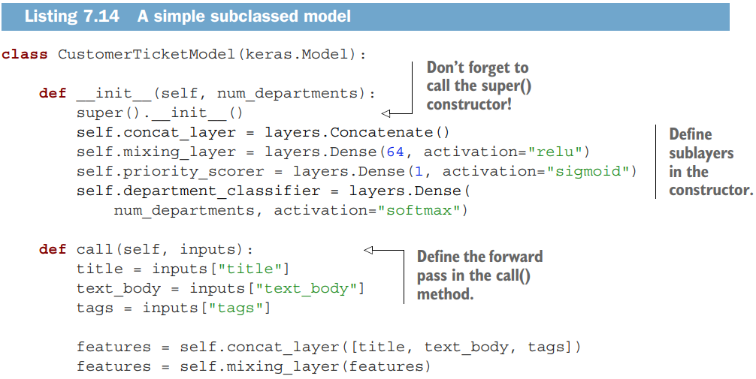

Rewrite our previous example as a subclass-ed model
Let’s take a look at a simple example: we will re-implement the customer support ticket management model using a Model subclass.

Slide 39

Rewrite our previous example as a subclassed model
Once you’ve defined the model, you can instantiate it. Note that it will only create its weights the first time you call it on some data, much like Layer subclasses:

Slide 40
Rewrite our previous example as a subclassed model
So far, everything looks very similar to Layer subclassing, a workflow you encountered in chapter 3. What, then, is the difference between a Layer subclass and a Model subclass? It’s simple: a “layer” is a building block you use to create models, and a “model” is the top-level object that you will actually train, export for inference, etc. In short, a Model has fit(), evaluate(), and predict() methods. Layers don’t. Other than that, the two classes are virtually identical. (Another difference is that you can save a model to a file on disk, which we will cover in a few sections.)

Slide 41
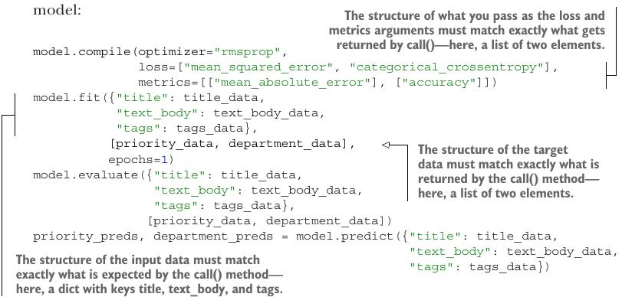
Rewrite our previous example as a subclassed model
You can compile and train a Model subclass just like a Sequential or Functional model:

Slide 42
Rewrite our previous example as a subclassed model
The Model subclassing workflow is the most flexible way to build a model. It enables you to build models that cannot be expressed as directed acyclic graphs of layers— imagine, for instance, a model where the call() method uses layers inside a for loop, or even calls them recursively. Anything is possible—you’re in charge.

Slide 43
Beware: what subclassed models don’t support
This freedom comes at a cost: with subclassed models, you are responsible for more of the model logic, which means your potential error surface is much larger. As a result, you will have more debugging work to do. You are developing a new Python object, not just snapping together LEGO bricks.
Functional and subclassed models are also substantially different in nature. A Functional model is an explicit data structure—a graph of layers, which you can view, inspect, and modify. A subclassed model is a piece of bytecode—a Python class with a call() method that contains raw code. This is the source of the subclassing workflow’s flexibility—you can code up whatever functionality you like—but it introduces new limitations.

Slide 44
Beware: what subclassed models don’t support
For instance, because the way layers are connected to each other is hidden inside the body of the call() method, you cannot access that information. Calling summary() will not display layer connectivity, and you cannot plot the model topology via plot_model(). Likewise, if you have a subclassed model, you cannot access the nodes of the graph of layers to do feature extraction because there is simply no graph. Once the model is instantiated, its forward pass becomes a complete black box.

Slide 45
Mixing and matching different components
Crucially, choosing one of these patterns—the Sequential model, the Functional API, or Model subclassing—does not lock you out of the others. All models in the Keras API can smoothly interoperate with each other, whether they’re Sequential models, Functional models, or subclassed models written from scratch. They’re all part of the same spectrum of workflows.

Slide 46
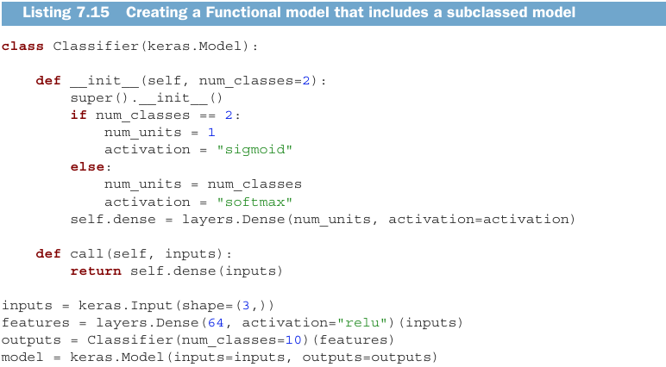
Mixing and matching different components
For instance, you can use a subclassed layer or model in a Functional model.

Slide 47
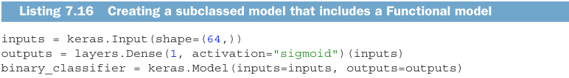
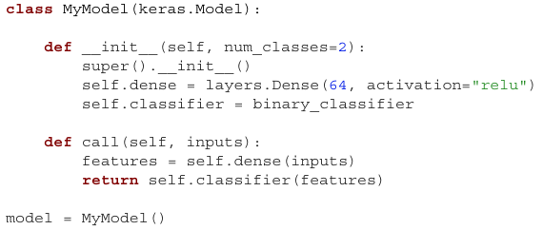
Mixing and matching different components
Inversely, you can use a Functional model as part of a subclassed layer or model.

Slide 48
Remember: use the right tool for the job
You’ve learned about the spectrum of workflows for building Keras models, from the simplest workflow, the Sequential model, to the most advanced one, model subclassing. When should you use one over the other? Each one has its pros and cons—pick the one most suitable for the job at hand.
In general, the Functional API provides you with a pretty good trade-off between ease of use and flexibility. It also gives you direct access to layer connectivity, which is very powerful for use cases such as model plotting or feature extraction. If you can use the Functional API—that is, if your model can be expressed as a directed acyclic graph of layers—I recommend using it over model subclassing.
Going forward, all examples in this book will use the Functional API, simply because all the models we will work with are expressible as graphs of layers. We will, however, make frequent use of subclassed layers. In general, using Functional models that include subclassed layers provides the best of both worlds: high development flexibility while retaining the advantages of the Functional API.

Slide 49
Using built-in training and evaluation loops
The principle of progressive disclosure of complexity—access to a spectrum of workflows that go from dead easy to arbitrarily flexible, one step at a time—also applies to model training. Keras provides you with different workflows for training models. They can be as simple as calling fit() on your data, or as advanced as writing a new training algorithm from scratch.
You are already familiar with the compile(), fit(), evaluate() , predict() workflow. As a reminder, take a look at the following listing. (In next slide)

Slide 50
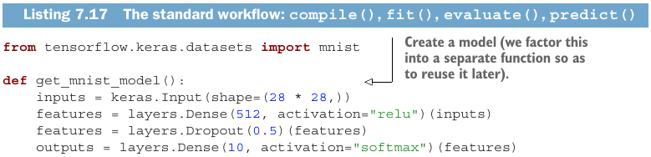
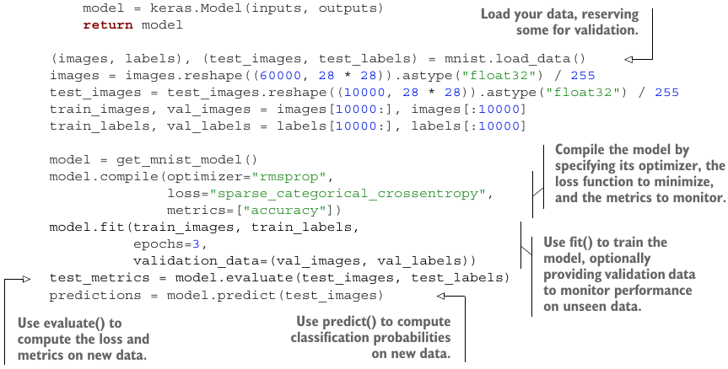
Using built-in training and evaluation loops
There are a couple of ways you can customize this simple workflow:
Provide your own custom metrics.
Pass callbacks to the fit() method to schedule actions to be taken at specific points during training.
Let’s take a look at these.

Slide 51
Writing your own metrics
Metrics are key to measuring the performance of your model—in particular, to measuring the difference between its performance on the training data and its performance on the test data. Commonly used metrics for classification and regression are already part of the built-in keras.metrics module, and most of the time that’s what you will use. But if you’re doing anything out of the ordinary, you will need to be able to write your own metrics. It’s simple!
A Keras metric is a subclass of the keras.metrics.Metric class. Like layers, a metric has an internal state stored in TensorFlow variables. Unlike layers, these variables aren’t updated via backpropagation, so you have to write the state-update logic yourself, which happens in the update_state() method.
For example, here’s a simple custom metric that measures the root mean squared error (RMSE).

Slide 52
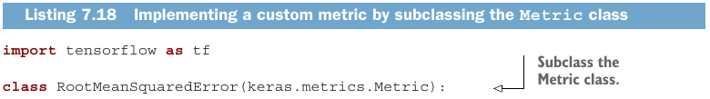
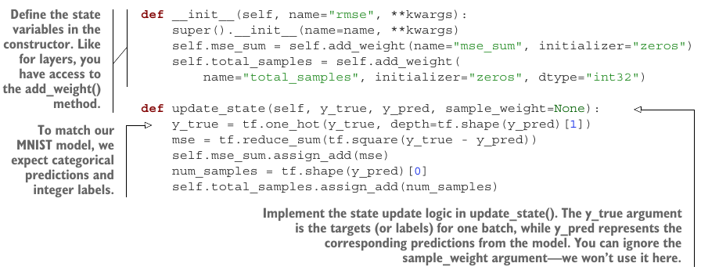
Writing your own metrics

Slide 53
Writing your own metrics
You use the result() method to return the current value of the metric:
Meanwhile, you also need to expose a way to reset the metric state without having to reinstantiate it—this enables the same metric objects to be used across different epochs of training or across both training and evaluation. You do this with the reset_state() method:

Slide 54
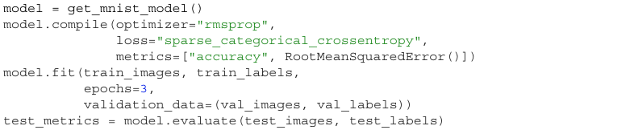
Writing your own metrics
Custom metrics can be used just like built-in ones. Let’s test-drive our own metric:
You can now see the fit() progress bar displaying the RMSE of your model.

Slide 55
Using callbacks
Launching a training run on a large dataset for tens of epochs using model.fit() can be a bit like launching a paper airplane: past the initial impulse, you don’t have any control over its trajectory or its landing spot. If you want to avoid bad outcomes (and thus wasted paper airplanes), it’s smarter to use, not a paper plane, but a drone that can sense its environment, send data back to its operator, and automatically make steering decisions based on its current state. The Keras callbacks API will help you transform your call to model.fit() from a paper airplane into a smart, autonomous drone that can self-introspect and dynamically take action.
A callback is an object (a class instance implementing specific methods) that is passed to the model in the call to fit() and that is called by the model at various points during training. It has access to all the available data about the state of the model and its performance, and it can take action: interrupt training, save a model, load a different weight set, or otherwise alter the state of the model.

Slide 56
Using callbacks
Here are some examples of ways you can use callbacks:
Model checkpointing—Saving the current state of the model at different points during training.
Early stopping—Interrupting training when the validation loss is no longer improving (and of course, saving the best model obtained during training).
Dynamically adjusting the value of certain parameters during training —Such as the learning rate of the optimizer.
Logging training and validation metrics during training, or visualizing the representations learned by the model as they’re updated—The fit() progress bar that you’re familiar with is in fact a callback!

Slide 57
Using callbacks
The keras.callbacks module includes a number of built-in callbacks (this is not an exhaustive list):
keras.callbacks.ModelCheckpoint
keras.callbacks.EarlyStopping
keras.callbacks.LearningRateScheduler
keras.callbacks.ReduceLROnPlateau
keras.callbacks.CSVLogger
Let’s review two of them to give you an idea of how to use them: EarlyStopping and ModelCheckpoint.

Slide 58
The EarlyStopping and ModelCheckPoint callbacks
When you’re training a model, there are many things you can’t predict from the start. In particular, you can’t tell how many epochs will be needed to get to an optimal validation loss. Our examples so far have adopted the strategy of training for enough epochs that you begin overfitting, using the first run to figure out the proper number of epochs to train for, and then finally launching a new training run from scratch using this optimal number. Of course, this approach is wasteful. A much better way to handle this is to stop training when you measure that the validation loss is no longer improving. This can be achieved using the EarlyStopping callback.

