Slide 1


10,000 Hand drawn Dog and Cat NFTs launching on Cardano

Slide 2
What is ShelterPets?
ShelterPets is an Non-Fungible Token (NFT) being minted on the Cardano (ADA) Blockchain (known as CNFTs).
The initial release consists of 10,000 hand drawn animal NFTs. With 5 cat and 5 dog breeds each with variable items and traits. Each NFT is a unique 4000x4000 PNG image.
The goal of this project is to raise over $500,000 or ~250,000 ADA for animal driven charities and provide unique pieces of art to holders!
The funds will be held SOMEWHERE PUBLIC and donated to charities chosen by the ShelterPets NFT holders.

Slide 3
Goals for ShelterPets?
Help all animals in need, specifically dogs and cats!
While the goal is to help Dog and Cat based charities. Other charities are welcome and it is up to the ShelterPets community to decide.
We just want to do as much good as possible for Cats, Dogs, and animals all over the world.
Provide unique hand drawn collectable art to anyone who wants a piece of art or to do some good!

Slide 4
Inspiration for ShelterPets?
Approximately 6.3 million companion animals enter U.S. animal shelters nationwide every year.
approximately 3.1 million are dogs and 3.2 million are cats
Each year, approximately 920,000 shelter animals are euthanized (390,000 dogs and 530,000 cats).
Approximately 4.1 million shelter animals are adopted each year (2 million dogs and 2.1 million cats).
About 810,000 animals who enter shelters as strays are returned to their owners. Of those, 710,000 are dogs and 100,000 are cats.
American Pet Products Association claims 2020 spending reached $103.6 billion on pets.
Vet care accounted for 31.4 Billion
Food and Treats for 42 Billion
ALL INFO DIRECTLY FROM: https://www.aspca.org/helping-people-pets/shelter-intake-and-surrender/pet-statistics

Slide 5
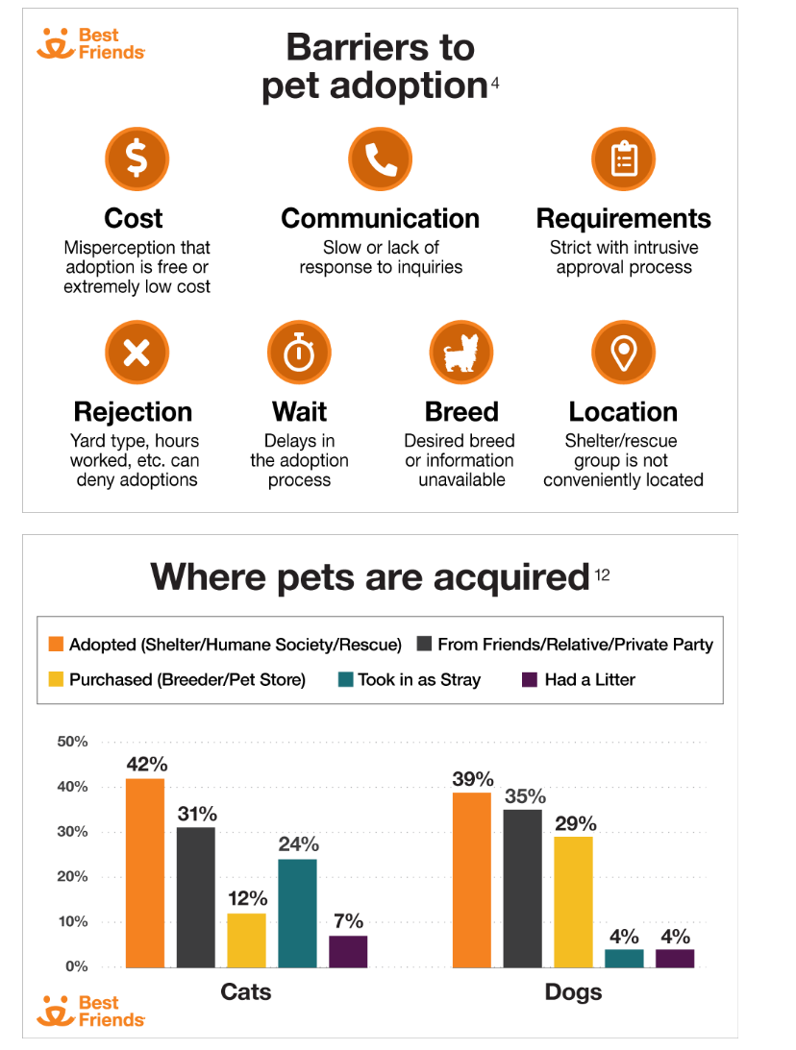
Inspiration for ShelterPets?

Slide 6
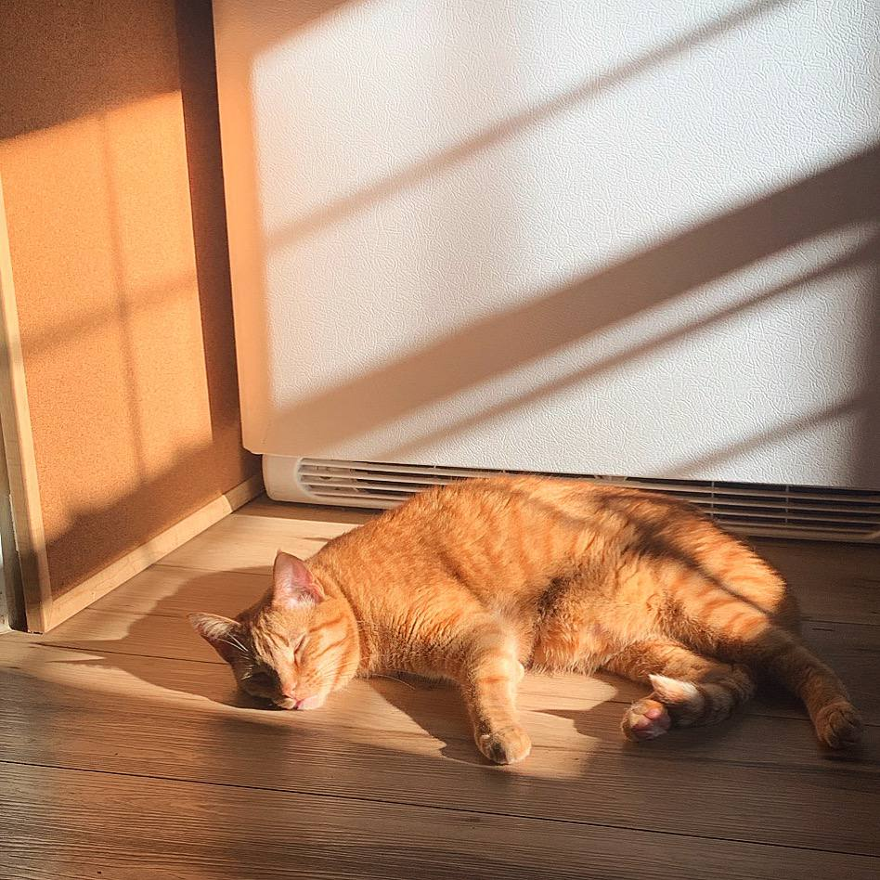
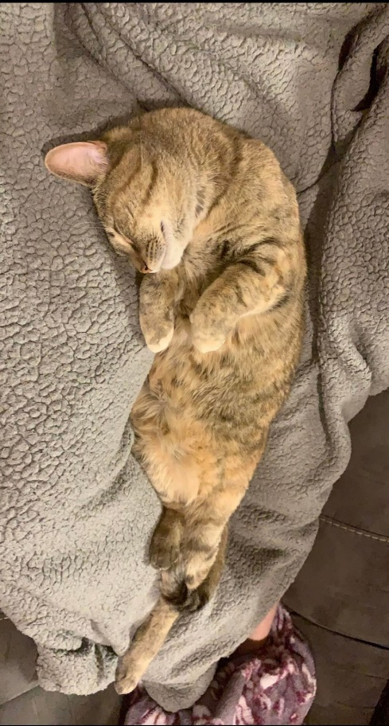
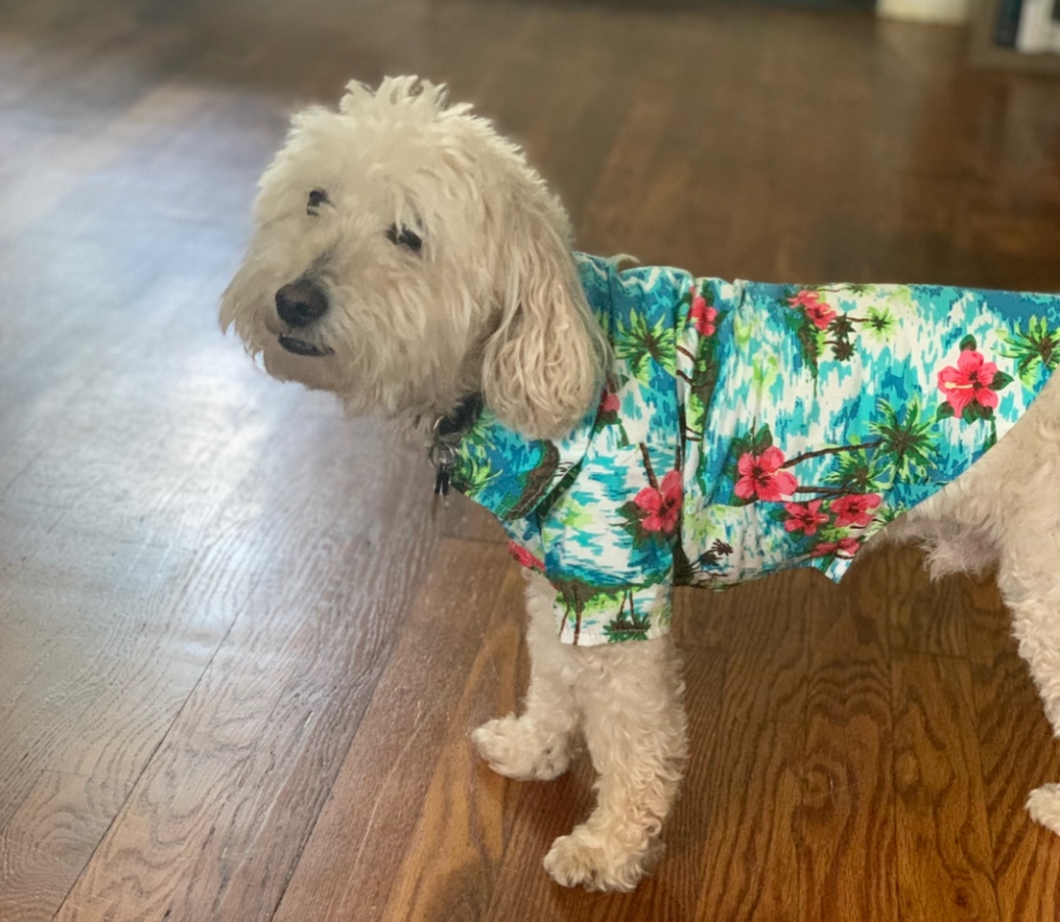
Inspiration for ShelterPets?
From Shelter AKA ShelterPets!
My own cats and dog.

Slide 7



Possible Charities for ShelterPets?
Best Friend: Save them all
Humane Society
Local Shelters
American Society for the Prevention of Cruelty to Animals®
International (NON-US) charities
And more!

Slide 8
How much will a ShelterPets NFT cost?
Each ShelterPets CNFT will cost 50 ADA to mint.
The mint will be done through CNFT-MAKER-PRO
2 ada fee to them and 2 ada fee to get you the NFT (Cardano req.)
Purchase price=~48 ada per NFT (due to the 2 ADA returning with your NFT)
ShelterPets take home = ~46 ada per NFT
50% will go to animal related charities. However, Non-animal charities can be included, if wanted.

Slide 9
ShelterPets Revenue Model?
MAX revenue 460,000 ADA (~$1,012,000 as of Nov. 9th)
Achievable if collection sells out only
50% will go to charity
5% will go to Hanzkingdom (artist) (was payed in advance as well)
45% to team
Founder/coder
Cofounder/graphic designer/discorder
Pay for any future “employees” or projects
*2% royalty for each secondary market sale, using CIP-027 standard
Split between artist and team (50/50)
*Royalty tokens not implemented on secondary markets as of Nov. 11 2021

Slide 10
ShelterPets Charitable distribution?
Trust?
Address where charitable ADA will be held will be made public.
Receipts for all donations will be provided.
Partnerships with trusted community member are in talks.
Initial plan: distribute all 250,000 ADA to varying charities.
Community voted alternatives:
Plan B: Stake the 250,000 ADA and donate staking revenue (~5% APY)
Plan C: Stake XXX,XXX ADA and donate XXX,XXX as a lump sum.
Plan D: Plan C + a “treat fund” where holders can get several ADA for treats!
Plan E: Plan D + vet fund
Plan E: Can be community suggested!!

Slide 11
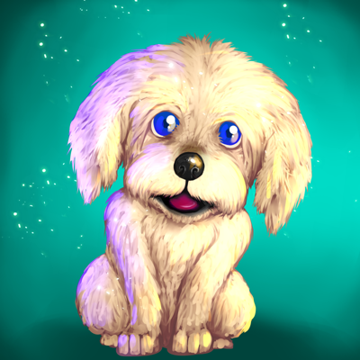
Who drew ShelterPets?
ARTIST: Hanzkingdom
“hi im hanz! Hanzkingdom conceptual Artist/Architect based in Malaysia”
Where can you find him?
Twitter: https://twitter.com/Hanzkingdom
Instagram: https://www.instagram.com/hanzartwork/

Slide 12
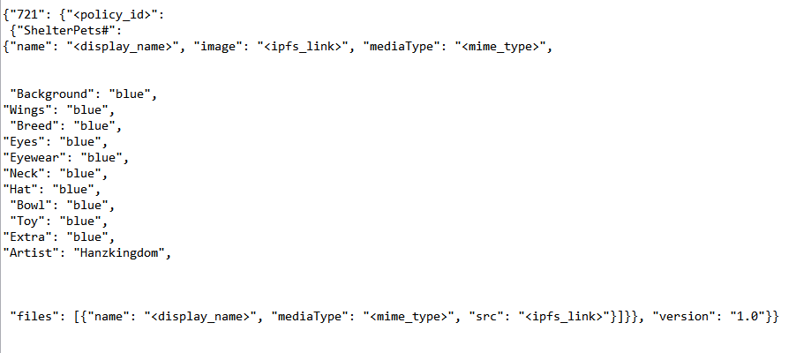
What makes each ShelterPets NFT Unique?
Example Metadata:

Slide 13
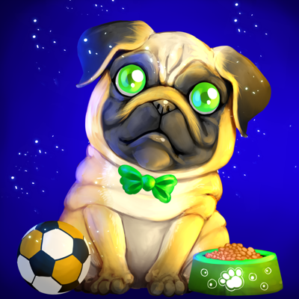
What makes each ShelterPets NFT Unique?
Variable traits: Each NFT is a unique and hand drawn, with variable items and attributes. () in parenthesis means number of unique attributes per category:
Background Color (8)
Wings (2)
Breed (10)
Eye color (8)
Eyewear (5)
Neck (16)
Hat (15)
Bowl (5)
Toy (11)
Extra (10)
BG Color: Blue
Wings: None
Breed : Pug
Eye color: Green
Eyewear: None
Neck: Green Bow
Hat: None
Bowl: Green
Toy : None
Extra: Soccer Yellow

Slide 14
ShelterPets Histograms and Ranking Info!
Graphs and plots and stuff go here

