Slide 1
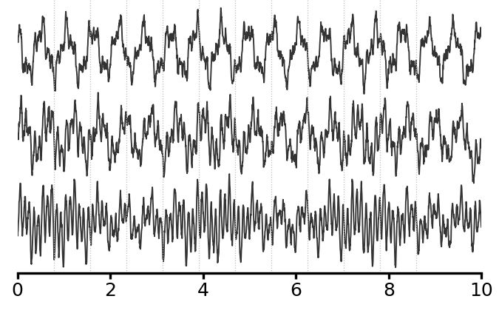
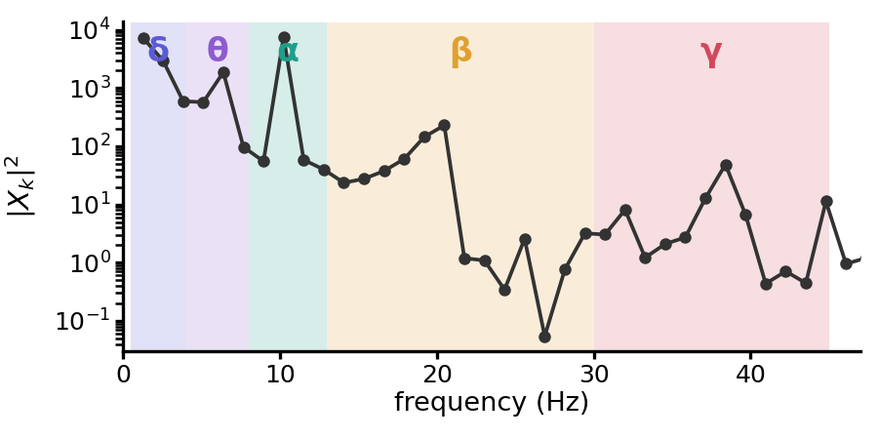
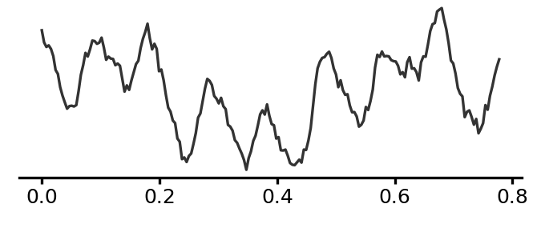
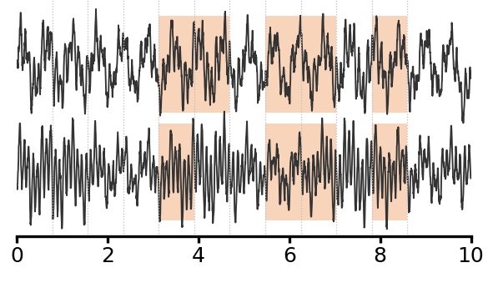
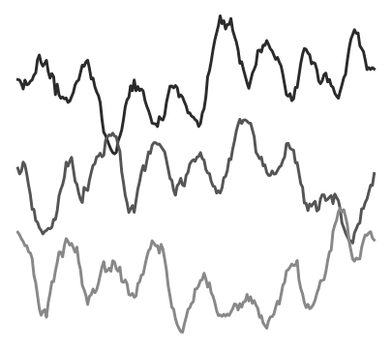
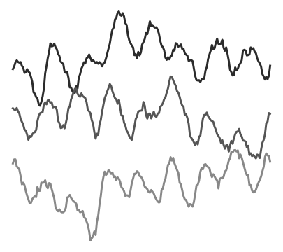
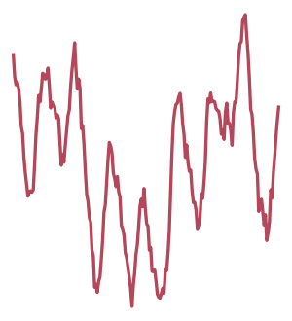
(a) Pretraining
Multichannel EEG, 0.78-s patches
token grid (channel × time patch)
Fp1
trainable
trainable
trainable
prediction ŷ_{c,t,b}
Fp1
M
M
M
M
M
M
Transformer
encoder
criss-cross: channel / time attention
Cz
Patchify +
linear
embedding
Band-power
head
Cz
M
M
M
M
M
O1
O1
M
M
M
M
time (s)
δ
θ
α
β
γ
masked tokens (p = 0.3) → learnable [M] token
same, uncorrupted
signal
the raw signal itself is not altered
per-patch periodogram (bins every 1.28 Hz)
one masked patch x_{c,t} (200 samples)
Parameter-free target
target y_{c,t,b}
masked patches only
FFT
1. Periodogram |X_{k}|²
2. Band power P_{c,t,b} = (2/P²) Σ_{f_k ∈ B_b} |X_{k}|²
time (s)
3. Log y_{c,t,b} = log(P_{c,t,b} + ε)
δ
θ
α
β
γ
δ
θ
α
β
γ
δ 0.5–4, θ 4–8, α 8–13, β 13–30, γ 30–45 Hz
ℒ = 1/(5|ℳ|) Σ_{(c,t) ∈ ℳ} Σ_{b} (ŷ_{c,t,b} − y_{c,t,b})²
trainable
predicted band power
target band power
hidden patch (panel b)
no reconstruction term, no regularizer
(b) What the target asks the encoder to learn
ours
Predict band power
alternative
Reconstruct the raw waveform
many waveforms
the same power
every sample of
the masked patch
one power
many possible waveforms
δ
θ
α
β
γ
δ
θ
α
β
γ
δ
θ
α
β
γ
infer the hidden patch's power from its context
phase is unpredictable and irrelevant:
learn the spectral state
infer the hidden patch's waveform from its context
capacity spent on phase and noise

