Slide 1
PROXMOX MIGRATION AND AWS RECOVERY
Northstar Repairs
12 minutes
Operator-measured recovery in one lab exercise
Six validation jobs recovered
Synthetic small-business case study, 4 October 2026
NORTHSTAR REPAIRS / SHEMAR MARKS
01
Notes:
Source: operator closeout request. The 12-minute measurement lacks retained exact timing endpoints. This is one exercise, not a production SLA.

Slide 2
BUSINESS PROBLEM
One VM held the shop’s job register
01
Repair intake and customer collections depended on the same records.
02
A lost Proxmox VM could remove both the application and its data.
03
The lab needed a repeatable host build and a recoverable copy outside the application disk.
NORTHSTAR REPAIRS / SHEMAR MARKS
02
Notes:
Synthetic five-person repair-shop scenario. Source: README and CASE-STUDY. No real client engagement claimed.

Slide 3
ARCHITECTURE
The AWS recovery environment
Staff workstation
EC2 application
Private S3
SSM port forwarding
Loopback Python service
SQLite on encrypted gp3
Versioned snapshots
Release and restore data
SNS email delivery
CloudWatch telemetry and alarms
Application health, disk use, backup age and EC2 status checks
Terraform provisions the hosting environment
NORTHSTAR REPAIRS / SHEMAR MARKS
03
Notes:
Source: repository Terraform and existing architecture diagram. Diagram describes configured implementation. Production reference architecture is separate.

Slide 4
MIGRATION
Proxmox workload migration
01
The operator completed migration of the Python/SQLite workload to AWS us-east-2.
02
Terraform and bootstrap recreated the hosting environment. S3 kept the migration and backup data off the root disk.
03
The retained final app screenshot corroborates the workload. Earlier baseline screenshots and migration transcript were unavailable in this closeout.
NORTHSTAR REPAIRS / SHEMAR MARKS
04
Notes:
Source: operator request and prior Plan Portfolio Project record. No migration duration or exact migration commands claimed.

Slide 5
SECURITY
Restricted access and scoped permissions
01
Session Manager supplied administration and port forwarding. The application listened on loopback.
02
Terraform defined zero security-group ingress, IMDSv2 and an encrypted root disk.
03
The instance role scoped release and backup access. Comprehensive IAM denial testing is not established by retained evidence.
NORTHSTAR REPAIRS / SHEMAR MARKS
05
Notes:
Source: terraform/main.tf, docs/IAM.md, deploy/northstar.service. Configuration claims are distinguished from enforcement tests. No credentials included.

Slide 6
DISASTER-RECOVERY EXERCISE
Replace the host, recover the records
01
The project record describes a replacement EC2 instance with zero jobs before restoration.
02
The operator restored an S3 backup. The record reports six jobs and SQLite integrity ok.
03
The final application shows the six recovered IDs and DR-TEST in Ready status.
NORTHSTAR REPAIRS / SHEMAR MARKS
06
Notes:
Source: retrieved Plan Portfolio Project record and original post-recovery screenshot. Zero-job and integrity results come from the prior record, not a retained raw transcript.

Slide 7
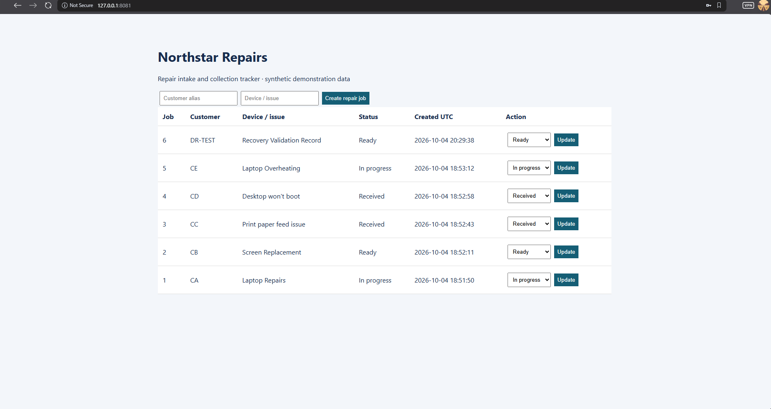
APPLICATION EVIDENCE
All six validation jobs returned
Original operator screenshot. AWS host attribution comes from the project record.
NORTHSTAR REPAIRS / SHEMAR MARKS
07
Notes:
Source: evidence/disaster-recovery/post-recovery-app.png. Original image retained unchanged. Localhost 8081 is the forwarded application URL.

Slide 8
RECOVERY RESULT
12-minute operator-measured RTO
12
30-minute design target
The exercise met the target. Exact start/end timestamps are not retained.
minutes
One exercise. No production SLA or measured RPO claimed.
NORTHSTAR REPAIRS / SHEMAR MARKS
08
Notes:
Source: operator measurement supplied in current request and prior project record. Timing scope is operator-led recovery. No exact stopwatch boundaries are reconstructed.

Slide 9
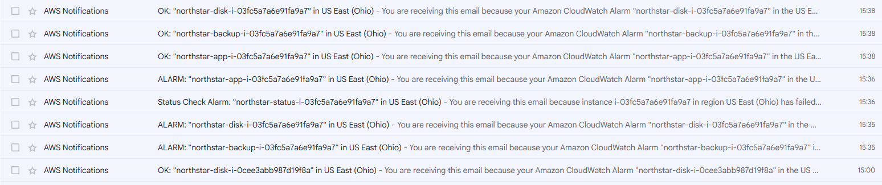
MONITORING EVIDENCE
CloudWatch notifications reached the inbox
App, disk and backup ALARM/OK emails, plus a status-check alarm in Ohio
Application-health alarm test. The inbox shows delivered ALARM and OK notifications.
NORTHSTAR REPAIRS / SHEMAR MARKS
09
Notes:
Source: evidence/monitoring/cloudwatch-sns-email.png. Alarms treat missing data as breaching, so replacement/bootstrap may produce transitions. Do not infer latency from inbox times.

Slide 10
LESSONS
What the exercise taught
01
Validate business records as well as application health. Count, IDs and the recovery marker make restoration visible.
02
Replacement changes access details and instance-specific alarm dimensions. Recovery needs an operator runbook.
03
Keep evidence and required backups outside the lab before destroying versioned storage. Empty Terraform state needs AWS inventory corroboration.
NORTHSTAR REPAIRS / SHEMAR MARKS
10
Notes:
Lessons derived from the project record, implementation and observed evidence. No teardown completion implied.

Slide 11
FINAL OUTCOME
A recoverable repair register
Migration completed
Six jobs recovered. Notification delivery observed.
12-minute operator-measured recovery
AWS teardown pending live Terraform access
NORTHSTAR REPAIRS / SHEMAR MARKS
11
Notes:
Evidence: repository evidence index and attributed recovery summary. Single-server synthetic proof of concept, shared credential, same-account regional backups. Actual billing and comprehensive security validation not claimed. Teardown pending.

