Slide 1


Case study
Northstar
Repairs
Proxmox migration and
AWS disaster recovery
Shemar Marks
October 2026
01
Notes:
Portfolio infrastructure lab for a synthetic five-person repair shop, not a client engagement. Actual Proxmox-to-AWS migration and AWS recovery exercise in us-east-2. Portrait supplied by Shemar Marks, displayed unchanged with a circular crop. Visual direction inspired by the user-supplied case-study template image. Decorative background is an illustration. Sources: README.md, docs/CASE-STUDY.md and evidence/disaster-recovery/closeout-checks.md.

Slide 2
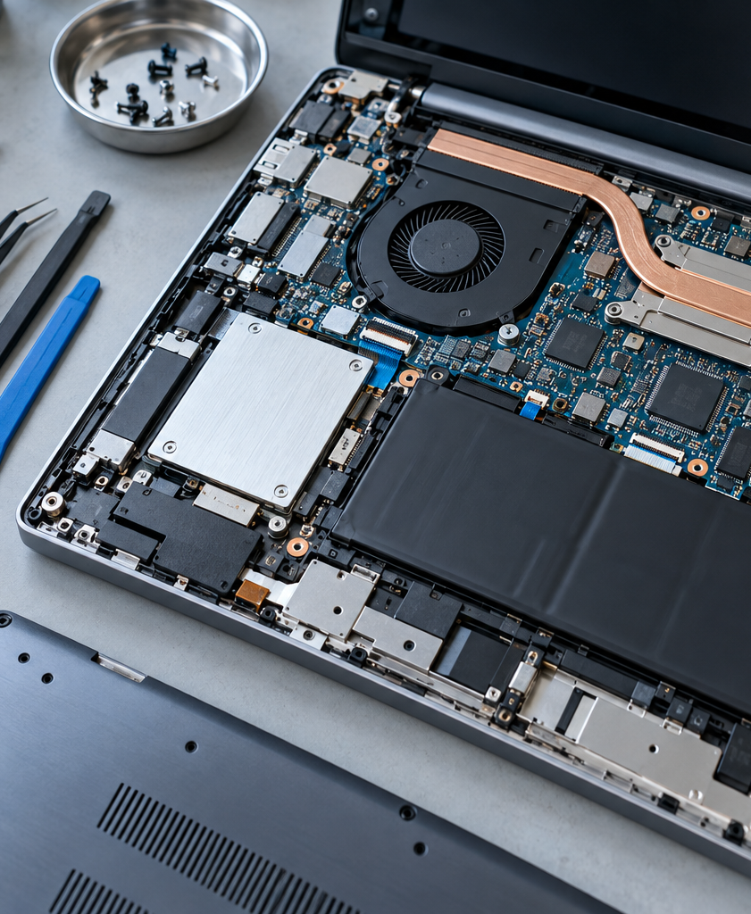
The repair register
Intake, repair status
and customer collection
The Proxmox VM held the Python app
and its SQLite records. A VM failure
could interrupt access to active jobs.
Five-person repair shop
Synthetic business scenario
Illustrative repair workbench
02
Notes:
The original app and database shared a Proxmox VM failure boundary. This is the risk in a synthetic small-business scenario, not a claim that a real shop experienced an outage. Repair-workbench image is an AI-generated editorial illustration, not lab or client evidence. Generated with the built-in image tool; asset provenance and exact prompt: docs/presentation/assets/README.md. Sources: docs/CASE-STUDY.md and docs/ARCHITECTURE.md.

Slide 3






AWS architecture
Single host in us-east-2, recoverable data in S3
Port forwarding
Dedicated VPC
Snapshots
Operator
SSM
EC2
S3
Workstation
Encrypted tunnel
Python / SQLite
Versioned snapshots
Metrics
Alarm
SNS
CloudWatch
Email alerts
Health metrics
03
Notes:
Editable topology. Terraform provisions the network, EC2, S3, IAM, CloudWatch and SNS. The dedicated VPC boundary contains the EC2 host. Session Manager, S3, CloudWatch and SNS are AWS services outside that boundary. Public IP/Internet Gateway supplies outbound HTTPS. The graphic simplifies networking and identity attachments. Source: terraform/main.tf and deployment scripts. AWS service/resource icons: https://aws.amazon.com/architecture/icons/ (July 31, 2026 package). Icons preserve original proportions and colors. Diagram labels and connections are editable.

Slide 4

Proxmox migration
5
Upload
Restore
Proxmox VM
S3 archive
AWS EC2
jobs in the
migration archive
SQLite snapshot
Compressed database
Application + data
Archive integrity check: ok
04
Notes:
Operator-observed Proxmox-to-AWS migration. Closeout directly decompressed backups/migration/northstar-proxmox-migration.sqlite.gz, verified five rows and PRAGMA integrity_check=ok. No migration duration is claimed. No original Proxmox console screenshot or migration transcript was retrieved. Source: evidence/disaster-recovery/closeout-checks.md. AWS service/resource icons: https://aws.amazon.com/architecture/icons/ (July 31, 2026 package). Icons preserve original proportions and colors. Diagram labels and connections are editable.

Slide 5
Access and security
No public web
or SSH ingress
Operator
SSM
EC2
AWS authentication
Port forwarding
127.0.0.1:8080
The app listens on loopback.
Session Manager provides access.
Encrypted root disk
IMDSv2 required
Scoped instance permissions
05
Notes:
Controls defined by source: no security-group ingress, loopback app bind, encrypted gp3 root disk, IMDSv2 required, scoped instance role, unprivileged systemd app. Actual access used SSM port forwarding. This is not a claim of comprehensive security or IAM negative testing. Shared app identity and broad HTTPS egress are lab limitations. Source: terraform/main.tf and app/bootstrap scripts. AWS service/resource icons: https://aws.amazon.com/architecture/icons/ (July 31, 2026 package). Icons preserve original proportions and colors. Diagram labels and connections are editable.

Slide 6
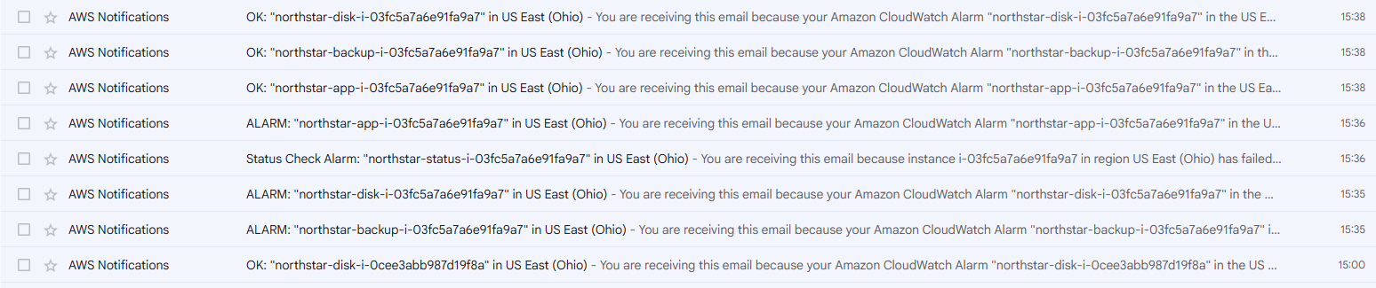
Application-health alarm
Service stopped
Health check failed
CloudWatch
SNS email
Unhealthy metric
Notification delivered
Actual ALARM and OK notifications from the lab
06
Notes:
Original email-list evidence unchanged and uncropped. A native outline highlights the application-health OK and ALARM entries. Application-health alarm was under test. CloudShell history confirms systemctl stop northstar, failed curl health request and metric publication at 2026-10-04 20:50:25 UTC. Operator confirmed notification evidence. Other visible lab notifications remain in the screenshot. No latency is calculated from inbox times. Sources: evidence/monitoring/cloudwatch-sns-email.png and evidence/disaster-recovery/closeout-checks.md. AWS service/resource icons: https://aws.amazon.com/architecture/icons/ (July 31, 2026 package). Icons preserve original proportions and colors. Diagram labels and connections are editable.

Slide 7
Replacement and restore
6
0
6
Original EC2
Empty replacement
Recovered app
All six jobs returned.
SQLite integrity: ok
S3 recovery backup
07
Notes:
Before replacement: six records, then zero records on the new host, followed by S3 restoration to six. Pre-replacement and empty-host sequence are attributed to the project record. Closeout directly checked the selected 20261004T203013Z backup with six rows and integrity ok and the 203743Z backup with zero rows and integrity ok. Final live app had health ok, six rows and integrity ok. No timeline segment durations are inferred. Sources: evidence/disaster-recovery/observed-results.md and closeout-checks.md. AWS service/resource icons: https://aws.amazon.com/architecture/icons/ (July 31, 2026 package). Icons preserve original proportions and colors. Diagram labels and connections are editable.

Slide 8
Observed recovery time
12
minutes
20:32:16–20:44:16 UTC
Interruption included
One exercise. No SLA or measured RPO.
08
Notes:
Operator-supplied UTC record: initiated 2026-10-04 20:32:16 UTC, validated 20:44:16 UTC. End minus start is 720 seconds, 12 minutes exactly. End boundary: restored six jobs including DR-TEST, SQLite integrity ok and application health ok. CloudShell recycled and Terraform required reinstallation. Timer was not paused and includes the interruption. One observed exercise against a 30-minute design target. No repeatability guarantee, production SLA or measured RPO. Source: evidence/disaster-recovery/recovery-timeline.md. Native chart preserves literal values 12 and 30 minutes.

Slide 9
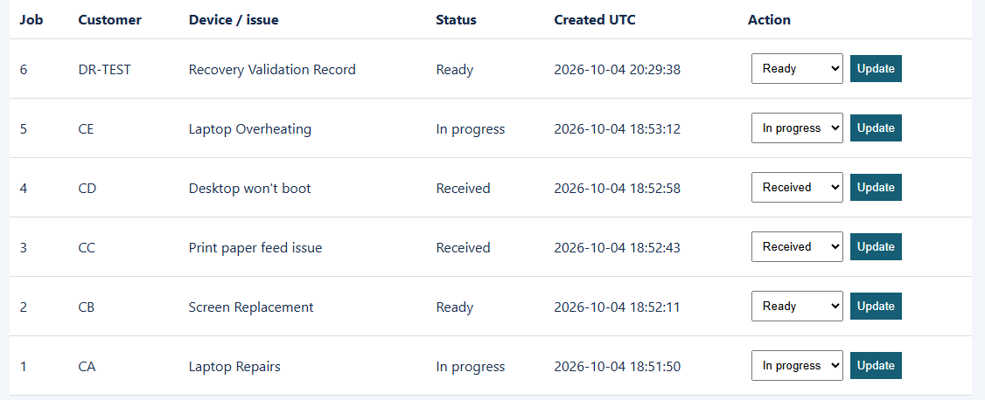
Six recovered repair jobs
DR-TEST returned in Ready status. SQLite integrity check: ok.
09
Notes:
Actual operator screenshot of the recovered application. Crop isolates the register table with all six rows, headers, statuses and UTC creation timestamps. The original PNG remains unchanged in evidence/disaster-recovery/post-recovery-app.png. Closeout independently confirmed live count 6, health ok and SQLite integrity ok. Data creation timestamps are not RTO endpoints. Source: evidence/disaster-recovery/closeout-checks.md.

Slide 10

Lessons for the runbook
Record checks
A healthy endpoint needed a second check:
original job IDs, status and the DR-TEST marker.
Replacement
access
The new host required a new SSM tunnel
and its current application credential.
Production improvements
Independent backup protection and individual user identities
10
Notes:
Record and access lessons follow from the project record and closeout. Bootstrap generates a new password and EC2 replacement changes the instance ID. No credential values appear. The last line identifies future improvements, not implemented or tested results. Current limits also include a single host, broad HTTPS egress and same-account regional backup. Versioning is not immutable retention. Source: docs/CASE-STUDY.md. AWS service/resource icons: https://aws.amazon.com/architecture/icons/ (July 31, 2026 package). Icons preserve original proportions and colors. Diagram labels and connections are editable.

Slide 11
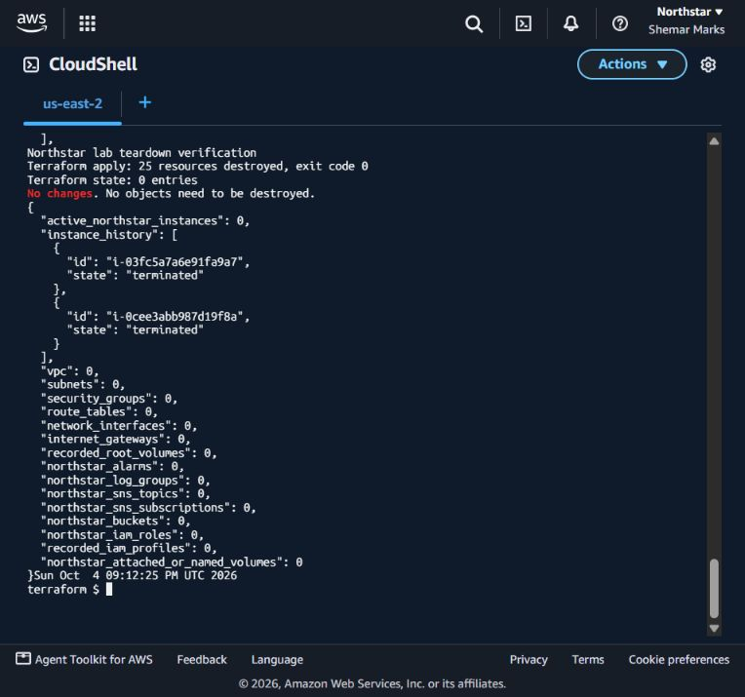
Lab teardown
25
resources destroyed
Evidence preserved first.
Terraform state is empty.
AWS checks found no active
Northstar lab resources.
11
Notes:
allow_bucket_destroy=true persisted and saved destroy plan reviewed: 25 managed resources, all deletes. Destroy completed with exit code 0 at 2026-10-04 21:10:29 UTC. Empty state and a fresh no-change destroy plan. Independent inventories verified at 21:12:25 UTC: no active Northstar EC2, root volumes, VPC resources, S3 buckets, IAM roles/profile, CloudWatch alarms/logs or SNS topic/subscriptions. Terminated EC2 history remains. Nine S3 versions exported privately in CloudShell before deletion. Sources: docs/TEARDOWN.md, evidence/teardown/verification.json and verified-cleanup.png. Screenshot unchanged.

Slide 12
Northstar Repairs
6 jobs restored
The Proxmox workload ran in AWS and recovered
from its independent S3 backup.
12-minute recovery in one lab exercise
Shemar Marks
12
Notes:
Operator-supplied UTC record: initiated 2026-10-04 20:32:16 UTC, validated 20:44:16 UTC. End minus start is 720 seconds, 12 minutes exactly. End boundary: restored six jobs including DR-TEST, SQLite integrity ok and application health ok. CloudShell recycled and Terraform required reinstallation. Timer was not paused and includes the interruption. One observed exercise against a 30-minute design target. No repeatability guarantee, production SLA or measured RPO. Source: evidence/disaster-recovery/recovery-timeline.md. Synthetic portfolio engagement, not paid client work. Lab teardown is complete.

